Slide 1

DFT investigation of para-substitution effects on the C—C bond activation of benzonitrile by a zerovalent nickel complex
Juliana Antonio Santiz
College of Sciences Annual Research Conference
November 19,2021

Slide 2
Inertness of C—C σ Bonds
C—C single bond is more stable than two M—C single bonds
thermodynamically
more stable
Halpern, J. Acc. Chem. Res. 1982, 15, 238−244.
C—C single bond possesses high directionality along the bond axis.
Comparison of the interactions of metal orbitals with C—C and C—H σ bonds
bonding
back bonding
bonding
back bonding
kinetically inaccessible
CC σ orbital
CC σ∗ orbital
CH σ orbital
CH σ∗ orbital

Slide 3
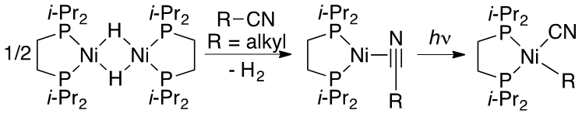
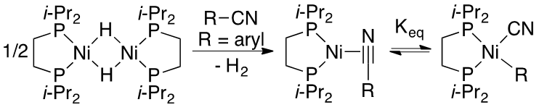
C-C Bond Activation with Ni
Alkyl Nitriles
Garcia, J. J.; Arevalo, A.; Brunkan, N. M.; Jones, W. D. Organometallics 2004, 23, 3997–4002.
Atesin, T. A.; Li, T.; Lachaize, S.; Brennessel, W. W.; Garcia, J. J.; Jones, W. D. J. Am. Chem. Soc. 2007, 129, 7562–7569.
Aryl Nitriles
Garcia, J. J.; Jones, W. D. Organometallics 2000, 19, 5544–5545.
Garcia, J. J.; Brunkan, N. M.; Jones, W. D. J. Am. Chem. Soc. 2002, 124, 9547–9555.
Atesin, T. A.; Li, T.; Lachaize, S.; Garcia, J. J.; Jones, W. D. Organometallics 2008, 27, 3811–3817.
Li, T.; Garcia, J. J.; Brennessel, W. D.; Jones, W. D. Organometallics 2010, 29, 2430–2445.

Slide 4
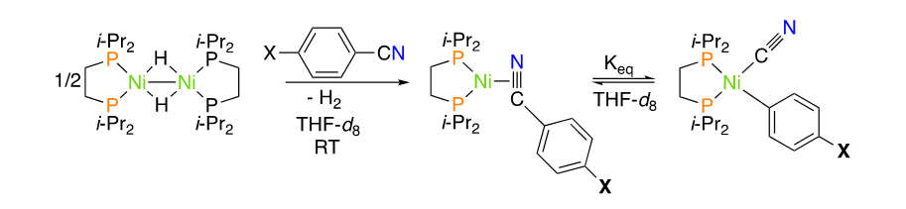
Reactions of Benzonitriles and Derivatives
Took a series of para-substituted benzonitriles and observed their equilibrium positions and rates of approach to equilibrium that were measured by NMR spectroscopy.
Benzonitriles Investigated
Garcia, J. J.; Brunkan, N. M.; Jones, W. D. J. Am. Chem. Soc. 2002, 124, 9547–9555.

Slide 5

Mechanistic Studies with Hammett Plot
Hammett plots are used to study mechanisms and reaction pathways.
Hammett equation
  $\log_{10}\left(\frac{k}{k_{0}}\right)=ρ σ$
  k –equilibrium constant
  k₀ –reference reaction rate
  ρ –reaction constant
  σ –substituent constant
Substituent | σ_{p}
NH₂ | -0.66
OCH₃ | -0.27
CH₃ | -0.17
H | 0
F | 0.06
CO₂CH₃ | 0.45
CF₃ | 0.54
CN | 0.66
Experimental Hammett Plot
  ln K_{eq} vs σ_{p}
  ln k₁ vs σ_{p}
McNaught, A.D. and Wilkinson, A. Oxford, 1997, https://doi.org/10.1351/goldbook.
Garcia, J. J.; Brunkan, N. M.; Jones, W. D. J. Am. Chem. Soc. 2002, 124, 9547–9555.

Slide 6
Experimental Hammett Plots for K_{eq} and k₁
Hammett plot for the equilibrium constants (K_{eq}) at 54°C*
Hammett plot for the forward rate constants (k₁) at 54°C
p-CF₃
p-CN
p-CO₂CH₃
p-CO₂CH₃
p-F
p-NH₂
p-H
p-CH₃
p-H
p-F
p-CH₃
p-OCH₃
p-OCH₃
*CN and NH₂ omitted
Garcia, J. J.; Brunkan, N. M.; Jones, W. D. J. Am. Chem. Soc. 2002, 124, 9547–9555.

Slide 7
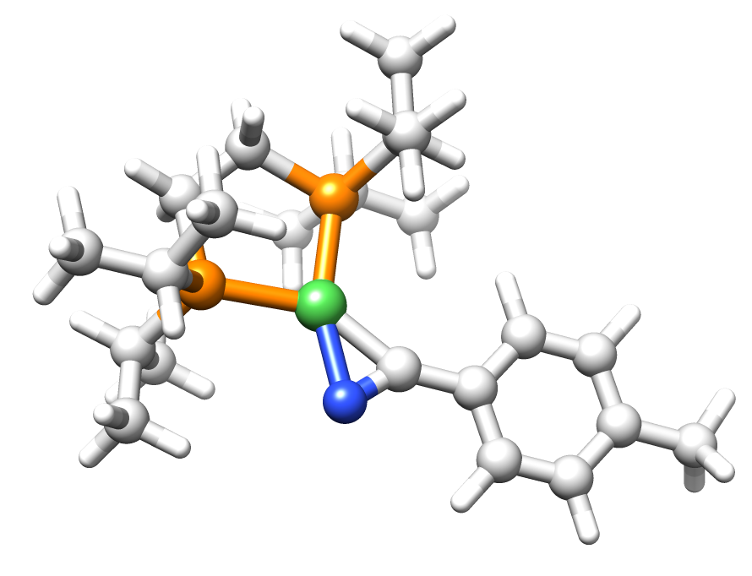
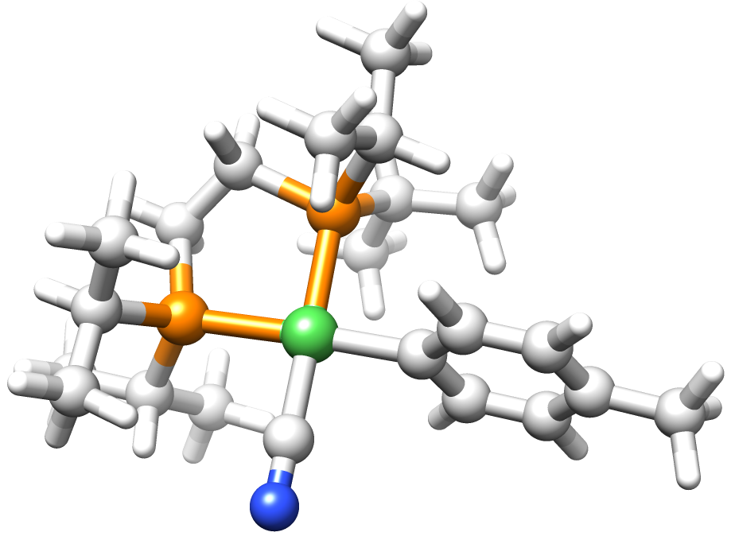
What DFT Investigation will accomplish
η²
Optimize Structures
  Ground States
    η² nitrile complex
    Oxidative addition product
Determine if there is a correlation between the experimental data and the computational data
    Focus on thermodynamics instead of kinetics
Future Benchmarks
  Meta-substituents
  Ortho-substituents
Ni
N
CH₃
    OA
Ni
CH₃
N

Slide 8
Methodology
[Ni(dippe)] fragment
Starting structures were obtained from previous C—C bond activation publication. ¹
  Inserted the p-substituents to the benzonitrile ring.
Optimized the η² and OA structures using B3LYP with Gaussian 16 package. ²⁻⁴
Basis Sets ⁵⁻⁷
  ECP of the Stuttgart group and associated basis sets for Pd and P.
  f-polarization functions for Ni and d-polarization functions for P.
  6-31G(d,p) for C, H, N, O and F
Frequency calculations
  Zero-point energy
  Thermal corrections
  Entropic corrections
Gibbs free energies at 327.15 K and 1 atm
Solvent corrections
  SMD in THF
Quasi-harmonic approximation
⁴Lee, C.; Yang, W.; Parr, R.G. Phys. Rev. B 1998, 37, 785.
⁵Hehre, W.J.; Ditchfield, R.; People, J.A. J. Chem Phs. 1972, 56, 2257.
⁶Ehlers, A.W.; Bohme, M.; Dapprich, S., Gobbi A., et. al. Chem Phys. Lett. 1993, 208, 111-114.
⁷Hollwarth, A.; Bohme, M.; Dapprich, S.; Ehlers, A.W., et. al. Chem. Phys. Lett. 1993, 208, 237-240.
¹Atesin, T. A.; Li, T.; Lachaize, S.; Garcia, J. J.; Jones, W. D. Organometallics 2008, 27, 3811–3817.
²Gaussian 16, Frisch, M. J.; Trucks, G. W.; Schlegel, H. B.; et. Al. Gaussian, Inc., Wallingford CT, 2016.
³Becke, A.D. J. Chem. Phys. 1993, 98, 5648

Slide 9

Relationship between ΔG and K_{eq}
$$∆G^{°}=−RTlnK_{eq}$$
$$lnK_{eq}=−\frac{∆G}{RT}$$
$$ln{(K}_{eq}/K_{H})=\frac{(∆G_{H}−∆G)}{RT}$$
Previous publication on the C—H bond activation compared the slopes of the experimental results with the computational results.
Experimental results are the ratio of the K_{eq} constants, where the computational results are the difference of the ΔG.
Jiao, Y.; Morris, J.;Brennessel, W.; Jones, William. J. Am. Chem. Soc. 2013, 135, 16198-16212

Slide 10
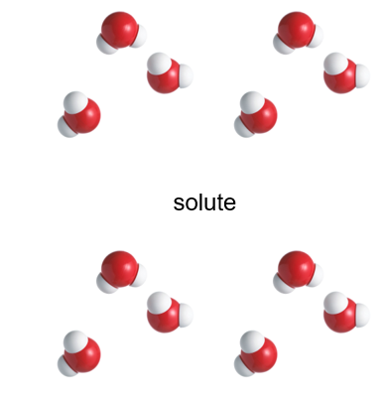
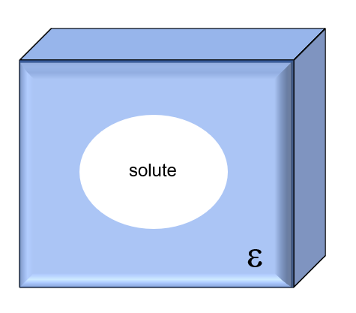
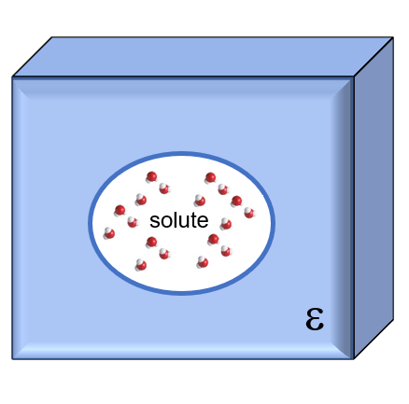
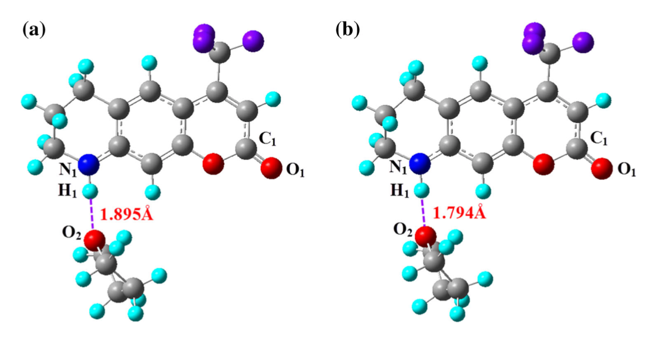
Why the removal of –NH₂
Explicit
Implicit
Hybrid
solute
solute
Optimized structures of hydrogen-bonded complex C340-THF (a, b) in the S0 state and S1 state, respectively.
Zhang, J.; Zhang, H.; Wu, T.; Wang, Q; van der Spoel, D. J Chem. Theory Comput., 2017, 13, 3, 1034-1043.

Slide 11
A comparison of ΔG(expt.) and ΔG(gas)
X | ΔG(expt.) | ΔG(gas) | ΔG(gas -THF) | ΔG^{qh}(gas-THF) | ΔG(THF) | ΔG^{qh}(THF)
NH₂ | 2.1 | 6.5 | 1.3 | 0.5 | 1.1 | 0.4
OMe | 0.7 | 6.1 | 0.3 | -0.4 | 0.5 | -0.2
Me | 0.2 | 5.8 | -0.1 | -1.1 | -0.4 | -1.2
H | -0.3 | 5.1 | -1.0 | -1.9 | -1.3 | -2.1
F | -0.9 | 4.8 | -1.7 | -2.5 | -1.5 | -2.4
CO₂Me | -2.2 | 3.5 | -3.3 | -3.9 | -3.1 | -3.9
CF₃ | -2.6 | 3.1 | -3.6 | -4.4 | -3.7 | -4.4
CN | - | 2.9 | -4.2 | -5.1 | -4.2 | -5.0
ΔG is in units of kcal/mol at 54° C

Slide 12
A comparison of ΔG(expt.) and ΔG(gas-THF)
X | ΔG(expt.) | ΔG(gas) | ΔG(gas -THF) | ΔG^{qh}(gas-THF) | ΔG(THF) | ΔG^{qh}(THF)
NH₂ | 2.1 | 6.5 | 1.3 | 0.5 | 1.1 | 0.4
OMe | 0.7 | 6.1 | 0.3 | -0.4 | 0.5 | -0.2
Me | 0.2 | 5.8 | -0.1 | -1.1 | -0.4 | -1.2
H | -0.3 | 5.1 | -1.0 | -1.9 | -1.3 | -2.1
F | -0.9 | 4.8 | -1.7 | -2.5 | -1.5 | -2.4
CO₂Me | -2.2 | 3.5 | -3.3 | -3.9 | -3.1 | -3.9
CF₃ | -2.6 | 3.1 | -3.6 | -4.4 | -3.7 | -4.4
CN | - | 2.9 | -4.2 | -5.1 | -4.2 | -5.0
ΔG is in units of kcal/mol at 54° C

Slide 13

Comparison of K_{eq} and ΔG(gas-THF) Hammett Plots
Hammett plot for K_{eq} at 54°C
Hammett plot for ΔG(gas-THF) at 54°C
p-CF₃
p-CN
p-CO₂CH₃
p-CF₃
p-CO₂CH₃
p-F
p-F
p-H
slope = 6.2
slope = 7.3
p-H
p-CH₃
p-CH₃
p-OCH₃
p-OCH₃
Gaussian16
B3LYP/gas phase/SMD (THF)
C, H, N, O F (6-31G**); Ni, P (SDDALL)
α(Ni) = 3.130, α(P) = 0.387
$$ln{(K}_{eq}/K_{H})=\frac{(∆G_{H}−∆G)}{RT}$$
18% overestimation
ΔG is in units of kcal/mol

Slide 14
A comparison of ΔG(expt.) and ΔG(THF)
X | ΔG(expt.) | ΔG(gas) | ΔG(gas -THF) | ΔG^{qh}(gas-THF) | ΔG(THF) | ΔG^{qh}(THF)
NH₂ | 2.1 | 6.5 | 1.3 | 0.5 | 1.1 | 0.4
OMe | 0.7 | 6.1 | 0.3 | -0.4 | 0.5 | -0.2
Me | 0.2 | 5.8 | -0.1 | -1.1 | -0.4 | -1.2
H | -0.3 | 5.1 | -1.0 | -1.9 | -1.3 | -2.1
F | -0.9 | 4.8 | -1.7 | -2.5 | -1.5 | -2.4
CO₂Me | -2.2 | 3.5 | -3.3 | -3.9 | -3.1 | -3.9
CF₃ | -2.6 | 3.1 | -3.6 | -4.4 | -3.7 | -4.4
CN | - | 2.9 | -4.2 | -5.1 | -4.2 | -5.0
ΔG is in units of kcal/mol at 54° C

Slide 15
Comparison of K_{eq} and ΔG(THF) Hammett Plots
Hammett plot for K_{eq} at 54°C
Hammett plot for ΔG(THF) at 54°C
p-CF₃
p-CO₂CH₃
p-CN
p-CF₃
p-CO₂CH₃
p-F
p-F
p-H
p-H
slope = 6.2
slope = 7.2
p-CH₃
p-CH₃
p-OCH₃
p-OCH₃
Gaussian16
B3LYP/THF/SMD (THF)
C, H, N, O F (6-31G**); Ni, P (SDDALL)
α(Ni) = 3.130, α(P) = 0.387
$$ln{(K}_{eq}/K_{H})=\frac{(∆G_{H}−∆G)}{RT}$$
16% overestimation
ΔG is in units of kcal/mol

Slide 16
Conclusions
The relative stability of C—C bond activation of the η² and oxidative addition product is influenced by the para-substituents on the benzonitrile ring.
When conducting benchmark studies, the experimental has a range of 4.7 kcal/mol. When optimizing in gas phase with solvent corrections, it has a range of 4.9 kcal/mol. When optimizing in THF with solvent corrections, it has a range of 4.8 kcal/mol. The range is the same with quasi-harmonic approximations.
Comparison of the slopes of the experimental and computational Hammett plots leads to a 15-18% overestimation of the computational slopes.
Empirical dispersion corrections and other DFT methods are underway.

Slide 17
Acknowledgments
Tülay A. Ateşin, Ph.D.
William D. Jones, Ph.D.
Abdurrahman Ç. Ateşin, Ph.D.
HPC Resources
University of Texas at Austin
Texas Advanced Computing Center
Funding
Engaged Scholarship Award
Subgroup member
Julissa Rodriguez (Fall 2020- )
Group members
Jennifer Sanchez (Fall 2020- )
Lubna Kader (Spring 2021- )
Dominique Gallegos (Fall 2019-Spring 2021)
Orion Nguyen (Fall 2020-Spring 2021)
Elizabeth Gamez (Fall 2020)
Aurodeep Panda(Fall 2020-) (Dr. Jones)
UTRGV Department of Chemistry

