Slide 1
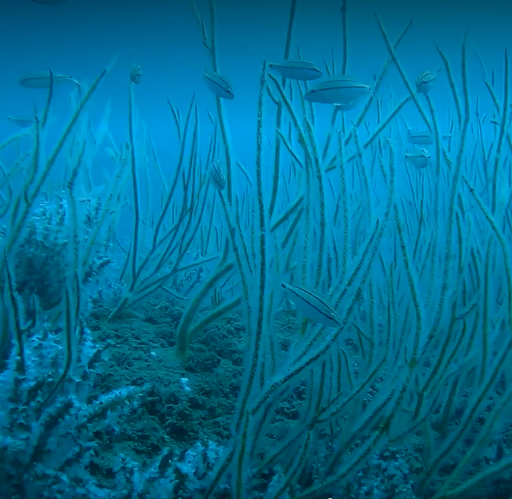
A Study Design for Evaluating the Productivity of The Rio Grande Valley Artificial Reef using Time Lapse Camera Data
By: Greta Hayden-Pless

Slide 2
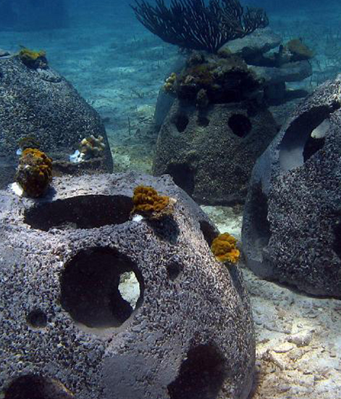
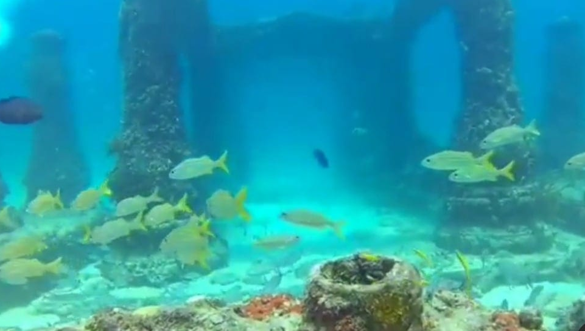
What is an Artificial Reef
a manmade structure that may mimic some of the characteristics of a natural reef
Provides a substrate for coral growth and habitat for fish and other marine organisms
Made from a variety of natural or synthetic materials
Comes in a number of shapes and styles.

Slide 3
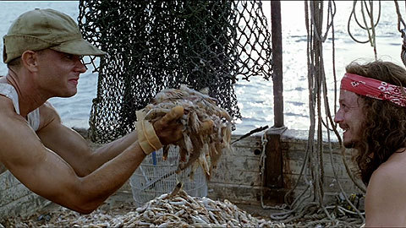
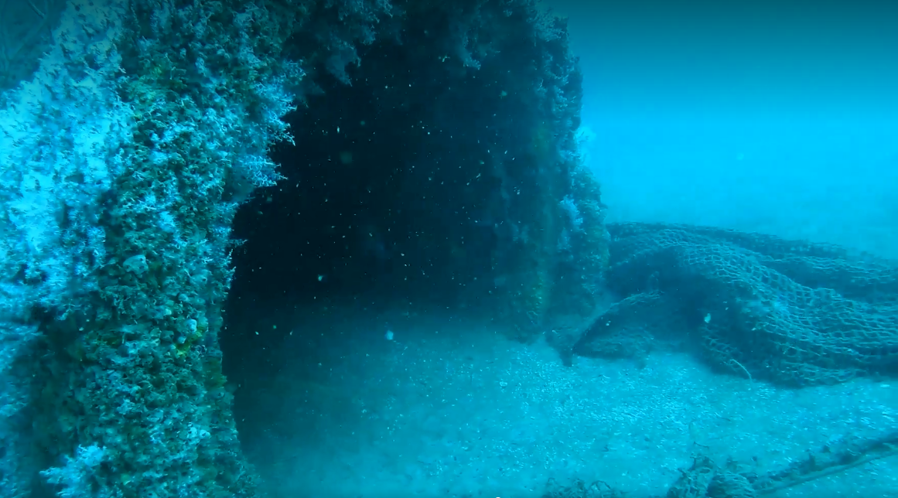
What Happened? Why?
Texas needs artificial reefs:
To mitigate the effects of high shrimping effort present in the Gulf of Mexico.
The Western Gulf of Mexico can’t sustain natural reefs, with some rare exceptions
Human disturbance in the nearshore Gulf of Mexico has reduced natural habitat for reef specie

Slide 4
Rio Grande Valley (RGV) Artificial Reef
Located 13 miles northeast of South Padre Island
Within state territorial waters
Covers 1650 acres (2.5 square miles)
The largest artificial reef off the Texas coast
This study focuses on three of the different types of structures placed within the RGV reef boundaries

Slide 5
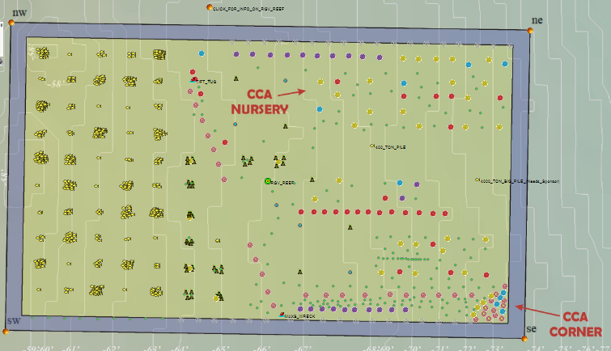

Slide 6
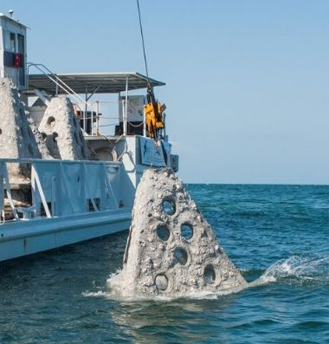
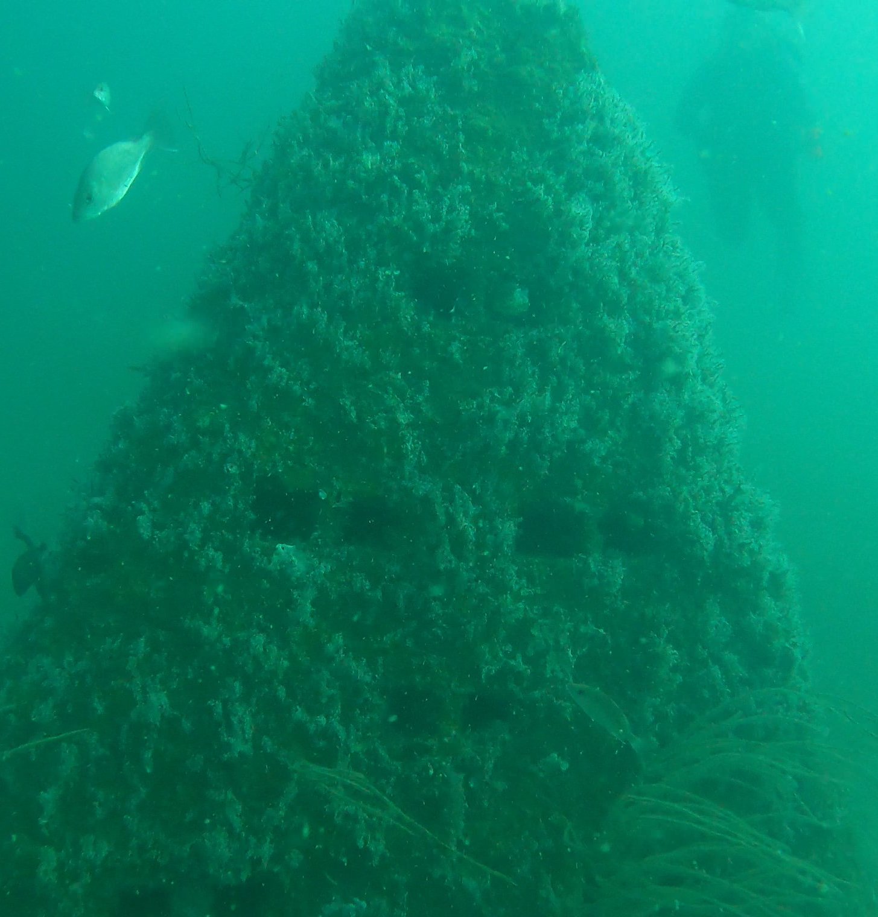
Pyramids

Slide 7
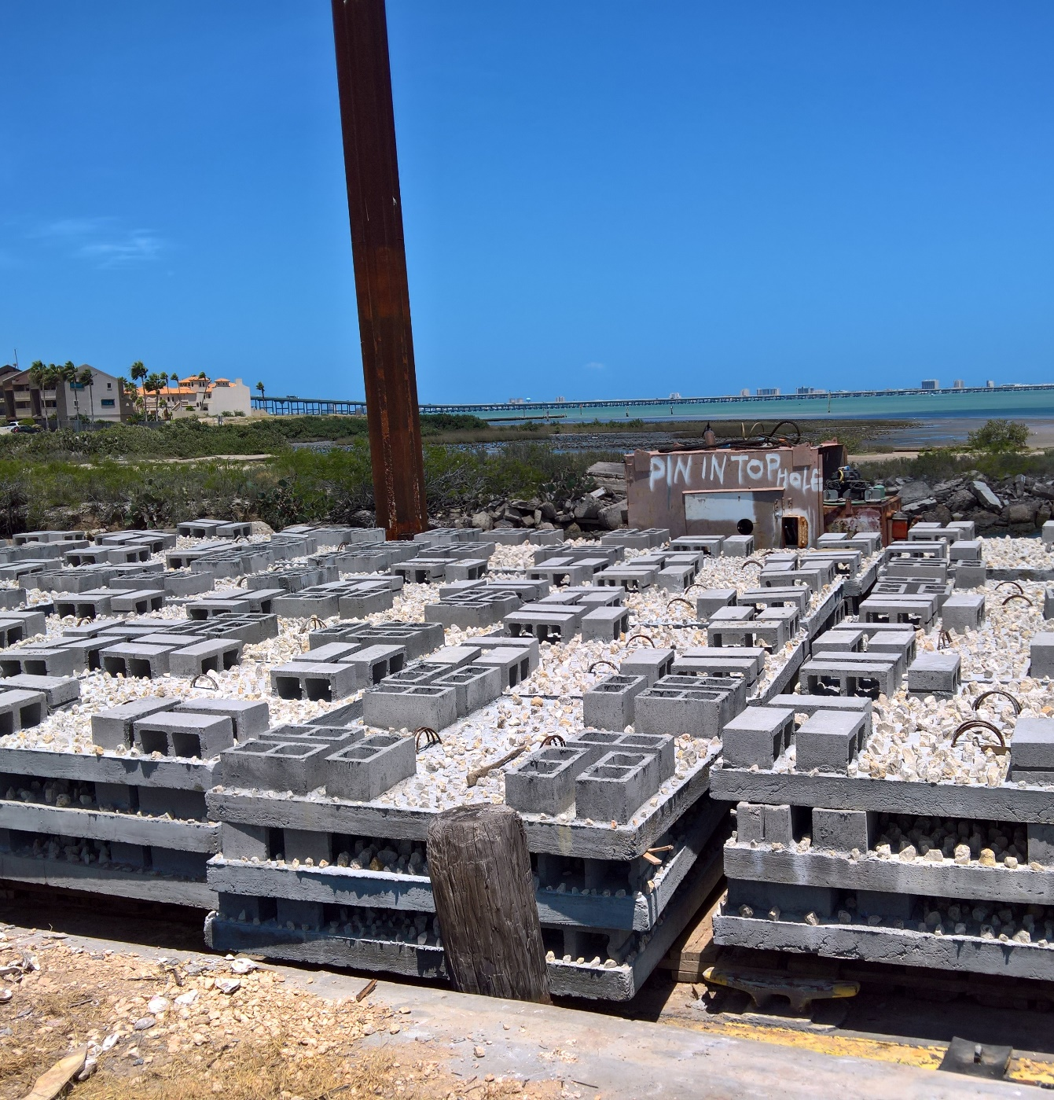
Low Profile Modules

Slide 8
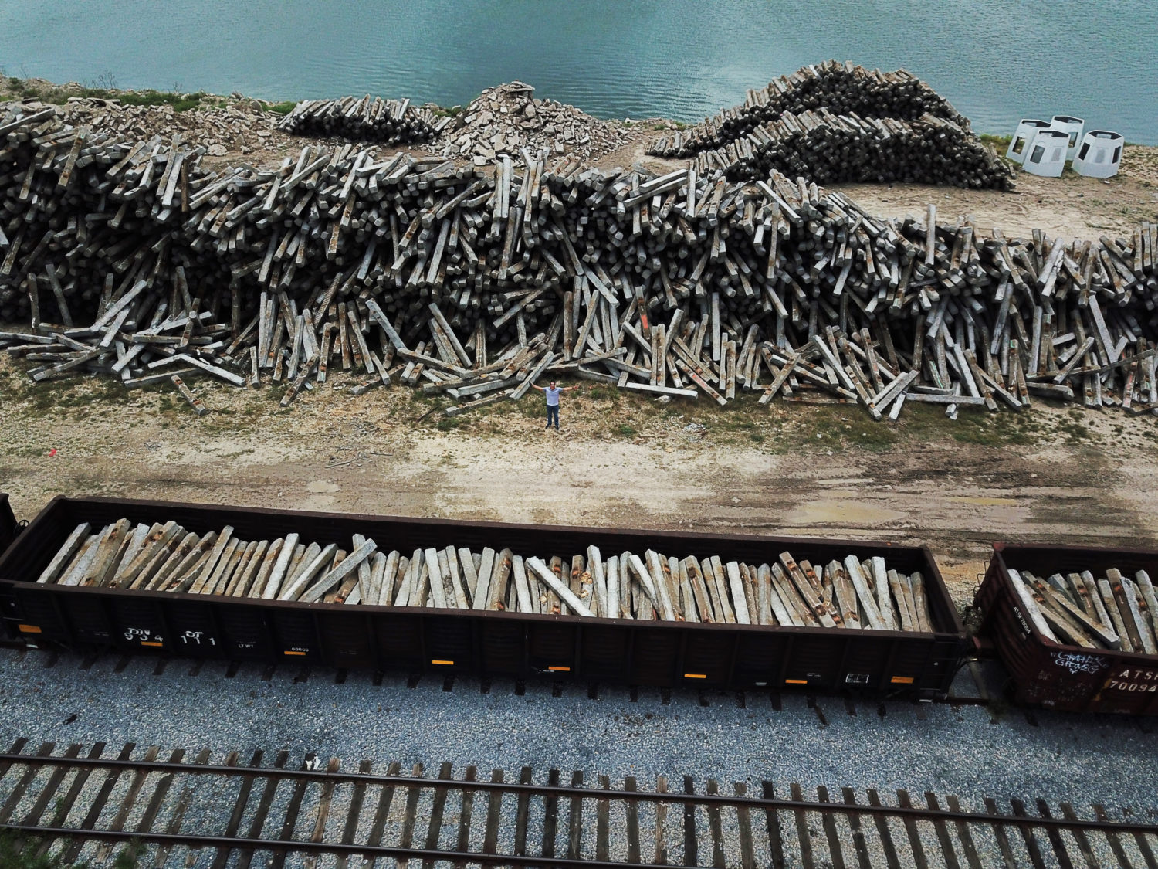
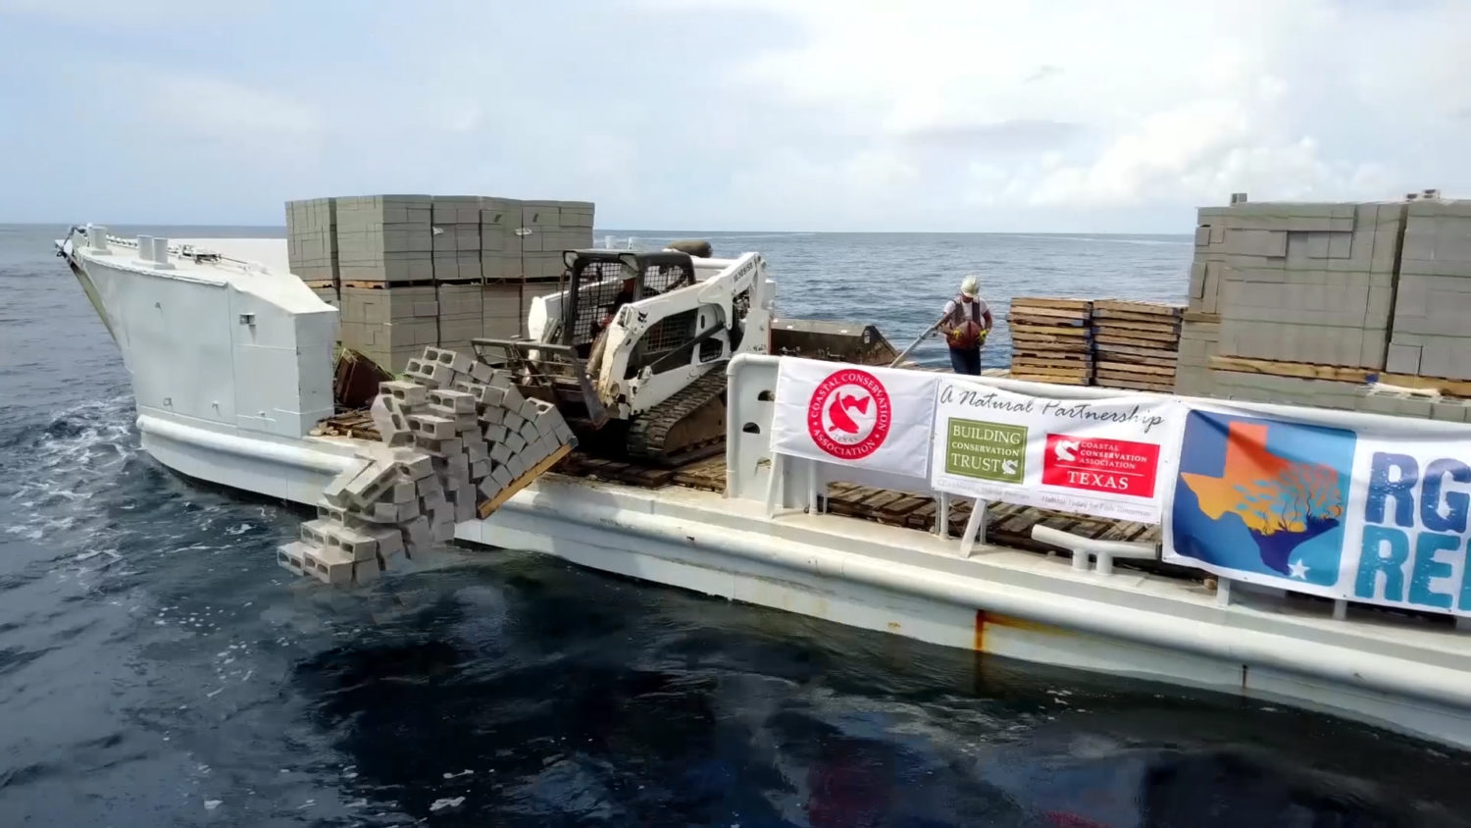
Mixed Sites

Slide 9
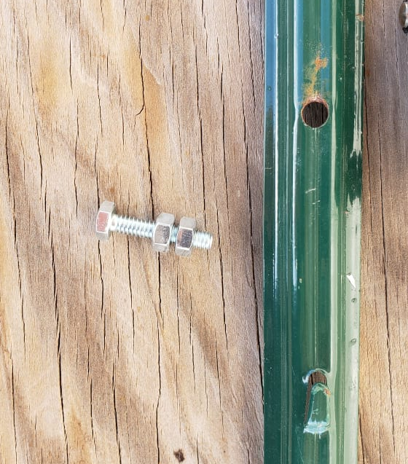
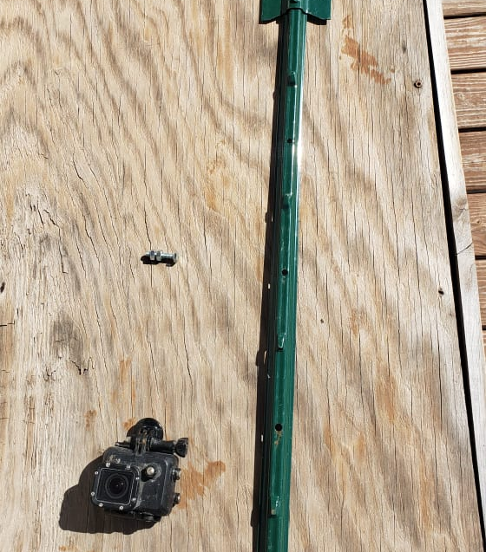
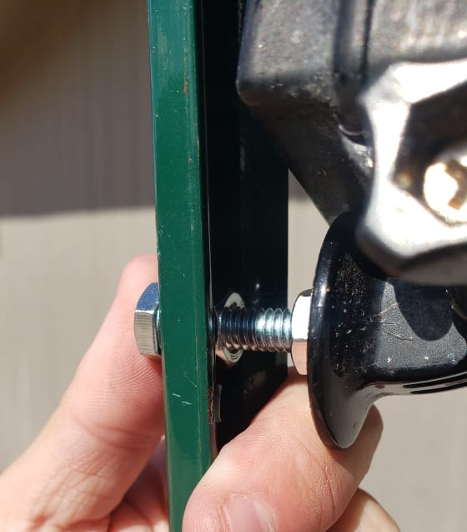
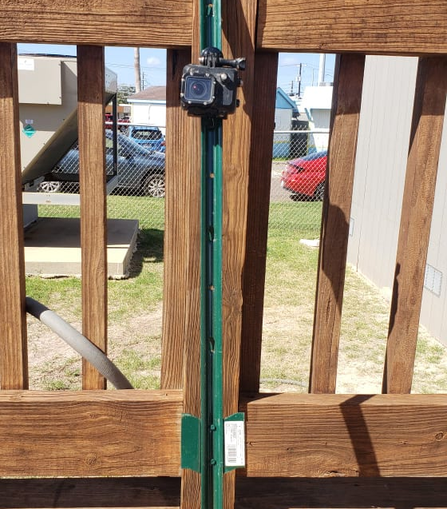
Materials
FOR EACH SITE
GoPro 3+ or 4
CamDo Blink
Three-foot T-post
Stainless steel bolt with two nuts
Underwater camera housing with a backpack

Slide 10
Objectives
During The Study
Determine the most comprehensive method for camera surveys
Determine best time lapse procedure to gain the most accurate view of species presence
Post Study
Determine the difference between the three reef structure types in terms of fish abundance and assemblage.
Determine which structural type is most suitable as nursery habitat for post-settlement reef fish.

Slide 11
Acknowledgements
A huge THANK YOU to:
Friends of Rio Grande Valley Reef – Gary Glick
Thank you to the divers who volunteered their time for this project. (Kier, Victoria, Marissa, Marybeth, Kathrene, Madison, Keegan, Curtis, William)
For donations of materials and such thank you to:
Port of Brownsville
Foremost paving
BNSF Railroad.

