Slide 1
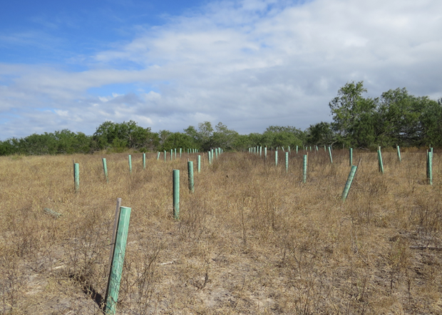
Are interspecific differences in seedling drought tolerance predictive of species performance in restoration plantings? A case study in South Texas
By: Zarek Contreras
Major Advisor: Dr. Bradley Christoffersen
Committee Members
Dr. Christopher Gabler
Dr. Alejandro Fierro Cabo

Slide 2
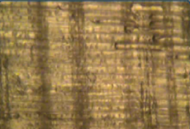
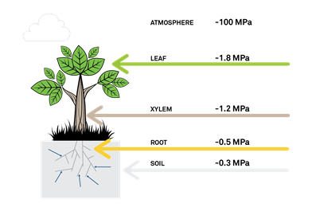
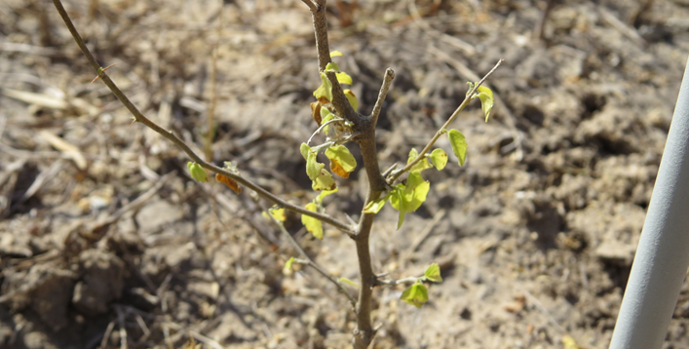
Drought Impacts on Plant Physiology
Increasingly severe droughts lead to severe water stress (Breda et al. 2006)
Can lead to embolism/cavitation formation, and hydraulic failure
Interspecific difference in drought tolerance affect forest composition (Clark et al. 2016; Blackman et al. 2019).
1. Bréda, Nathalie, et al. "Temperate forest trees and stands under severe drought: a review of ecophysiological responses, adaptation processes and long-term consequences." Annals of Forest Science 63.6 (2006): 625-644.
2. Clark, J.S., Iverson, L., Woodall, C.W., Allen, C.D., Bell, D.M., Bragg, D.C., D'Amato, A.W., Davis, F.W., Hersh, M.H., Ibanez, I., Jackson, S.T., Matthews, S., Pederson, N., Peters, M., Schwartz, M.W., Waring, K.M. and Zimmermann, N.E. (2016), The impacts of increasing drought on forest dynamics, structure, and biodiversity in the United States. Glob Change Biol, 22: 2329-2352.

Slide 3
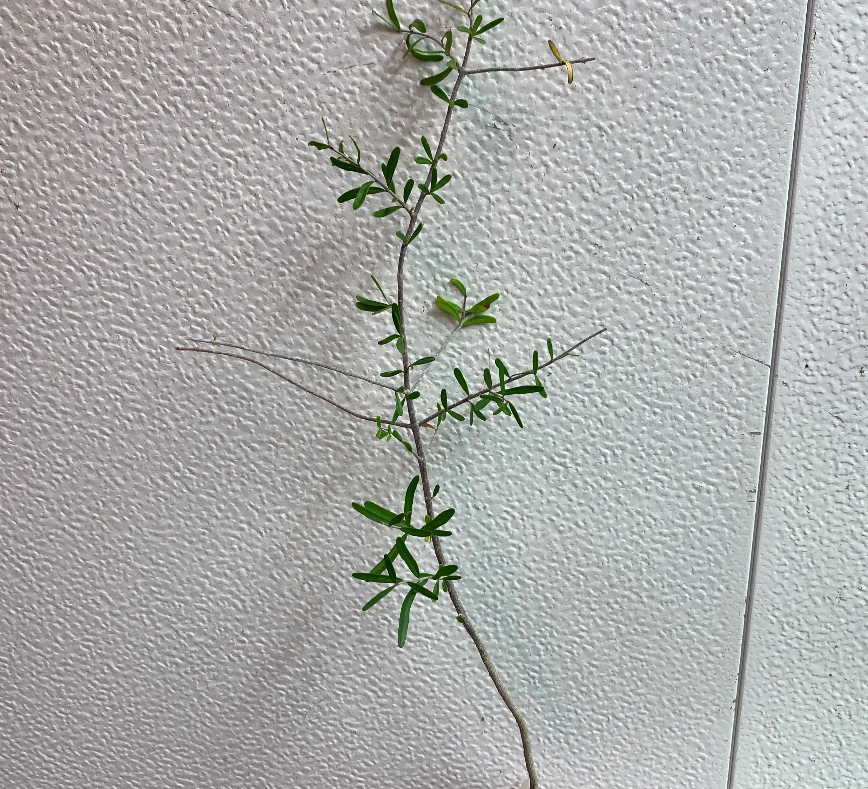
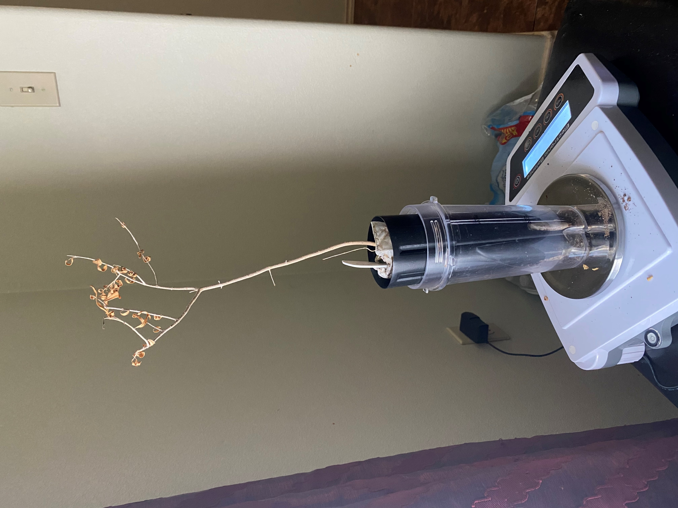
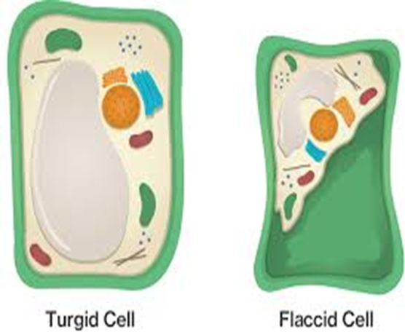
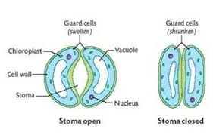
Study Questions
1. What are interspecific differences in leaf wilting patterns? Are they related to how much water the seedlings transpire?
2. What are the some of the interspecific differences in mortality patterns? How do they compare to in-field mortality in restoration?
3. How do leaf wilting patterns compare to mortality patterns seen in the pilot study?
“Transpiration.” BIOLOGY4ISC, biology4isc.weebly.com/transpiration.html.
Course Hero, Inc. “Plant Movement.” Course Hero, www.coursehero.com/sg/introduction-to-biology/plant-movement/.

Slide 4
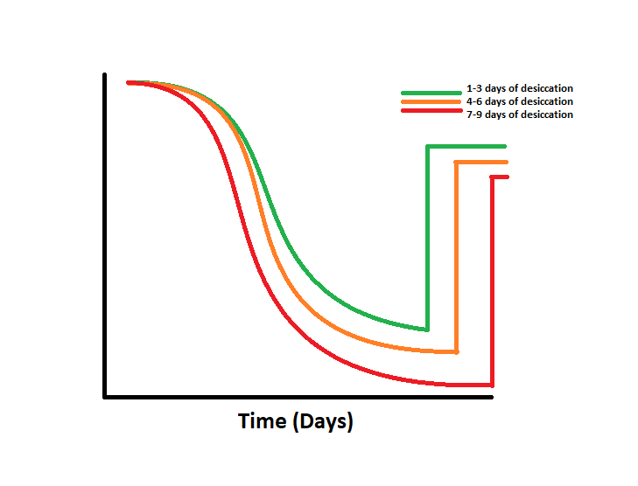
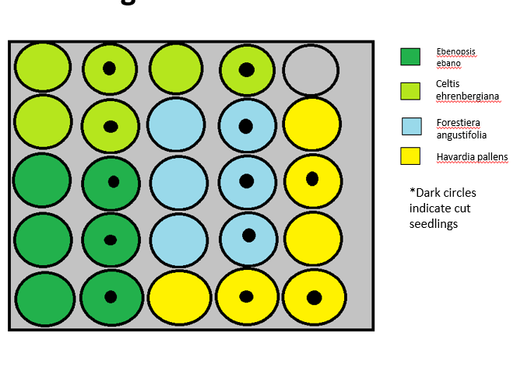
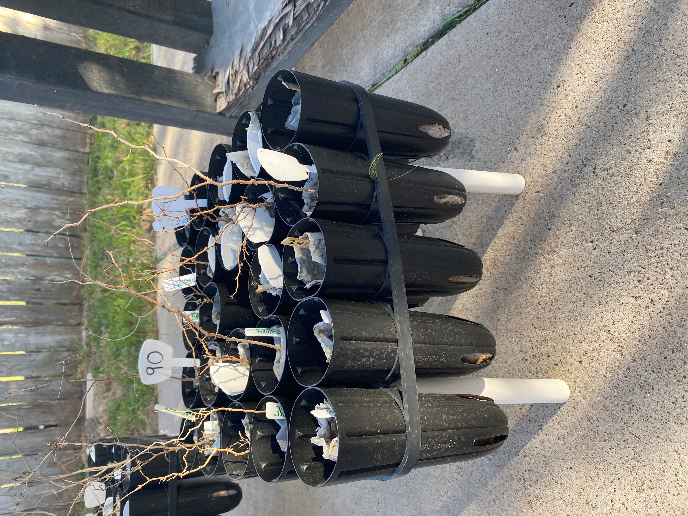
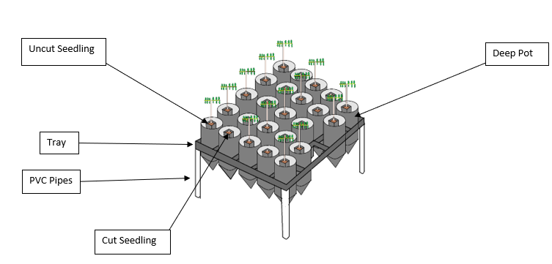
Pilot study: Interspecific differences in drought tolerance
Pilot Study
3 Desiccation Treatments
Mass (g)
1. What are interspecific differences in drought tolerance? Are they related to how aggressive or conservative they use water/transpire during drought?
1-3 days of desiccation:58 seedlings
4-6 days of desiccation: 56 seedlings
7-9 days of desiccation: 56 seedlings
Estimating Traspiration (g)
Mass (g)

Slide 5
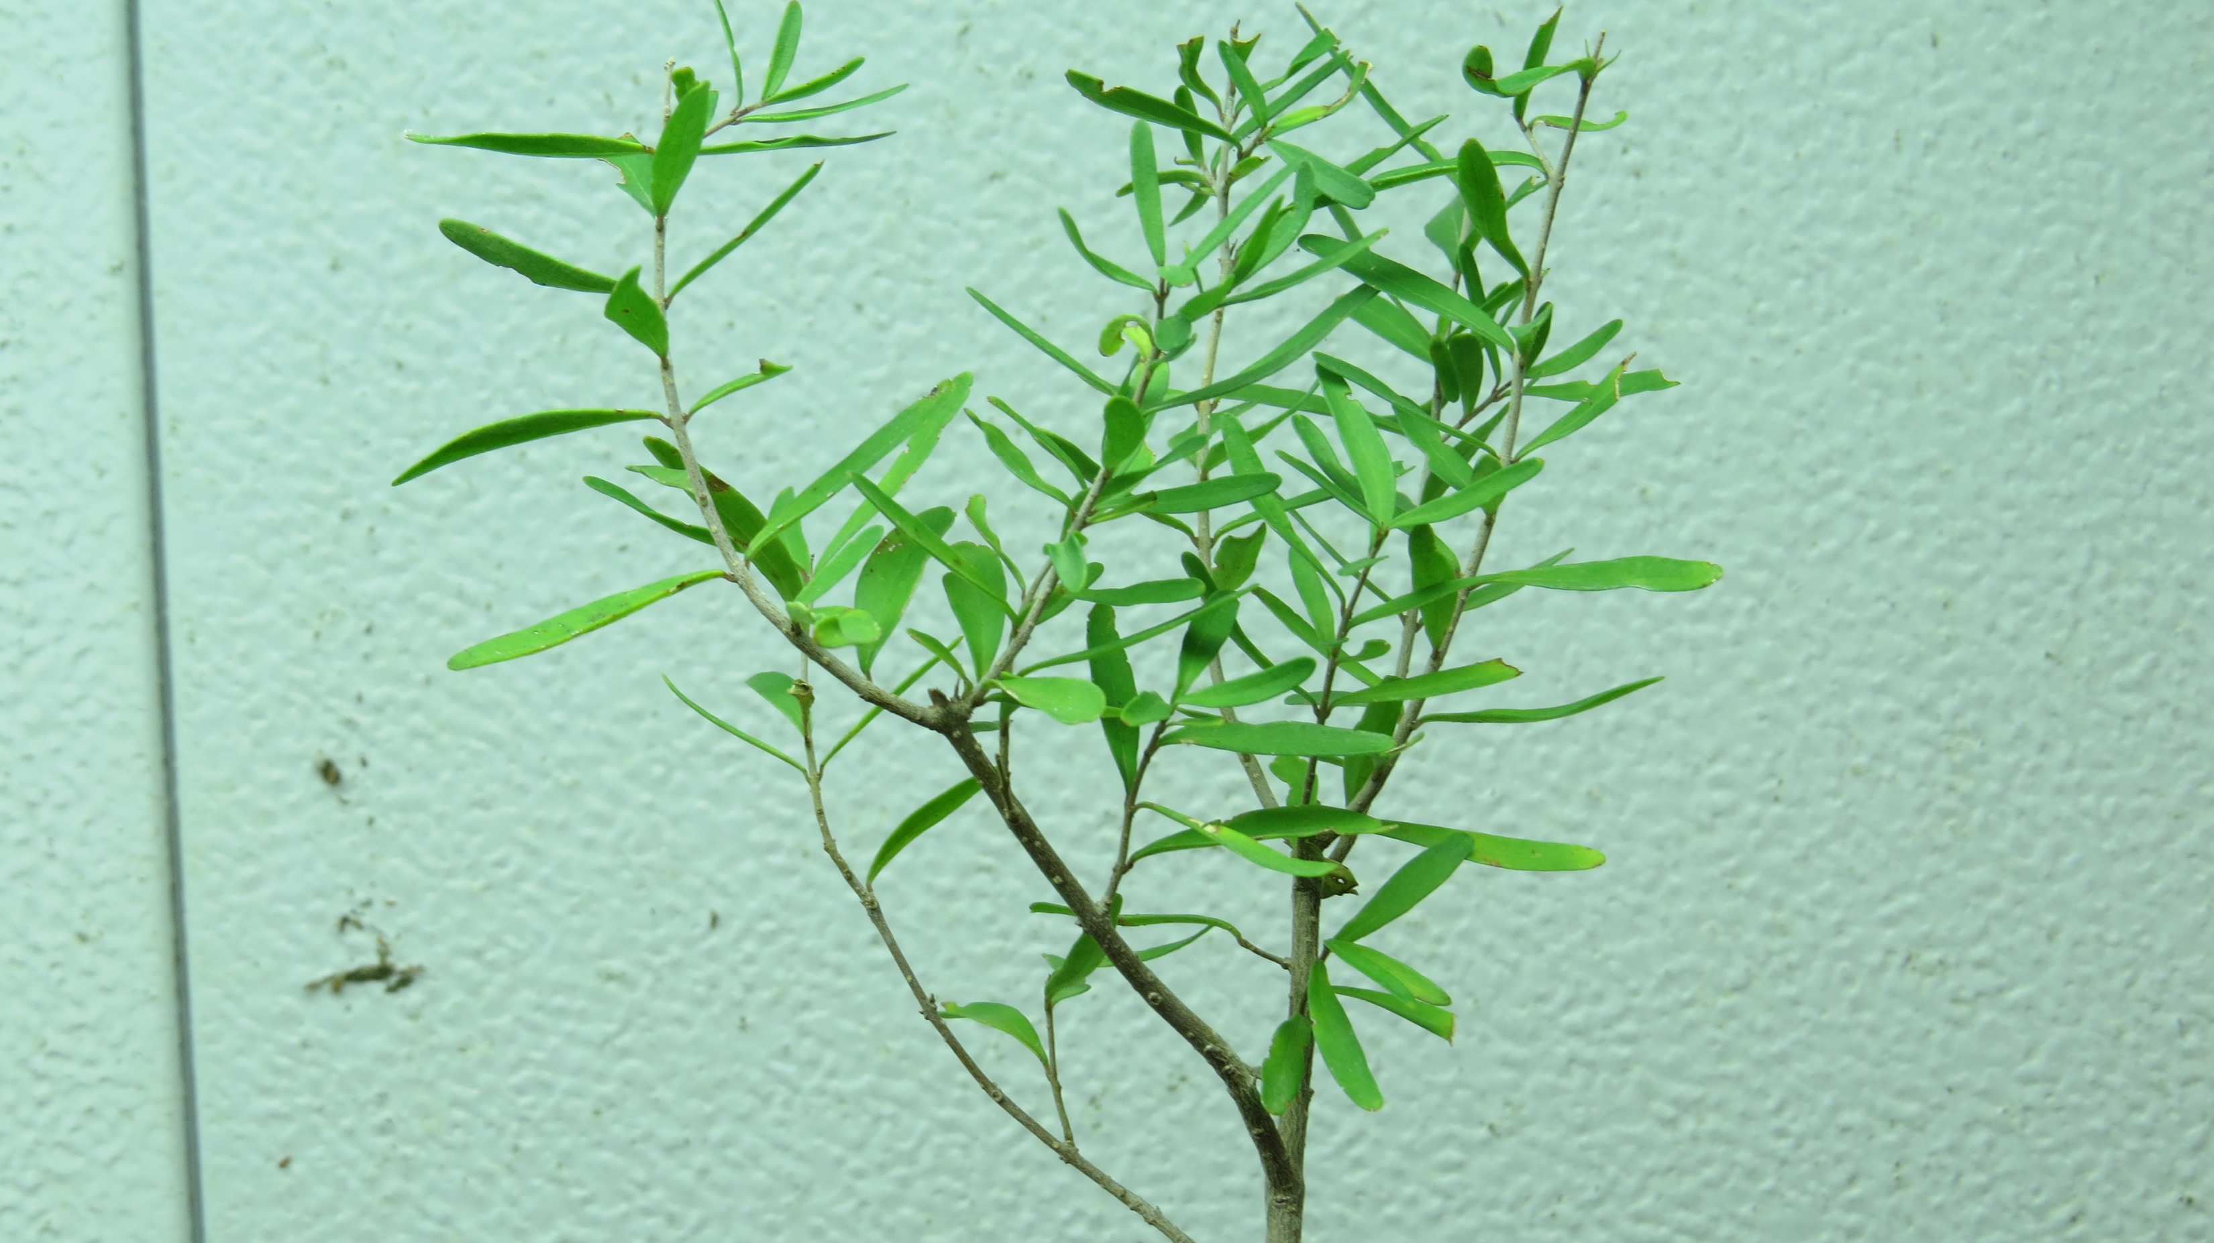
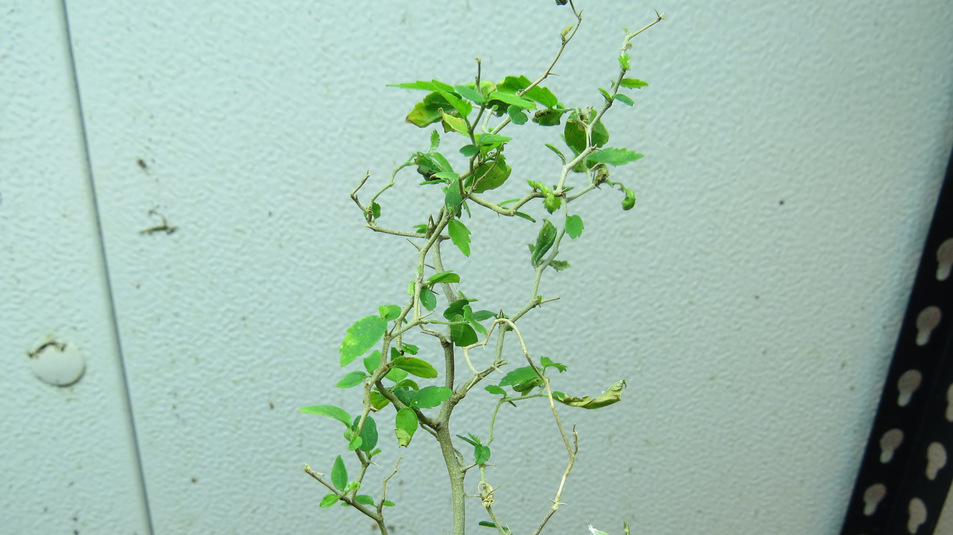
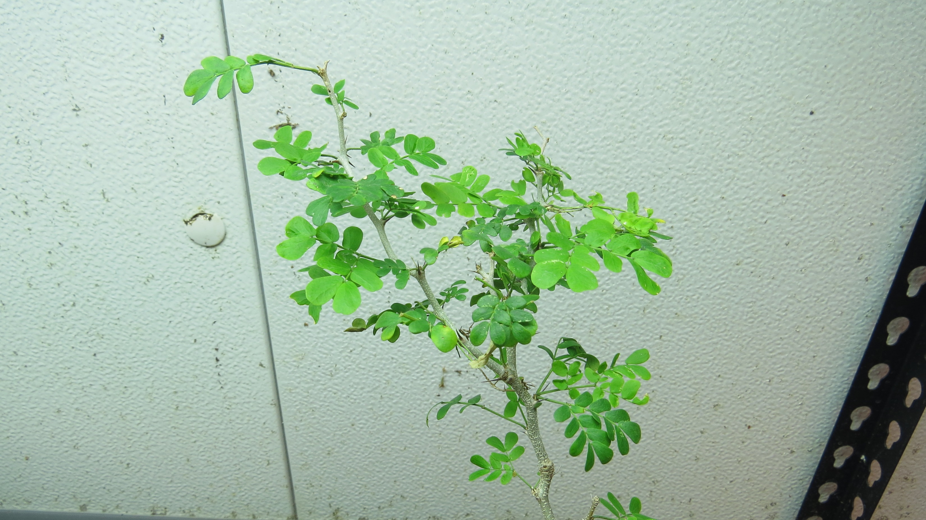
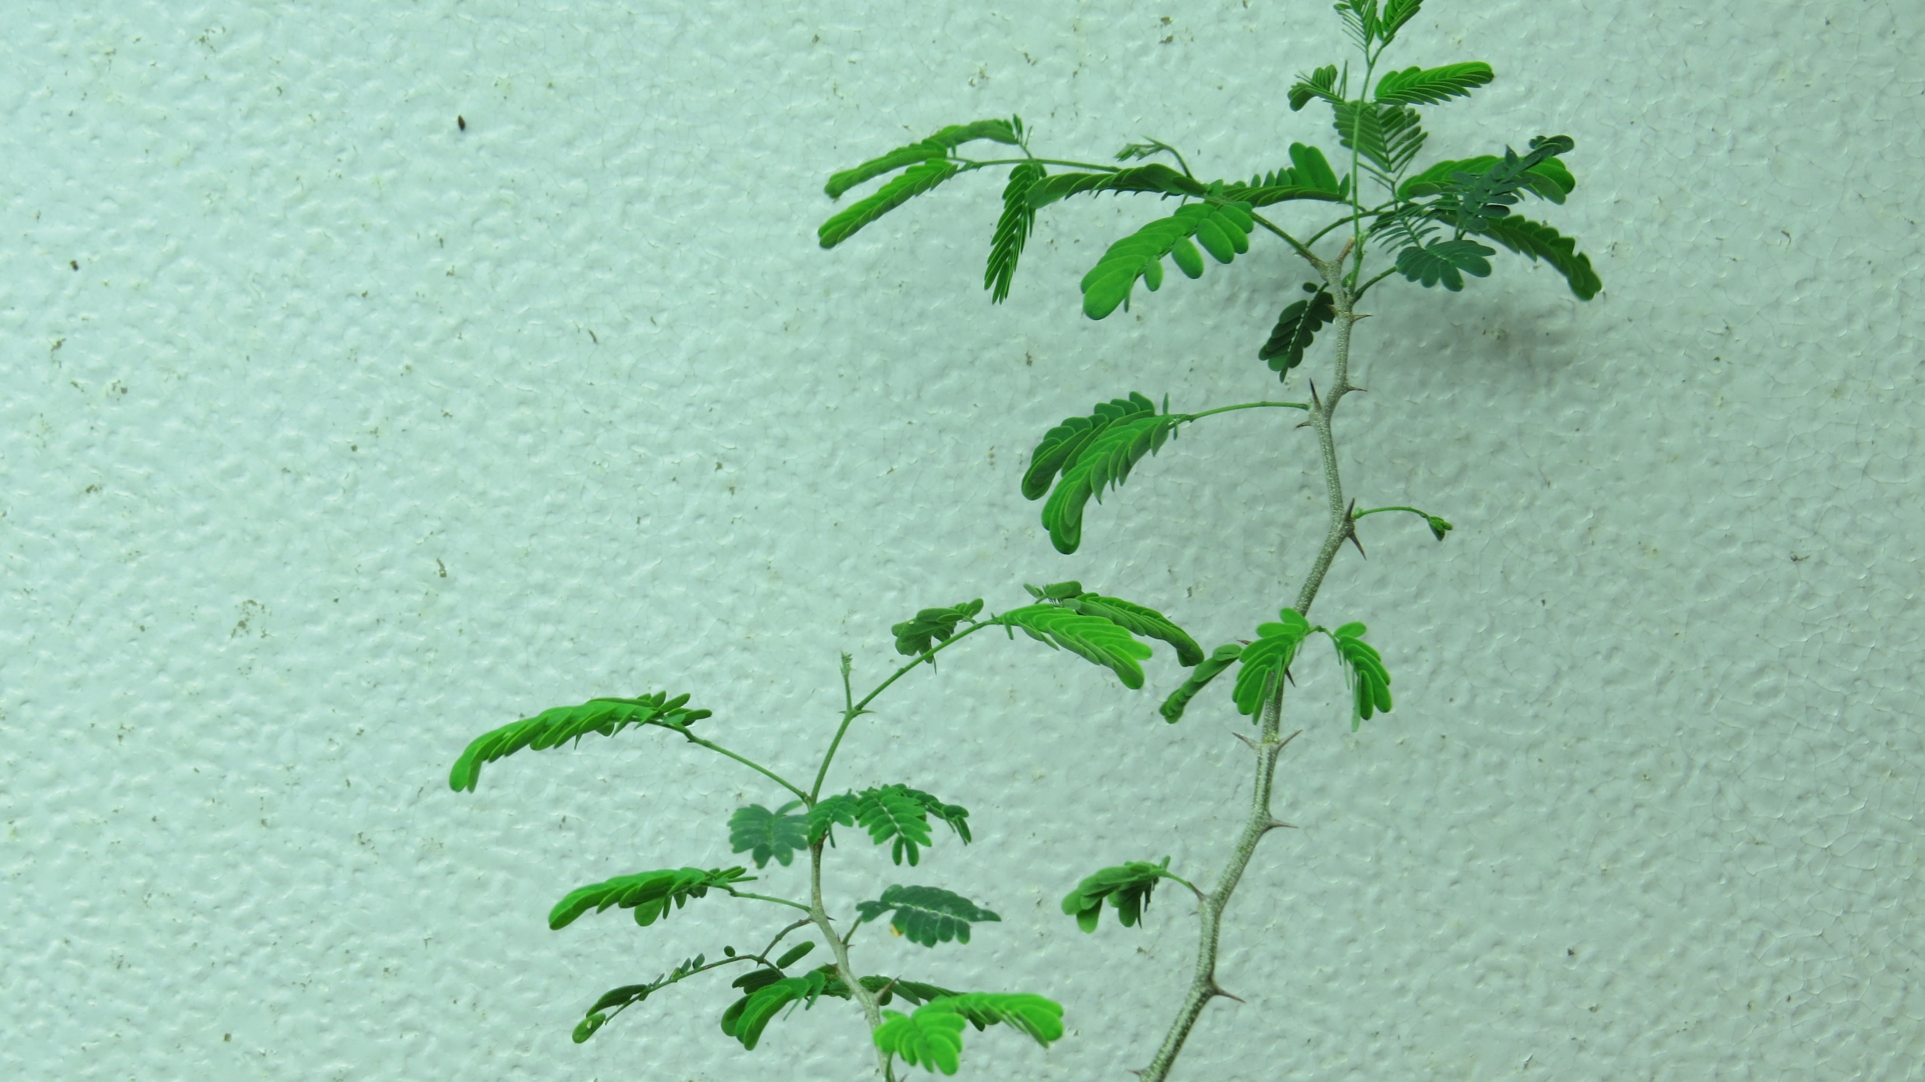
Forestiera angustifolia
Celtis ehrenbergiana
Granjeno
Narrow-Leaf Elbowbush
Ebenopsis ebano
Havardia pallens
Texas Ebony
Tenaza

Slide 6
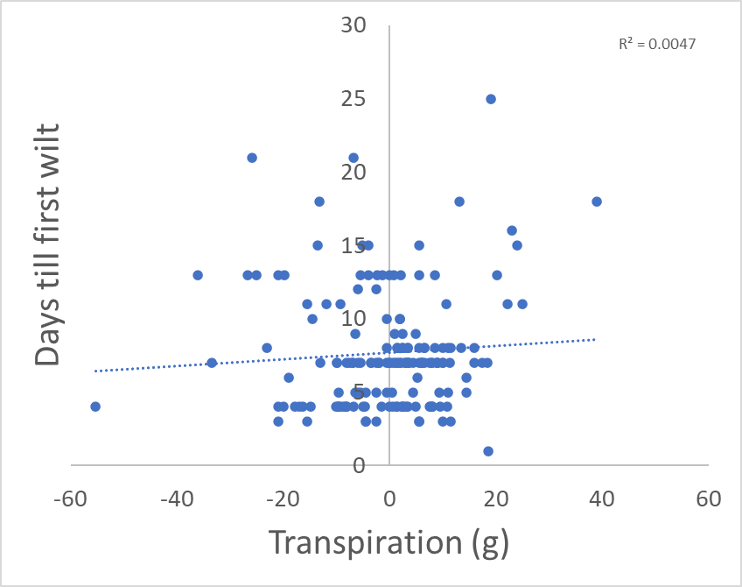
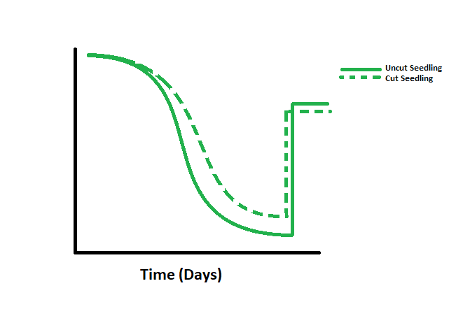
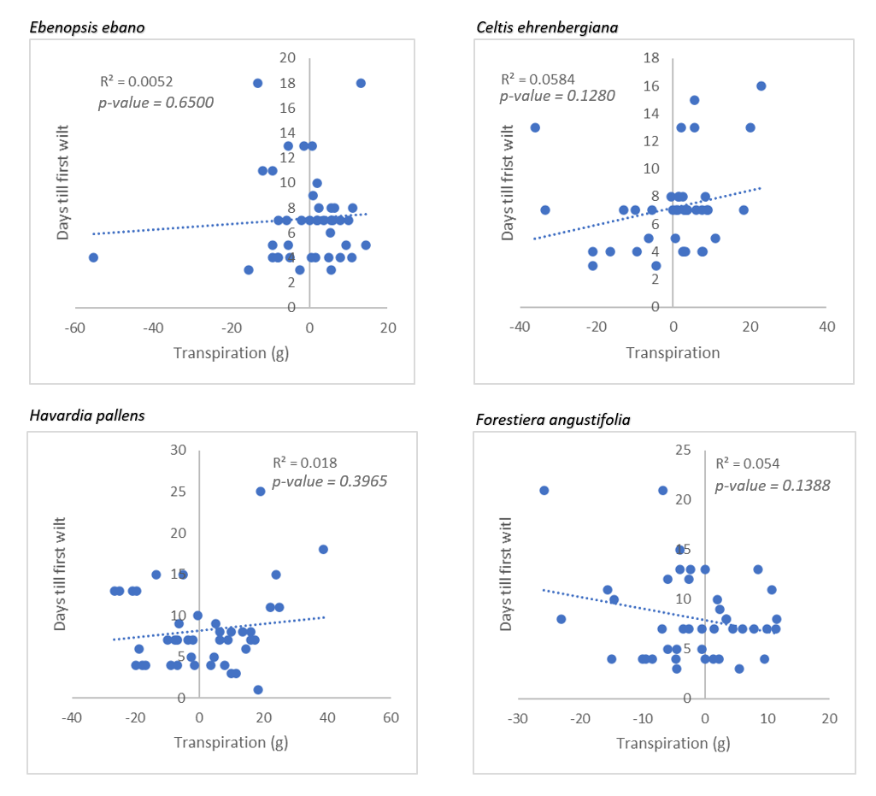
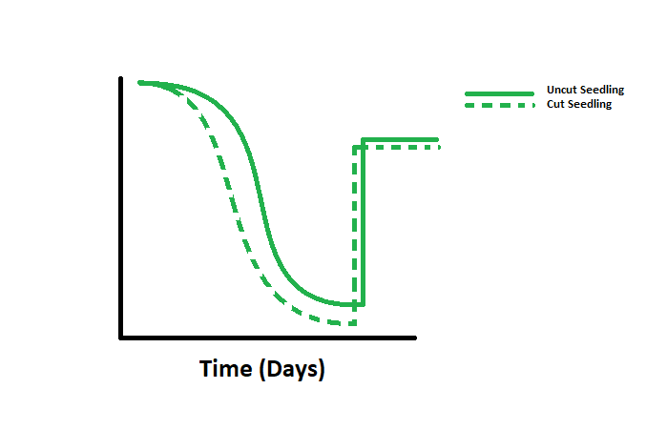
Interspecific differences in leaf wilting patterns? Related to water use?
Regardless of species, leaf wilting was not related to how aggressive or conservative the seedlings used water.
Whole Seedling Water Loss (g) Relative to Roots and Soil Alone
Positive Values (g)
Whole Seedling Water Loss (g) Relative to Roots and Soil Alone
Whole Seedling Water Loss (g) Relative to Roots and Soil Alone
Negative Values (g)
Whole Seedling Water Loss (g) Relative to Roots and Soil Alone
Whole Seedling Water Loss (g) Relative to Roots and Soil Alone

Slide 7
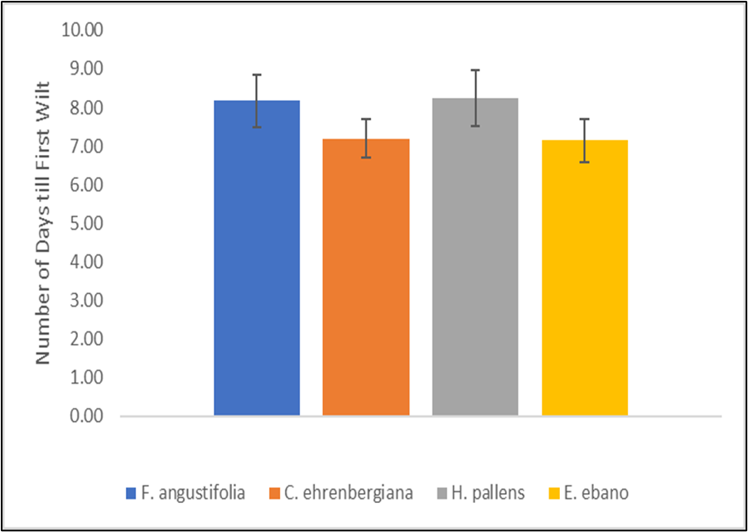
Interspecific differences in leaf wilting patterns?
Forestiera angustfolia and Havardia pallens had the higher average number of days till first wilt. Celtis ehrenbergiana and Ebenopsis ebano had the lower average number of days till first wilt

Slide 8
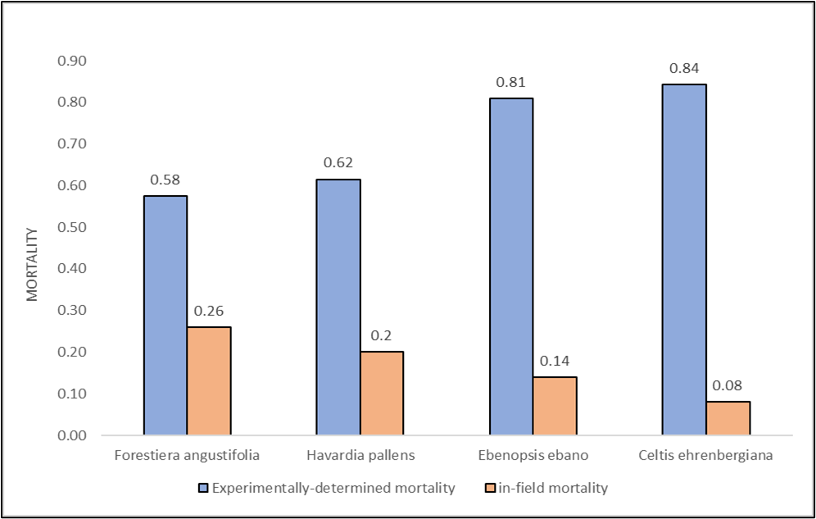
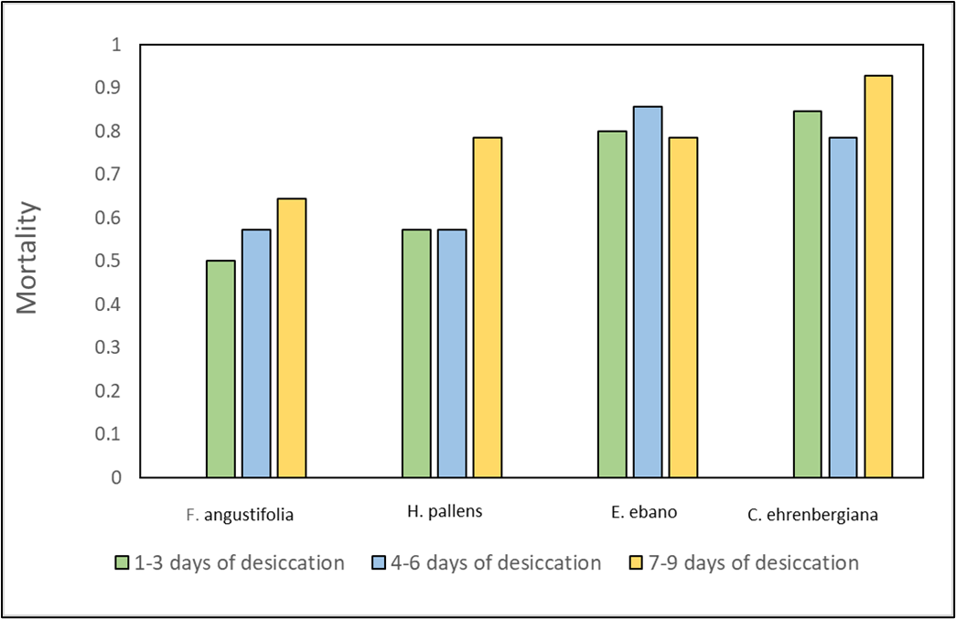
Interspecific differences in mortality?
Our experimentally determined mortality differed from in-field mortality.
Mortality across different ranges of length of desiccation varied with species.

Slide 9
Conclusion
No relationship between leaf wilting and transpiration
Interspecific differences in mortality complimented leaf wilting
Experimentally determined mortality was different from in-field mortality

Slide 10
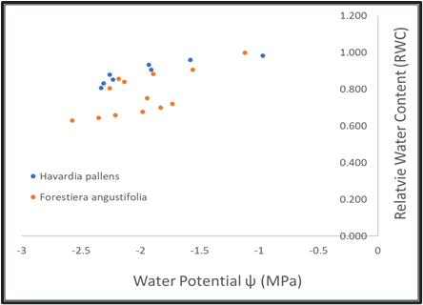

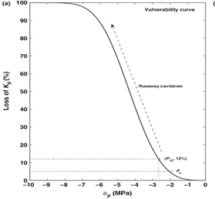

Future Directions
Pressure-Volume Curve
Construction of Pressure-Volume Curves
Construction of Vulnerability Curves
Adjustments and refinements to Pilot Study
Replication of Pilot Study in Spring & Summer
Vulnerability Curve

Slide 11
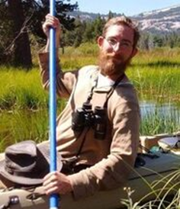


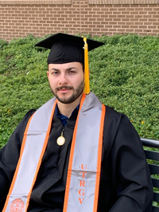


Acknowledgements
USDA National Needs Fellowship – (PI - Dr. Alexis Racelis)
Dr. Bradley Christoffersen
Dr. Christopher Gabler
Dr. Alejandro Fierro Cabo
Kimbery Wahl (U.S Fish & Wildlife)
Fellow labmates: Cliften Albrecht, Sara Godwin ,David Garza, & Mylen Arias
Clifton Albrecht
Mylen Arias
David Garza
Sarah Godwin

