Slide 1
Rhizosphere microbiome and potential of range expansion of exotic invasive guinea grass, Panicum maximum in the Lower Rio Grande Valley
Vanessa E. Thomas and Dr. Pushpa Soti
Department of Biology, University of Texas, Rio Grande Valley, Edinburg, TX 78501, United States

Slide 2
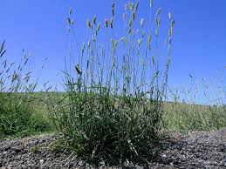
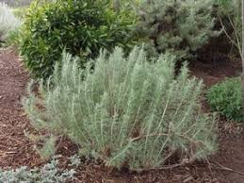
Invasive spp. and Soil Microbial Interactions
Microbial soil organisms can develop a symbiotic relationships with plants in exchange for nutrients
Invasive grass Phalaris aquatica has symbiotic relationship with several plant growth promoting organisms to improve nutrients in soil but has negatively impacted the soil microbial community for native plant restoration projects.
Bacteroidetes, Proteobacteria, Agrobacterium, Bradyrhizobium, Rhizobium (R. leguminosarum), Candidatus koribacter, Candidatus solibacter, and rhizophilic arbuscular mycorrhizal fungi, and fewer Planctomycetes, Acidobacteria, Nitrospira, and Rubrobacter
Legacy impact on soil
In South Texas, this area of study is open for research opportunities to ask
.
Phalaris aquatica native to Europe, Invasive in Australia and California U.S.A
.
Artemisia californica, also known as California sage brush Native

Slide 3
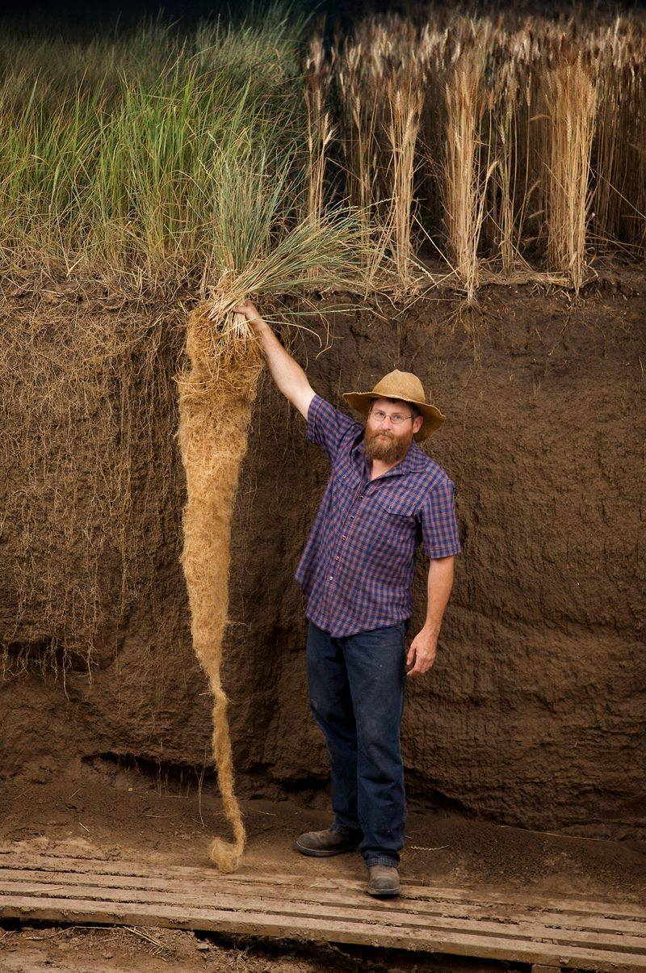
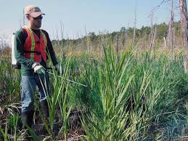
Alterations in Soil Chemistry
.
Invasive grasses can alter the soil chemistry directly
higher pH
Dehydrate the soil
Alter the nutrient cycle
.
Indirect changes to soil chemistry
Introductions of fertilizer to replenish soils
Additional chemicals such as Herbicide
Nitrogen pools from symbiotic organisms
Weidenhamer, Jeffrey D., and Ragan M. Callaway. "Direct and indirect effects of invasive plants on soil chemistry and ecosystem function." Journal of chemical ecology 36.1 (2010): 59-69.

Slide 4
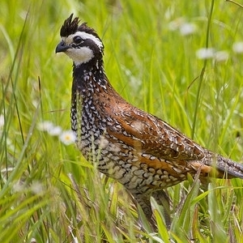
Invasive non-native grasses of south Texas
Invasive organisms can be native or nonnatives that have taken over a space and decreasing diversity in a habitat
Examples in Texas,
Cenchrus ciliaris (Buffle grass) Native to Africa and Asia
Guinea Grass (panicum maximum) Native to Africa
Grasses not only displace native grasses but native animals as well including the northern bobwhite
Moore, Sarah F. "Effects of guineagrass on northern bobwhite habitat use." Masters Abstracts International. Vol. 49. No. 02. 2010.

Slide 5
Panicum maximum (Guinea Grass)
Introduced to Texas as cattle graze fodder from its native range of Africa
Is one of the fastest growing non-native invasive in south Texas
Hardy bunch grass that has a high stress tolerance and is competitive to native plants
Has displaced many native plants and shifting habitats in LRGV.
Is invasive to other countries including Brazil, India and Australia. It is a fire hazard in Hawaii and Australia.
The grass is nitrogen dependent and may be benefitting from native rhizobacteria.
Sal Del Rey photo by Vanessa Thomas

Slide 6
Guinea Grass Range
Invasive range
Native range

Slide 7
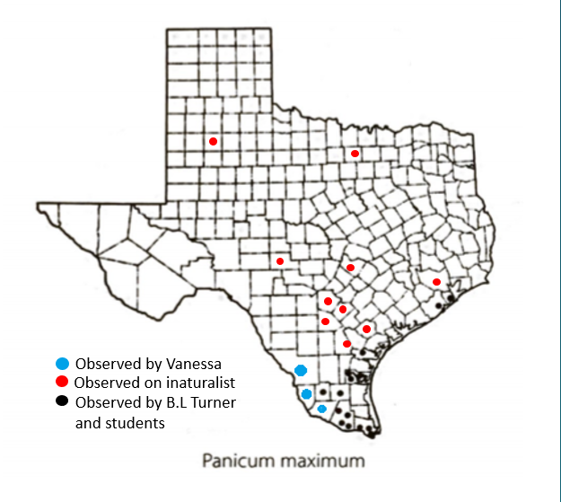
Data taken from University of Texas Austin Professor B.L Turner and students in 2003.
Edited Vanessa Thomas UT Rio Grande Valley Thomas 2020 and inaturalist dots

Slide 8
Arbuscular mycorrhizal (AMF)
Ectomycorrhiza (EcM)
Live on the interior of the root
Exchange carbohydrates and sugars for nutrients such as phosphorous and water, can increase root efficiency.
Produce glomalin a chemical that can store nitrogen and carbon in the soil. (Hawkes, Christine V., et al.)
Previous study with semi-arid regions of Utah and California found AMF to increase with presence of Exotic grasses then in Native grasses
Research supports AMF can help guinea grass in increased temperatures brought on by climate change (Řezáčová, Veronika, et al)
Live on the exterior of the root and do not enter hosts cell wall
Build a hyphal wall against the cell wall of plant that can grow and gather Nitrogen for nutrient exchange.
Extraradical hyphae may be used to collect water further then plant root, also may allow the plant to survive soils under drought tolerant and other negative soil habitats including salt and heavy metal concentrations.
Previous research of symbiotic relationship between EcM and Panicum spp. had an incrasee of biomass and micronutrients.
.
Hawkes, Christine V., et al. "Arbuscular mycorrhizal assemblages in native plant roots change in the presence of invasive exotic grasses." Plant and Soil 281.1-2 (2006): 369-380.
Řezáčová, Veronika, et al. "Little cross-feeding of the mycorrhizal networks shared between C3-Panicum bisulcatum and C4-Panicum maximum under different temperature regimes." Frontiers in plant science 9 (2018): 449.
Ghimire, Sita R., and Kelly D. Craven. "Enhancement of switchgrass (Panicum virgatum L.) biomass production under drought conditions by the ectomycorrhizal fungus Sebacina vermifera." Applied and environmental microbiology 77.19 (2011): 7063-7067.

Slide 9
Objectives
01
02
03
Determine the influence of Guinea grass on the soil chemical and physical properties across different habitat types in south Texas.
To characterize and compare the rhizosphere and endosphere microbial community associated with Guinea grass.
Survey the distribution of Guinea grass in south Texas and predict the future distribution range.

Slide 10
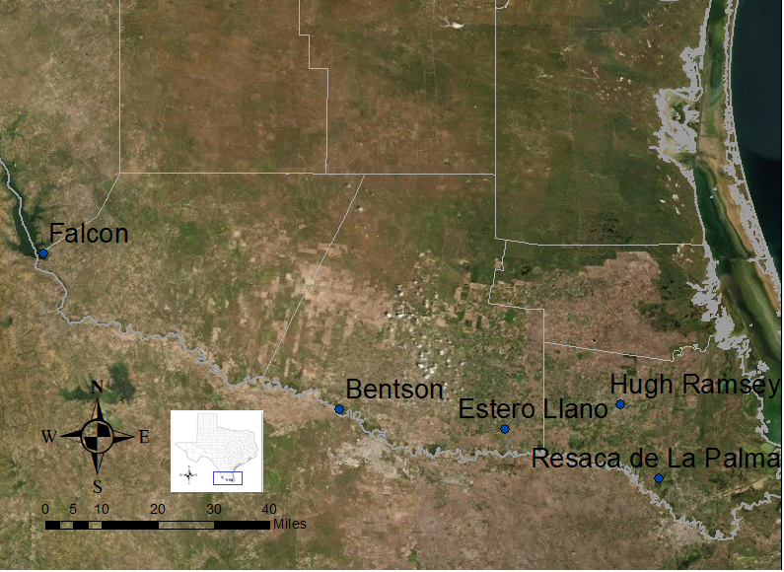
Methodology
GG
Bentson State park – Hidalgo
Estero Llano Grande – Hidalgo
Hugh Ramsey - Cameron
Resaca de La Palma - Cameron
Falcon State park – Starr
Highest
Lowest

Slide 11
Methodology
01
Carbon and Nitrogen
Dry combustion method
PAR *name
Organic Matter by combustion method
Moisture on site with probe
Compaction tested with Penetrometer
Soil Texture tested with Hydrometer method
Soil Chemistry and Physics

Slide 12
Preliminary Results of Soil Properties for Habitat Preference
Invasive
Native
Invasive
Native
Invasive
Native
Invasive
Native

Slide 13
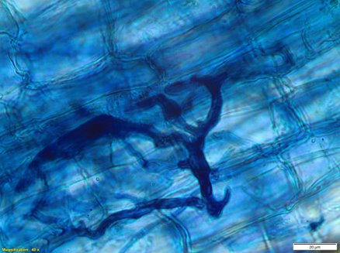
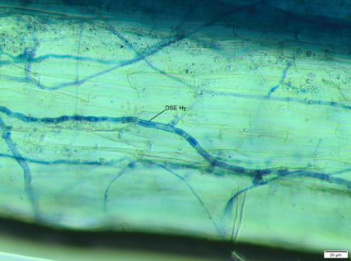
Preliminary microbial results
Arbuscular Mycorrhizal Fungi (AMF) and Dark Septate Endophyte (DSE) hyphae in the roots of Guinea Grass. ​

Slide 14
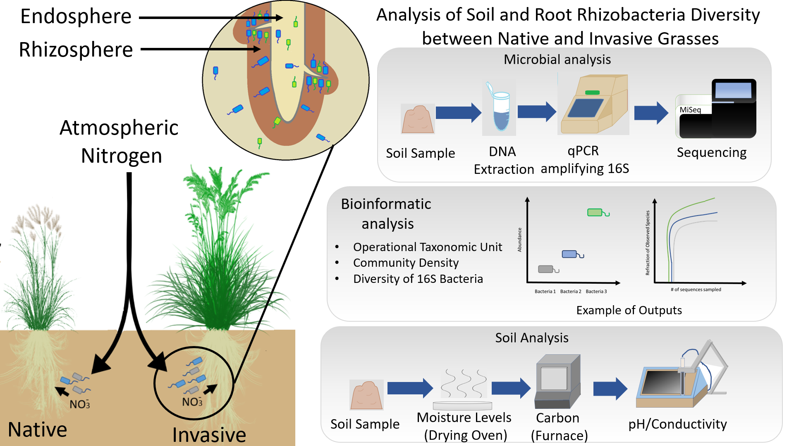
Ongoing Research
02
Microbial Diversity
Rhizoplane
Rhizosphere
PCR
Diversity of fungi

Slide 15
Acknowledgments
Dr. Mirayda Torres-Avila
Dr. Erin Schuenzel
Dr. Pushpa Soti
Dr. Kristine Lowe

Slide 16
Questions

