Slide 1
Automated Identification of Lines in Data from Gravitational Wave Detectors
Thomas Cruz, Presenter
Soumya Mohanty, Advisor
Dept. of Physics and Astronomy, UTRGV

Slide 2
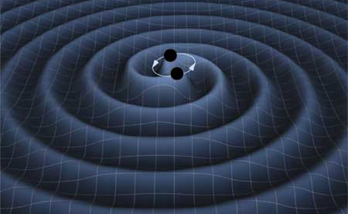
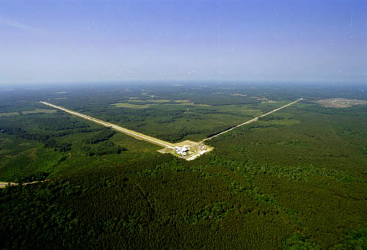
Gravitational Waves and LIGO
Gravitational Waves (GW) are distortions in space-time, they are created by moving masses such as two orbiting black holes.
Of the four fundamental forces, gravity is the weakest. Because of this gravitational waves are exceedingly difficult to detect.
GW detection uses kilometer-scale interferometers, collectively called LIGO, which measure the interference patterns produced by laser light propagating in the two arms.
4 km
Images courtesy of LIGO.org
Notes:
Gravitational Waves are rare and transient events that are difficult to detect.
Scientists all over the world are racing to build the technology needed to detect the faintest of signals.
With data streaming from all parts of the world we also need something to sift through all the data and extract the useful information.

Slide 3
GW discoveries
Barry C. Barish
Rainer Weiss
Kip S. Thorne
Only 11 confirmed detections have been made since its first GW on Sept. 14,2015
Pictures from https://www.nobelprize.org/prizes/physics/2017/press-release/
Notes:
The Nobel Prize in Physics 2017 was divided, one half awarded to Rainer Weiss, the other half jointly to Barry C. Barish and Kip S. Thorne "for decisive contributions to the LIGO detector and the observation of gravitational waves.”

Slide 4
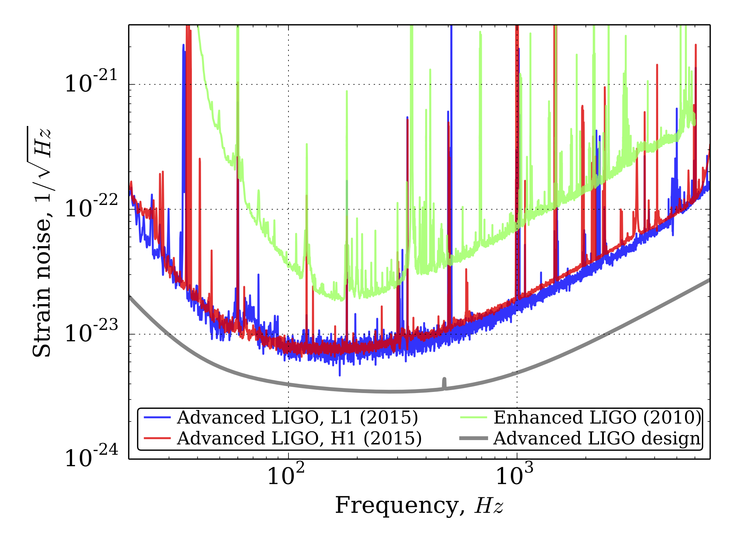
Noise in GW detectors
The detection of GWs must confront a high level of noise from instrumental and environmental sources.
The distribution of noise power in frequency is measured by the Power Spectral Density of the noise.
Figure from https://www.advancedligo.mit.edu/
Notes:
(Show LIGO PSDs and point out the design sensitivity vs. true noise PSD differences; highlight line features and how high in power they are compared to the noise floor)

Slide 5
Power Spectral Density (PSD)
PSD of Real data from LIGO’s Hanford detector with the noise floor flattened (“whitened”)
Data from LIGO-Hanford Detector on Aug. 17, 2017.
Notes:
Data Analysis is crucial in detecting what is and what isn’t a gravitational wave event.
Data is processed and converted to Power Spectral Densities (or PSDs) which measure power fluctuations.
These PSDs contain many spectral line features that correspond to terrestrial interference which need to removed before we can search for GW signals.
We use window smoothing which allows our estimation tool to have enough data points for the smaller features of the data set.

Slide 6
Line Identification: A Major Problem
Identification and removal of lines is a key step that must precede any search for GW signals in LIGO data
This is an open and important problem with many different proposed solutions. Below are a few articles which delve into the topic
Littenberg, and Cornish, PRD, 2015.
Biscoveanu, et. al., PRD, 2020.
Moore, et. al., PRD, 2016.
Edwards, et. al., PRD, 2015
Notes:
The articles listed, and many others, show methods of marginalizing the effect of the line features based on the standard noise model of stationary features.
They all aim to remove the effect of the line features using various types of estimation tools.
The problem of line identification is a troublesome one, especially if the lines are randomly positioned.

Slide 7
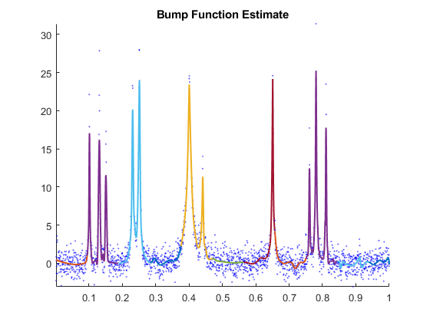
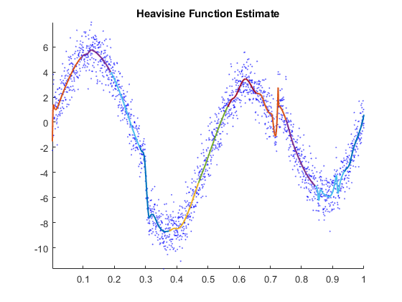
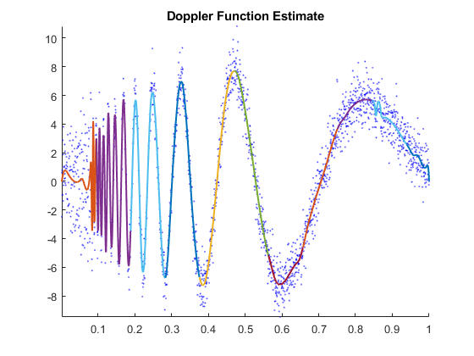
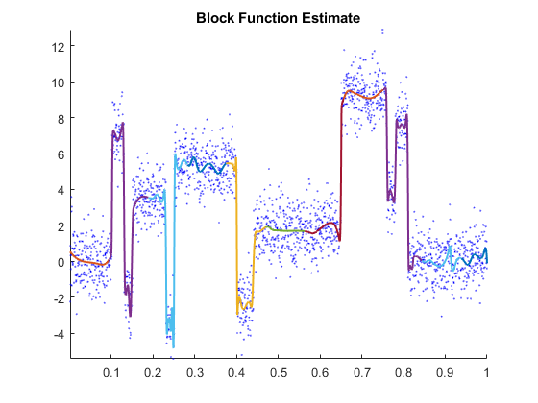
SHAPES
Our approach to line identification is based on using a curve fitting method called SHAPES
SHAPES: Swarm Heuristics based Adaptive and Penalized Estimation of Splines
Mohanty, Fahnestock, Computational Statistics, 2020
Public domain code on GitHub†: mohanty-sd/SHAPES
SHAPES is a non-parametric curve fitting method that can fit both continuous and discontinuous curves.
It fits a cubic spline with adaptive knot placement and allows knot repetition in order to fit discontinuities.
It is limited by the length of the input data if the underlying curve is complicated and requires a large number of knots for fitting
†https://github.com/mohanty-sd/SHAPES
Notes:
SHAPES is a versatile algorithm which uses PSO, or Particle Swarm optimization, to determine the best location of knots which are used to fit the curves.

Slide 8
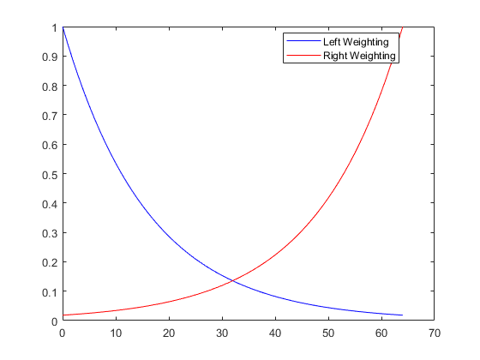
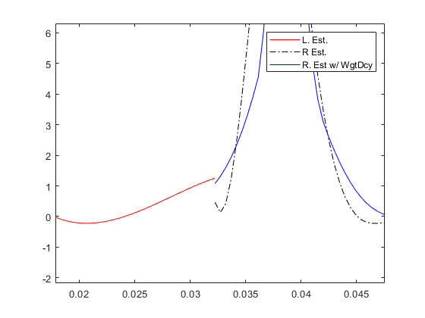
Enhancing SHAPES
SHAPES is a powerful tool, but it is restricted to a small data set (~256 data points). Before applying SHAPES to large gravitational wave data sets, we first had to rectify its length limitation. This is done by segmenting the data overlapping pieces and using exponential weighting of estimates in the overlapped regions.
$$1000$$
$$250$$
$$83.\overline{3}$$
$$166.\overline{6}$$
Notes:
We want the overlap between segments because it will allow us to have a smooth connection between segments.
This is done by taking a weighted exponential average of the overlapped region and replacing the 2nd segment’s estimate with the averaged estimate.
We then have continuous non overlapping segments.

Slide 9
Notes:
Tricks, such as smoothing the PSD, have to be used to resolve very sharp features

Slide 10
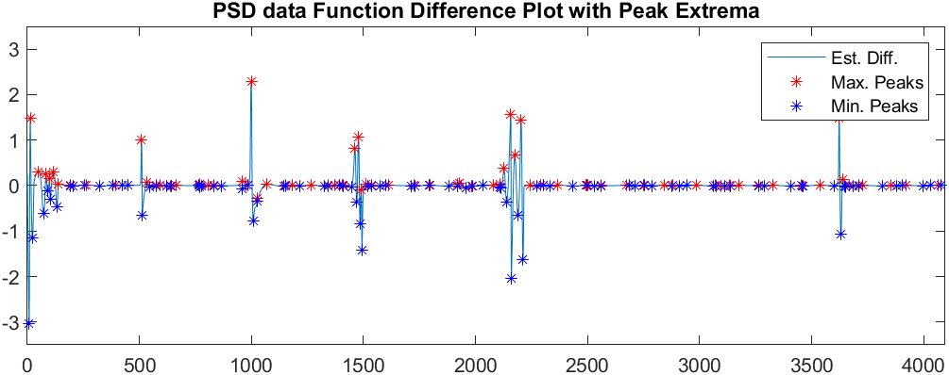
Identifying Patterns in Line Features
If we take the difference plot from estimated PSD data, we can clearly see the features have large positive and negative peaks.
With a simple max/min location finding algorithm we have the locations of features, but we must filter out lesser data using a threshold limit.

Slide 11
Notes:
This is the result of SHAPES on a 4000 data point set, which identifies the location of line features (blue triangles).
As this work is ongoing there are some features, ~250 and ~2000 where the sharpness of the feature or limited number of points leads to omission.
However, the work shows that SHAPES and the Line Identification Algorithm can determine the location of sharp line features.
This work can be applied to more PSDs for line removal or to works in all fields where line identification could be useful.

Slide 12
Future
Optimize
Optimize line filtration parameters for any kind of PSD input.
Normalize
Normalize the input data for a more accurate fit .
Extend
Extend SHAPES to thousands of data realizations for further tuning
Refine
Improve the thresholding scheme to catch weaker lines

Slide 13
Questions?

