Slide 1
INTEGRATED ELECTROMAGNETIC-TRIBOELECTRIC HYBRID NANOGENERATOR: CONVERSION OF BIOMECHANICAL ENERGY TO ELECTRICAL ENERGY
PRESENTED BY
FARZANA TASNIM
SUPERVISOR
DR. M. JASIM UDDIN
PHOTONICS & ENERGY RESEARCH LAB,
DEPARTMENT OF CHEMISTRY

Slide 2
Motivation
A floor tile on busy metropolitan streets experiences up to 400,000 footsteps daily
The footstep of one individual would be 7,000
This energy tile can be a cost- medium to utilize this unused bio-mechanical energy in large scale

Slide 3
Theroretical Background
In 2012, Z.L Wang developed the first Triboelectric Nanogenerator (TENG)
Wu et al., has shown that the Triboelectric Nanogenerator (TENG) and Electromagnetic generator (EMG) hybrid almost doubles the quantitative output when compared to a single NG.
Wang et al. hybridized a nanogenerator composed of EMG, TENG, and a thermoelectric generator (ThEG) that shows constant output voltage of 5V by simultaneously harvesting both mechanical and thermal energies.
Zhu et al. devised a TENG floor tile which reached 2 mA current, using the materials of Poly(methyl methacrylate) (PMMA) and polydimethylsiloxane (PDMS) with gold nanoparticles.

Slide 4
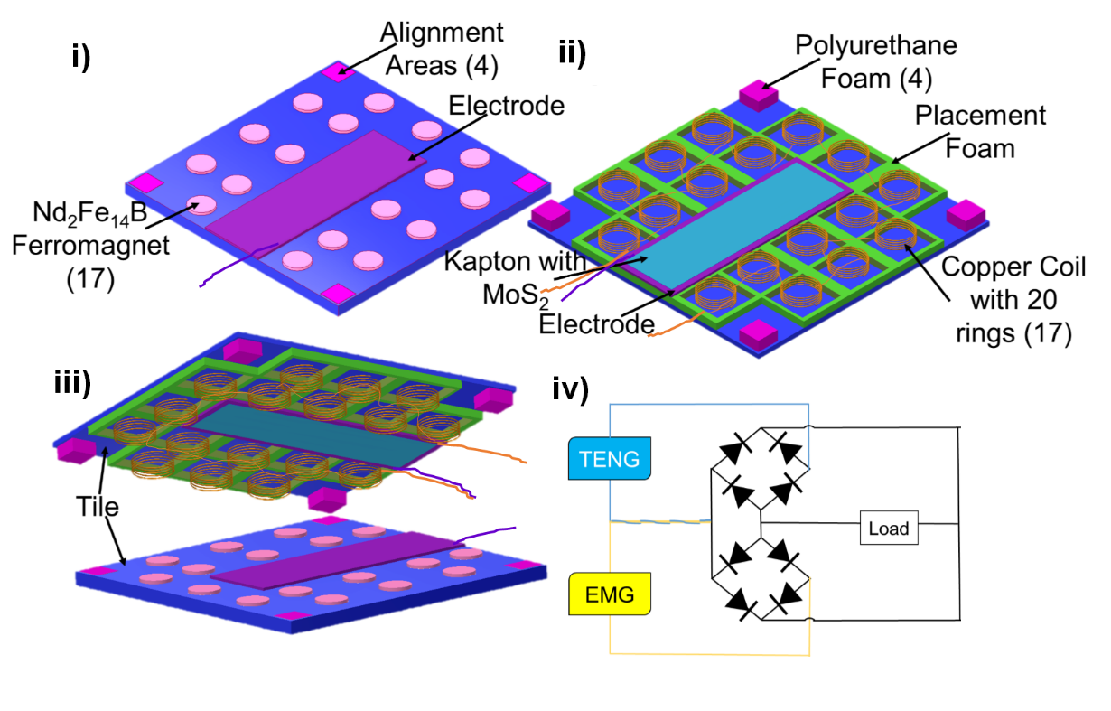
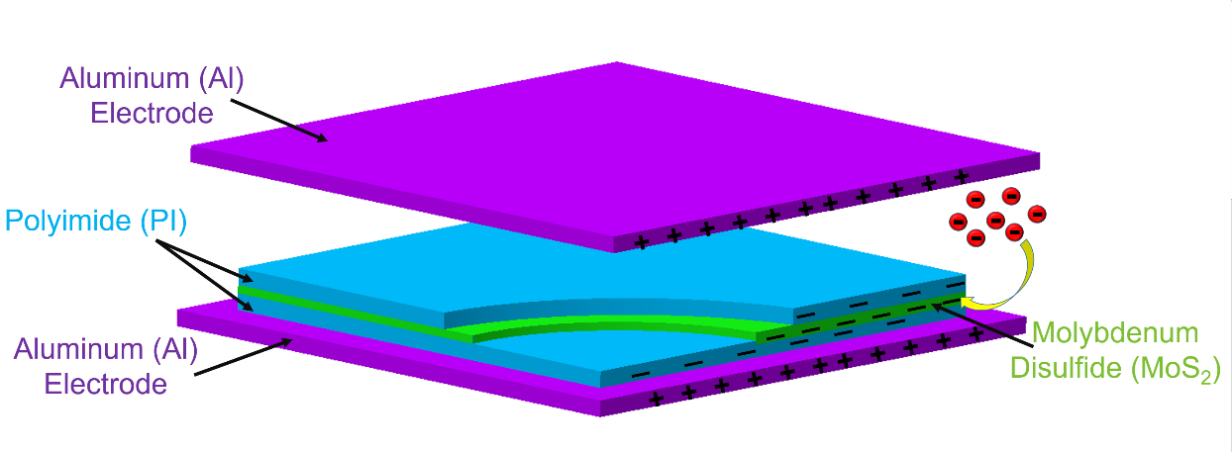
Device Structure

Slide 5
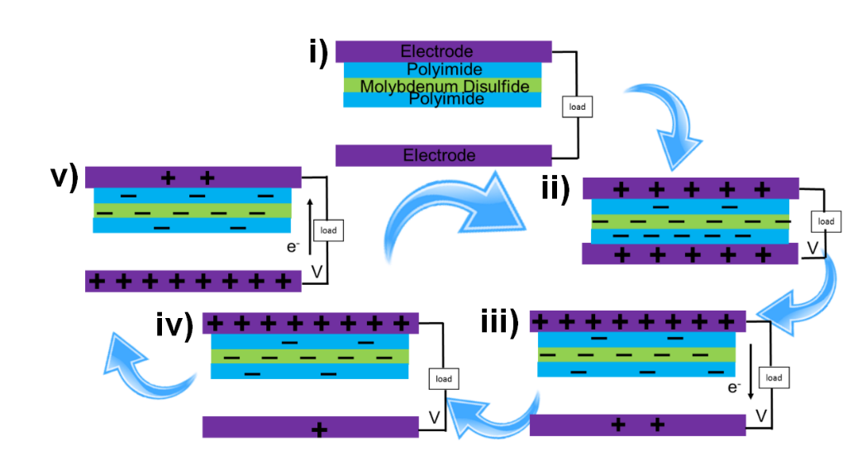
Working Principle
Triboelectric Mechanism
Stage-1: The Al becomes positively charged and the Kapton coupled with the MoS2 layer gets negatively charged (Fig. i, ii)
Stage-2: A voltage difference occurs between two electrodes. To neutralize the polarizing effect electron starts moving from the top Al layer to the bottom Al layer. (Fig. iii, iv)
Stage-3: The energy tile becomes temporarily neutralized due to the balance of the triboelectric charges throughout the device.
Stage-4: the upper layer starts to move towards the bottom Al layer (Fig. v). The whole process gets reversed and electron starts moving towards the opposite direction resulting an AC signal in the output.
Electromagnetic Mechanism
With the contact and separation of the top and bottom layer magnets parallelly move in and out of the Cu coils resulting Faraday’s EMG induction

Slide 6
Energy Diagram of The Triboelectric Layers
When the device is in the initial position, TENG remains in a flat band state, as no electron transfer occurs at this stage (Fig. i).
When the external force is applied, electron transfer initiates, and the electron displaces through Kapton (PI) to be captured in the MoS₂ layer (Fig. ii).
During separation, captured electrons are released from the MoS₂ layer as electron flow is reversed, and some of the electrons return to the Al electrode (Fig. iii).
As a result, some electrons are stored within the MoS₂ layer (Fig. iv).

Slide 7
UV-Vis Absorption Spectroscopy and FTIR Spectroscopy
Functional groups identification:
C-H stretching= 3000-3250 cm-1, 2750 cm-1, and 2500 cm-1
C-H bending= 1875 cm⁻¹
C=C stretching= 1625 cm-1 and 1600 cm⁻¹
C-N bond= 1400 cm⁻¹
C=O bond= 570 cm⁻¹
Peak indication:
Kapton at 400 nm
Aluminum at 600 nm
MoS2 from 300 nm to 450 nm

Slide 8
Circuitry Diagrams to Measure The Output Performance of The Energy Tile
TENG individually with rectifier
TENG individually without rectifier
EMG individually with rectifier
EMG individually without rectifier
Hybrid TENG-EMG circuit without bridge rectifier

Slide 9
Performance Testing in Lab
TENG and EMG Individual Performance in walking conditions at 120 bpm
EMG (a low of 1.25 mA and a high of 2 mA )
TENG (a low of 20 μA, and a high of 38 μA )
EMG (a maximum of 8 V and a minimum of 4 V )
TENG (a maximum of 500 V a minimum of 350 V )
Performance of Hybrid Tile at 60, 90, 120 bpm
(a maximum of 1.6 mA and a minimum of 0.6 mA)
(a maximum of 400 V a minimum of 250 V )

Slide 10
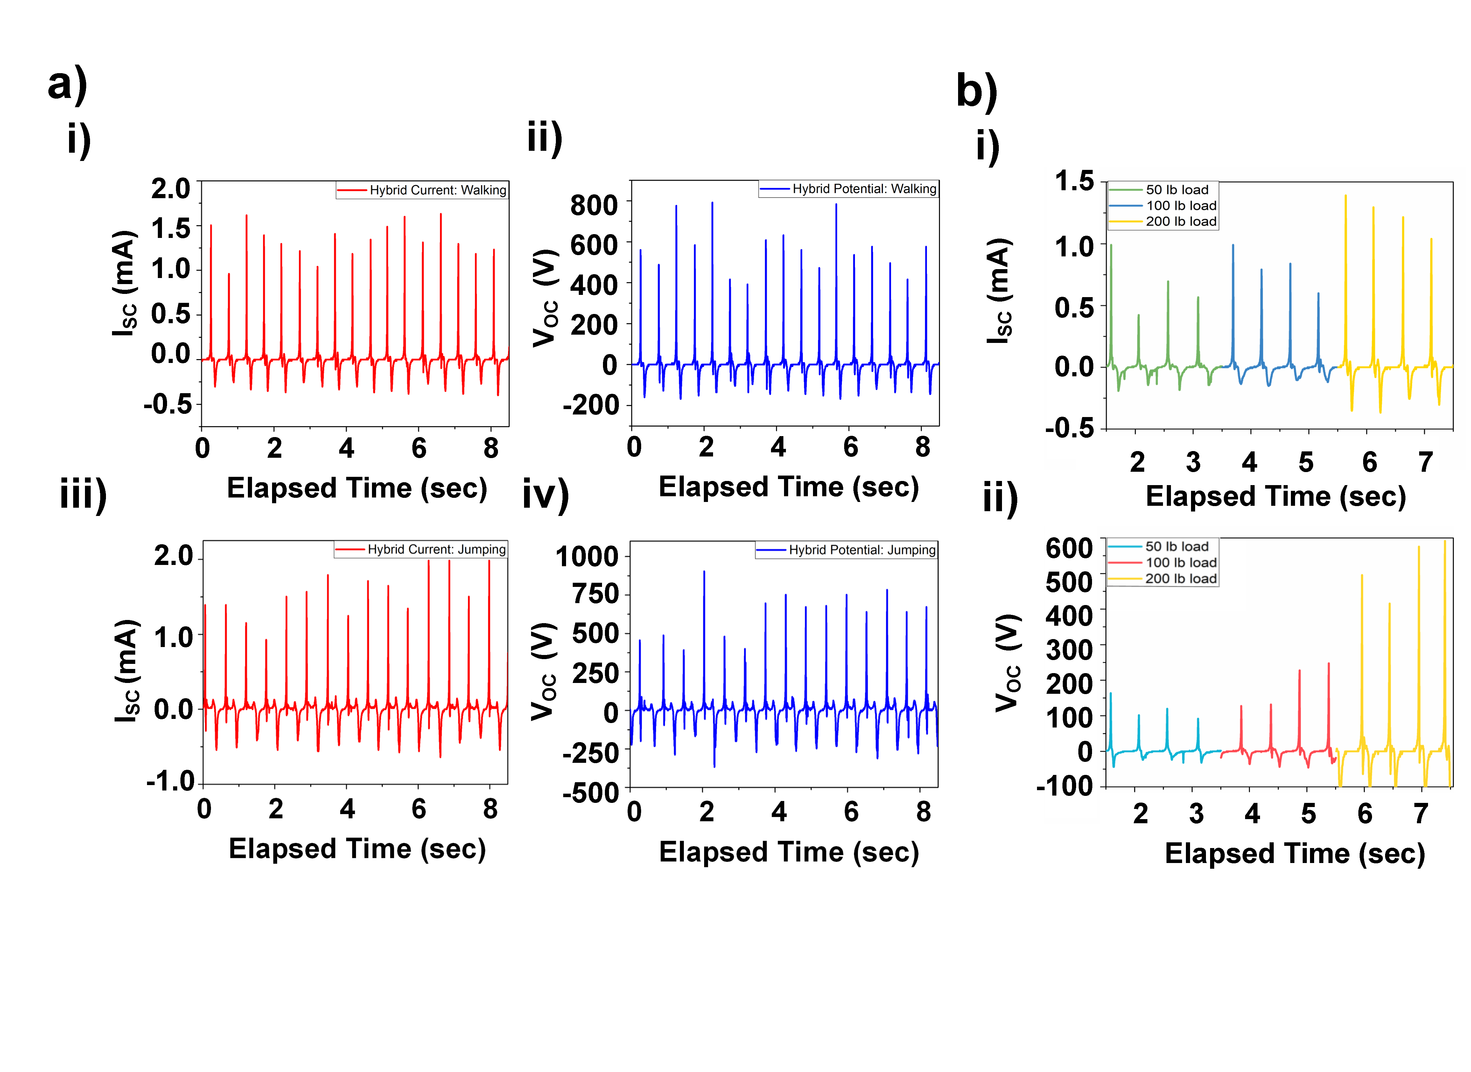
Hybrid Performance of Energy Tile Under Real-life Conditions
Testing movements
Walking (varied between 1 mA and 1.6 mA)
Walking motion (ranged from 400 V to 800 V)
Jumping motion (a minimum of 0.8 mA and a maximum of 2 mA)
Jumping motion (a low of 375 V and a high of 875 V)
Testing the energy tile with human weights of 50, 100, and 200 lb.
(0.8 mA for 50 lb, 1 mA for 100 lb, 1.4 mA for 200 lb)
(150 V for 50 lb, 300 V for 100 lb, 600 V for 200 lb)

Slide 11
Testing Performance of The Energy Tile Under Multiple Parameters
Surface area of force based on hand and foot combinations
(1 hand 980 V, 2 hand 1200 V, 1 foot 600 V)
(1 hand 3mA, 2 hand 5mA, 1 foot 2mA)
Force exertion from hand and foot
The distance of footfall
(3in 450 V, 6in 600 V, 12in 1000 V )
(3in 1.5mA, 6in 2mA, 12in 4.5mA)
Schematic view of the footfall
The distance of the energy tile to ground
(0 ft. 800V,1.5ft. 1200V,3ft. 1200V)
(0 ft. 3.5mA,1.5ft. 5mA, 3ft. 5 mA )
Schematic view of the distance of the energy tile from ground

Slide 12
Capacitor Test & Durability Test
Electrical circuit to run the capacitor test with the energy tile.
Charging and discharging of 1µF capacitor at 240 bpm with the energy tile
Output voltage response by the energy tile during the drop test with 2lb, 4lb and 6lb object.
Output response by the energy tile during the durability test for 2700 loading cycles.

Slide 13
The LED Test Demonstration

Slide 14
Conclusion
Triboelectric Nanogenerator (TENG) and Electro Magnetic Generator (EMG) based hybrid floor-tile has been developed to convert the Bio-Mechanical energy of human footsteps to Electrical Energy
The TENG consists of oppositely charged layers of conductive aluminum and high-polarized Kapton with a layer of MoS2 as electron acceptor. The EMG is composed of copper coils and neodymium magnets
The maximum output is 1200V as open-circuit voltage, 5mA as short-circuit current, and 6W as power.
Produces 20% more power than a commercially sold energy-harvester floor tile
This hybrid nanogenerator has the potential to be easily mass-produced for energy harvesting due to the cost-effective, simple design and selective materials.

Slide 15
Acknowledgement

Slide 16
Thank You

