Slide 1
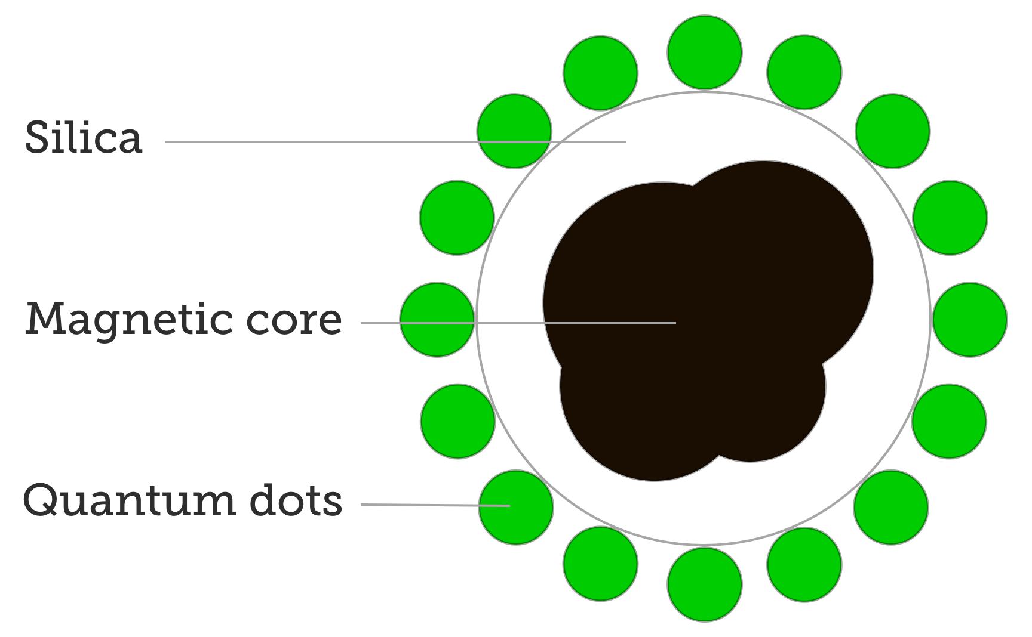
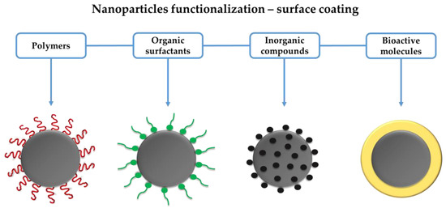
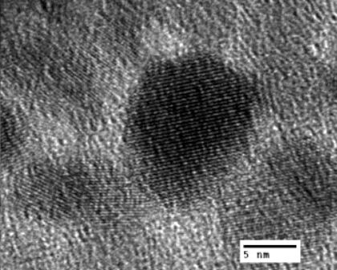
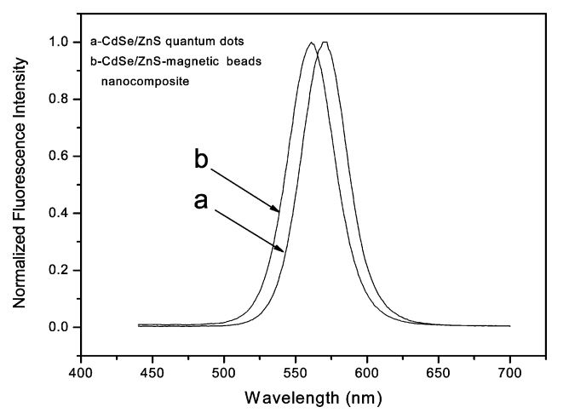
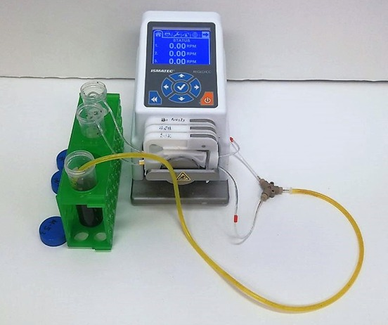
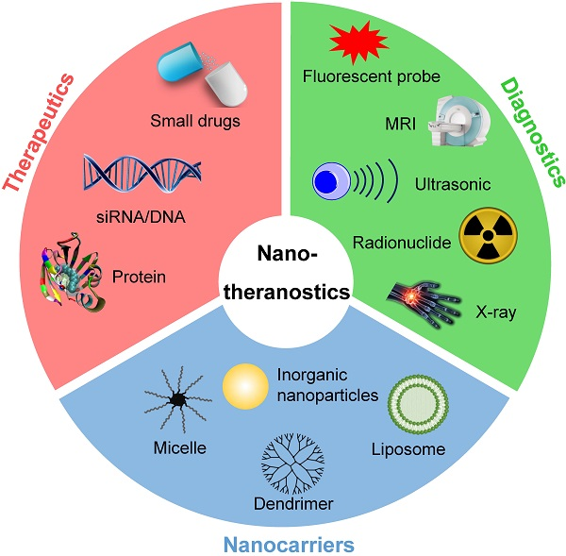
Tuning Properties of Super Paramagnetic Iron Oxide Nanoparticles by Microfluidics Approach
Department of Physics and Astronomy
S. Lopez, C. M. Trevino De Leo, Z. Lawera, and K.S. Martirosyan
Silverio.lopez01@utrgv.edu and karen.martirosyan@utrgv.edu
INTRODUCTION
XRD Analysis of Fe3O4 SPIONS synthesized via microfluidics
Surface Functionalization
Superparamagnetic Iron Oxide Nanoparticles (SPIONs) are nanoparticles comprised of an FeO-Fe2O3 matrix structure. A ferromagnetic nanoparticle has a transition to superparamagnetism when the particle diameter goes under the critical size 150nm of the material. Over 150nm, a particle is composed of several magnetic domains containing multiple magnetic moment. As a function of size, these magnetic domains decrease in size until the critical size is reached, where a particle becomes single-domain and has an overall magnetic moment.
SPIONs have great potential in the biomedical field for diagnostic and therapeutic purposes, as well as the emerging field of theranostic medicine in which simultaneous imaging and treatment is achieved. Currently, SPIONs have been employed as contrast agents in Magnetic Resonance Imaging to detect metastases, drug-delivery vehicles (nanovectors), and in cell identification.
SPIONs permit relatively low resolution compared to other nanomaterials; however, through the coupling of SPIONs to Quantum Dots (QDs), tumor seeking nanocomplexes can be generated for increased tumor visualization and concomitant treatment.
Quantum Dots are semiconducting nanocrystals, exhibiting a broad excitation spectra, narrow emission bandwidth, and excellent photostability. These properties are a product of quantum confinement, as the QD size, just 1-10nm results in quantum confinement of an electron; thus, the band-gap of the QD is dependent on its size, allowing for highly tunable photoemission.
All reaction parameters can be controlled in microfluidic syntheses, due to control over pH, flow rate, and temperature, which allows for the fine tuning of reactions with high product yield.
Figure 2: X-Ray Diffraction Data for Superparamagnetic Fe3O4
Borrowed from Wu et al., 2008
Table 1: Organic macromolecules and their advantages of functionalized SPIONs
Surface ligand varies the growth rate of SPIONs during a reaction.
Target tissue must be considered when selecting for the appropriate ligand.
Ligand functionalization can induce a hydrophobic or hydrophilic state.
Borrowed from Nanocomposix.com
Borrowed from Arias et al., 2018.
Figure 3: Magnetic-Fluorescent Nanoparticle
Figure 7: Nanoparticles functionalized with varying ligands
Objective & Hypothesis
Coupling
The objective of this study is to consider how variations in microfluidic system parameters effects SPIONs size, and how a microfluidic system may be used to generate SPION-QD nanocomplexes.
We hypothesize by introducing previously capped SPION and QD reagents to a microfluidic system, SPION-QD nanocomplexes for theranostic treatments may be synthesized.
DISCUSSION & CONCLUSION
SPION coupling with other nanoparticles relies on –SH groups
Coupling SPIONS and QDs can be achieved by sonication of organic/water two phase mixture
Experiments have shown that high pH, and Dextran result in smaller and more uniform particle size. However, there are upper limits to the percentage of dextran as too much will cause the iron nanoparticles to lose their magnetic properties.
To further increase the biomedical capacity of SPIONS, future research will be aimed at producing nanocomposites comprised of SPIONs and QDs for theragnostic approaches.
Further testing with various ligands needs to be done to elucidate the best method for producing SPION-QD nanocomposites that are stable and biocompatible.
In the future, experiments will revolve around varying the reaction temperature during microfluidic synthesis to determine how it effects particle size.
Experimental Methods
Borrowed from Wang et al., 2004.
Figure 5: TEM of an Fe2O3-SPION particle coated with CdSe/ZnS quantum dots.
Iron (II) Sulfate Heptahydrate an Iron (III) Nitrate Nonahydrate were mixed via a Y PEEK connector and precipitated using an excess of NaOH with 8.8% of Dextran.
The product was then purified using multiple rounds of centrifugation and decanting for the collection of the SPIONs. The synthesis occurred at a flow rate of 20 RPM (0.04 ml/s) under a Nitrogen rich environment to prevent oxidation of the reactants.
Borrowed from Wang et al., 2004.
Borrowed from Wang et al., 2004.
Figure 6: SPION functionalized with Carboxylic acid and thiol groups, coated with CdSe/ZnS QDs
References
Figure 7: Luminescence Spectra of (a) CdSe/ZnS QD and (b) CdSe/ZnS-SPION
[1]Wahajuddin, Arora S. Superparamagnetic iron oxide nanoparticles: magnetic nanoplatforms as drug carriers. Int J Nanomedicine. 2012;7:3445-71. doi: 10.2147/IJN.S30320. Epub 2012 Jul 6. PMID: 22848170; PMCID: PMC3405876. [2]Harisinghani MG, Barentsz J, Hahn PF, Deserno WM, Tabatabaei S, van de Kaa CH, de la Rosette J, Weissleder R. Noninvasive detection of clinically occult lymph-node metastases in prostate cancer. N Engl J Med. 2003 Jun 19;348(25):2491-9. doi: 10.1056/NEJMoa022749. Erratum in: N Engl J Med. 2003 Sep 4;349(10):1010. PMID: 12815134. [3]Song EQ, Wang GP, Xie HY, Zhang ZL, Hu J, Peng J, Wu DC, Shi YB, Pang DW. Visual recognition and efficient isolation of apoptotic cells with fluorescent-magnetic-biotargeting multifunctional nanospheres. Clin Chem. 2007 Dec;53(12):2177-85. doi: 10.1373/clinchem.2007.092023. Epub 2007 Oct 25. PMID: 17962366. [4]Alivisatos, A. P., Perspectives on the physical chemistry of semi-conductor nanocrystals. J.Phys. Chem. 1996, 100, 13226–13239 [5]Karaagac, Oznur & Köçkar, Hakan. (2012). Effect of Synthesis Parameters on the Properties of Superparamagnetic Iron Oxide Nanoparticles. Journal of Superconductivity and Novel Magnetism. 25. 2777-2781. 10.1007/s10948-011-1264-8. [6]Laurent, Sophie & Forge, Delphine & Port, Marc & Roch, Alain & Robic, Caroline & Vander Elst, Luce & Muller, Robert. (2008). Laurent S, Forge D, Port M, Roch A, Robic C, Vander Elst L, Muller RNMagnetic iron oxide nanoparticles: synthesis, stabilization, vectorization, physicochemical characterizations, and biological applications. Chem Rev 108:2064-2110. Chemical Reviews. 110. 10.1021/cr068445e. [7]Wang, D., He, J., Rosenzweig, N., & Rosenzweig, Z. (2004). Superparamagnetic Fe2O3Beads−CdSe/ZnS Quantum Dots Core−Shell Nanocomposite Particles for Cell Separation. Nano Letters, 4(3), 409-413. doi:10.1021/nl035010n [8]Wu, W., He, Q. & Jiang, C. Magnetic Iron Oxide Nanoparticles: Synthesis and Surface Functionalization Strategies. Nanoscale Res Lett 3, 397 (2008). https://doi.org/10.1007/s11671-008-9174-9 [9]Rhyner, M. N., Smith, A. M., Gao, X., Mao, H., Yang, L., & Nie, S. (2006). Quantum dots and multifunctional nanoparticles: New contrast agents for tumor imaging. Future Medicine. [10]Wang J, Cui H. Nanostructure-Based Theranostic Systems. Theranostics. 2016 Jun 18;6(9):1274-6. doi: 10.7150/thno.16479. PMID: 27375778; PMCID: PMC4924498.[11]Arias, L.S.; Pessan, J.P.; Vieira, A.P.M.; Lima, T.M.T.; Delbem, A.C.B.; Monteiro, D.R. Iron Oxide Nanoparticles for Biomedical Applications: A Perspective on Synthesis, Drugs, Antimicrobial Activity, and Toxicity. Antibiotics 2018, 7, 46. [12]Arafa, K., El-Sherhbiny, I., Aziz, O., & Dena, A. (n.d.). Superparamagnetic Iron Oxide Nanoparticles (SPIONs): Preparation and Recent Applications. Journal of Nanotechnology and Advanced Materials, 8(1).
Figure 1: Microfluidic Pump
Figure 8: Nano-theranostics
Notes:
4 feet wide, 3 feet high

