Slide 1

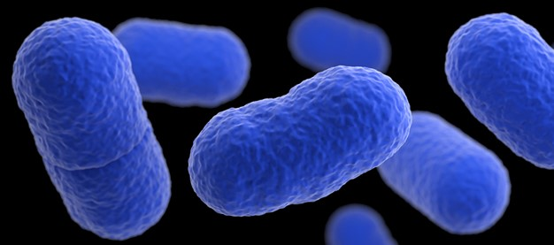
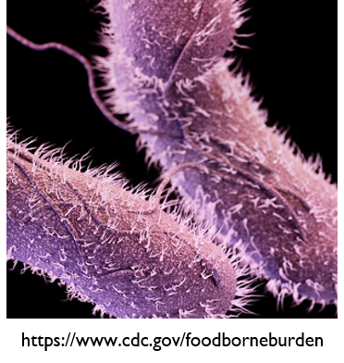
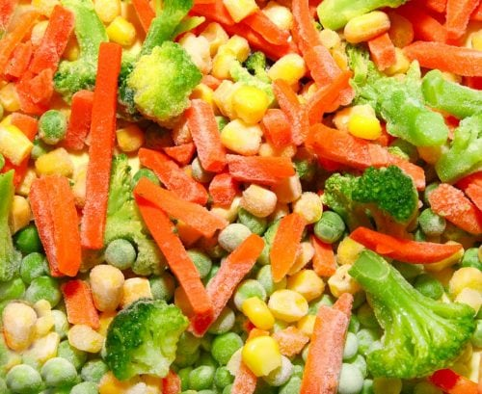
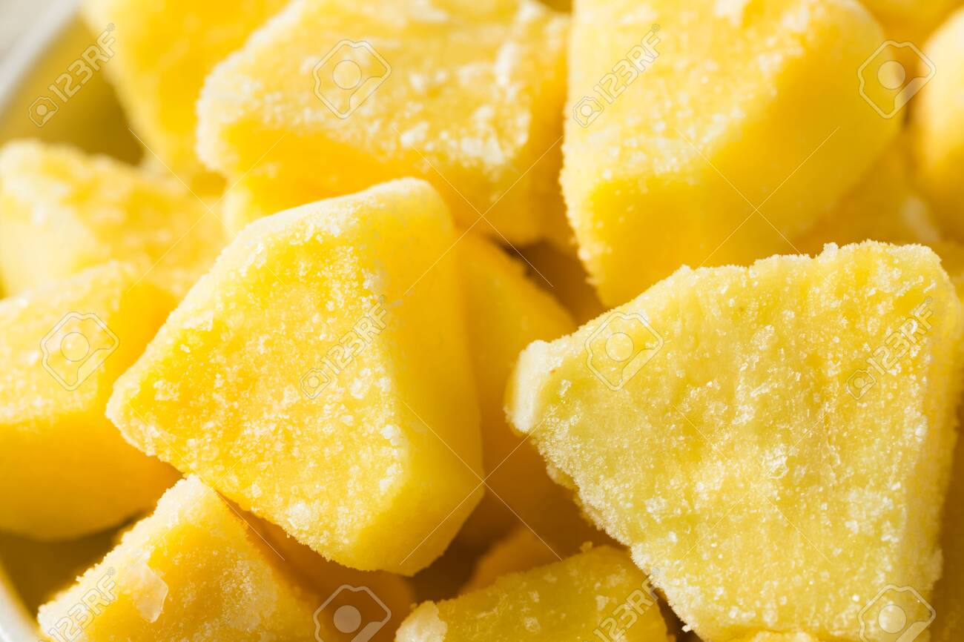
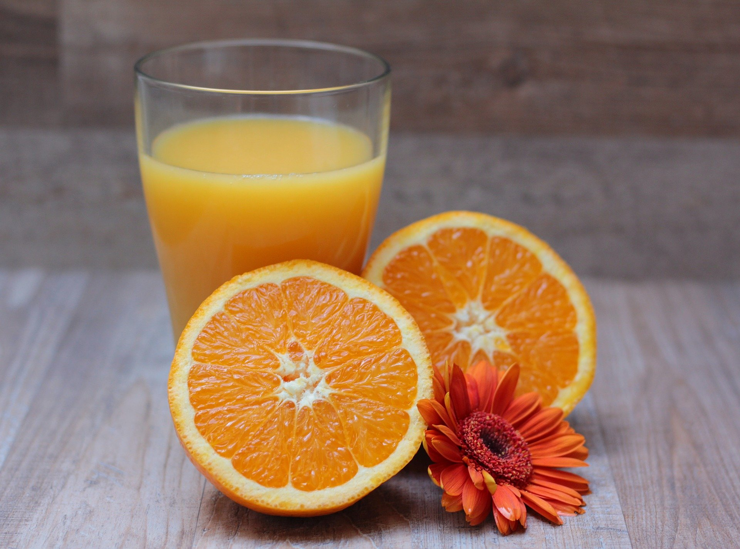
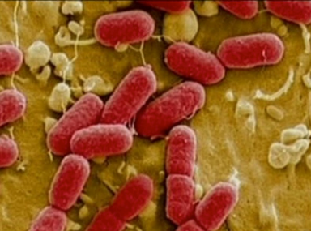
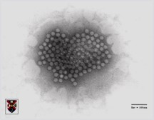
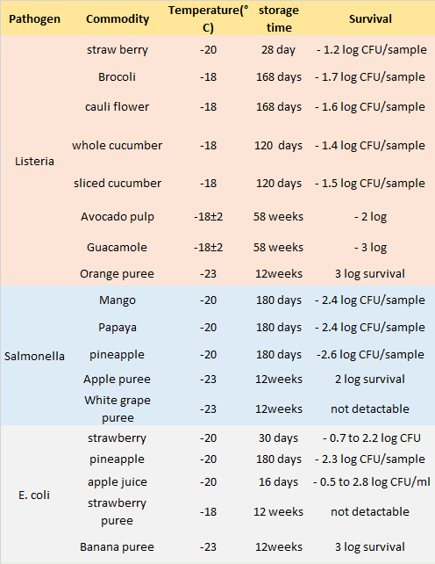
Microbiological Safety of Frozen Fruits and Vegetables
Rajat Sharma, Veerachandra K. Yemmireddy
Department of Biology, University of Texas Rio Grande Valley, Edinburg, TX
Ma
BACKGROUND
The global frozen food market size is valued at $292 B ($ 4B: Frozen F&V)
COVID-19 pandemic showed a meteoric rise in the growth of frozen food sector
Availability, long shelf-life, preserve nutrients and convenance are key considerations
Microbiological safety of frozen foods is still a mystery especially with the advent of
SUPER BUGS
MAJOR FINDINGS
I. Major pathogens of concern
II. Major fruits & vegetables of concern
OBJECTIVES
Evaluate current scientific understanding on the microbiological safety of frozen fruits & vegetables
Study of factors that influence growth of microbial pathogens in frozen fruits & vegetables and promising technologies to curtail the risk
Listeria monocytogenes
Salmonella spp.
Berries
Vegetable mixes (beans, carrot, peas, brocolli)
Juices & purees: avocado, banana, pineapple, apple
Survived at -15 to -23 °C,
Storage time: 4 to 52 weeks
A reductions of 3 log CFU/gm
METHODS
Data was converted into numerical format for easy comparison and evaluation when data was represented using figures and images. Studies providing data on survival of foodborne pathogens were evaluated to obtain comprehensive information about the pattern of survival of individual pathogen on different frozen fruits and vegetables.
E. coli O157:H7
Viruses: Hep A, Noroviruses, Rotaviruses
616 Potentially relevant papers identified through database search:
PubMed: 112
Google Scholar: 196
Web of Science: 43
Science direct: 56
Journal of Food Protection: 185
Agricola: 24
III. Influencing factors on pathogen survival
Type of produce
Type of organism
Levels of contamination
Handling: freezing and thawing cycles
Cryoprotectants
IV. Novel intervention strategies
Freezing slows down growth of foodborne pathogens but survives
Post-process contamination & abuse conditions are detrimental
Light treatments (UVC, LED, Pulsed light, IR etc)
Cold plasma
Ozone
High pressure processing
Washing with organic acids
Key words: survival, frozen, produce, fruits, vegetables, foodborne pathogens, outbreaks, growth, risk, treatment and inactivation
Pathogen | Commodity | Temperature(°C) | Storage time | Survival | Reference
Listeria | Straw berry | -20 | 28 day | 1.2 log CFU/sample decline | Flessa et al 2005
 | Broccoli, Cauliflower, cucumber | -18 | 120-168 days | 1.4-1.7 log CFU/sample decline | Strawn et al (2019) (2020)
 | Avocado pulp, Guacamole | -18±2 | 58 weeks | 2-3 log decline | ITURRIAGA et al 2002
 | Apple, orange, pineapple, white grape, banana purees | -23 | 12weeks | 3 log survival | OYARZA´ BAL et al 2003
Salmonella | Mango, Papaya, pineapple | -20 | 180 days | 2.4 log CFU/sample decline | Strawn et al 2010
 | strawberry puree | -18 | 12 weeks | 0-1 log CFU/sample | Huang et al 2013
 | Apple, orange, pineapple, white grape, banana purees | -23 | 12weeks | 0-2 log survival | OYARZA´ BAL et al 2003
E coli O157: H7 | strawberry | -20 | 30 days | 0.7- 1.4 log | Knudsen et al 2001
 | pineapple | -20 | 180 days | 2.3 log CFU/sample decline | Strawn et al 2010
 | White grape, banana puree | -23 | 12weeks | 0-3 log survival | OYARZA´ BAL et al 2003
Norovirus | Strawberry, raspberry, blueberry | -20 | 90 days | 0.1-0.9 PFU | Butot et al 2008
219 duplicates removed
354 papers excluded on the basis of unclear survival data & methodologies
43 papers were included in review after thorough evaluation
CONCLUSIONS
More survival data is needed specific to foodborne pathogen and frozen commodity to evaluate risk contamination
Challenge studies to validate novel interventions should be conducted
ACKNOWLEDGEMENTS
The authors would like to thank UTRGV College of Sciences for funding support through start-up funds

