Slide 1
UTRGV resources in the battle against COVID-19: Chemical modification and in silico validation of an on-campus natural compound and other medicinally privileged scaffolds as SARS-CoV-2 protease inhibitors
Precious Okwuchukwu
Sid- 20533627
Mentor- dr. debasish Bandyopadhyay

Slide 2
Presentation layout
Introduction
Background
AIM
Extraction of Magnolol
General semi-synthetic procedure
In silico study
Characterization
Conclusion
Future aspects
References
Acknowledgement

Slide 3
Introduction
The World Health Organization (WHO) declared Covid-19 a global pandemic on 11th March (Wednesday), 2020.
As of November 12, 2020, approximately 240,000 deaths (cdc.gov) have been recorded in the United States alone
Coronaviruses are enveloped, single-stranded, positive-sense RNA viruses having large-scale viral genomes
SARS-Cov-2, family coronaviridae, genus Betacoronavirus.
Phytochemicals can be broadly categorized into five major categories such as phytoceuticals, nutraceuticals, additives (narcotics), toxins, and biologically inactive compounds.
Phytochemicals and nutraceuticals are pharmacologically active molecules, they produce positive therapeutic effects when applied.
Chemical modification of natural products by total and semi- synthesis is an important tool in drug research and development.
Ultimately, chemical modification of natural compounds can lead to discovery of novel synthetic pathways that can significantly increase therapeutic potency and therapeutic profile , provide adequate safety, improve drug-like properties.

Slide 4
Background
Natural products and their pharmacophores have been used in the development and discovery of novel promising curative final drug entities.
Promising area of drug discovery and development research.
Several herbal medicines and pure natural products serve as diverse sources for development of novel antiviral drugs.
In chemotherapy, 75% of anticancer drugs and 78% of antibacterial drugs are either directly obtained from natural resources, or semi-synthetic natural products.
Antiviral drugs obtained from pure natural products has shown diverse antiviral activities against viral pathogens such as dengue virus, human immunodeficiency virus (HIV), influenza virus, hepatitis virus etc.
Currently, about 25% of medicines obtained directly from nature. 61% of new drug entity (NCE) originates from natural product
Other synthetic molecular scaffolds such as Adamantane, 4- aminoquinoline derivatives has shown notable activity against viruses (Influenza virus) and fatal diseases like malaria.

Slide 5
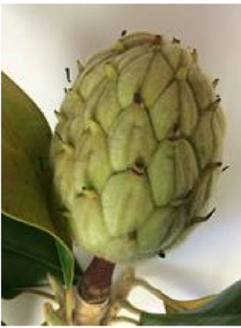
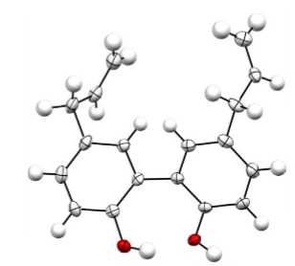
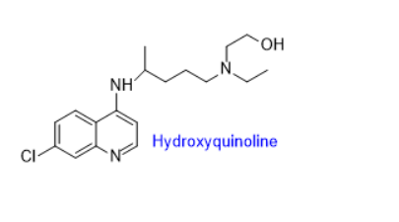
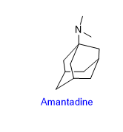
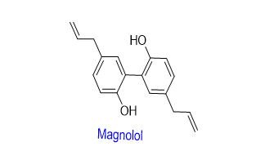
Chemically modified derivatives of magnolol, adamantane, and 4-amino quinoline.
Magnolol (5,5′‐Diallyl‐[1,1′‐biphenyl]‐2,2′‐diol) is the major active constituent found in the seedless cones obtained from magnolia grandiflora (belong to family Magnoliaceae).
Hydroxylated biphenyl with several therapeutic applications such as anti-oxidation, antiviral, anti-neoplastic, anti-fungal and anti-inflammatory etc.
Drawback; poor aqueous solubility
Adamantane derivatives; Adamantadine and Rimatandine are the first antiviral agents developed in 1964 for treatment of viral diseases in humans. They prevent uncoating and replication of the influenza virus. Pilot studies has reported their activity against viral load of SARS-CoV-2.
4-amino quinoline, derivatives,; chloroquine and hydroxychloroquine, obtained from cinchona tree.
Used as antimalarial, anti viral (Influenza A virus, HIV-1)
Inhibits replication of SARS-CoV-2 but has severe adverse effects such as cardiotoxicity, retinopathy, and neuropathy.
X-ray crystallographic analysis of Magnolol
Structure of a few medicinally privileged compounds and scaffolds

Slide 6
AIM
To conduct phytochemical investigations to design structural frameworks that can improve protein-ligand binding in COVID-19 proteases Thus, enhance antiviral effects and overcome limitations.
Careful transformation of reactive sites on compounds of interest aiming to synthesize suitable semi-synthetic compounds for drug–protein interactions, might lead to the development of novel therapeutics.
Subsequent druggability determination of the medicinally privileged semi-synthetic derivatives by an energy-based technique known as molecular docking.
Characterize novel chemically modified derivatives through various analytical techniques including gas chromatography-mass spectroscopy (GC-MS) and X-ray crystallographic analysis
In silico evaluation of Protein-Ligand interactions.
In vivo and in vitro testing (future aspects).

Slide 7
Extraction and isolation of Magnolol
Pure magnolol is expensive to obtain. 10mg of ≥95% Magnolol costs $140 on Sigma-Aldrich.
130-140mg required for each reaction.
Therefore, the extraction and isolation of magnolol from fresh mature green seed cones collected directly from a Magnolia grandiflora tree located on the Edinburg campus of UTRGV is first carried out.
Collect mature green seed cones
Chop into small fragments
Dry at room temperature
Grind dried seedcones into small particles
Immerse in diethyl ether for 48 hrs
Purify isolated product by crystallization
Cold extraction at 25 °C for 21 hours
Evaporate under reduced pressure
Dry obtained gummy mass on heat mantle for 72 hours
Further drying in a desiccator for 48 hours
Separation of constituent by column chromatography
Structural elucidation using different spectroscopic methods

Slide 8
General synthetic procedure and table of reaction.

Slide 9
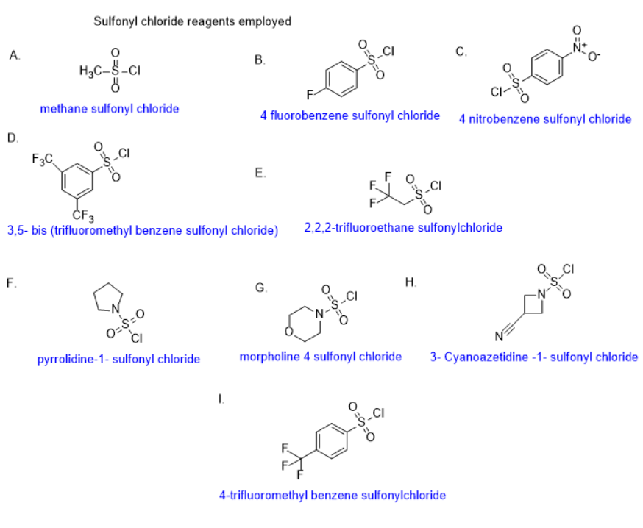
Chemically modified magnolol derivatives

Slide 10
Chemically modified adamantane (DBADAPO series) and 4- aminoquinoline (DBQPO series) derivatives

Slide 11
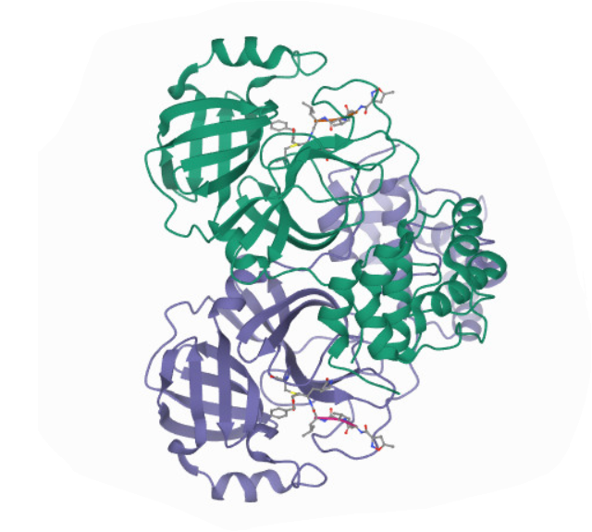
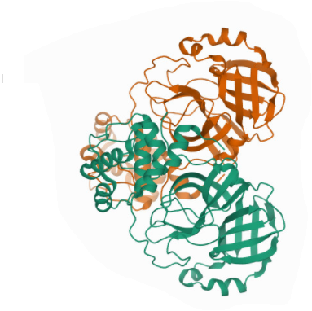
In silico study
Protein-ligand docking- used in virtual screening to identify lead compounds.
Magnolol, adamantadine, 4-amino quinoline and their sulfonyl chloride derivatives were docked into the active site of 3-dimensional structure of the COVID-19 main protease (PDB ID: 6LU7) and SARS-CoV-2 3CL protease (PDB ID: 6M2Q) complexed with an inhibitor.
All docking simulation was conducted using AutoDock Vina, Avogadro, Maestro and MGL tools.
Crystal structure of the COVID-19 main protease (PDB ID: 6LU7) and SARS-CoV-2 3CL protease (PDB ID: 6M2Q)

Slide 12
DBPO Series: Docking with the two COVID-19 spike proteins [PDB codes: 6LU7 (in complex with an inhibitor N3) and 6M2Q]
Code | Eluting solvent | MP (°C) | Docking score (6LU7) Kcal/mol | Docking score (6M2Q) Kcal/mol | MW Calc.) g/mol | Yield (mg)
Magnolol | 3% EA/HEX | 101.5-102 | -6.4 | -7.2 | 266.4 | 818
DBMGPO-1 | 5-20% EA/HEX | - | -5.8 | -6.0 | 422.52 | 53
DBMGPO-2 | 5-6% EA/HEX | 107.1-107.8 | -5.9 | -7.1 | 582.64 | 156
DBMGPO-3 | 8% EA/HEX | 160.3-161.4 | -6.5 | -7.1 | 636.66 | 146
DBMGPO-4 | 2-4% EA/HEX | 122.2-123.5 | -7.5 | -5.8 | 818.65 | 206
DBMGPO-5 (This reaction did not give good yield, only 16 mg after three efforts). | 20-30% EA/HEX | - | -5.9 | -6.3 | 558.51 | 16
DBMGPO-6 | 1%, 4-5% EA/HEX | 173.3-183.1 | -5.9 | -6.6 | 532.68 | 204

Slide 13
Code | Eluting solvent | MP (°C) | Docking score (6LU7) Kcal/mol | Docking score (6M2Q) Kcal/mol | MW (Calc.) g/mol | Yield (mg)
DBMGPO-7 | 11% EA/HEX | - | -6.6 | -5.6 | 564.68 | 30
DBMGPO-8 | 26% EA/HEX | 89.4-90.5 | -7.2 | -7.2 | 554.65 | 440
DBADAPO-1A (3-Amino-1-adamantanol derived products) | 50% EA/HEX | 152.4-153.7 | -6.7 | -7.6 | 311.40 | 18
DBADAPO-1B | 50% EA/HEX | 144.4-147.8 | -7.3 | -9.1 | 455.56 | 54
DBADAPO-1C | 50-75% EA/HEX | 151.0-152.0 | -7.6 | -7.6 | 599.71 | 111
DBQPO-1A | 50% EA/HEX | 151.8-155.2 | -7.2 | -6.8 | 466.93 | 95
DBQPO-1B | 80-85% EA/HEX | 105.1-107.8 | -5.9 | -6.6 | 532.68 | 75

Slide 14
Code | Eluting solvent | MP (°C) | Docking score (6LU7) | Docking score (6M2Q) Kcal/mol | MW Calc.) g/mol | Yield (mg)
DBQPO-2A | 75% EA/HEX | 252-254 | -7.3 | -7.6 | 386.78 | 623
DBQPO-2B | 50% MEOH/EA |  | -8.0 | -7.3 | 594.94 | 62
DBACPO-1 | - | - | -6.2 | -7.2 | 369.36 | -
Inhibitor N3 | N/A | N/A | -7.2 | -7.5 | 682.82 | N/A

Slide 15
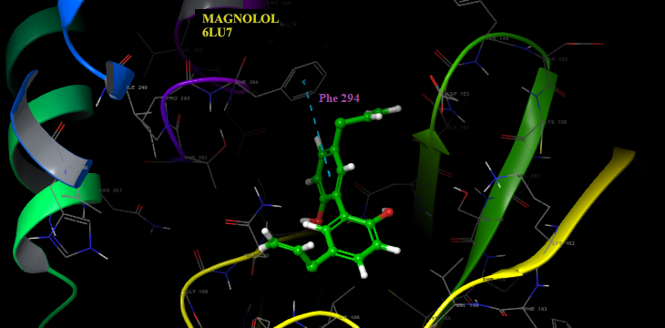
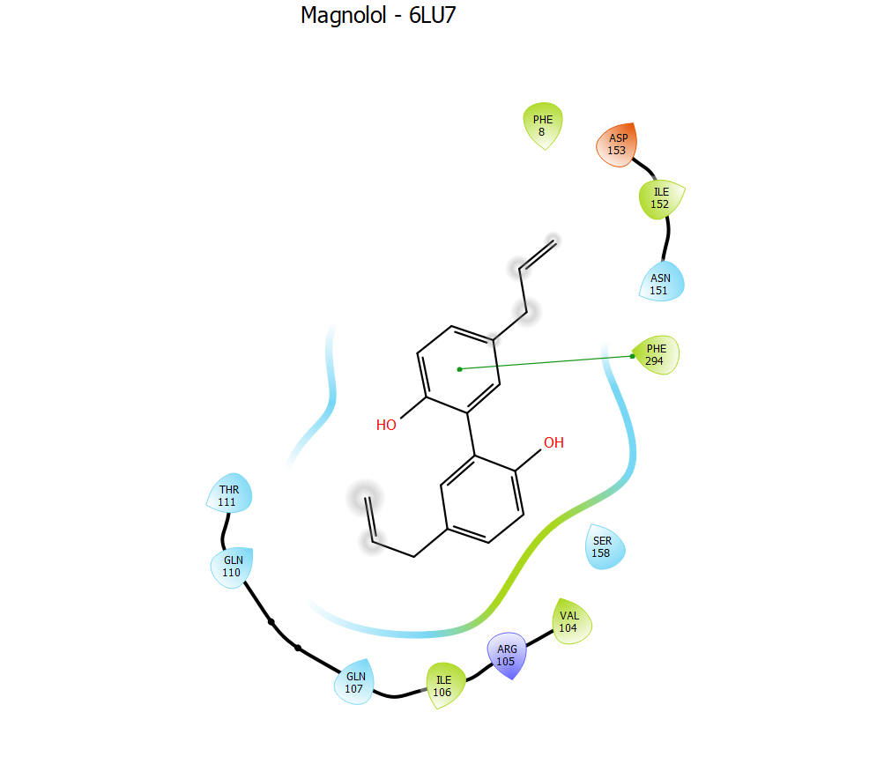
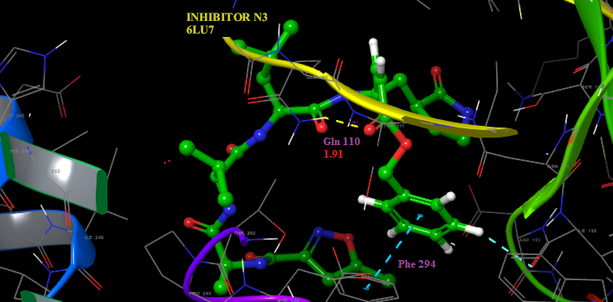
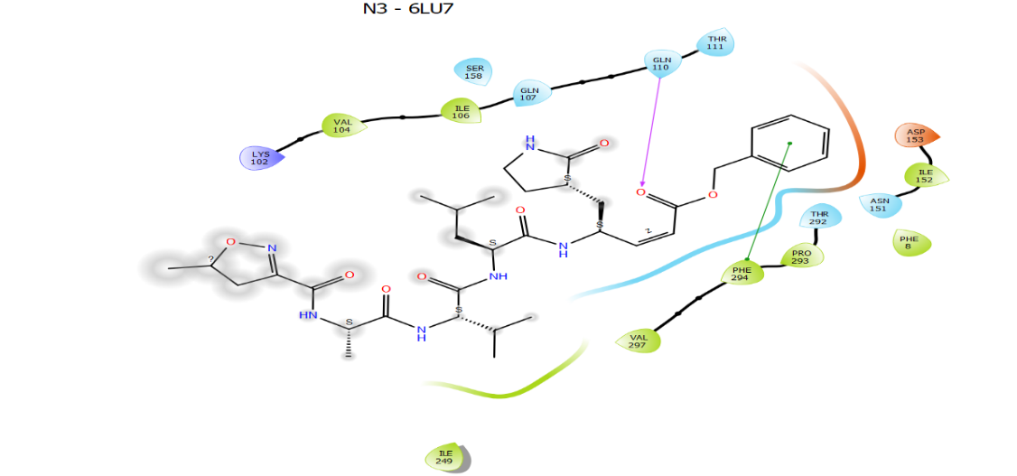
Binding modes of Magnolol and inhibitor N3 in the binding pocket of COVID-19 protein with PDB ID: 6LU7
The compounds are indicated in sticks; hydrogen bonds are shown as dashed yellow line; aromatic hydrogen bond are shown as blue dashed lines; pi cation are shown as green dashed lines

Slide 16
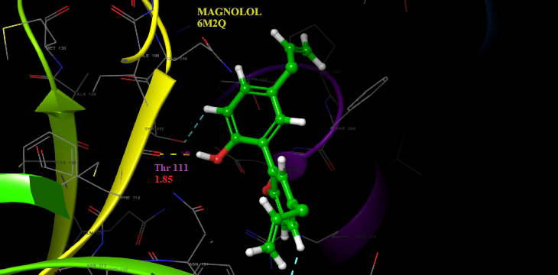
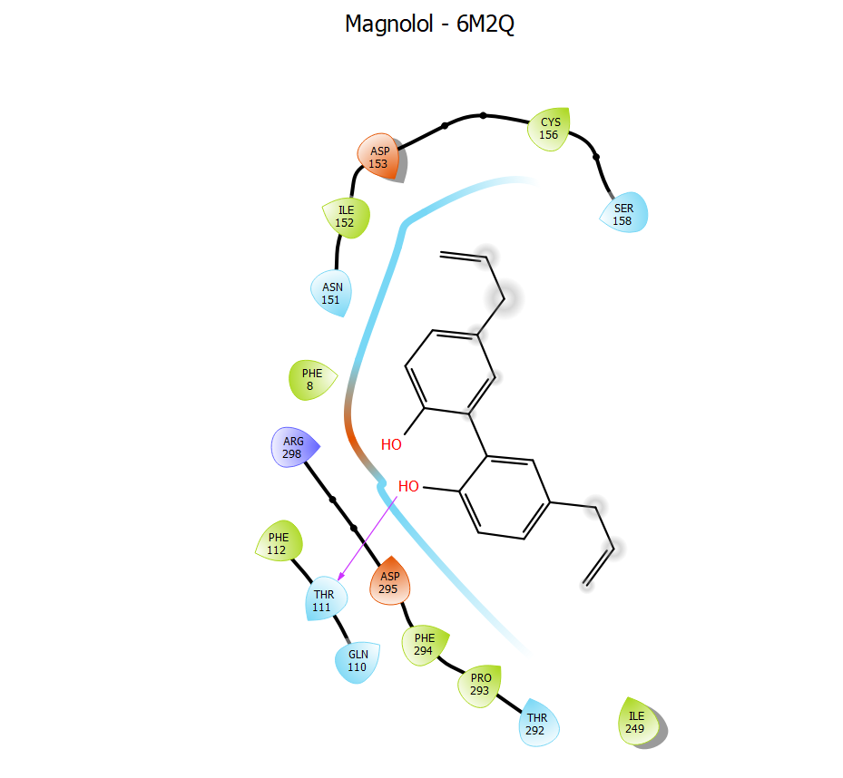
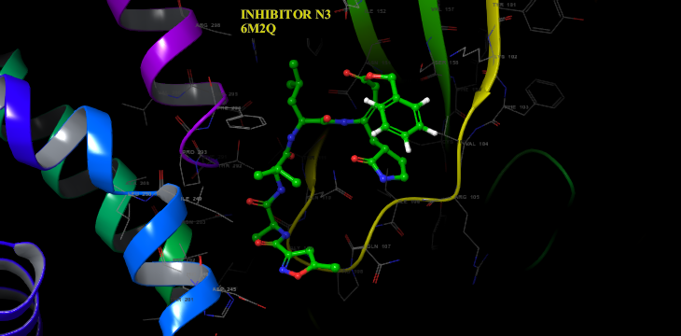
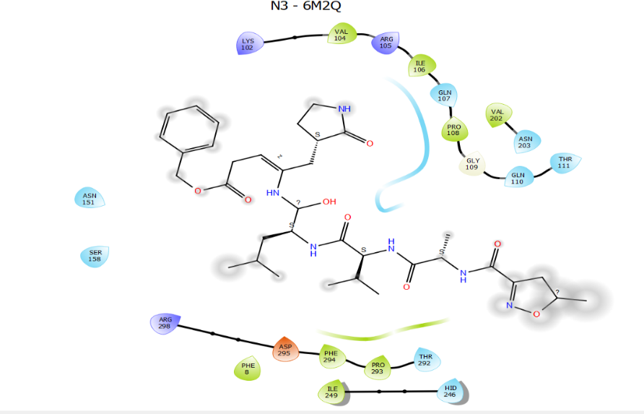
Binding modes of magnolol and inhibitor N3 in the binding pocket of COVID-19 protein with PDB ID- 6M2Q
The compounds are indicated in sticks; hydrogen bonds are shown as dashed yellow line; aromatic hydrogen bond are shown as blue dashed lines; pi cation are shown as green dashed lines

Slide 17
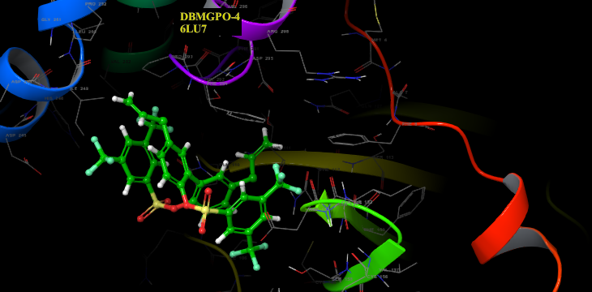
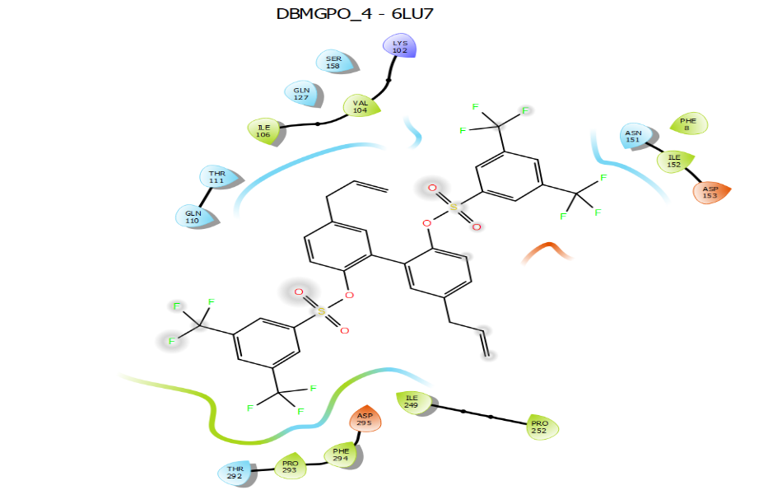
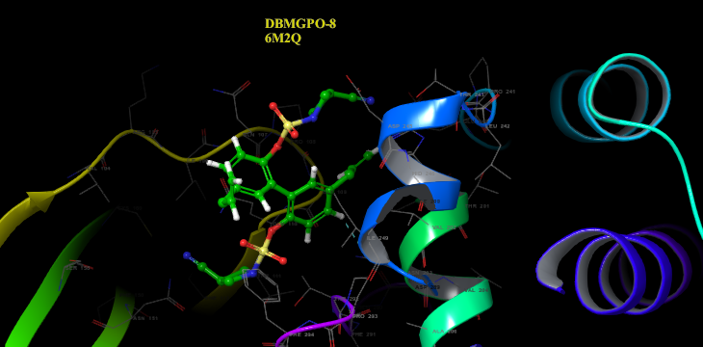
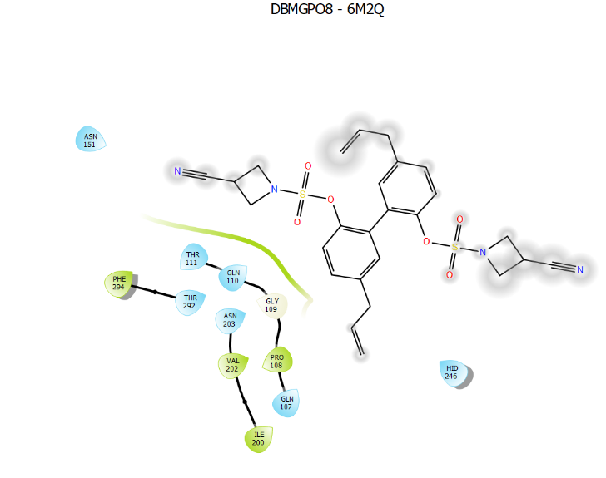
Protein-Ligand complex of DBMGPO series with top scoring functions against COVID-19 proteases (PDB ID- 6LU7, 6M2Q)
The compounds are indicated in sticks; hydrogen bonds are shown as dashed yellow line; aromatic hydrogen bond are shown as blue dashed lines; pi cation are shown as green dashed lines

Slide 18
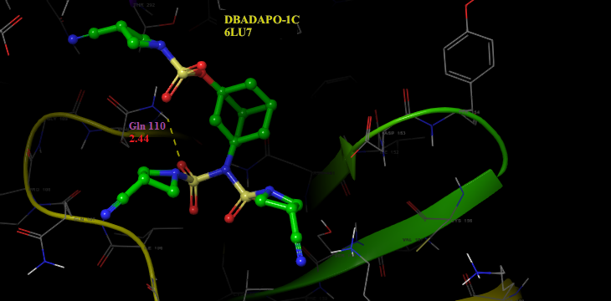
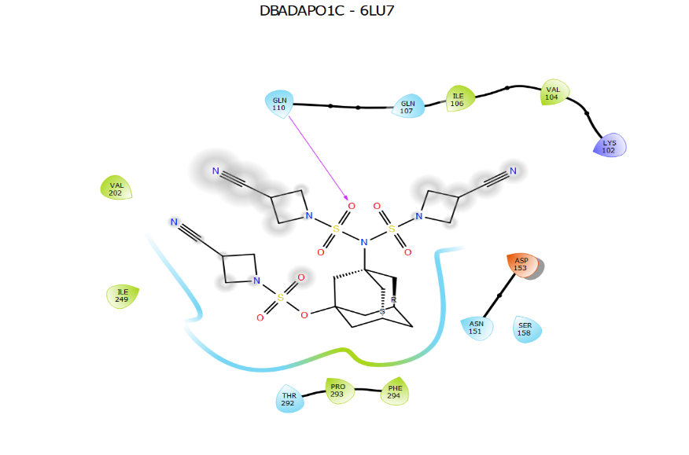
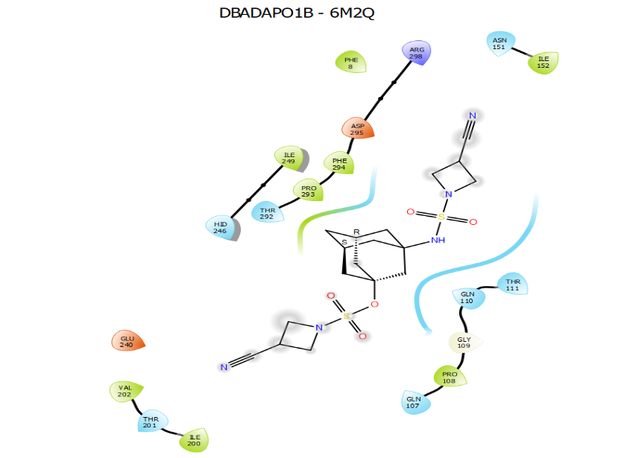
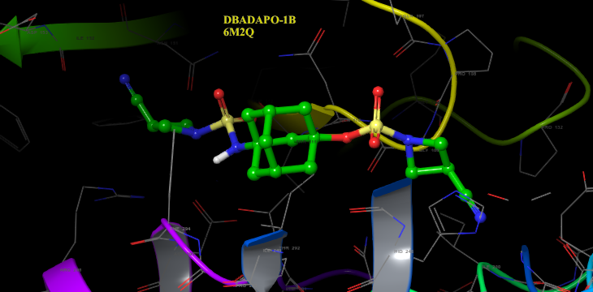
Protein-Ligand complex of DBADAPO series with top scoring functions against COVID-19 proteases (PDB ID- 6LU7, 6M2Q).
The compounds are indicated in sticks; hydrogen bonds are shown as dashed yellow line; aromatic hydrogen bond are shown as blue dashed lines; pi cation are shown as green dashed lines

Slide 19
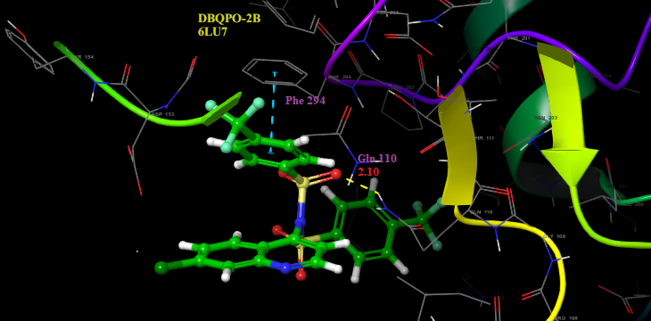
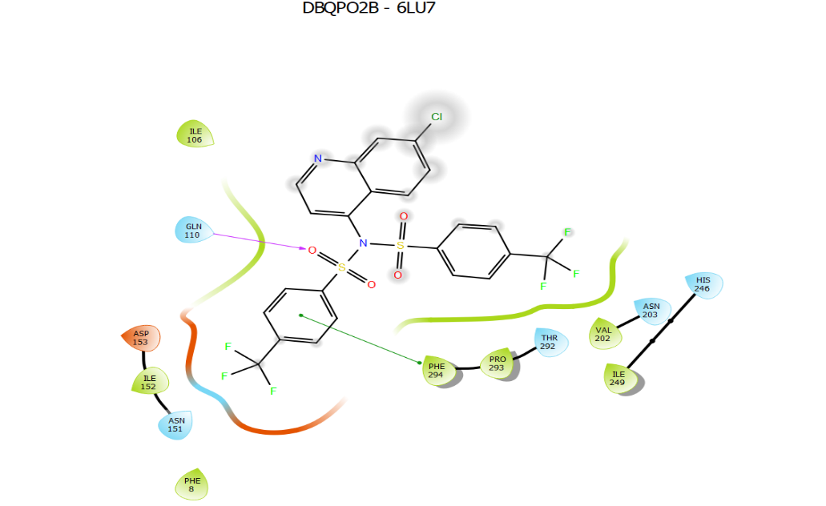
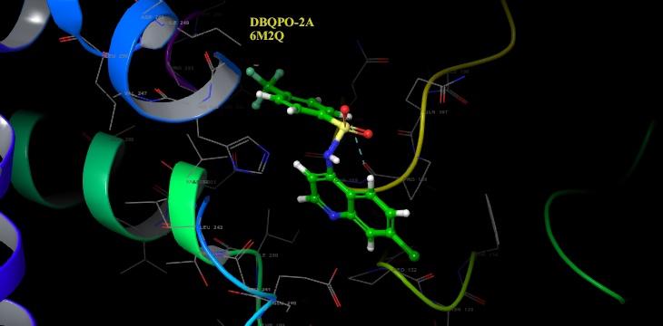
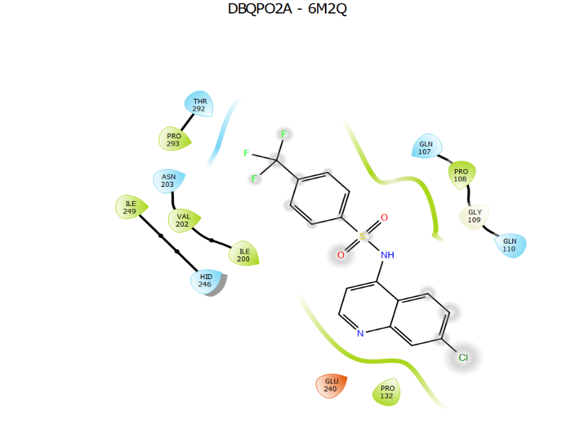
Protein-Ligand complex of DBQPO series with top scoring functions against COVID-19 proteases (PDB ID- 6LU7, 6M2Q)
The compounds are indicated in sticks; hydrogen bonds are shown as dashed yellow line; aromatic hydrogen bond are shown as blue dashed lines; pi cation are shown as green dashed lines

Slide 20
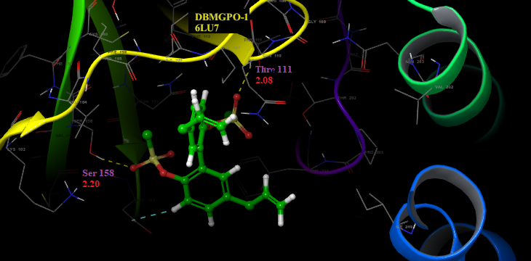
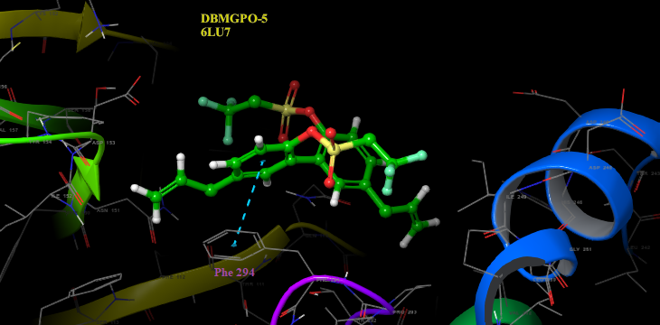
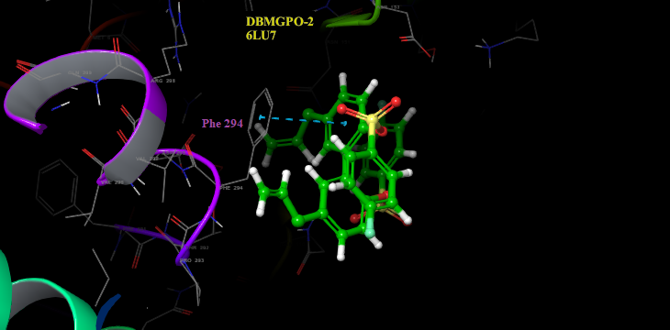
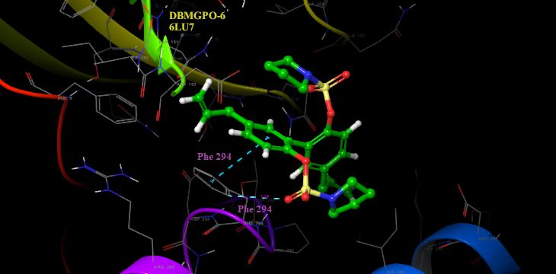
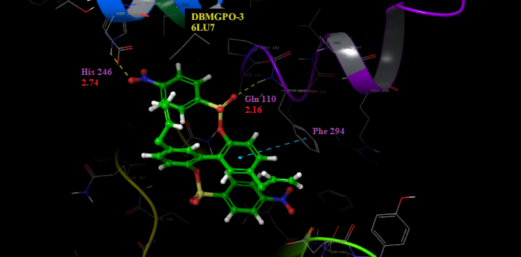
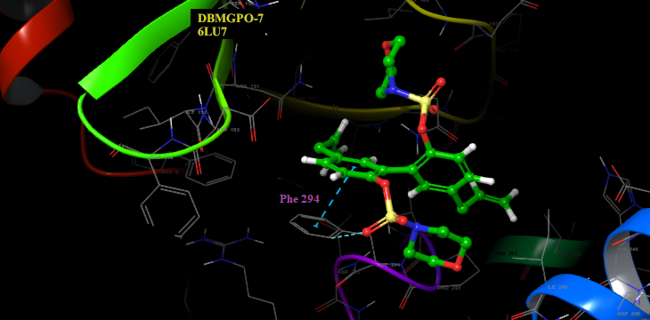
Protein-Ligand complex showing the binding modes of novel magnolol derivatives from the DBMGPO series in the COVID-19 protease (PDB ID- 6LU7) binding pocket
The compounds are indicated in sticks; hydrogen bonds are shown as dashed yellow line; aromatic hydrogen bond are shown as blue dashed lines; pi cation are shown as green dashed lines

Slide 21
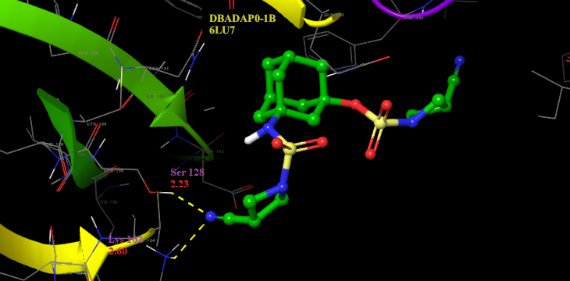
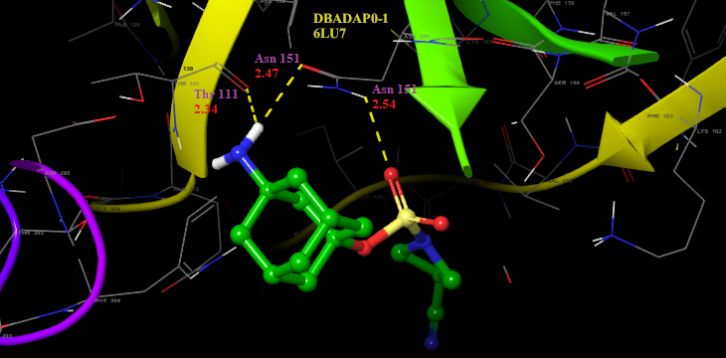
Protein-Ligand complex showing the binding modes of novel adamantane derivatives from the DBADAPO series in the COVID-19 protease (PDB ID- 6LU7) binding pocket
The compounds are indicated in sticks; hydrogen bonds are shown as dashed yellow line; aromatic hydrogen bond are shown as blue dashed lines; pi cation are shown as green dashed lines

Slide 22
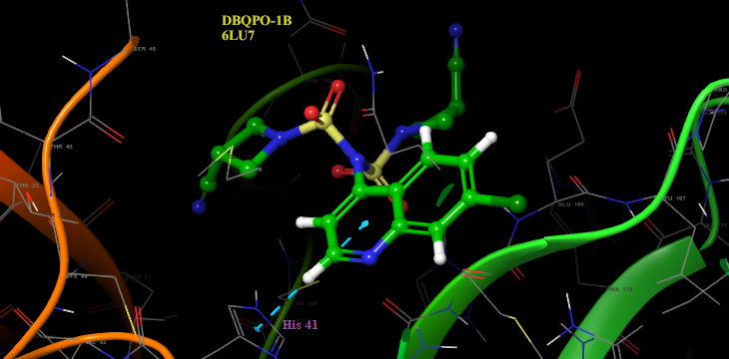
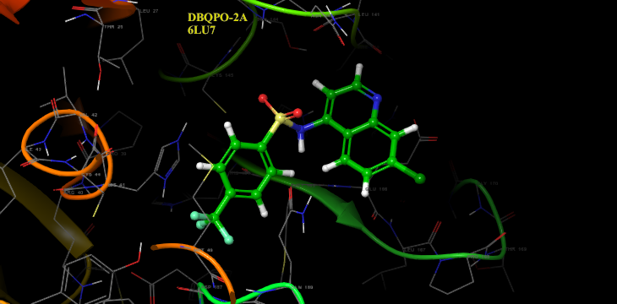
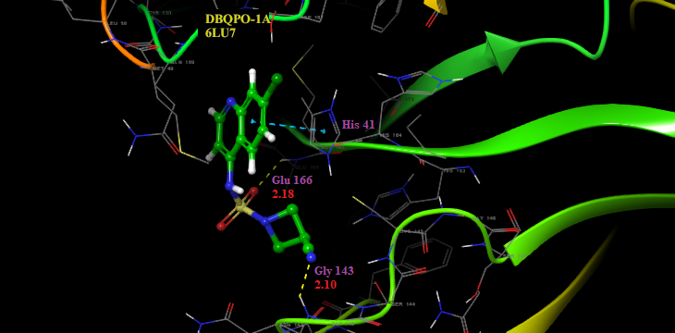
Protein-Ligand complex showing the binding modes of novel 4-amino quinoline derivatives from the DBQPO series in the COVID-19 protease (PDB ID- 6LU7) binding pocket
The compounds are indicated in sticks; hydrogen bonds are shown as dashed yellow line; aromatic hydrogen bond are shown as blue dashed lines; pi cation are shown as green dashed lines

Slide 23
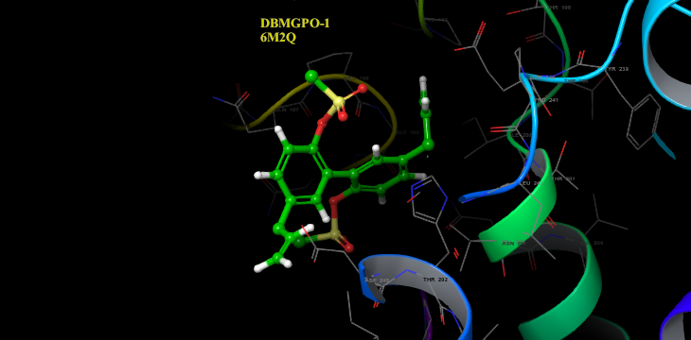
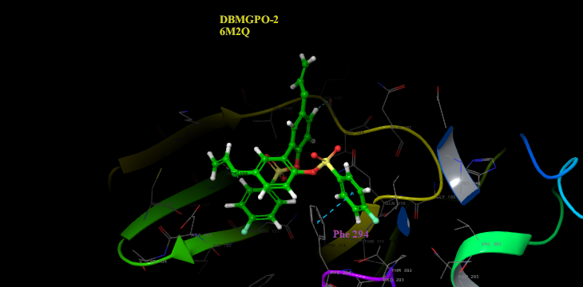
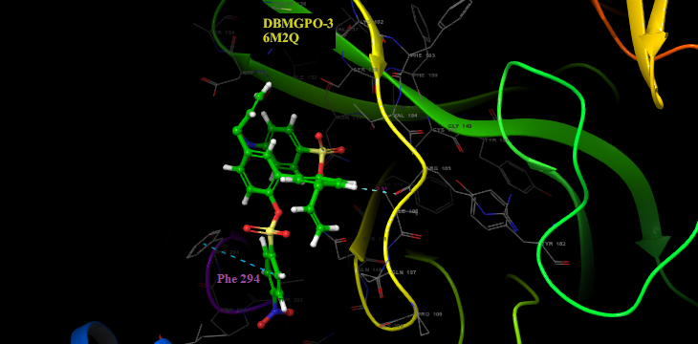
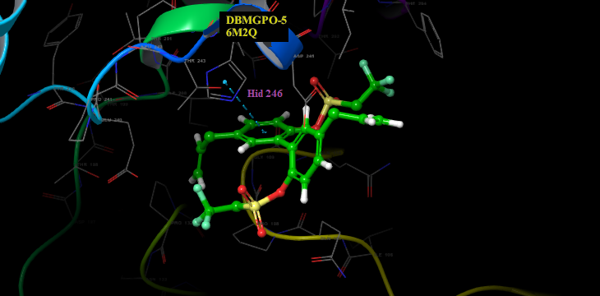
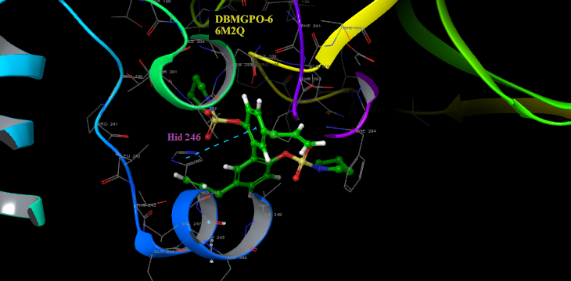
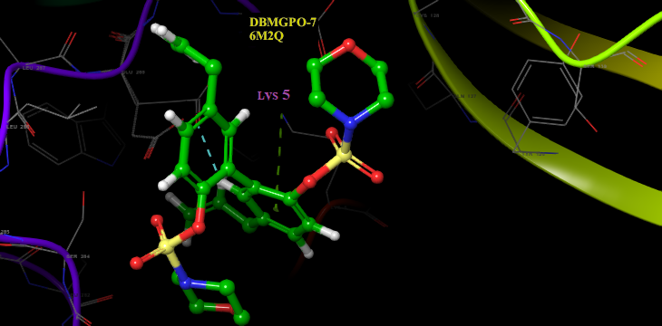
Protein-Ligand complex showing the binding modes of novel magnolol derivatives from the DBMGPO series in the COVID-19 protease (PDB ID: 6M2Q) binding pocket
The compounds are indicated in sticks; hydrogen bonds are shown as dashed yellow line; aromatic hydrogen bond are shown as blue dashed lines; pi cation are shown as green dashed lines

Slide 24
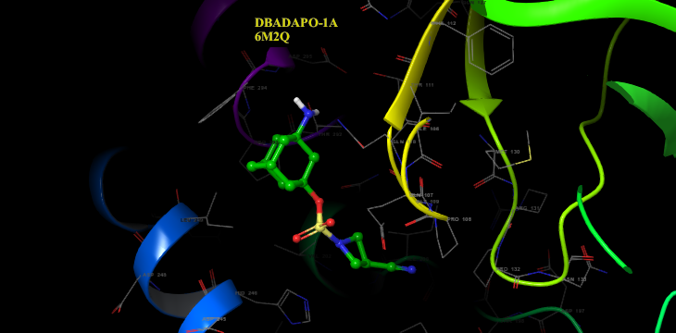
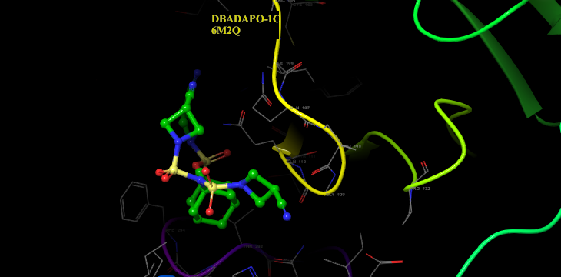
Protein-Ligand complex showing the binding modes of novel adamantane derivatives from the DBADAPO series in the COVID-19 protease (PDB ID: 6M2Q) binding pocket
The compounds are indicated in sticks; hydrogen bonds are shown as dashed yellow line; aromatic hydrogen bond are shown as blue dashed lines; pi cation are shown as green dashed lines

Slide 25
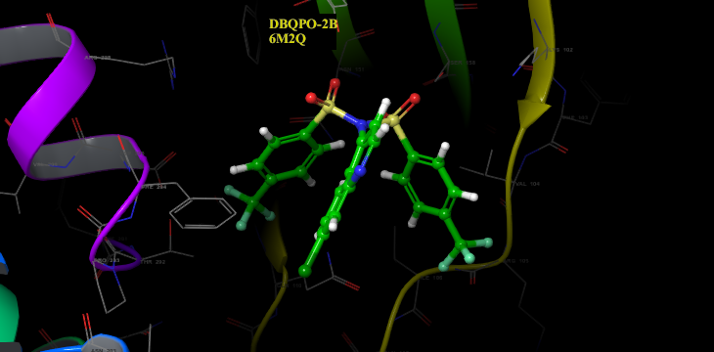
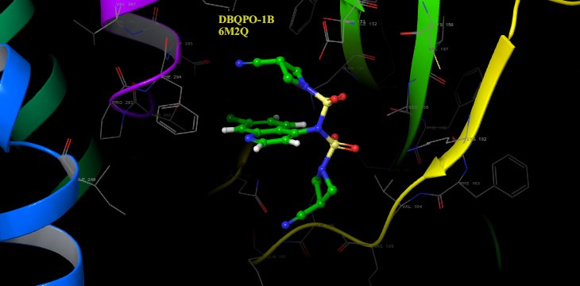
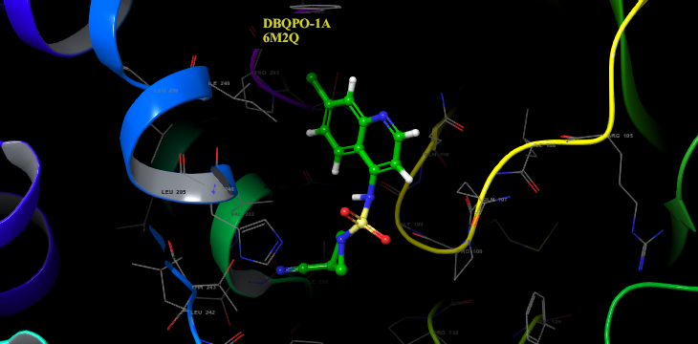
Protein-Ligand complex showing the binding modes of novel 4-amino quinoline derivatives from the DBQPO series in the COVID-19 protease (PDB ID: 6M2Q) binding pocket
The compounds are indicated in sticks; hydrogen bonds are shown as dashed yellow line; aromatic hydrogen bond are shown as blue dashed lines; pi cation are shown as green dashed lines

Slide 26
Conclusion
Magnolol, a natural product has been isolated from the green seed cones of Magnolia grandiflora, available on-campus, its derivatives and other synthetic molecular scaffolds (Adamantane and 4-aminoquinoline) derivatives have also been successfully synthesized.
In silico evaluation of the novel derivatives against COVID-19 proteases (PDB IDs: 6LU7, 6M2Q) was successfully conducted.
Virtual screening utilizing AutoDock Vina identified lead compounds in the entire series.
DBADAPO- 1B had the top scoring function (-9.1) for COVID-19 protease, PDB ID -6M2Q and DBQPO- 2B showed top scoring function (-8.0) for COVID-19 protease, PDB ID- 6LU7 in comparison to Inhibitor N3 (-7.2, -7.5 for 6LU7 and 6M2Q, respectively).
Thus, biological investigation is encouraged as these novel compounds could lead to the development of potential antiviral drugs for the treatment COVID-19 disease.

Slide 27
Future aspects
Evaluation of enzyme inhibitory activity against SARS-CoV-2 spike proteases.
Biological evaluations (In vitro, In vivo testing)
Binding assays
Determination of pharmacological and toxicological profiles.

Slide 28
References
1.Garza, B., Echeverria, A., Gonzalez, F., Castillo, O., Eubanks, T., Bandyopadhyay, D. (2019). Phytochemical investigation of Magnolia grandiflora green seed cones: Analytical and phytoceutical studies. Food science & nutrition, 7(5), 1761–1767. https://doi.org/10.1002/fsn3.1016.
2. Laskar, S., Espino, O., Bandyopadhyay, D. (2019) “Isolation, solid-state structure determination, in silico and in vitro anticancer evaluation of an indole amino acid alkaloid L-Abrine”. Curr. Cancer Drug Targets. 19(9), 707–715 (This paper was highlighted as Front Cover featured article).
3. Bandyopadhyay, D., Banerjee, M., Laskar, S., Basak, B. (2011). Asimafoetidnol: A new Sesquiterpenoid Coumarin from the gum resin of Ferula assa‐foetida L. Natural Product Communications, 6, 209–212.
4. Maioli, M., Basoli, V., Carta, P., Fabbri, D., Dettori, M. A., Cruciani, S., Serra, P. A., Delogu, G. (2018). Synthesis of magnolol and honokiol derivatives and their effect against hepatocarcinoma cells. PLOS one, 13(2).
5. Liang-Tzung, L; Wen-Chan, H; Chun-Ching, L. Antiviral Natural Products and Herbal Medicines. (2014) J Tradit Complement Med., 4(1), 24-35.
6. Pereira, B. B. Challenges and Cares to Promote Rational Use of Chloroquine and Hydroxychloroquine in the Management of Coronavirus Disease 2019 (COVID-19) Pandemic: A Timely Review. J. Toxicol. Environ. Heal. - Part B Crit. Rev. 2020, 23 (4), 177–181. https://doi.org/10.1080/10937404.2020.1752340.

Slide 29
Acknowledgements
I wish to express my sincere appreciation to the graduate college for presenting me with the Presidential graduate research assistantship (PGRA) award.
I am extremely grateful to Dr. B. Connie Allen, Interim Chair, Chemistry Department for her relentless assistance during this project.
I also wish to express my deepest gratitude to my mentor, Dr. Debasish Bandyopadhyay for his invaluable support, guidance, constructive advice, patience and encouragement throughout the duration of this research.
Finally, I’d like to recognize my thesis committee members; Dr. Hassan Ahmad, Dr. Tulay Atesin, and Dr. Javier Macossay-Torres for their practical contribution and insightful suggestions.

