Slide 1
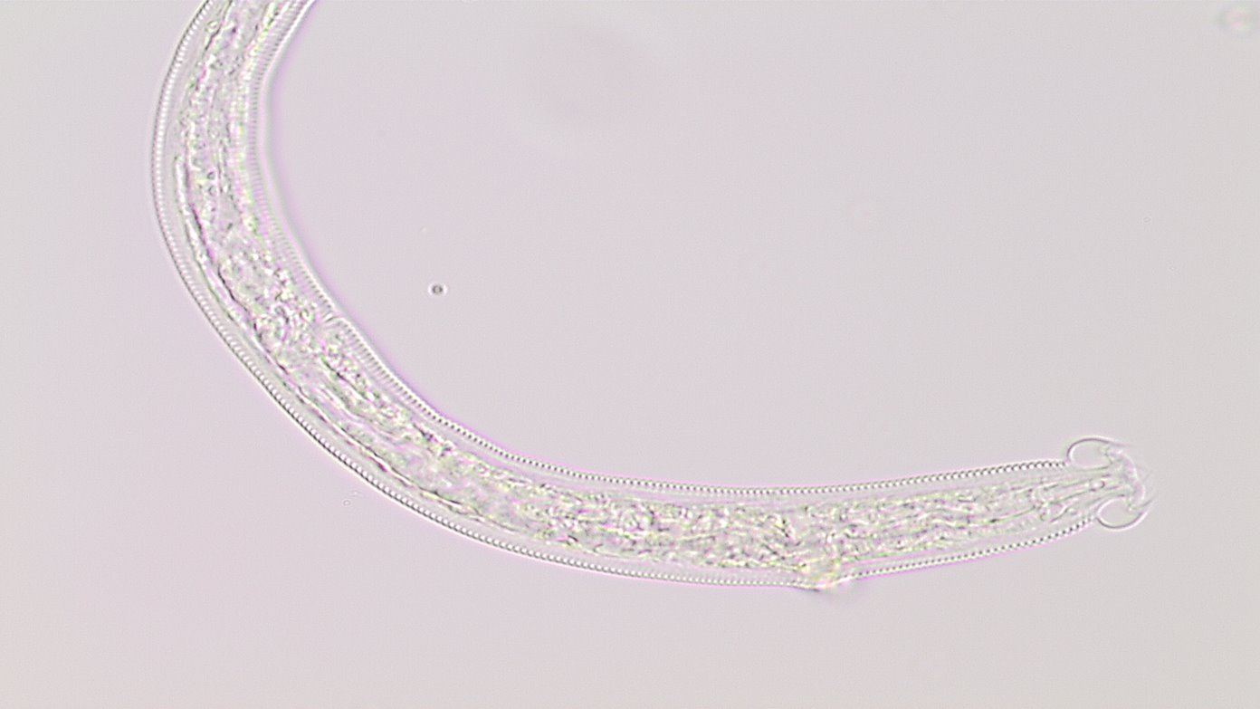
Characterization of soil nematode community as influenced by weedy plants and environmental variables.
by
Orlando Garcia, Andrea Mota, Justin Lerma, and Dr. Pushpa Soti
University of Texas Rio Grande Valley
Department of Biology

Slide 2
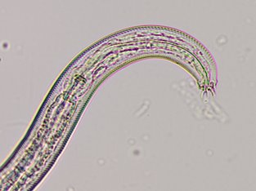
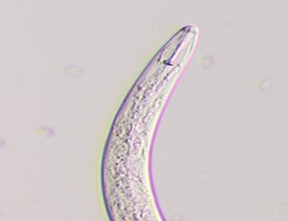
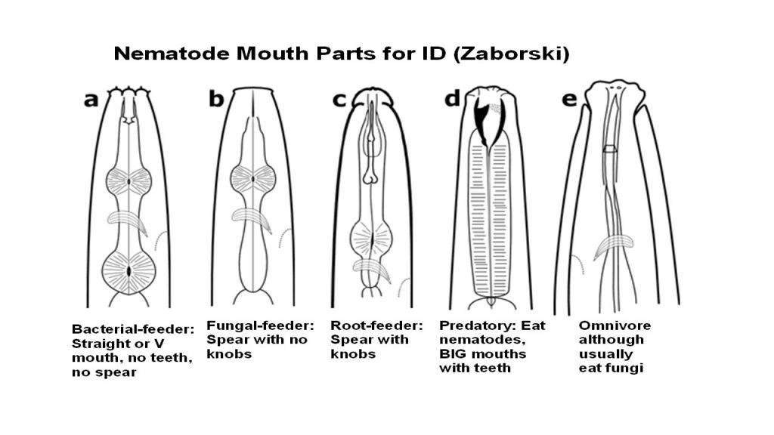
Soil nematode community
Plant-Parasitic
Fungal feeder
What are nematodes?
•Microscopic roundworm
•Live both in aquatic and terrestrial
•Phylum: Nematoda
Soil nematode community can be categorized into feeding groups.
•Bacterial Feeders
•Fungal Feeders
•Predatory
•Omnivore
•Plant-Parasitic
Bacteria feeder
https://www.gardentara.com/types-of-nematodes-in-soil/

Slide 3
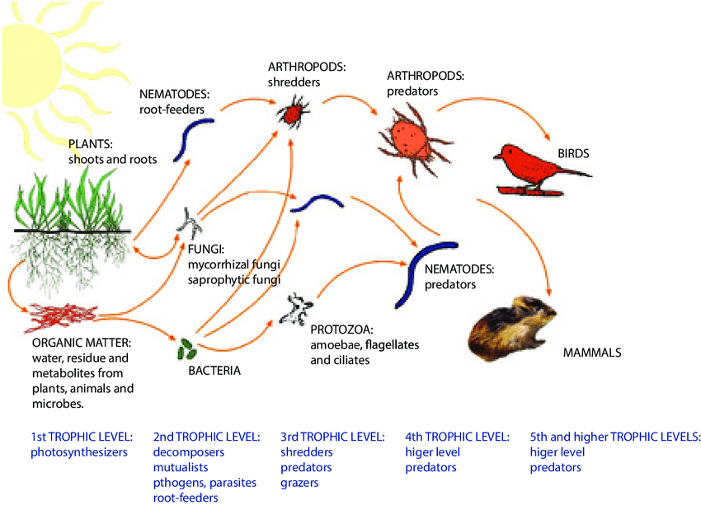
Nematodes as indicator of soil health
Nematodes are great indicators as they appear in all types of soil and have relatively short life spans that fluctuate with environmental conditions.
Bacterial and Fungal nematodes indicate nutrient recycling with high nitrogen levels or recent tillage.
The lack of omnivore nematodes may indicate pollutants in soil and the history of tillage in the area.
High numbers of both omnivore and predator nematodes indicate suppression of plant parasitic nematodes.

Slide 4
Influence of weeds on agriculture production
Weeds: Are plants that are not valued where there grown and compete with other desirable plants.
Direct impact | Indirect impact
Compete with crops for resources | Hosts of plant diseases
Increased labor cost | Hosts of pests
lower quality of crop yield | Changes in soil microorganisms
Increase herbicide usage | Changes organic matter

Slide 5
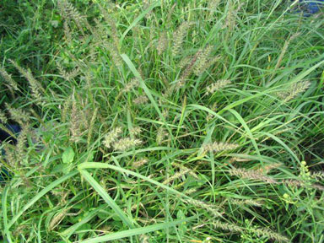
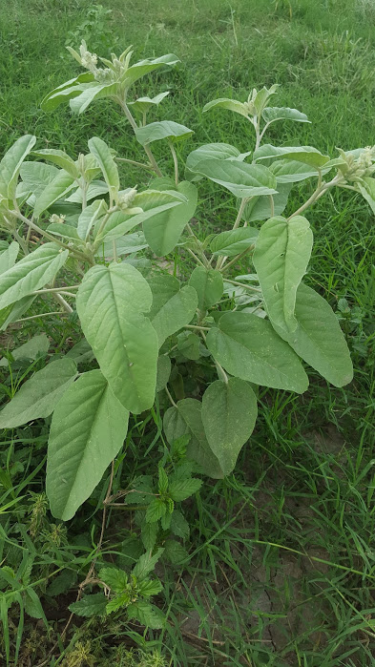
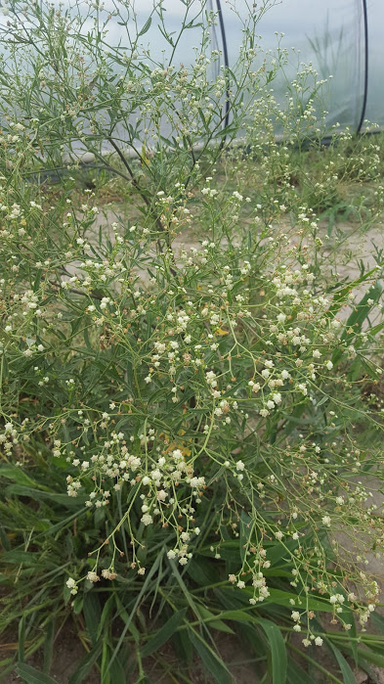
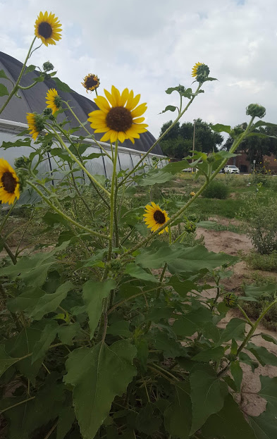
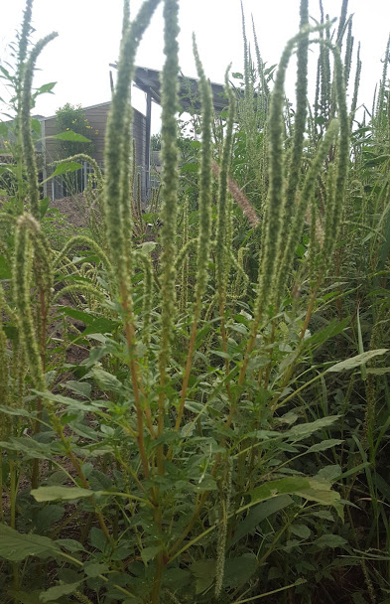
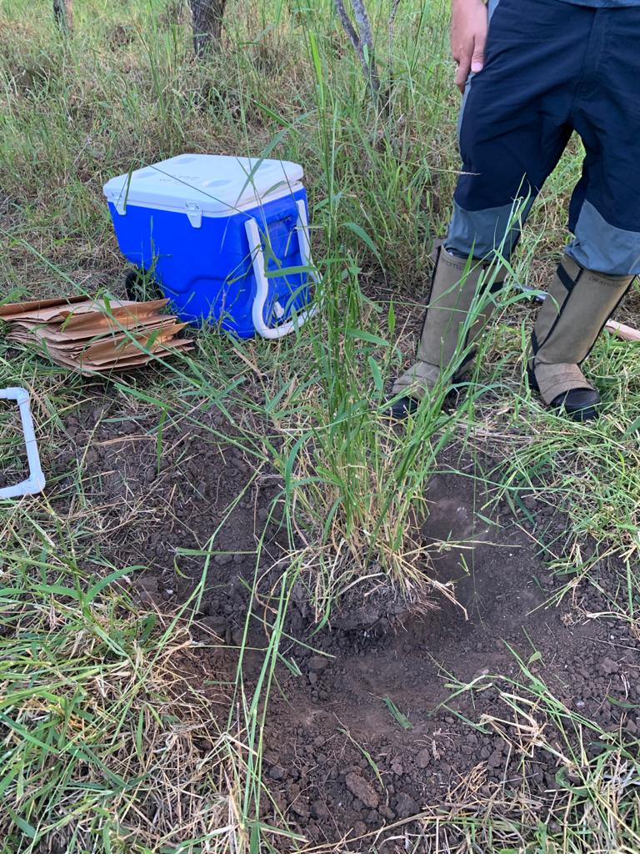
Weeds being analyzed
Pennisetum ciliare (Buffelgrass).
Solanum elaeagnifolium (Silver Leaf Nightshade)
Parthenium hysterophorus (White Top)
Helianthus annuus (Sunflower)
Amaranthus spp. (Pigweed)
Megathyrsus maximus (Guinea grass)
Silver Leaf Nightshade
Buffelgrass
White Top
Sunflower
Pigweed
Guinea grass

Slide 6
Objectives
My specific objectives are:
To analyze the soil nematode community associated with the major weeds in the LRGV
To examine the correlation between soil edaphic properties and soil nematodes.
To determine the influence of plant volatiles on the structure nematode communities of weeds in LRGV

Slide 7
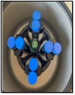
Methods
Sucrose centrifugal-flotation technique (Jenkins, 1964)
Observe 1 mL of solution under microscope, take
pictures, and collect data
pass soil through sieves
Add sugar solution
Collect soil samples from different locations
Centrifuge again
Centrifuge and pour supernatant
out
5 weed species
5 sites x 5 reps
3 times
N=375

Slide 8
Preliminary Results
Guinea grass followed by sunflower had significantly higher number of plant parasitic nematodes (520 and 375 ).
Pigweed had the lowest number of plant parasitic nematodes (135).
No difference among silver leaf nightshade, white top, and buffelgrass.
Figure: Density of plant parasitic nematodes among the six different weed species based on morphological analysis.

Slide 9
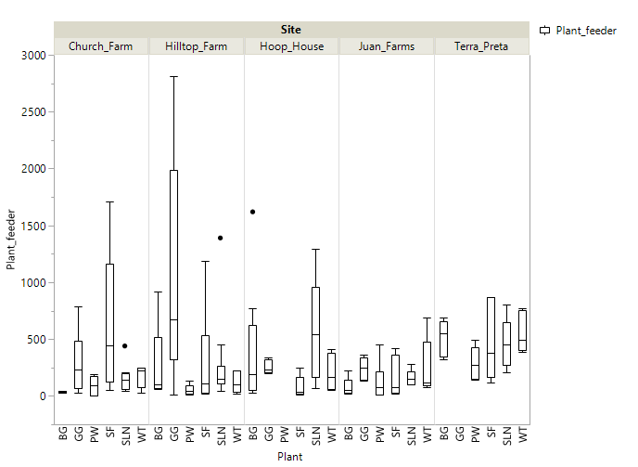
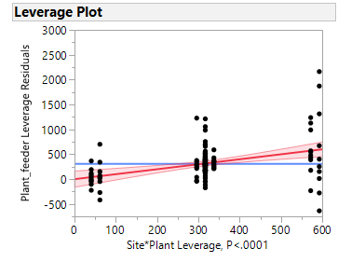
Preliminary Results
The difference in the plant parasitic nematodes was site specific
Density of Plant parasitic nematodes in the rhizosphere is different plants in the study sites

Slide 10
Phase I, Preliminary Results Correlations between soil properties and nematode populations
Nonparametric: Spearman's ρ
Variables | Plant feeder | Bacteria Feeder | Fungal feeder | Predator
Salinity | 0.36 | 0.29 | 0.26 | -0.0294
P value | <0.001 | <0.001 | 0.018 | 0.82
OM% | 0.47 | 0.16 | 0.32 | -0.014
P value | <0.0001 | 0.018 | 0.001 | 0.48
Soil Moisture % | 0.38 | -0.48 | 0.16 | 0.11
P value | 0.001 | 0.27 | 0.0055 | 0.08
While this associations are statistically significant there is no strong correlation among the soil parameters and soil nematode community

Slide 11
Phase I, Preliminary Results
Fungal feeders: No significant difference among different plants (P>0.05)
Bacteria feeders: No significant difference among different plants.
Predators: No significant difference among different plants.

Slide 12
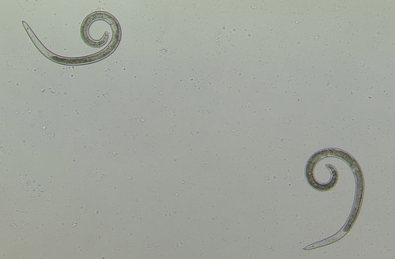
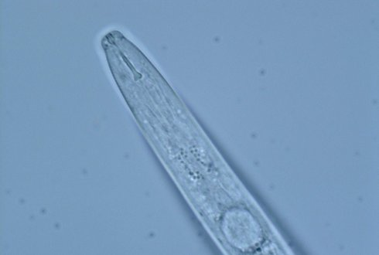
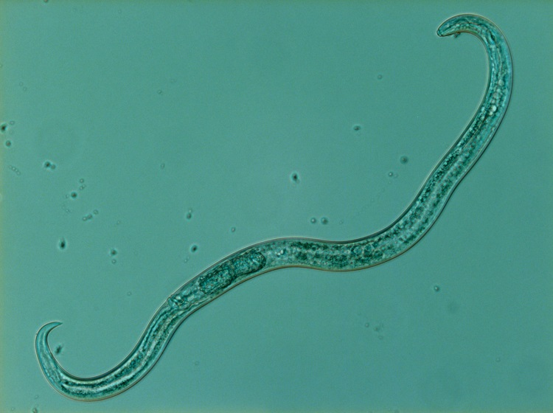
Common Plant-Parasitic Nematodes Observed
Helicotylenchus spp
•Spiral Nematode
•Host plants:
Potato
Wheat
Soybean
Maize
Coffee
Pratylenchus spp
•Lesion Nematode
•Host plants:
Fruit
Woody Ornamentals
Vegetables
Maize
Aphelenchoides spp
•Foliar nematode
•Host plant:
Tobacco
Ornamentals
Strawberries
Flowers

Slide 13
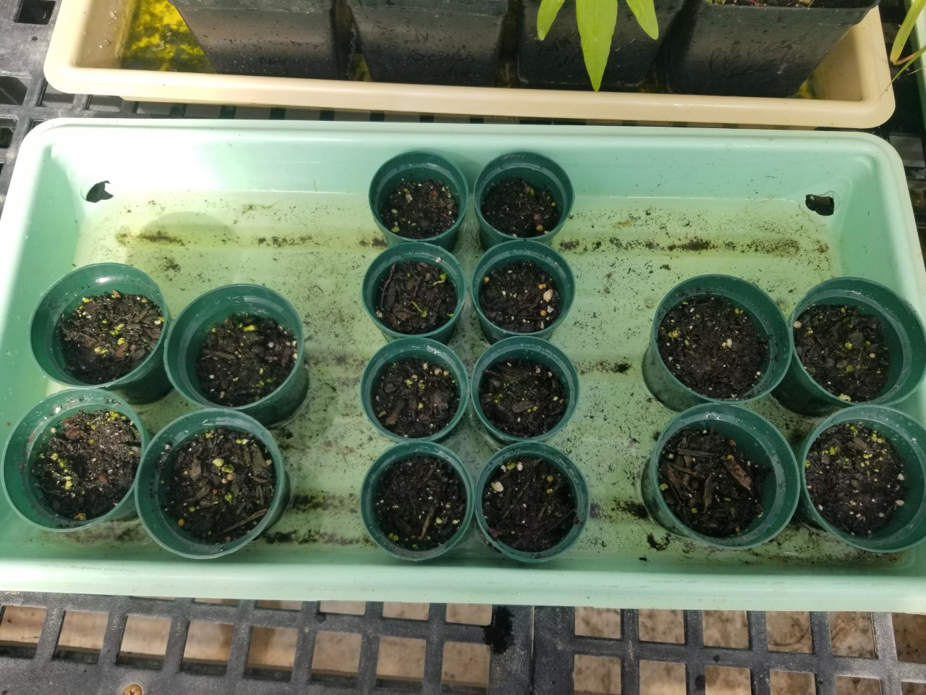
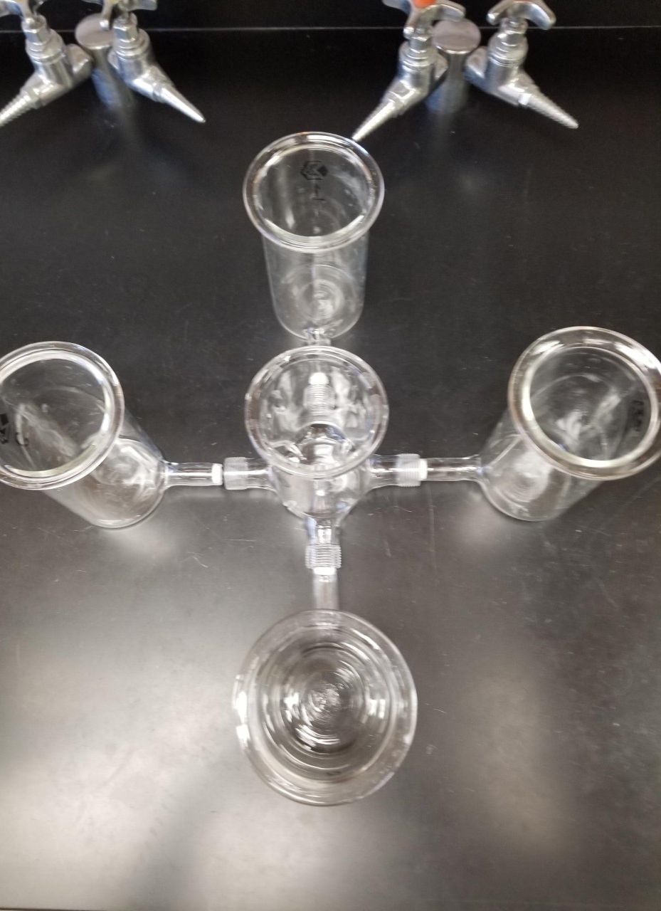
Methods
Phase II: Exploring the influence of plant specific volatiles on soil nematode community
•Cultivation of weeds
10 weed grown in the green house.
2 per weed species.
•Analyze/extract volatiles of weeds using a GC
•Olfactometer for the detection of nematode movement.
Outer chamber of the olfactometer will be inoculated with extracted volatiles.
Center chamber is inoculated with nematodes that have been identified morphologically
Observe the number of nematodes that have moved towards the weed chambers
Repeat 5 times

Slide 14
Acknowledgements
We thank Dr. Rupesh Kariyat, and Dr. Alexis Racelis for their support and advice. We would also like to thank former graduate student Habraham Lopez for his help with identifying nematode species and the different farms for allowing us to collect samples.

Slide 15
Thank you for your time. Questions?

