Slide 1
Pesticides affect Apoptosis, DNA damage, and global DNA Methylation in aquatic organisms.
By: Michelle Rivera, eSmirna cantu, Alexa Campos

Slide 2
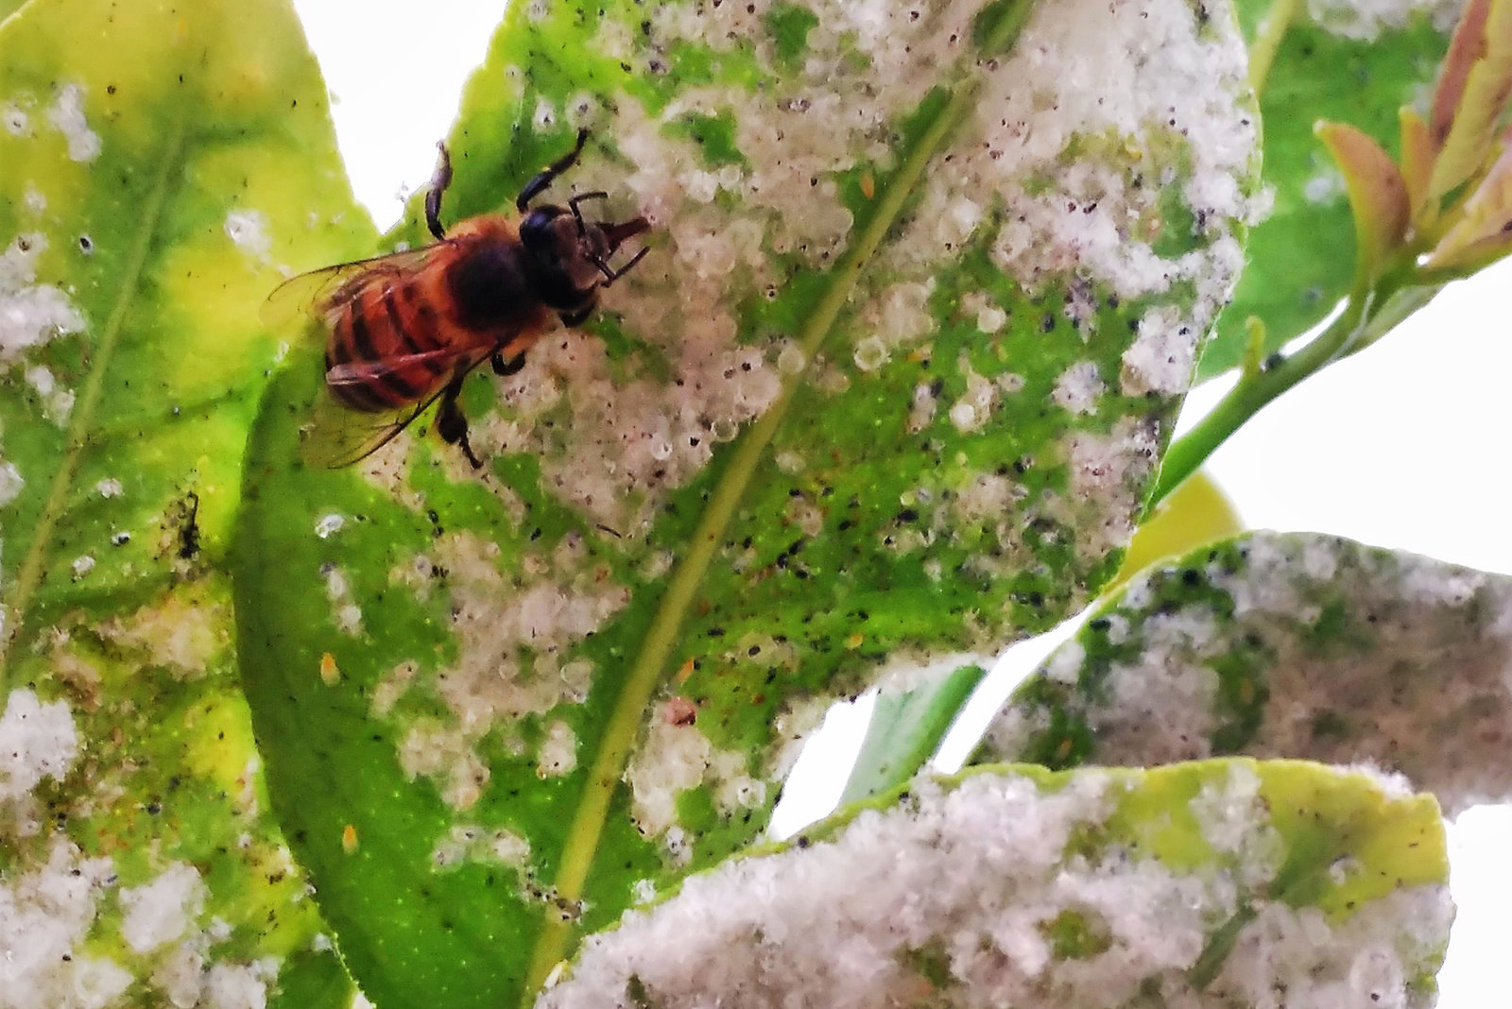
What are pesticides?
Pesticides is a generic term that many chemicals fall under.
Brief functions of pesticides.
List of pesticides used.
S-metolachlor, linuron, isoproturon, tebucanozole, aclonifen, atrazine, pendimethalin, azinphos-methyl
Negative effects of pesticides.
Image by :iStockphoto.com/alffoto
Image by :Alejandro Tena

Slide 3
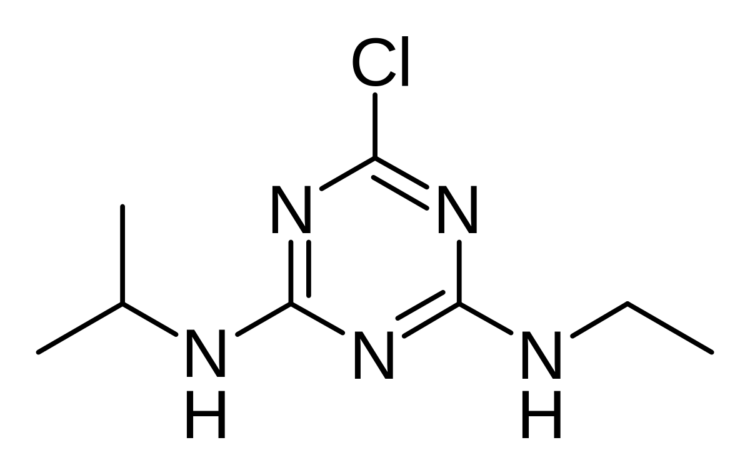
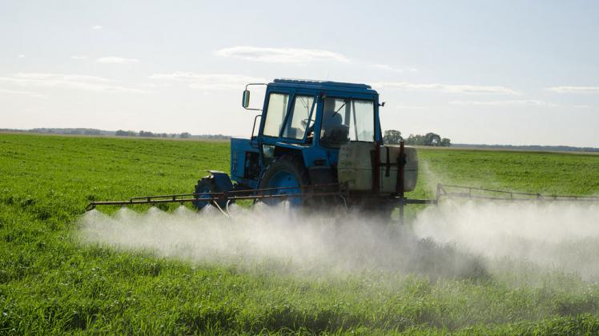
Atrazine
Atrazine is herbicide of the triazine class.
Atrazine is a very commonly used pesticide for farmers to use.
It is popular due to the atrazine being able to prevent pre-emergence broadleaf weeds.
One of the most widely used pesticide in both the US & Australia.
Picture by J3D3 (Castilian)
Picture by Aqua Mechanical

Slide 4
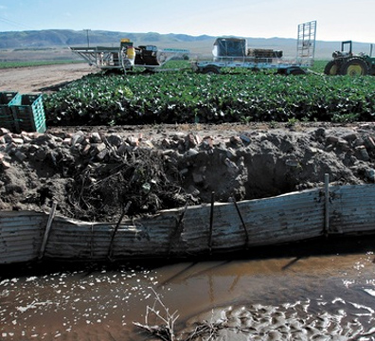
Environmental impact
Surface runoff affecting water sources
Aquatic populations face inherent harm due to inundation by noxious chemicals.
Aquatic populations experiencing cellular apoptosis & DNA damage
Image by The Otter Project

Slide 5
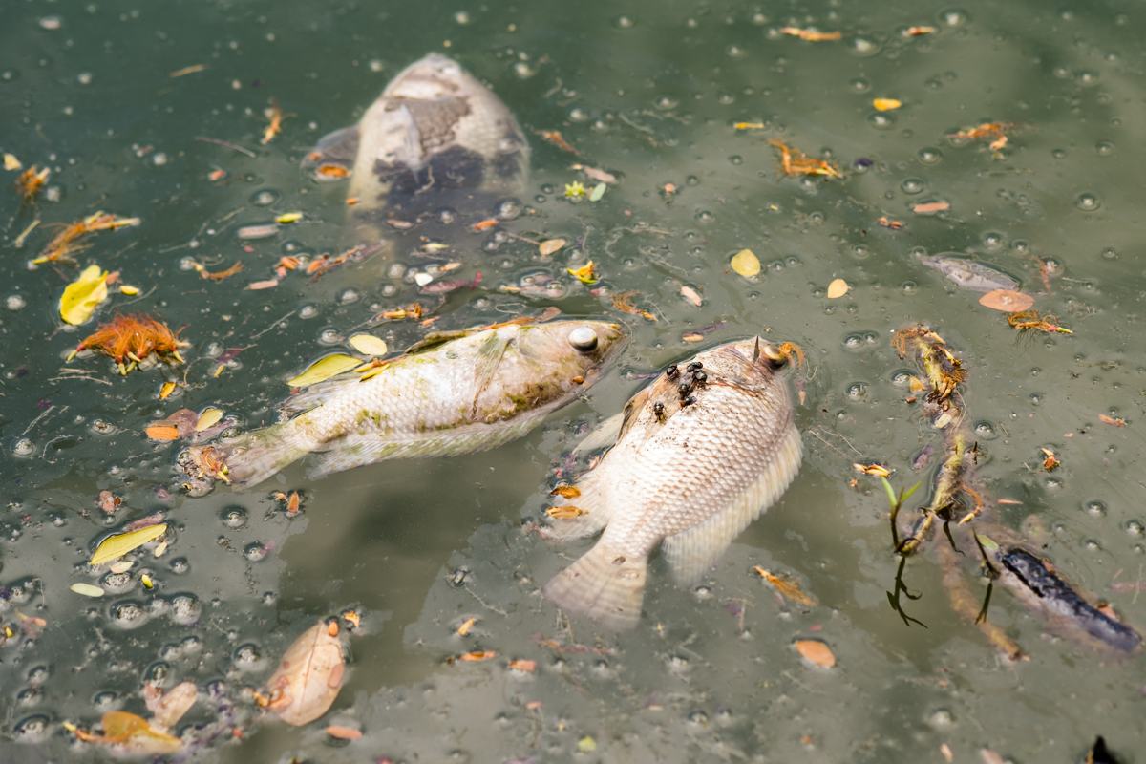
Health Impacts
Consuming contaminated fish causes negative health effects
This poses a problem for both animals and the people of our community.
The contaminated fish it will result in people getting sick.
Endocrine system and birth defects
Animal affecting the ecosystems
Sickness, weak offspring and starvation
Image by HelpSaveNature

Slide 6
Methodology Timeline
Purchase of goldfish and letting them acclimate for 4 weeks.
Exposing the fish to the pesticides for 2 weeks.
Analyzing the image data.
Collecting behavioral data.
Creating slides and preforming histology.
Collecting tissue sample and preparing them for blocking.
Immunohistochemistry and apoptosis analysis.

Slide 7
Expected results
We expect to be able to analyze the behavior data and see a decline in the fishes free-swimming behavior
We also predict that there will be a negative effects in the fish's DNA, they will experience DNA damage along with alteration of protein expression and DNA methylation.
We expect results to support the evidence of harmful effects of pesticides in our aquatic environment.
We will also be able to explain the risk factors that affect human health, such as people who have encountered or consumed fish/water with a toxic load of pesticides.
This data will also help us to determine how pesticides provoke mechanisms of endurance in aquatic life, and how this can impact future generations (transgenerational effects).

Slide 8
Questions

Slide 9
References
Albone, E. S., Eglinton, G., Evans, N. C., Hunter, J. M., Rhead, M. M. (1972) Fate of DDT in Severn estuary sediments. Environmental Science & Technology 6(10): 914-919.
Bhandari RK. (2016. Medaka as a model for studying environmentally induced epigenetic transgenerational inheritance of phenotypes. Environmental Epigenetics 2016;2(1).
Boskovic A, Rando OJ. (2018) Transgenerational epigenetic inheritance. Annu Rev Genet. 52:21–41.
Elmore, S. (2007). Apoptosis: a review of programmed cell death. Toxicologic Pathology, 35(4), 495–516.
Franco, R., Sánchez-Olea, R., Reyes-Reyes, E.M., Panayiotidis, M.I. (2009). Environmental toxicity, oxidative stress and apoptosis: Ménage à Trois. Mutation Research/Genetic Toxicology and Environmental Mutagenesis, 674, 3–22.
Kass SU, Pruss D, Wolffe AP. (1997). How does DNA methylation repress transcription? Trends Genet. 13 (11):444–449.
Li E, Beard C, Jaenisch R. (1993). Role for DNA methylation in genomic imprinting. Nature, 366(6453):362.
Papoulias DM, Noltie DB, Tillitt DE. (2000). An in vivo model fish system to test chemical effects on sexual differentiation and development: exposure to ethinyl estradiol. Aquatic Toxicology 48(1):37–50.
Reik W, DeanW,Walter J. (2001). Epigeneticreprogrammingin mammalian development. Science, 293:1089–1093. Skinner MK. (2007). Epigenetic transgenerational toxicology and germ cell disease. Internation Journal of Andrology, 30:393–397.

