Slide 1
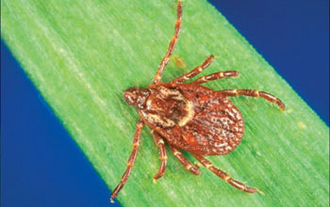
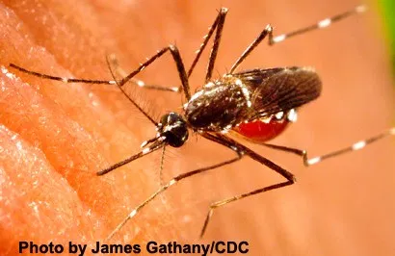
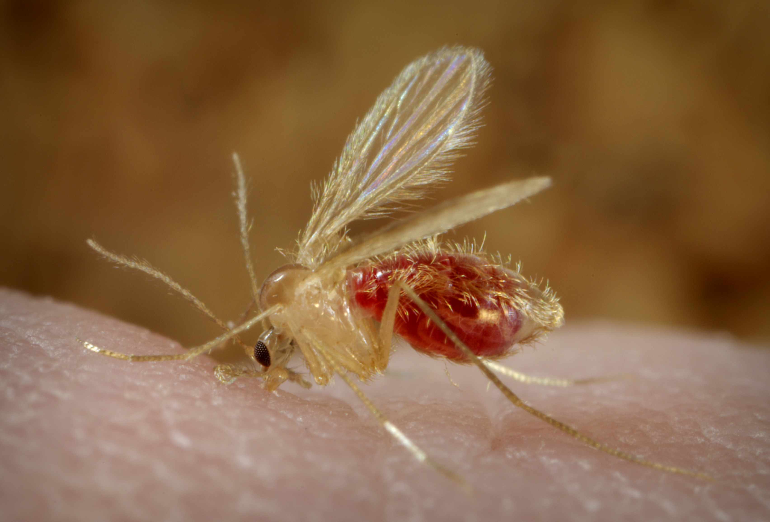
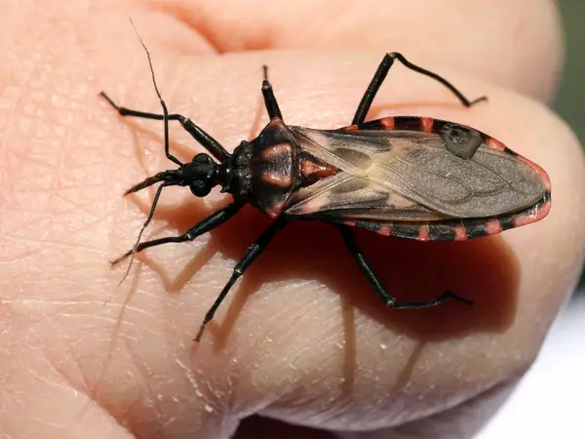
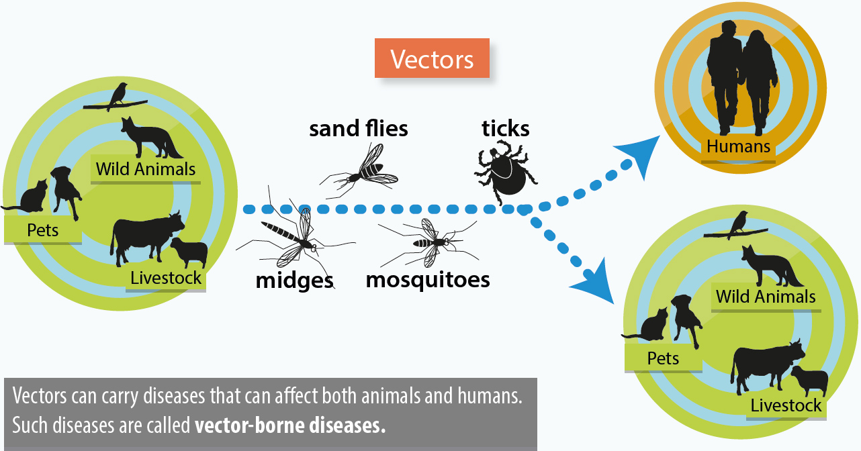
Assessing the potential effects of Global Change Drivers on Vector-Borne Diseases
Melissa Salinas and Teresa Patricia Feria Arroyo
melissa.salinas01@utrgv.edu and teresa.feriaarroyo@utrgv.edu
The University of Texas Rio Grande Valley, Department of Biology, 1201 W University Drive Edinburg, TX 78539, USA
ABSTRACT
MATERIALS & METHODS
RESULTS CONTINUED
Global change drivers such as climate change, deforestation, urbanization, and increased trade and travel, are a cause for concern especially when combined with their potential impact on vector-borne diseases.
Vector-borne diseases are illnesses that are carried by vectors such as mosquitoes, ticks, fleas, and flies. Global change refers to the environmental changes that occur due to human activity.
In the Texas-Mexico transboundary region exists a political border dividing two countries where vector surveillance and management are different.
Given this challenge, the objective of this project is to raise awareness and assess the impact of global change drivers on vector-borne diseases specifically to the Texas-Mexico Transboundary region.
This was done through a literature review of literature pertinent to species interactions, global change, and vector-borne diseases in our study area.
We found that the distribution, seasonality, and prevalence of these vectors and diseases are influenced by global change drivers such as climate factors, deforestation, and an increase in travel.
Literary Research and Publications
After finding relevant information, the articles obtained were read and summarized. This was done to learn about the publication and specify the information that would be used in this literary research project.
Analyzation and Interpretation of Results
After reading and summarizing the data collected, data analysis and interpretation. Maps, spatial distribution, and tables were adapted in order to fully convey the message of how global change affects vector borne diseases.
Collection of Data
Search engines such as Google scholar and the UTRGV Library Databases was used using specific keywords to find publications and literature pertinent to species interaction and vector-borne diseases. This step of the process was broader than the rest.
Published Article | Author and Year | Region | Global Change Driver (CAUSE) | Impacts of Global Change Drivers (EFFECT)
Assessing the potential impacts of a changing climate on the distribution of a rabies virus vector | Hayes & Piaggo 2018 | Texas-Mexico Transboundary Region | Climate Change | Spatial Distribution Breeding Season Habitat Suitability
Deforestation and avian infectious diseases | Senghal 2009 | International | Climate Change Deforestation | Spatial Distribution Breeding Season Habitat Suitability Host Specificity
Zika and chikungunya: mosquito-borne viruses in a changing world | Shrangai et al 2017 | United States | Urbanization Climate Change Human interaction | Spatial Distribution Breeding Season Habitat Suitability Host Specificity
Global Change and Human Vulnerability to Vector-Borne Diseases | Sutherst 2004 | International | Climate Change Deforestation Urbanization Agricultural Land Clearing | Climate Change can cause breeding season to be lengthened in ticks and mosquitoes and cause more spatial distribution due to habitat suitability. Deforestation causes lack of hosts and more irrigation and water breeding sites. Urbanization causes human/ rodent interaction and more container breeding.
INTRODUCTION
RESULTS
What are vector-borne diseases?
Vector-borne diseases are illnesses caused by parasites, viruses and bacteria that are transmitted by vectors to humans and animals.
What are vectors?
Vectors are living organisms that can transmit infectious pathogens between humans, or from animals to humans. Some of these include blood sucking insects, ticks, mosquitoes, and many other organisms.
How do they transmit diseases?
Sometimes these vectors become infected from other animals or humans by taking a blood meal from them. Then, the virus, bacteria, or parasite can either cyclo-propagate, transovarial transmit, propagative transmission, or even mechanical transmit the disease.
Published Article | Author and Year | Region | Global Change Driver (CAUSE) | Impacts of Global Change Drivers (EFFECT)
The Impacts Of Climate Change On Human Health In The United States | Beard et al 2016 | United States of America | Climate Change Land use | Climate change is allowing northward expansion of ticks which carry lyme disease. This is due to land use patterns, precipitation, and rising temperatures.
Pathogenic landscape of transboundary zoonotic diseases in the Mexico–US border along the Rio Grande | Esteve-Gassent et al 2014 | Texas-Mexico Transboundary Region | Climate Change Invasive Species Travel and Transport | Pathogenic landscape and spatial distribution are altered by rising temperatures. Travel and Transport pose a threat to both Texas and Mexico. Invasive Species such as giant reeds make a perfect suitable habitat.
High-resolution predictive mapping for Boophilus annulatus and B. microplus (Acari: ixodidae) in Mexico and Southern Texas | Estrada & Venzal 2006 | Texas-Mexico Transboundary Region | Climate Change Land Use | Spatial distribution of ticks will move northbound and southbound due to climate change and land use for agricultural purposes allowing a more suitable habitat for these species.
Implications of climate change on the distribution of the tick vector Ixodes scapularis and risk for Lyme disease in the Texas-Mexico transboundary region | Feria Arroyo Et Al 2014 | Texas-Mexico Transboundary Region | Climate Change | This article strives to establish more information of how climate change can affect the spatial and temporal distribution of these disease-causing vectors since other studies have not taken this region into account.
A tale of two cities: Aedes Mosquito surveillance across the Texas-Mexico Border | Feria Arroyo et al 2020 | Texas-Mexico Transboundary Region | None, this article was used for comparison of mosquito surveillance techniques. Can fall under travel. | Potential Effects can come from trade, travel, and climate change.
One Health Interactions of Chagas Disease Vectors, Canid Hosts, and Human Residents along the Texas-Mexico Border | Garcia et al 2016 | Texas-Mexico Transboundary Region | None, this article was used to show the prevalence of Chagas disease in this region and how it can impact both countries. | Potential Effects can come from trade, travel, and climate change.
The Effects of Global Change on the Threat of Exotic Arthropods and Arthropod-Borne Pathogens to Livestock in the United States | George and Sparagano 2008 | Texas | Climate Change Trade and Travel Invasive Species | Spread of arthropods throughout the united states is a threat both economically and medically.
Climate Change and Risk of Leishmaniasis in North America: Predictions from Ecological Niche Models of Vector and Reservoir Species | Gonzalez et al 2010 | Texas-Mexico Transboundary Region | Climate Change | Spatial Distribution Breeding Season Habitat Suitability
DISCUSSION
Global Change Drivers can cause increased potential human vulnerability to vector-borne diseases.
Climate Change causes ticks to be more spatially distributed.
Invasive species such as weeds, harbor a perfect habitat for vectors.
Deforestation causes increased surface water for agricultural uses here in the LRGV increasing flooding and increasing breeding grounds for mosquitos.
Increased travel has increased exposure and potential transfer of pathogens between both countries.
What can we do to bring awareness to vector borne diseases and global change issues?
Public Education
Local Government Awareness and Ordinances
Funding for Research on the Texas-Mexico Transboundary Region
Fig 1. Tick. Source: Beard et al 2016
Fig 2. Mosquito. Source: CDC / James Gathany
Fig 3. Mosquito. Source: CDC/ Frank Collins
Fig 4. Kissing bug Source: Reuters / German Portar
REFERENCES
Why are they important? How do they affect us?
They are important especially in the Texas-Mexico Transboundary region because there is a border that divides two countries, but this does not stop the vectors from distribution. They affect us because they cause illness and even economical impact.
ALL REFERENCES ARE IN THE RESULTS TABLE
Beard, C., Eisen, R., Barker, C., Garofalo, J., Hahn, M., Hayden, M., … Schramm, P. (2016). Ch. 5: Vectorborne Diseases. The Impacts of Climate Change on Human Health in the United States: A Scientific Assessment. https://doi.org/10.7930/j0765c7v
Esteve-Gassent, M. D., Leã³N, A. A. P. R. D., Romero-Salas, D., Feria-Arroyo, T. P., Patino, R., Castro-Arellano, I., … Estrada-Franco, J. G. (2014). Pathogenic Landscape of Transboundary Zoonotic Diseases in the Mexicoâ€“US Border Along the Rio Grande. Frontiers in Public Health, 2. https://doi.org/10.3389/fpubh.2014.00177
Estrada-Peña, A., & Venzal, J. (2006). High-resolution predictive mapping for Boophilus annulatus and B. microplus (Acari: ixodidae) in Mexico and Southern Texas. Veterinary Parasitology,142(3-4),350–358. https://doi.org/10.1016/j.vetpar.2006.07.003
Feria-Arroyo, T. P., Castro-Arellano, I., Gordillo-Perez, G., Cavazos, A. L., Vargas-Sandoval, M., Grover, A., … Esteve-Gassent, M. D. (2014). Implications of climate change on the distribution of the tick vector Ixodes scapularis and risk for Lyme disease in the Texas-Mexico transboundary region. Parasites & Vectors, 7(1), 199. https://doi.org/10.1186/1756-3305-7-199
Feria-Arroyo, Teresa Patricia; Aguilar, Consuelo; and Oraby, Tamer, "A tale of two cities: Aedes Mosquito surveillance across the Texas-Mexico Border" (2020). Biology Faculty Publications and Presentations. 20. https://scholarworks.utrgv.edu/bio_fac/20
Garcia, M. N., O’Day, S., Fisher-Hoch, S., Gorchakov, R., Patino, R., Arroyo, T. P. F., … Murray, K. O. (2016). One Health Interactions of Chagas Disease Vectors, Canid Hosts, and Human Residents along the Texas-Mexico Border. PLOS Neglected Tropical Diseases, 10(11). https://doi.org/10.1371/journal.pntd.0005074
Fig 5. General transmission cycle between vectors, animals, and humans. Source: CDC website
OBJECTIVES
ACKNOWLEDGEMENTS
The purpose of this peer-review is to bring awareness to the Transboundary Region of Texas and Mexico. There is information and maps lacking in this area regarding vector-borne diseases and how global change can affect them. Global change drivers are a cause for concern especially in a region that is divided by a border where surveillance efforts are different.
First of all, I would like to thank Dr. Feria for the support through this project and opportunity for allowing me to conduct independent research. I would also like to thank everyone is Dr. Feria’s lab and class especially Victoria Cantu, Gisel Garza, Chelsey Faris, Katherine Alvarez, Yoselin Martinez, Victoria Cantu, Consuelo Aguilar, and Elizabeth Gonzalez, for helping me review and edit as well as welcoming me as part of their team. Thank you to all the authors that focused on the Texas-Mexico Transboundary region, especially Dr. Feria.

