Slide 1
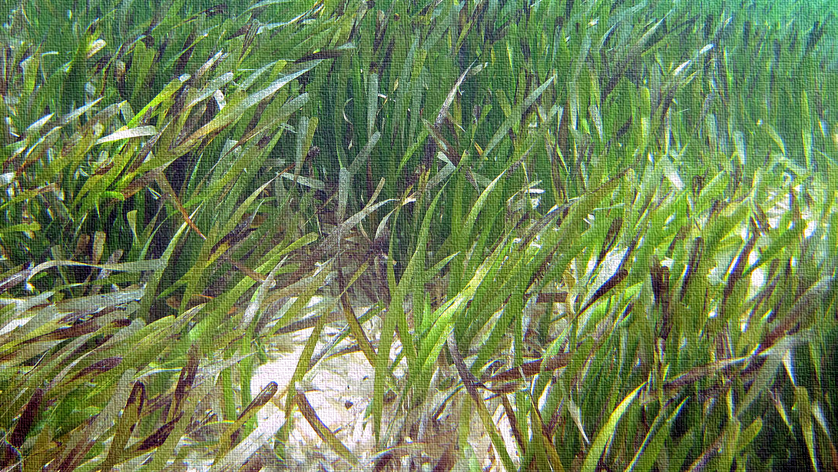
Bare Patch Dynamics of the Seagrass Thalassia Testudinum
School of Earth, Environmental and Marine sciences
Nicole M. Laas and Hudson DeYoe
This Photo by Unknown Author is licensed under CC BY-SA
Notes:
Do not mess with Cover page! Formatting is how COS has requested. Do not change a thing unless its the color!

Slide 2
Seagrass are essential ecological drivers
Provides habitat, breeding ground and food source to marine species
Contributes to ecological biodiversity
Stabilizes sediment
Filters nutrients from the water
Edge of a seagrass meadow and the exposed bare sediment area
Photo courtesy of Dr. Hudson DeYoe
Notes:
Intro to seagrass and seagrass beds what they do why they are important

Slide 3
What are bare patches and what are they doing?
Are patches decreasing or increasing in size?
Two patch types :
1. Sediment only in patch
2. Seagrass shoots absent but viable roots and rhizomes in patch sediment
Notes:
Since they are ecologically important, we should know what they are up to. What are they doing? Are they getting bigger, smaller, staying the same?
Two types of patches
Dead material means sg once was there and now its not
So to answer these questions several experiments were conducted to monitor changes.

Slide 4
Lower Laguna Madre: Site locations and descriptions:
Patches chosen based on:
Size:
- minimum of 250 m² or larger
Location:
- NE, NW, SE, SW
Seagrass:
- Thalassia testudinum
Notes:
Intro to photo regions

Slide 5
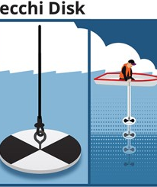
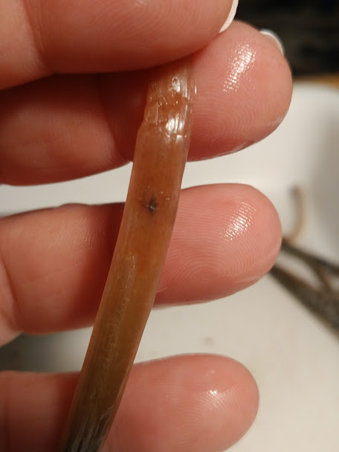
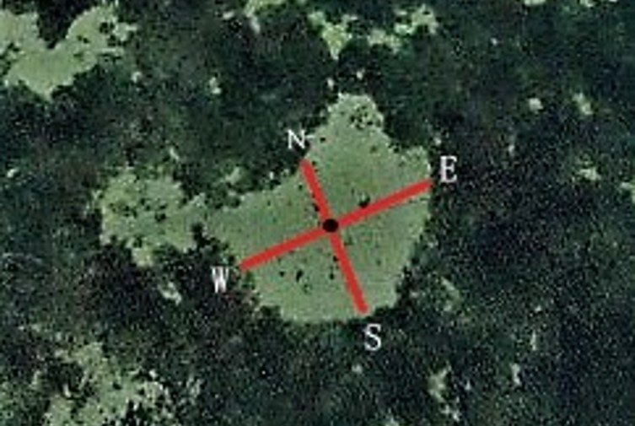
Materials and Methods
Gap dimensions
Water Clarity
Seagrass biomass
Seagrass growth
Notes:
Began observing and measuring gap dimensions
We noticed they were not moving as much as suspected
Other factors such as water clarity, growth and BM all provide information that can help determine whether the SG are healthy

Slide 6
Gap Dimension change
Statistical analysis show movement rate is not significant
Pattern not detected over the one-year study
Edge activity varies between patches
Northwest region patch movement for site 129
Notes:
Graphs pretty much all show the same data which is not statistically relevant indicating changes in gap shapes are slower than anticipated. So although changes are noticeable on graphs the change is slow and varies at each patch.

Slide 7
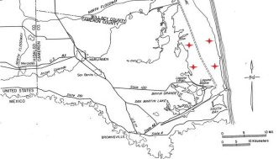
Materials and Methods: Water clarity / light
Notes:
Water clarity has various factors including wind and wave action that are more prominent in the western regions than the east. Eastern areas have barrier island protection and water clarity is generally better. SG need light to grow so this impacts that ability and changes the way they grow.. Leading to next slide.

Slide 8
Seagrass growth: Monthly blade elongation trends among regions March, May, June 2018
Site | Region | Average PCD patch center depth | Average depth M | Average Secchi
119 | NE | 1.09 | 1.05 | 1.04
131 | NW | 0.80 | 1.45 | 0.53
123 | SE | 1.45 | 1.46 | 1.39
137 | SW | 1.17 | 1.18 | 0.57
EDGE |  |  |  |  |  | REFERENCCE
March | 173 | NE | 117 | 15.23 |  | March | 173 | NE | 117 | 20.43
May | 173 | NE | 117 | 40.27 |  | May | 173 | NE | 117 | 36.89
June | 173 | NE | 117 | 42.91 |  | June | 173 | NE | 117 | 35.28
March | 170 | NW | 127 | 20.25 |  | March | 170 | NW | 127 | 24.92
May | 170 | NW | 127 | 42.66 |  | May | 170 | NW | 127 | 40.85
June | 170 | NW | 127 | 57.40 |  | June | 170 | NW | 127 | 45.73
March | 175 | SE | 126 | 9.73 |  | March | 175 | SE | 126 | 5.77
May | 175 | SE | 126 | 32.59 |  | May | 175 | SE | 126 | 36.43
June | 175 | SE | 126 | 49.57 |  | June | 175 | SE | 126 | 49.34
Notes:
Here you can talk about how sediment and light play a role in leaf width and length and that areas to the west generally have more suspended sediment contributing to longer leaves

Slide 9
Seagrass growth: Monthly blade Length and Width trends among regions March, May, June 2018
Notes:
Here you can talk about how sediment and light play a role in leaf width and length and that areas to the west generally have more suspended sediment contributing to longer leaves

Slide 10
Seagrass biomass
Higher biomass = higher productivity.
Assumption: during the summer growing season biomass would be higher along the edges
Notes:
Began observing and measuring gap dimensions
We noticed they were not moving as much as suspected
Other factors such as water clarity, growth and BM all provide information that can help determine whether the SG are healthy

Slide 11
conclusions
Generalizing assumptions about bare patches is challenging
They are individuals
Bare patch edges do not act uniformly
They all do different things at different times
Various factors impact change

Slide 12
Questions?
Special thanks to my advisor and mentor Dr. Hudson DeYoe for his guidance and patience along with Dr. Warren Pulich Jr. of Texas State University and the countless volunteers who helped with the project and the OCES program for the opportunity to present this research.

