Slide 1
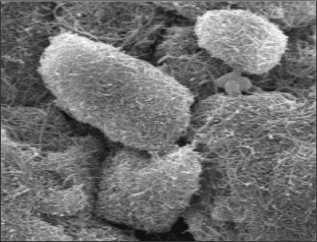
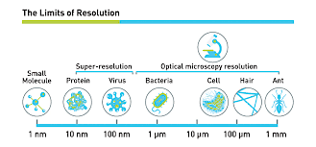
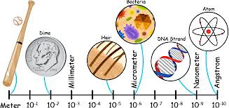
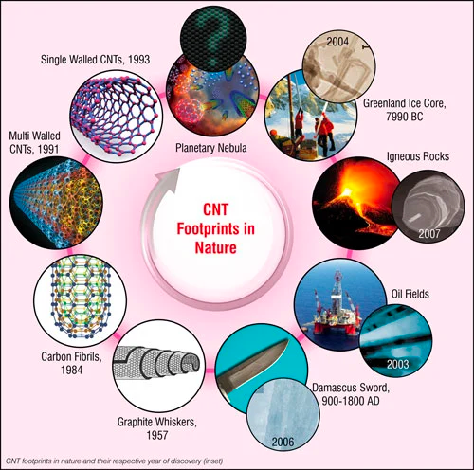
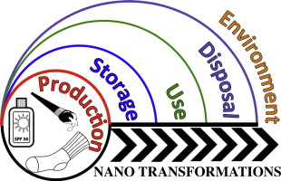
A Review of The Toxic Effects of Carbon Nanotubules on Microorganisms
K. Zarzosa, K. Lowe
¹Department of Biology, University of Texas Rio Grande Valley, Edinburg, TX.
Kusy.zarzosa01@utrgv.edu, Kristine.lowe@utrgv.edu
Summary
Scanning Electron Microscopy
Results
Carbon-based nanomaterials and their composites possess promising applications in a wide range of fields such as electronics, biomedical aids, membranes, and flexible wearable sensors.
Carbon nanotubes (CNT) are a therapeutic nano tool in biology, biomedical science, agriculture, environmental science and biotechnology.
Studies have shown that CNT display antibacterial and anti-fungal properties.
Different CNT concentrations and nanotube types were effective against Gram-positive and Gram-negative bacteria
Different CNT concentrations affect Pseudomonas aeruginosa and the opportunistic fungus Candida albicans.
However, the issue of cytotoxicity of CNTs is an area that has not resulted in a definitive answer yet. Here we present examples of CNT toxic effects and preliminary data of the antimicrobial mechanisms of carbon nanotubes (CNTs).
In contrast, a more recent study revealed that a specific microorganism, Staphylococcus epidermidis, displayed increased growth rates and changes in gene expression when exposed to low concentrations of CNT.
Housekeeping genes expressed by S. epidermidis
Gene | Possible Function | Small CNT
gatA, B | Encodes for subunits of glutamyl-tRNA amidotransferase; amino acid synthesis | x
groEL, ES | Encode for heat shock proteins | x
infA, C | Encodes for Translation Initiation Factor IF-1 | x
rplA-C, E-F, J,L, Q, R-V | Encodes for Ribosomal Protein L1-L3, (L-5, L-6, L-10, L-12, 17-21) in the large subunit | x
rpmA, B, D, G, E2, J | Encodes for Ribosomal Protein L27-28, (L-33, L-36) in the large subunit | x
rpsB-F, H-U | Encodes for Ribosomal Protein S2 in the small subunit | x
SecA, Y | Involved in protein secretion | x
sucA-C | Involved in the Krebs Cycle | x
tuf | Translation elongation factor | x
ureA - C | Genes of the urease operon; encode for the production of urease | x
Figure 2. Carbon nanotubes (CNTs) are cylindrical molecules that consist of rolled-up sheets of single-layer carbon atoms (graphene). They can be single-walled (SWCNT) with a diameter of less than 1 nanometer (nm) or multi-walled (MWCNT), consisting of several concentrically interlinked nanotubes, with diameters reaching more than 100 nm.
Table 1. Genes of S. epidermidis grown in the presence of small carbon nanotubules that were significantly expressed compared to controls.
Number of Genes Expressed in Treatments But Not Controls
Found Only in Small CNT Treatment | 19
Found Only in Medium CNT Treatment | 12
Found in Only Large CNT Treatment | 2
Found in All Treatments | 69
Figure 3. SEM Representative image of a carbon nanotubule (CNT) showing the length-to-diameter ratio.(top left). CNT typically are nanometers in length compared to micrometers in diameter. Photo credit: Nano Technology Overview 2017 (www.nanoscience.com).
Figure 4. Number of genes expressed by S. epidermidis grown in the presence of small, medium or large carbon nanotubule but not expressed in control cultures.
Review of Toxic Effects
Discussion & Future Work
Introduction
The study concluded that CNT positively affected the growth rate and gene expression by S. epidermidis, a bacterium found as part of the human microflora, in a size-dependent manner. Smaller CNT caused higher growth rates and higher rates of gene expression changes compared to larger CNT. Numerous genes were upregulated in the presence of CNT.
A 2013 study of Staphylococcus aureus, Pseudomonas aeruginosa and the opportunistic fungus Candida albicans, results showed that all the carbon nanotube types possess a highly significant antimicrobial capacity. Their data suggested that the reduced capacity of microbial cells to forming colonies and their oxidative response could be related to the cellular stress induced by the interactions of pathogens with the CNTs.
A 2007, study proposed that a purified single-walled carbon nanotubes (SWNTs) exhibit strong antimicrobial activity, by using a pristine SWNT with a narrow diameter distribution, they demonstrated that cell membrane damage resulting from direct contact with SWNT aggregates is the likely mechanism leading to bacterial cell death.
In a 2012 review, carbon nanotube and graphene-based materials were highlighted as a current opinions within the scientific community on the toxicity and safety of these carbon structures; where physicochemical characteristics, such as diameter, length, presence of impurities, surface functionalization, and surface wettability were factors considered. They concluded Nanotoxicity Mechanisms in the lungs, Subcellular localization and intracellular trafficking based on how the CNTs entered the cell (active transport via endocytosis, phagocytosis and pinocytosis ).
Similar studies showed that single-wall CNT were toxic to fungal cells and had antibacterial properties against Escherichia coli ATCC 41570, Streptococcus faecalis and Staphylococcus aureus. In contrast, a more recent study revealed that a specific microorganism, Staphylococcus epidermidis, displayed increased growth rates and changes in gene expression when exposed to low concentrations of CNT.
Given the inconclusive state of these nanotoxicology studies, more systematic biological evaluations of CNTs having various chemical and physical properties are warranted in order to determine their cytotoxicity, and optimal dosages.
Evaluation of precise pharmacokinetics
Functionalized CNTs, guidance needed from agency, currently no clear regulations
We should consider the ecological affects of use and disposal CNTs composites.
Next steps include:
In-vivo studies for environmental risk hazards
Antibacterial sensitivity testing of surrogate pathogen to CNT
CNTs are mainly used as additives to synthetics and are commercially available as a powder
CNTs functionalized, surface is chemically adapted for optimal incorporation into different materials and for the specific application
Image not to scale
References and Acknowledgement
CNTs materials promise to offer increased wear resistance and breaking strength, antistatic properties as well as weight reduction
CNT membrane as part of future energy-efficient water purification.
Ashley N. Vasquez, et all 2018, THE EFFECTS OF CARBON NANOTUBULES ON THE GROWTH RATE, BIOFILM FORMATION AND GENE EXPRESSION OF STAPHYLOCOCCUS EPIDERMIDIS.
Fisher, C., Rider, A. E., Jun Han, Z., Kumar, S., Levchenko, I., and Ostrikov, K. K. (2012). Applications and nanotoxicity of carbon nanotubes and graphene in biomedicine. J. Nanomater. 2012:315185. doi: 10.1155/2012/315185
Olivi, M.; Zanni, E.; De Bellis, G.; Talora, C.; Sarto, M.S.; Palleschi, C.; Flahaut, E.; Monthioux, M.; Rapino, S.; Uccelletti, D.; et al. Inhibition of Microbial Growth by Carbon Nanotube Networks. Nanoscale 2013, 5, 9023–9029.
Kang, S., Pinault, M., Pfefferle, L. D., and Elimelech, M. (2007). Single-walled carbon nanotubes exhibit strong antimicrobial activity. Langmuir 23, 8670– 8673. doi: 10.1021/la701067r
Zau, X., Zhang, L., Wang, Z., and Luo, Y. (2016). Mechanisms of the antimicrobial activities of graphene materials. J. Am. Chem. Soc. 138, 2064–2077. doi: 10.1021/ jacs.5b11411
This work was supported by UTRGV alumni Ashley Vasquez, we thank her for the most recent data provided.
Figure 1. Carbon nanotube enabled nanocomposites are alternatives to conventional composite materials due to their mechanical, electrical, thermal, barrier and chemical properties such as electrical conductivity, increased tensile strength, improved heat deflection temperature, or flame retardancy.

