Slide 1
Nanodiamond-based antiretroviral drug delivery to the brain
UTRGV College of Science (COS)
Annual Research Conference (ARC)
20 November 2020
Earl Novilla
Co-mentors: Dr. Shizue Mito, Department of Chemistry; Dr. Upal Roy, Department of Health and Biomedical Science

Slide 2
The neurological problem of HIV/AIDS
HIV/AIDS affects an estimated 1.2 million people in the US as of 2018
approx. 14% of affected individuals are unaware of their infection
Since its epidemic emergence, HIV treatments have incredibly progressed
Fewer complications related to the disease
Patients live much longer with current established clinical regimen
Patients who live longer are at increased risk for neurological conditions
Neurological decline may be compounded by HIV infection (HIV-associated neurological disorder, or HAND)
Infection of neurological organ reservoirs causes neurotoxin secretion, which results in encephalopathy
Difficult to treat with anti-HIV drugs alone due to the action of the blood brain barrier (BBB)

Slide 3
Nanodiamond-based medicine
ND: a diamond particle of size below 1 micrometre
Produced by large impact events
Nanodiamond (ND) is largely researched in the development for targeted drug delivery pathways
Pathogenic disease
Chronic illness
Cancer
Our previous studies characterized ND with important properties for use in targeted delivery (Roy et al, 2018)
Biocompatible
Nontoxic
Molecular adsorption
Capable of passing through the blood brain barrier (BBB) with attached molecules

Slide 4
Objective: The goal of this ongoing investigation is to harness the molecular properties to nanodiamond to develop an anti-HIV drug delivery pathway targeted to the brain for the treatment of HIV-associated neuropathologies.

Slide 5
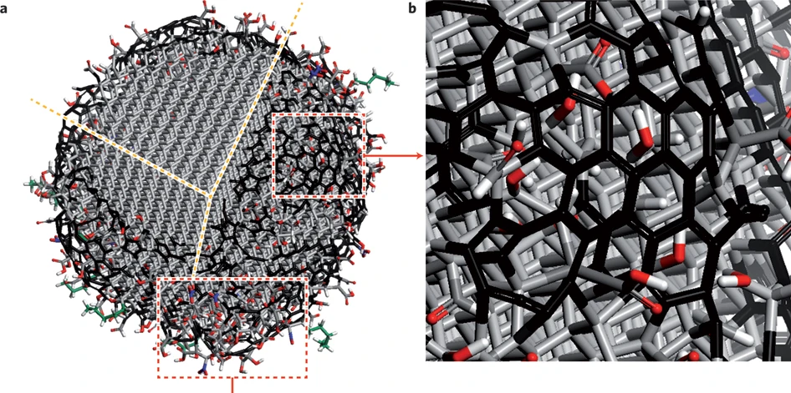
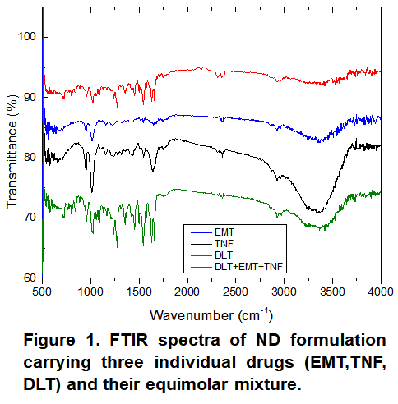
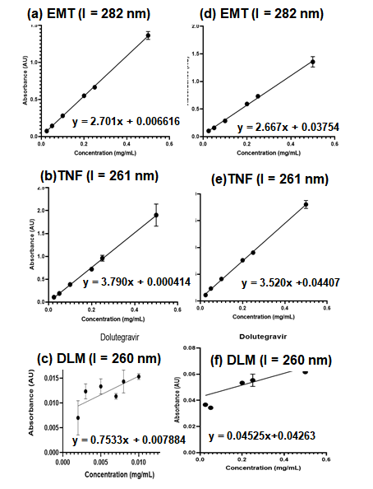
Nanoformulation process
Mochalin, V., Shenderova, O., Ho, D. et al. The properties and applications of nanodiamonds. Nature Nanotech 7, 11–23 (2012). https://doi.org/10.1038/nnano.2011.209
Biofunctionalization is achieved by surface modification
Noncovalent adsorption through weak chemical interaction (e.g. H-bonding, electrostatic force, π-π stacking, van der Waals forces, and hydrophobic/hydrophilic interaction
More stable and specific linkage by covalently bonding biomolecules or functional groups
Emtricitabine
Tenofovir
Figure 2. Calibration curves of emtricitabine (EMT), tenofovir (TNF), and dolutegravir (DLM) : (a)-(c) in DMSO:H2O = 1:9, (d)-(f) in PBS
Dolutegravir

Slide 6
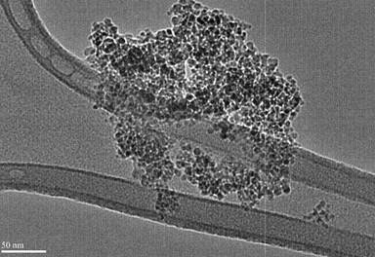
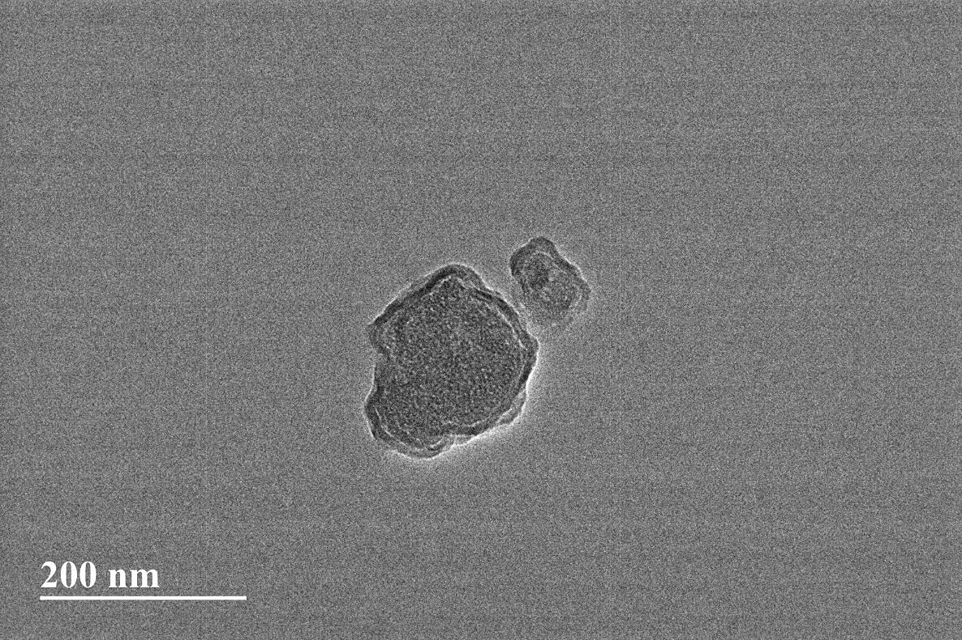
Formulation process (cont)
Nanodrug formulations are encapsulated by a silica coat for...
Added structural support
Colloidal stability
The silica coat described is characterized by the following properties (Bumb et al, 2013)
Nontoxic
Biocompatible
Lyophilic in aqueous and nonaqueous solutions
Si(OC₂H₅)₄ + 2 H₂O → SiO₂ + 4 C₂H₅OH
Tetraethyl orthosilicate (TEOS) reacts with water in a phospholipid reaction vessel to form silica
Catalyzed by triethylamine (TEA), an ammonia-based compound
Figure 3. TEM micrograph of unencapsulated nanodrug (top) and encapsulated nanodiamond (bottom) particles

Slide 7
Cellular uptake study
Examine the efficacy of microglia-cell mediated endocytosis of nano-drug in an in vitro biological system
Human HMC-3 microglia
Examined using nano-drug formulations of dolutegravir, emtricitabine, and tenofovir
Cellular uptake will be evaluated by high performance liquid chromatography (HPLC)
Cell uptake of nanoformulated drug is expected to be comparable or improved compared to free (unformulated) drug (Solarska-Ściuk et al, 2014)
Figure 4. Micrograph of intracellular uptake of nano-drug by human microglial (HMC-3) cells in Eagle’s Minimal Essential Medium (EMEM)

Slide 8
Future studies
in vitro dissolution of nano-drug formulation (Roy et al, 2015)
Analyze sustained drug release profile of nano-drug in BBB model
Nano-drug is expected to show improved sustained release over free drug
Mouse model study
Characterize the targeted drug delivery in a biological system
Evaluate the efficacy of the proposed pathway before furtherance to clinical trials

Slide 9
Acknowledgements
Collaborative team
Dr. Upal Roy, UTRGV, College of Health Professions, Department of Health and Biomedical Sciences (collaborative investigator)
Dr. Shizue Mito, UTRGV, College of Sciences, Department of Chemistry (collaborative investigator)
Dr. Vadym Drozd, FIU, College of Engineering and Computing, Department of Mechanical and Materials Engineering (collaborative investigator)
Mrs. Deepa Roy, UTRGV, College of Health Professions, Department of Health and Biomedical Sciences (research coordinator)
Funding
This work is supported by National Institutes of Health grants (1R15NS108815-01).

Slide 10
References
Bumb, Ambika, et al. "Silica Encapsulation of Fluorescent Nanodiamonds for Colloidal Stability and Facile Surface Functionalization." Journal of the American Chemical Society, vol. 135, 2013, pp. 7815-7818.
Katarzyna Solarska-Ściuk, Agnieszka Gajewska, Sława Glińska, Maciej Studzian, Sylwia Michlewska, Łucja Balcerzak, Janusz Skolimowski, Bogumiła Kolago, Grzegorz Bartosz, Intracellular transport of nanodiamond particles in human endothelial and epithelial cells, Chemico-Biological Interactions, Volume 219, 2014, Pages 90-100, ISSN 0009-2797. https://doi.org/10.1016/j.cbi.2014.05.013
Mochalin, V., Shenderova, O., Ho, D. et al. The properties and applications of nanodiamonds. Nature Nanotech 7, 11–23 (2012). https://doi.org/10.1038/nnano.2011.209
Roy, Upal et al. Characterization of Nanodiamond-based anti-HIV drug Delivery to the Brain. Science Reports. 25 January 2018. doi:10.1038/s41598-017-16703-9.
Roy, Upal, et al. Preparation and characterization of anti-HIV nanodrug targeted to microfold cell of gut-associated lymphoid tissue (Anti-HIV activity of nanodrug). International Journal of Nanomedicine, volume 10, p. 5819-5835. 2015. Doi: 10.2147/IJN.S68348

