Slide 1
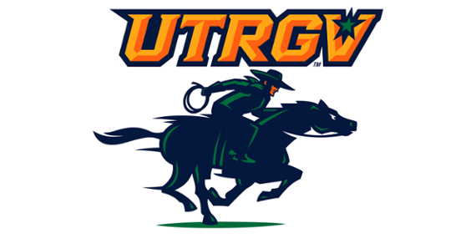
Functionalized Cotton Fibers with Self-Cleaning, UV-Shielding and Energy Generation Capability
Valeria Suarez Vega, Carolina J Olivares, Isaac Martinez, M. Jasim Uddin
Photonics and Energy Research Laboratory
Dr. Uddin
COS Annual Research Conference

Slide 2
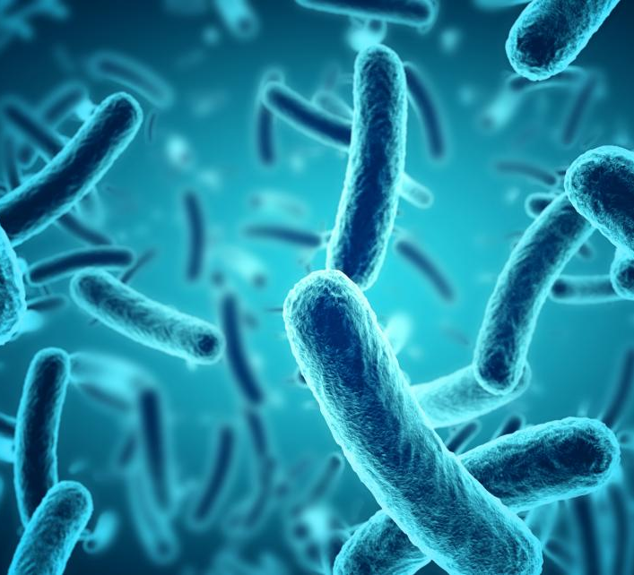
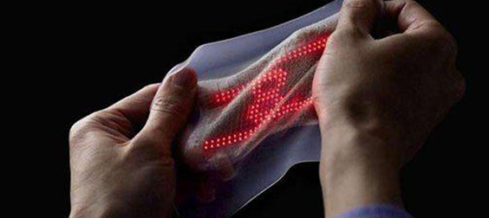
Introduction
Co
Composite fabric consists of three individual coated with molecules that give rise to extra functionalities.
TiO₂ :UV-Blocking and Self-Cleaning.
Polypyrrole (PPY): Electroactive.
PVDF: Energy Harvesting.

Slide 3
Materials and Methods
TiO₂ coating of fibers.
_{Ag doping.}
Photocatalytic degradation of MB.
_{UV Protection studies.}
In Situ Polymerization of Polypyrrole on Cotton Fibers.
_{Ag and I doping.}
_{PVDF.}
_{Nanogenerator assembly.}
Morphological and Electrical Characterization.

Slide 4
Morphological Characterization
PPY coated cotton fibers.
Ag-PPY coated cotton fibers.
c & d) I-PPY coated cotton fibers.

Slide 5
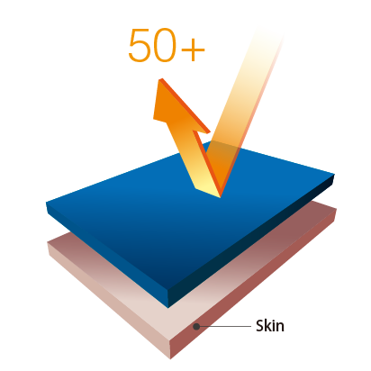
UV-Blocking Properties of TiO₂ and Ag-TiO₂ Coated Cotton Fibers

Slide 6
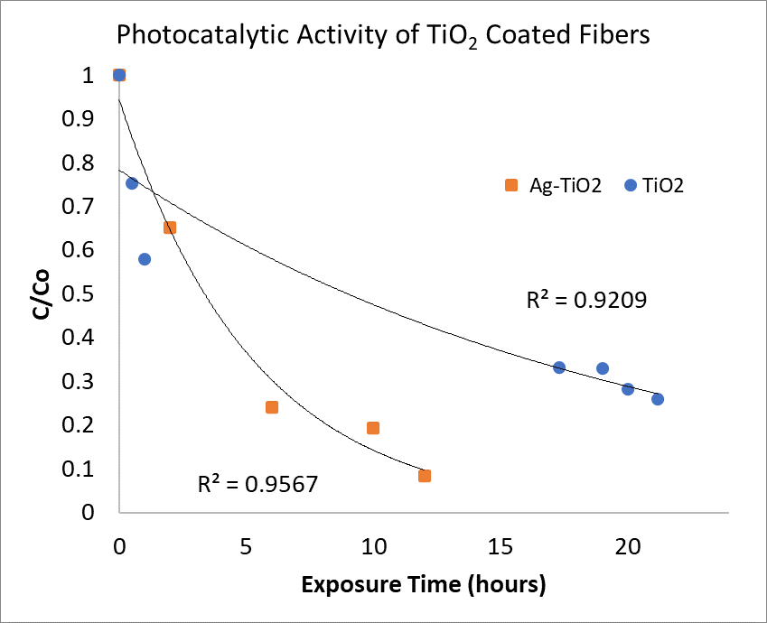
Self-Cleaning Cotton: Photocatalytic Degradation of Methylene Blue

Slide 7
Electrical Characterization of Polypyrrole Coated Cotton
. Current vs Voltage(I-V) graph showing the ohmic behavior of (a) Polypyrrole
(b) Ag-Polypyrrole
(c) I-Polypyrrole conductive fibers.
(d) Picture of Polypyrrole coated cotton strand.

Slide 8
Conclusion
UV-Blocking Properties of TiO₂ coated cotton fibers demonstrated.
Self-cleaning properties of TiO₂ coated cotton fibers.
Ability to conduct electricity by PPY coated cotton fibers.
Generation of electricity by piezoelectric and triboelectric effect of textile based nanogenerator.
Proposed antimicrobial activity based on previous studies.

Slide 9
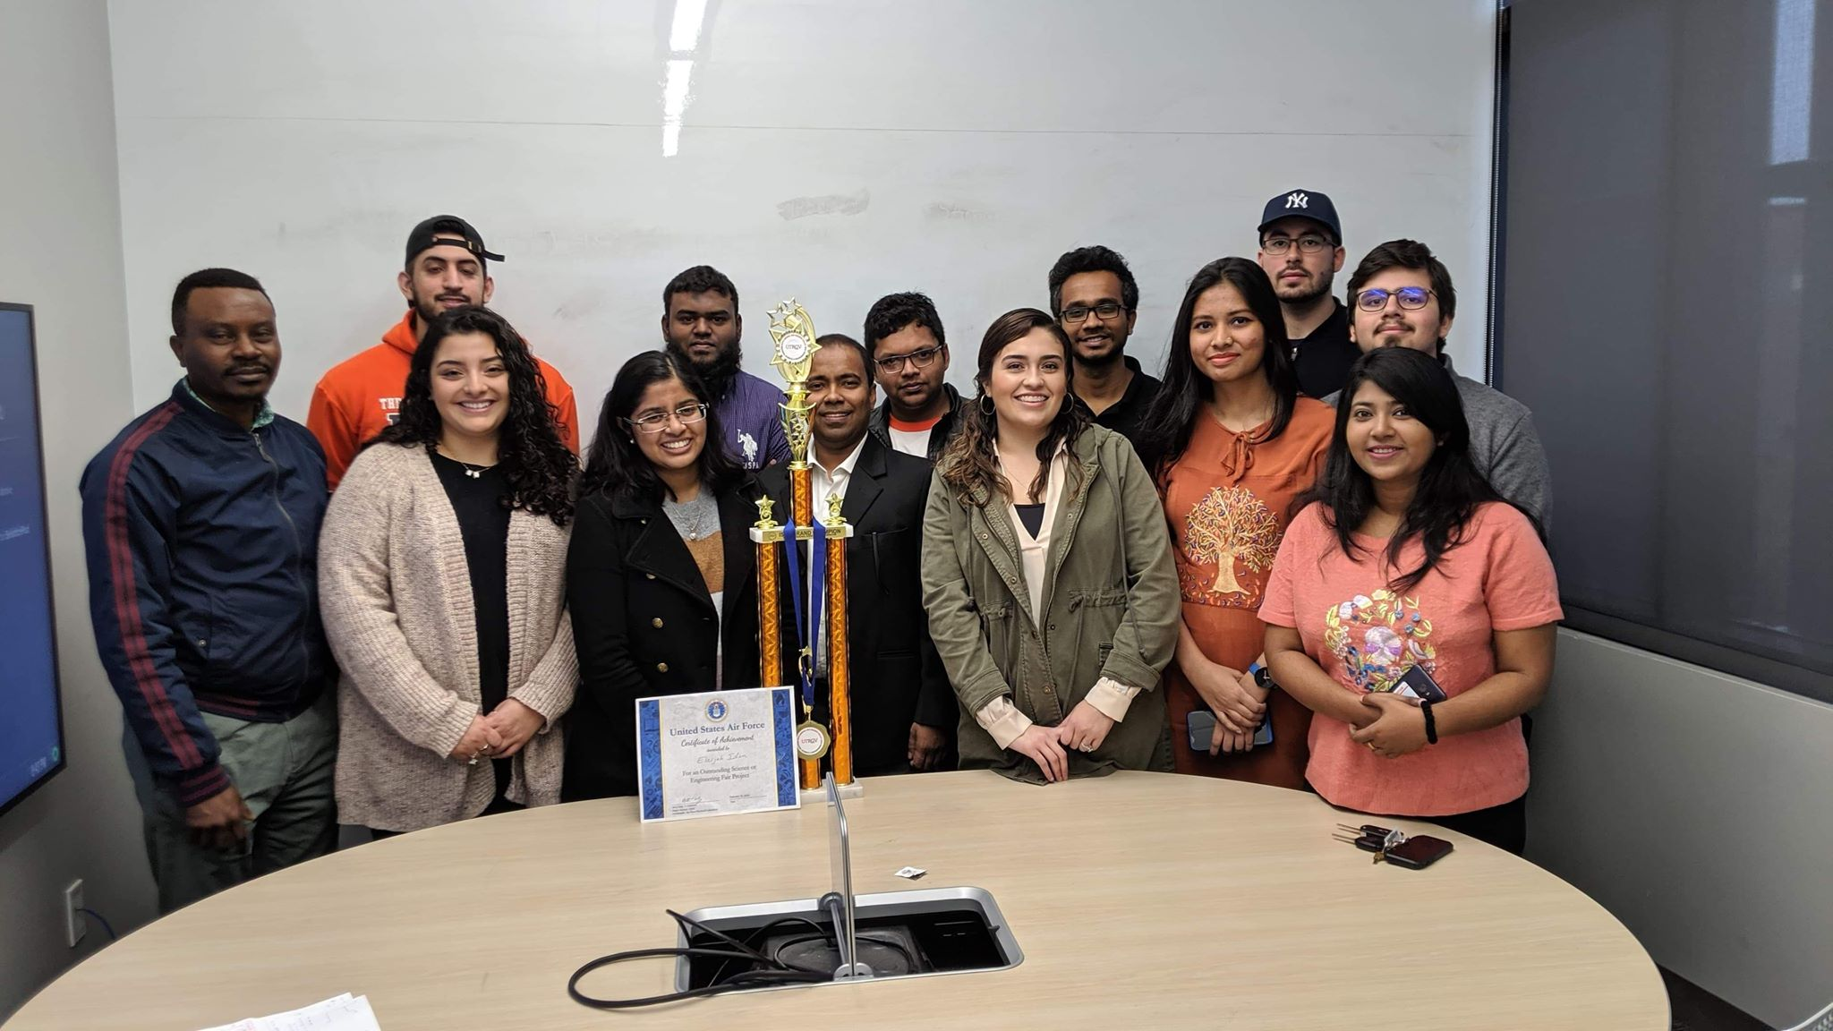
Thank you!
?

