Slide 1


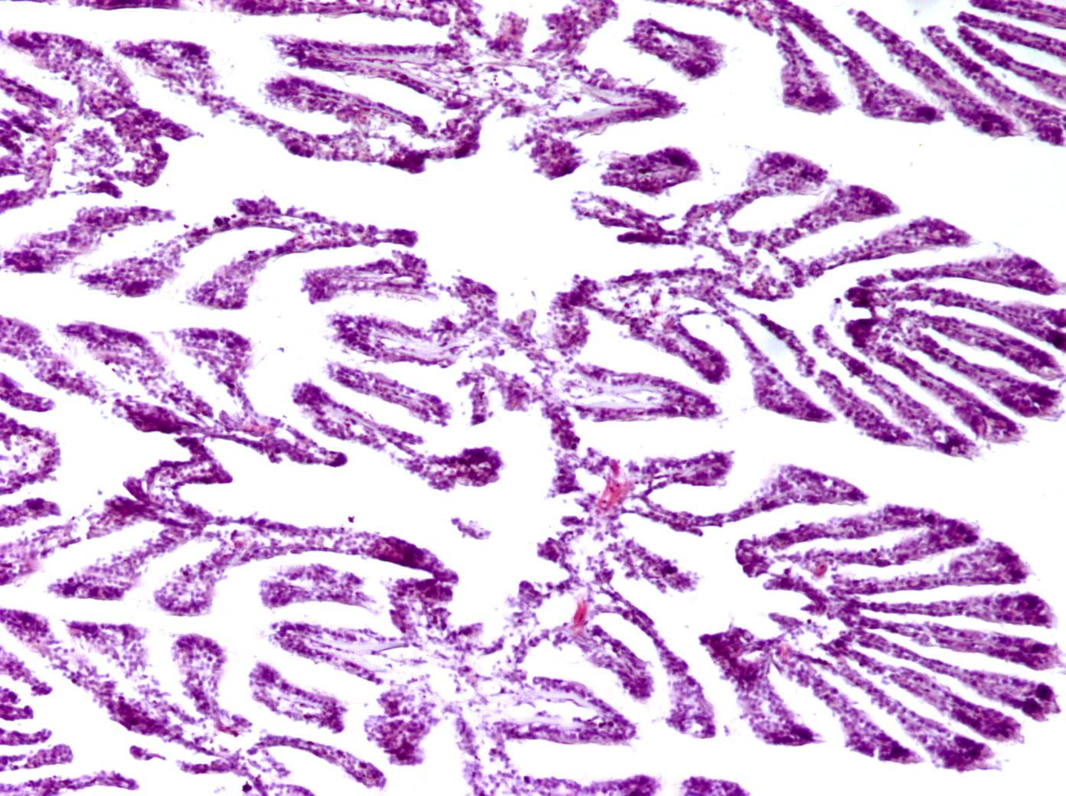
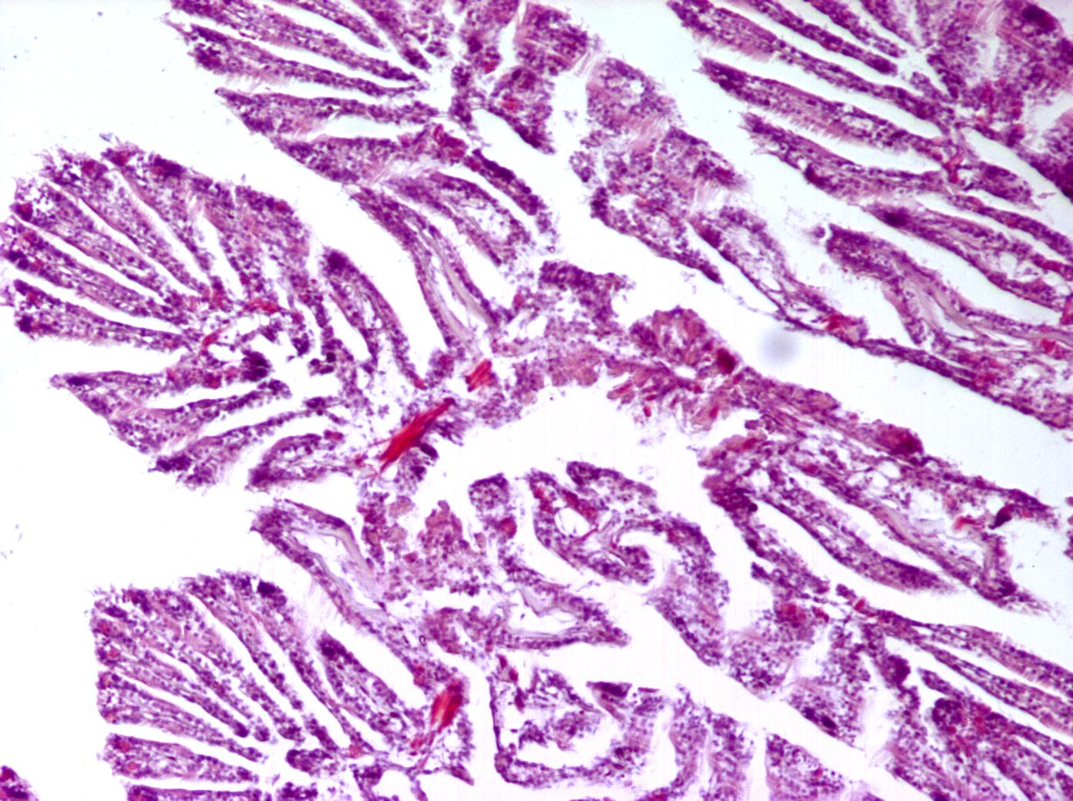
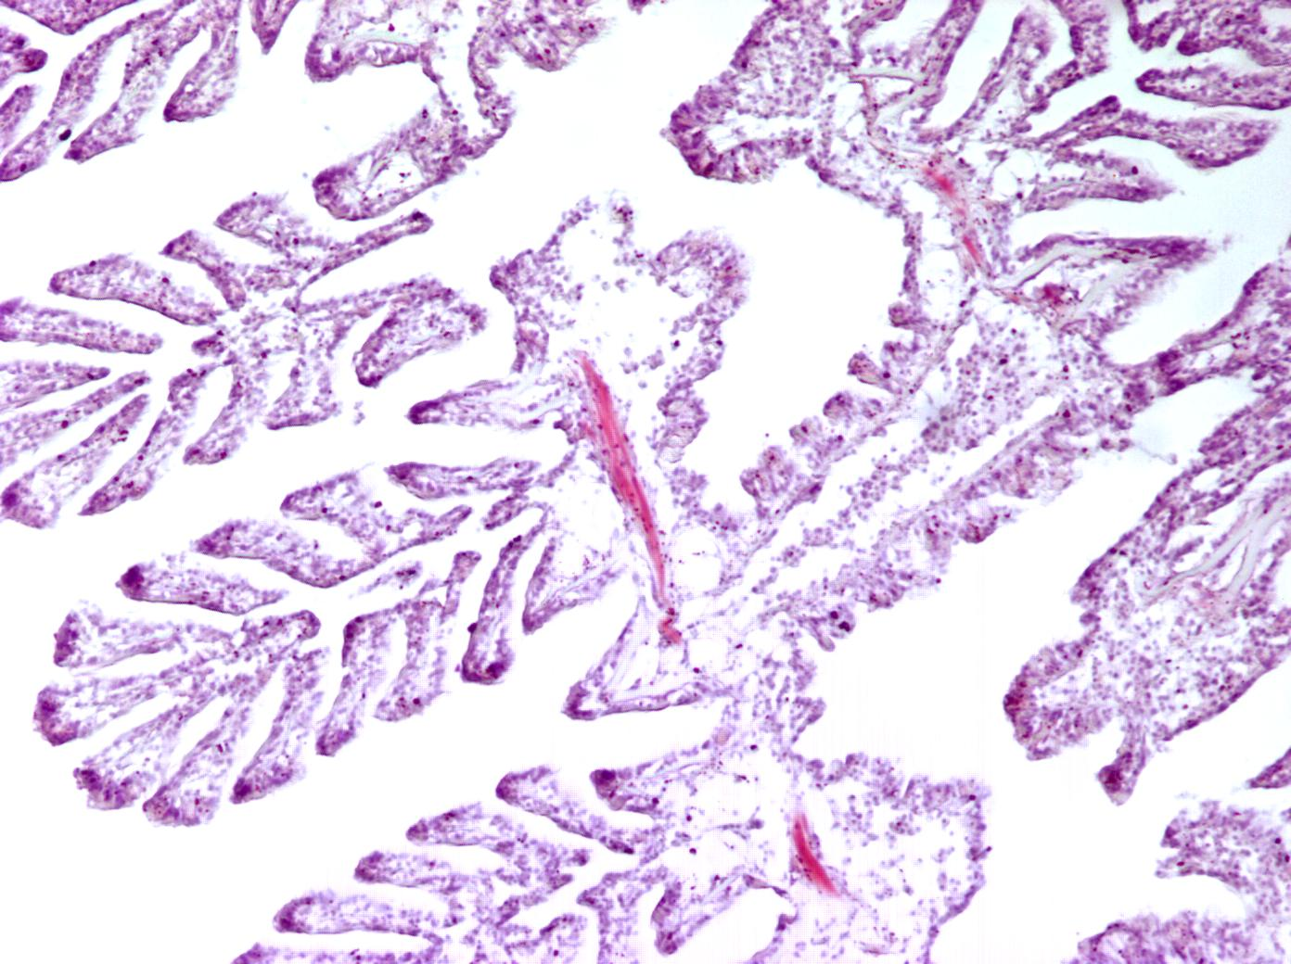
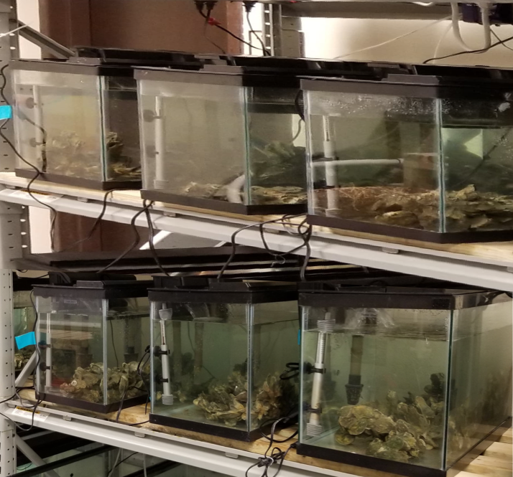
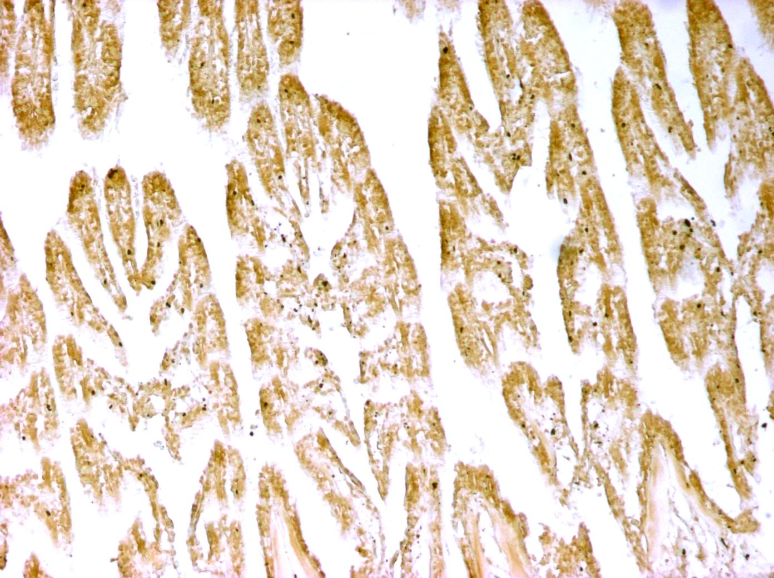
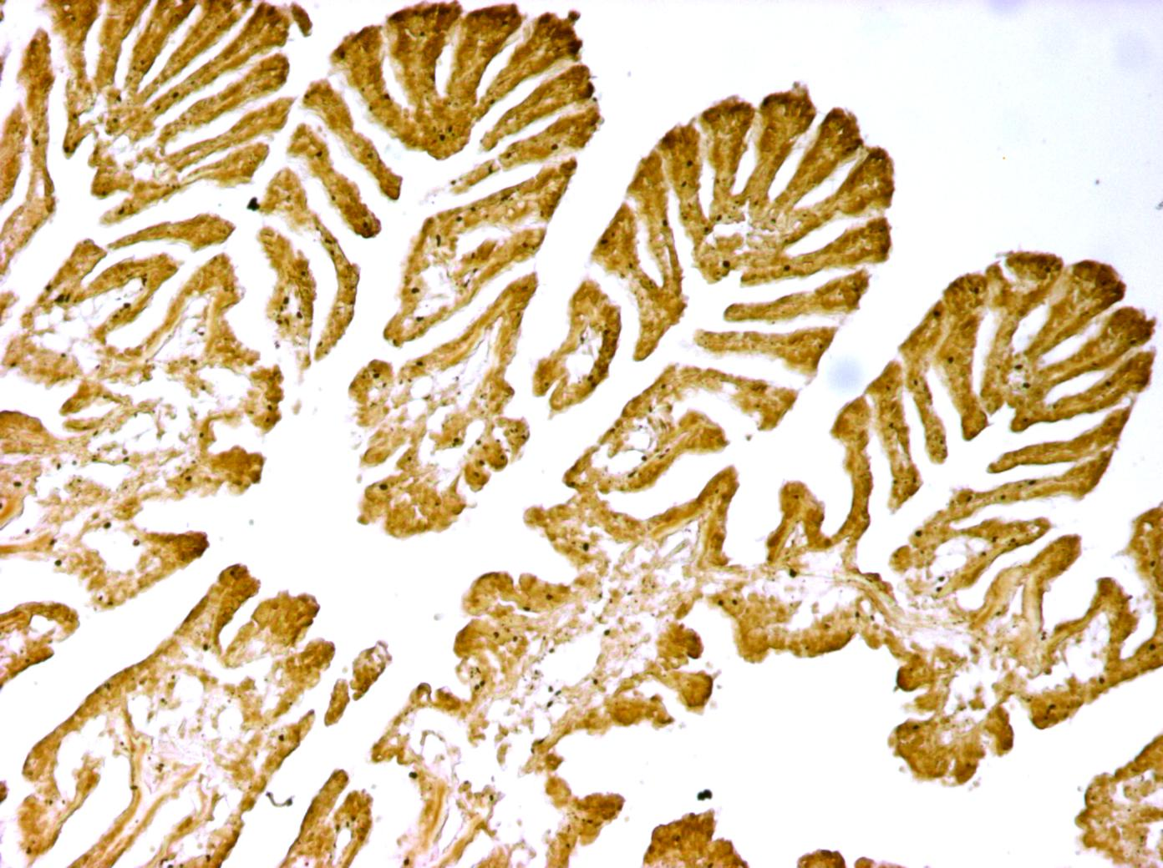
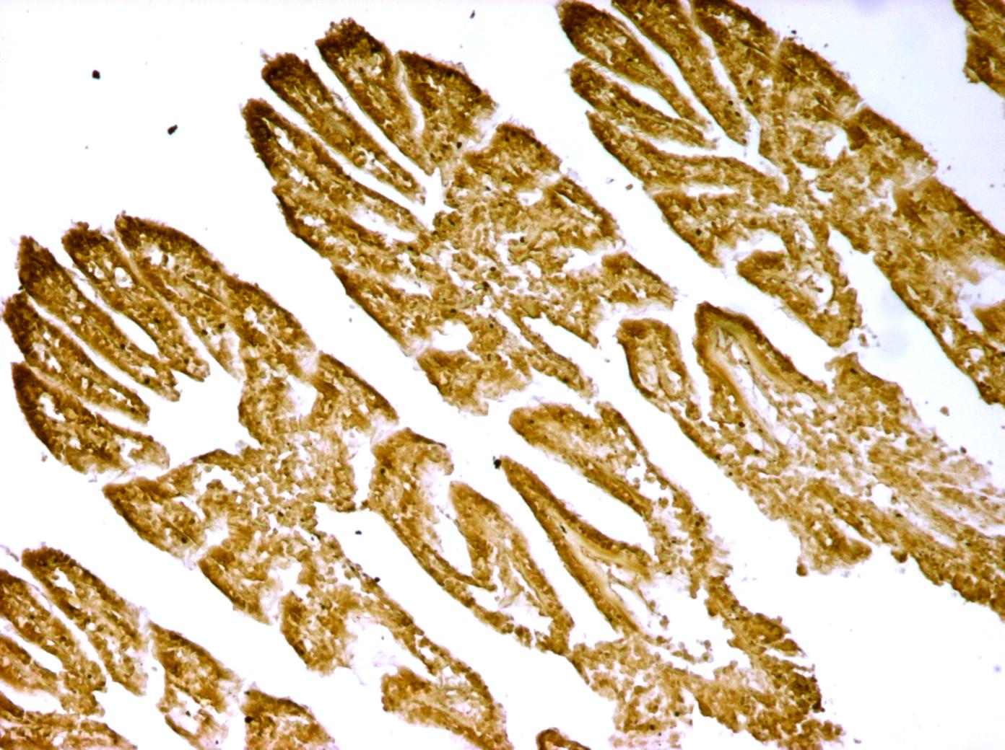
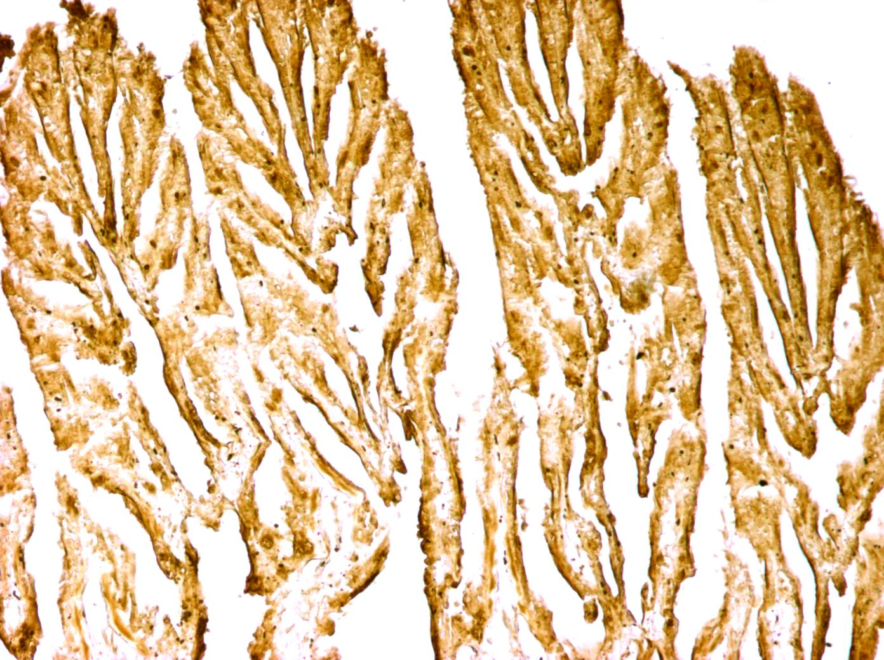
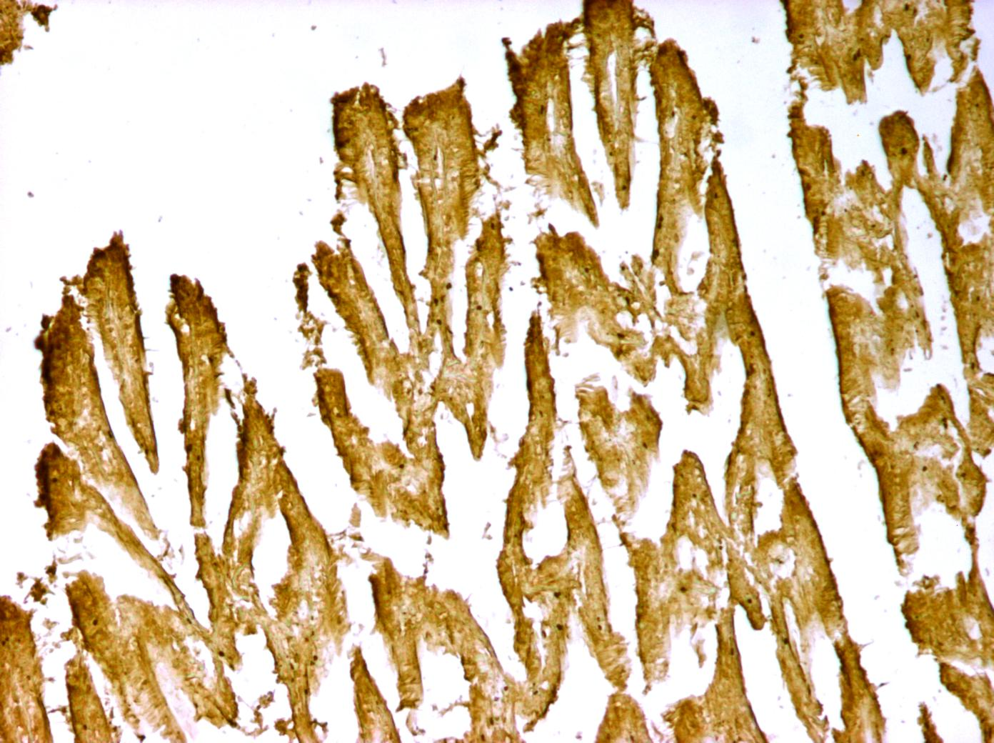
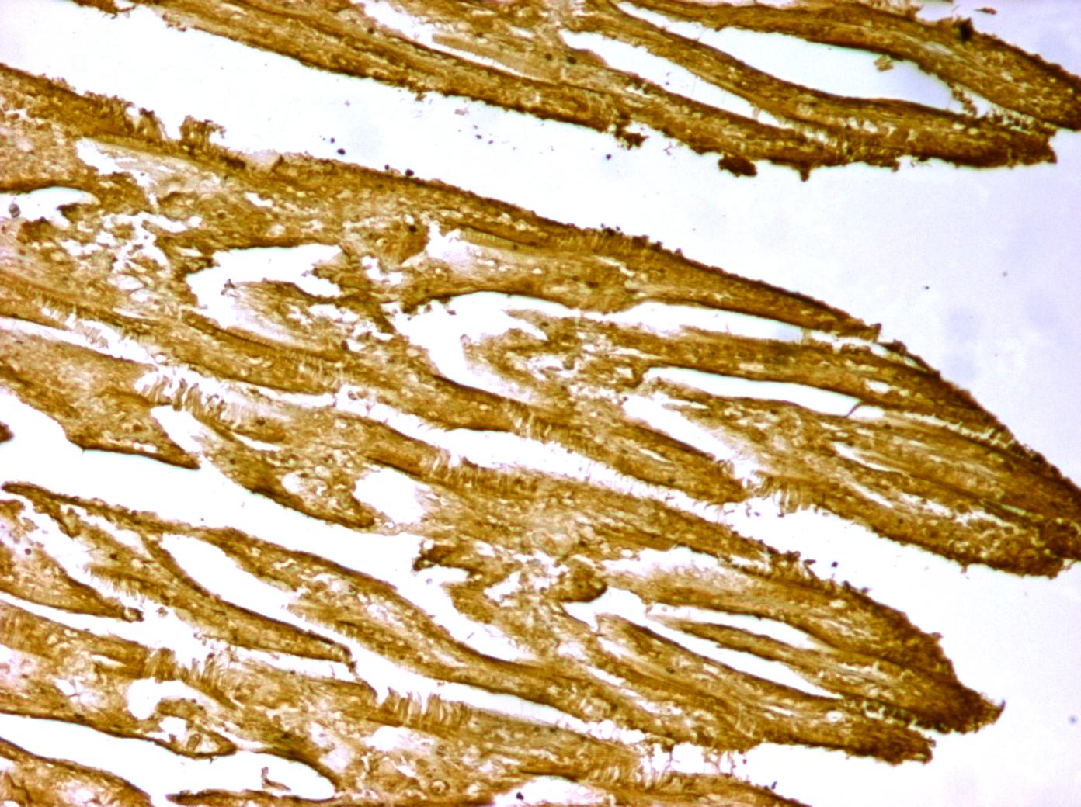
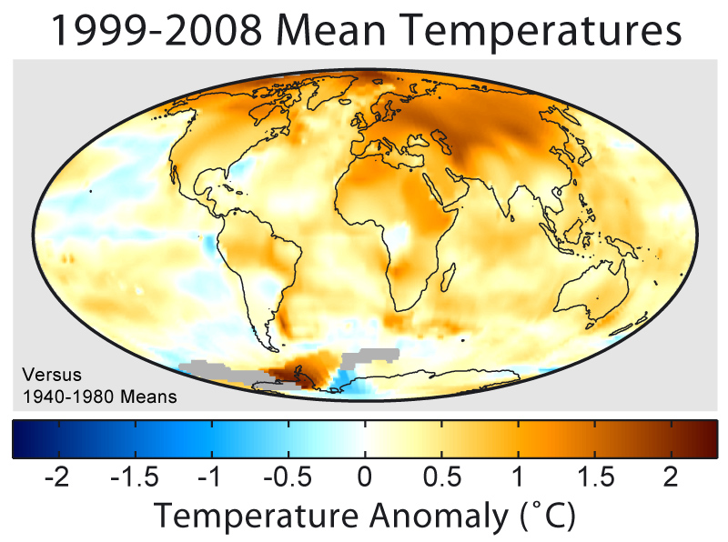
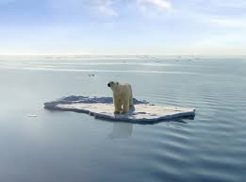

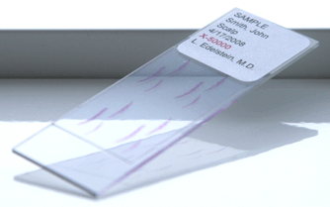
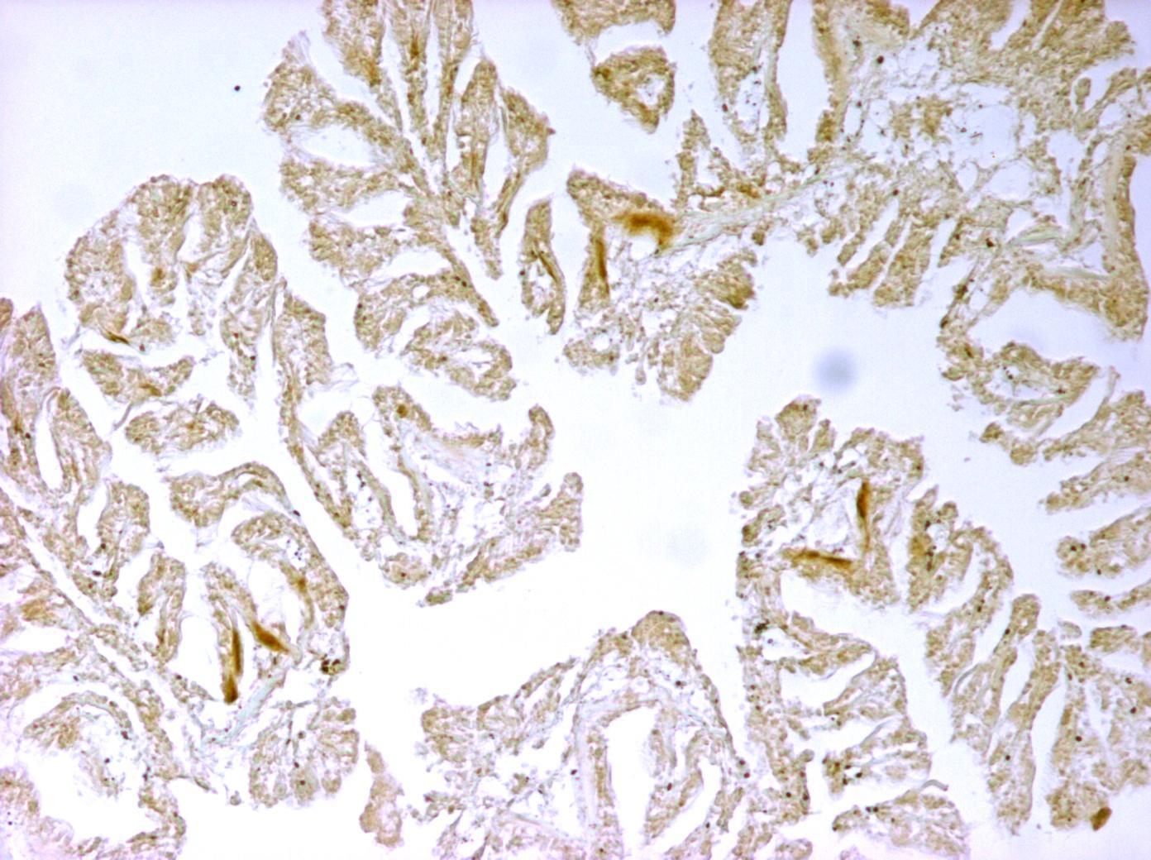
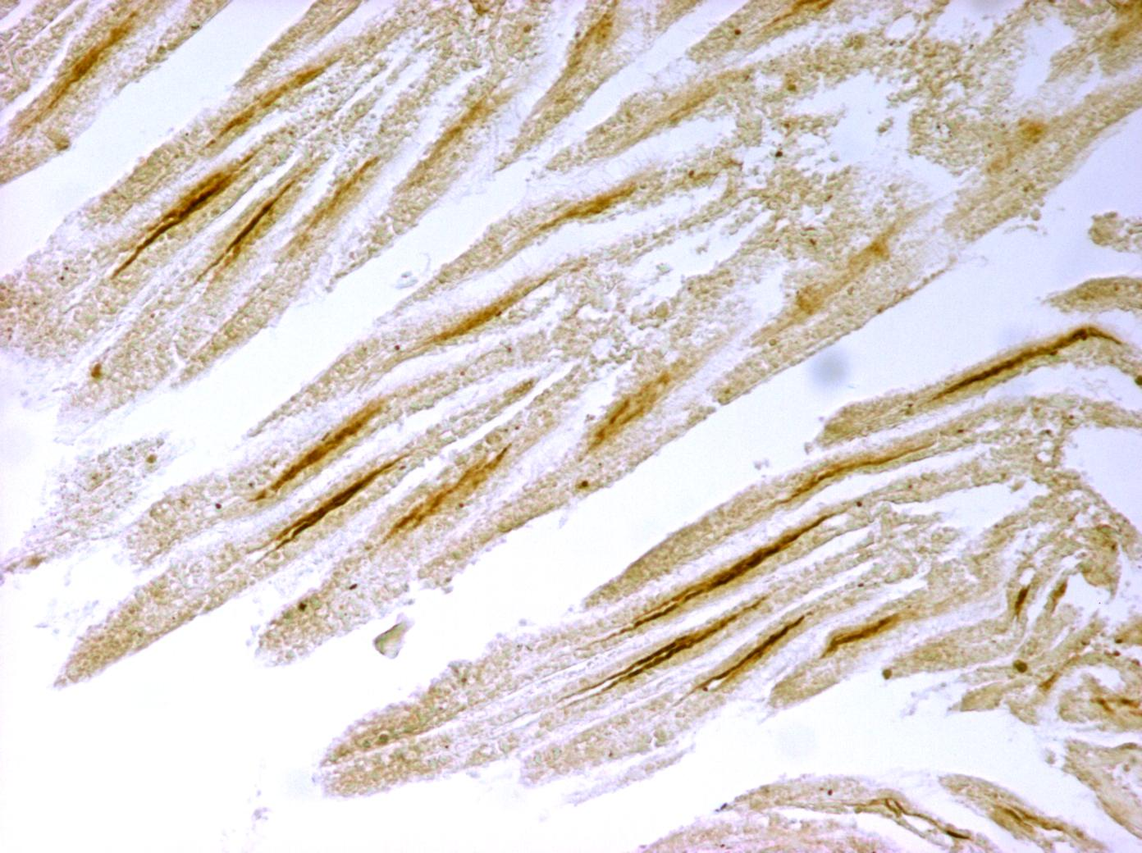
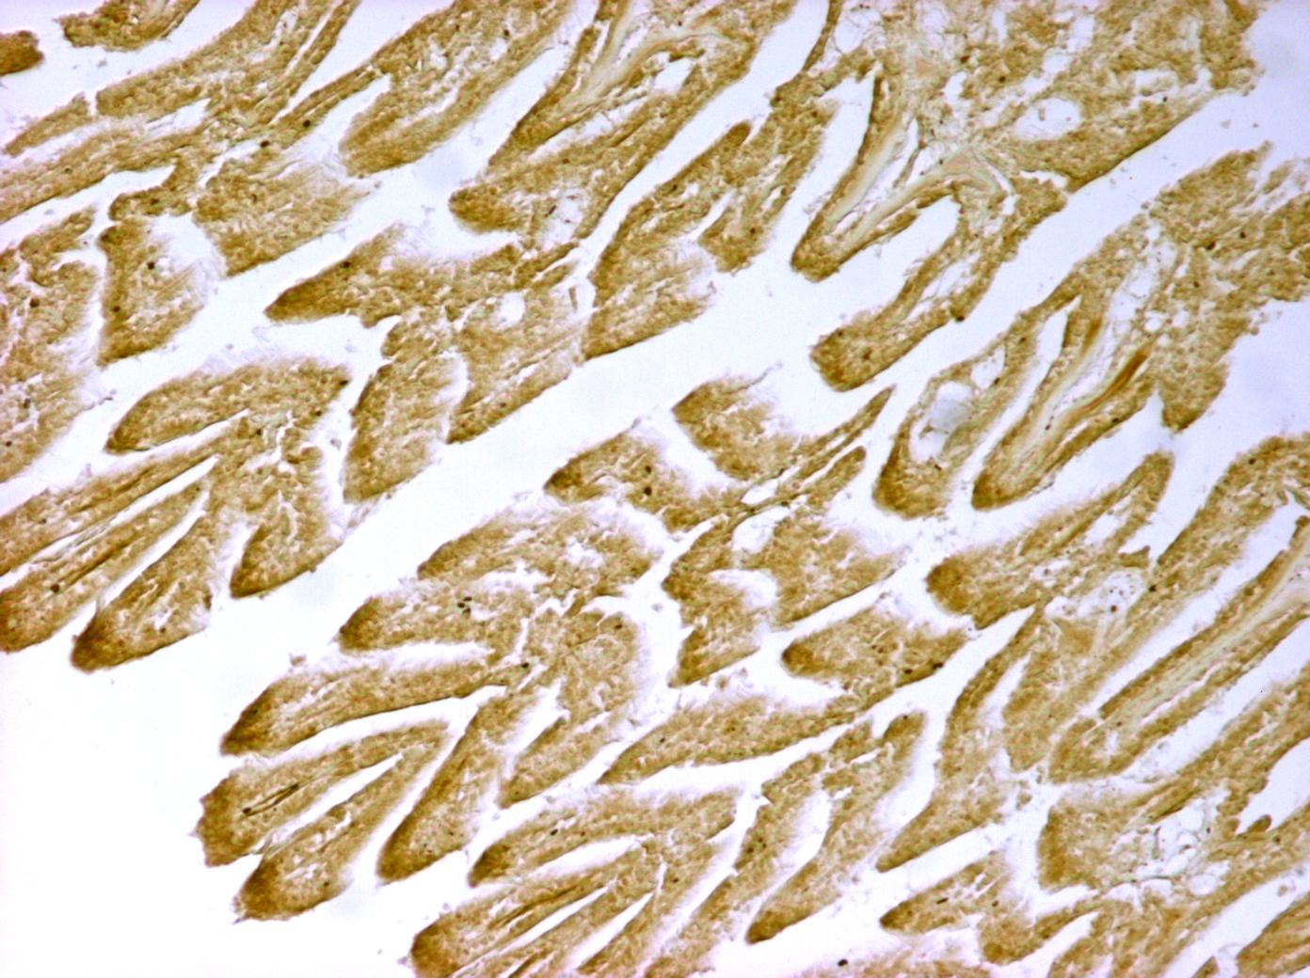
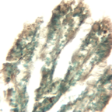
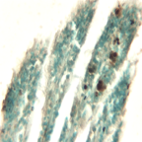
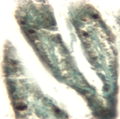
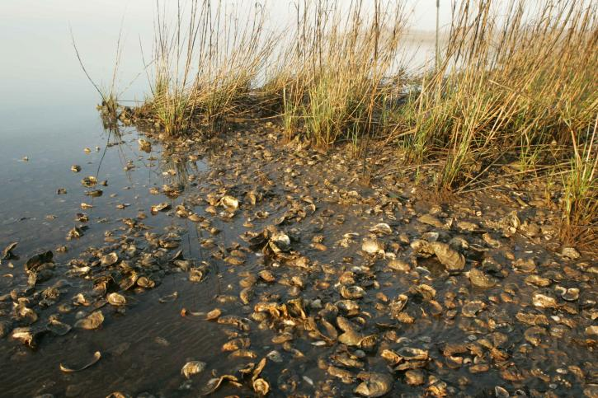

Does High Temperature cause DNA damage in American oyster?
Md Faizur Rahman and MD Saydur Rahman
University of Texas Rio Grande Valley, Texas
Introduction
Climate Change and Global Warming
Global warming is predicted to have far-reaching, long-lasting and devastating consequences in our earth.
The anthropogenic causes of green house effects such as carbon dioxide gas and other green house gas emissions to the atmosphere are considered as the main culprits to this negative impacts.
The global average temperature has increased by about 1.4 degree Fahrenheit (0.8ºC) over the last century an is predicted to increase by 4.5ºC by 21th century.
Global warming may lead to extreme weather conditions, Habitat loss, Ice melt and sea level rise, Ocean acidification, Glacial retreats droughts, Polar jet stream, Intense hurricane formation, major changes in wind pattern, annual precipitation and seasonal temperature variations, Thawing permafrost and disease outbreaks.
Global temperature increase pose more prominent threats to marine and coastal environment (i.e., corals, oysters) and their life history patterns.
American oyster
Why do we care about oyster?
Excellent indicator species, and ideal among bivalves to study on global warming and oxidative DNA damage.
Highly commercial species across the world (popular sea food –USA, Canada).
Filter feeders- improve basin-wide water quality and maintain phytoplankton dynamics (filtrates 190 liters of water daily).
Important reef building bivalves, provide habitats for other animals (i.e., shrimps, crabs, jellyfish etc.).
Results and Discussion
Effects of Elevated Temperature on Morphology of Gills
Effects of Elevated Temperature on HSP70 Expression
Effects of Elevated Temperature on 8-OHdG Expression
Effects of Elevated Temperature on γH2AX Expression
Effects of Elevated Temperature on Cellular Apoptosis
Materials and Methods
60 oysters collected from South Padre Island (SPI)
10 American oysters in each of 6 glass aquaria (capacity; 20 gallons) in three different temperatures (24ºC, 28ºC, 32ºC) – a week
Oyster cracked open, Collected gills, fixation with 4% paraformaldehyde
Histology (7 μm thickness tissue), Staining (Hematoxylin & Eosin)
Immunohistochemistry (Primary & Secondary Antibodies)
TUNEL-assay (Dead End Colorimetric TUNEL system)
Data Collection- ImageJ
Data Analysis- GraphPad
Statistical Analysis; ANOVA (P<0.05)
CTL (24^{O}C)
MT (28^{O}C)
HT (32^{O}C)
Gills
Integrated density of HSP70 (arbitrary units)
b
b
a
CTL (24^{O}C)
MT (28^{O}C)
HT (32^{O}C)
24ºC
28ºC
32ºC
b
b
Integrated density of 8-OHdG
(arbitrary units)
a
Water heater
Filter
Microtome machine
Oysters
Embedding Cassette
Histological slide
CTL (24^{O}C)
MT (28^{O}C)
HT (32^{O}C)
b
Integrated density of γH2AX (arbitrary units)
a
a
CTL (24^{O}C)
MT (28^{O}C)
HT (32^{O}C)
a
a
a
Integrated density of apoptotic cells
(arbitrary units)
CTL (24^{O}C)
MT (28^{O}C)
HT (32^{O}C)
Conclusion
Heat stress induces DNA damage, apoptosis, and may decrease physiological functions in oysters

