Slide 1
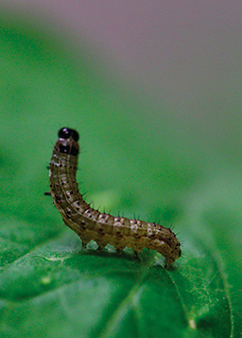
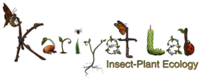
Exposure to polyphenol-rich purple corn pericarp extract restricts fall armyworm (Spodoptera frugiperda) growth
Sukhman Singh
MS Biology student
Department of Biology

Slide 2
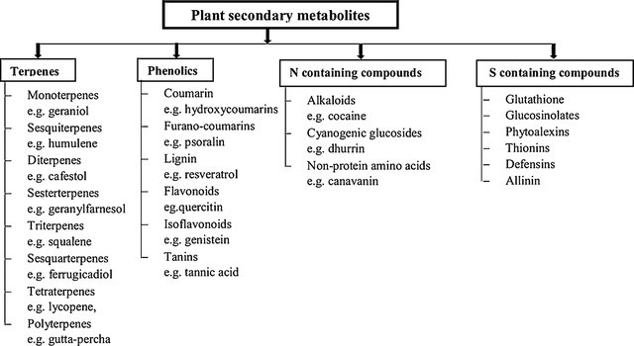
Introduction:
Bioactive secondary compounds are present in plants.
Have the potential to be developed as safe alternative to chemical pesticides.
However, extraction is expensive.
Testing on multiple herbivores
Jamwal et al., 2018; Gupta and Dikshit, 2010

Slide 3
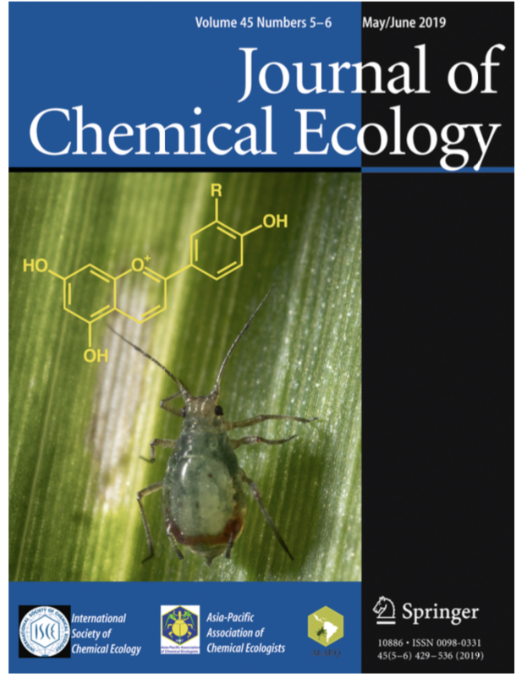
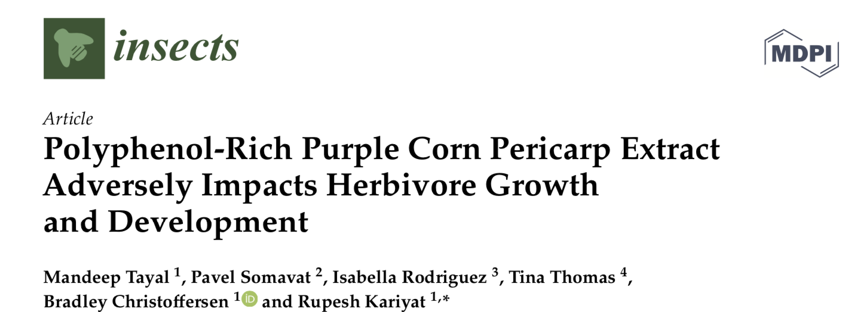
Lab focus: polyphenols and flavonoids affect herbivores

Slide 4
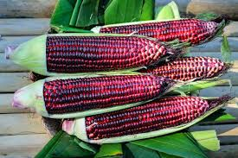
Introduction:
Purple corn pericarp: rich in polyphenols.
Pericarp: byproduct of corn processing.
~4710.08$±$43.13 mg/kg anthocyanin in pericarp.
Li et al., 2017; Tayal et al., 2020

Slide 5
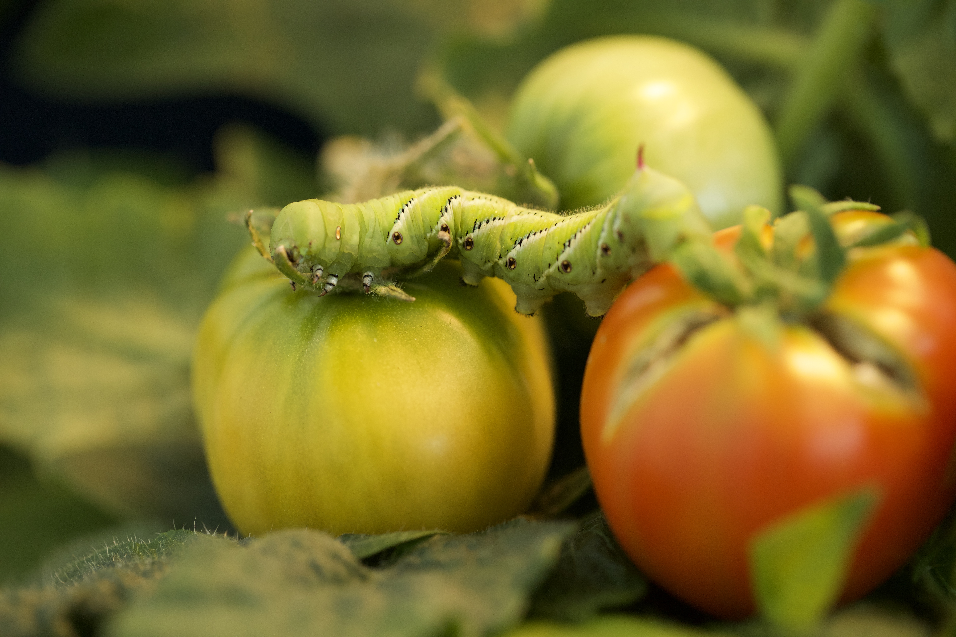

Slide 6
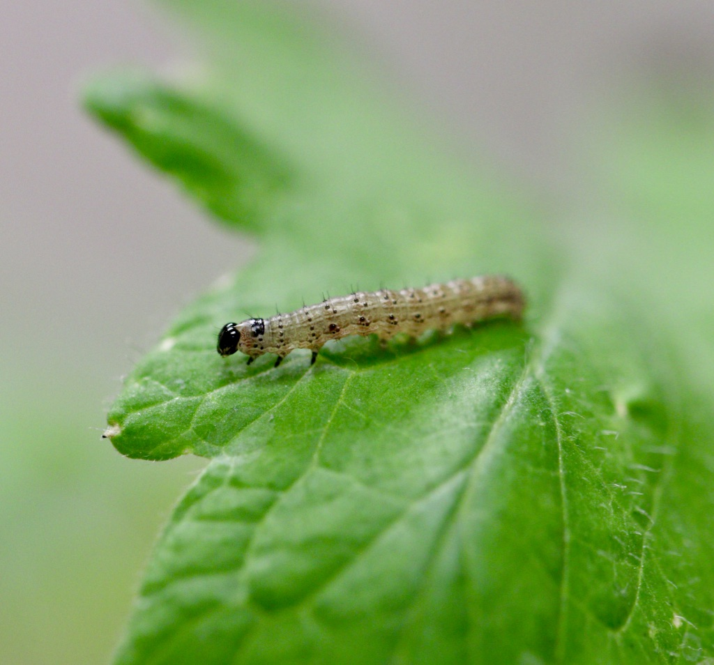
Hypothesis:
Purple corn pericarp rich in polyphenols will restrict the growth and development of generalist caterpillars.
It will also negatively affect its pupal stages as well.
Spodoptera frugiperda Fall Army Worm

Slide 7
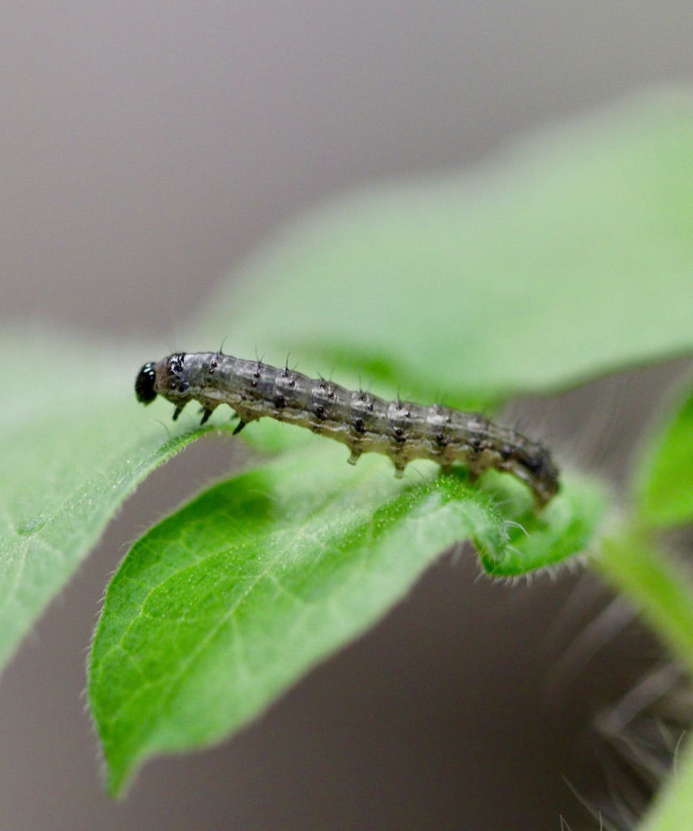
Material and methods:
Purple corn
Purple corn pericarp
Purple corn pericarp extract
Artificial diet prepared from pericarp extract
Control artificial diet
S. frugiperda

Slide 8
Results: caterpillar mass gain over previous mass
Control
Purple corn
Purple corn pericarp fed S. frugiperda gained lower mass than control diet treatment.
Kruskal-Wallis test

Slide 9
Results: caterpillar mass gain over initial mass
Control
Purple corn
Purple corn pericarp negatively affected growth and development of S. frugiperda.
Kruskal-Wallis test

Slide 10
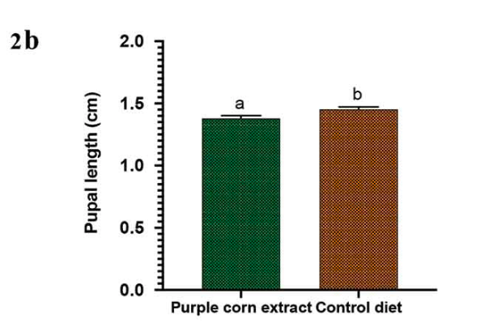
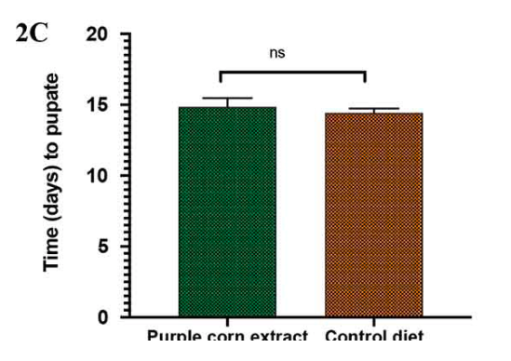
Results: pupae mass, length and time to pupate
t- test
Kruskal-Wallis test
Kruskal-Wallis test
Purple corn negatively affected pupal stage of S. frugiperda

Slide 11
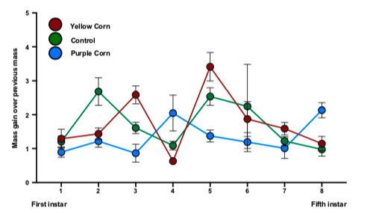
Effects are different for Manduca and FAW
Control
Purple corn

Slide 12
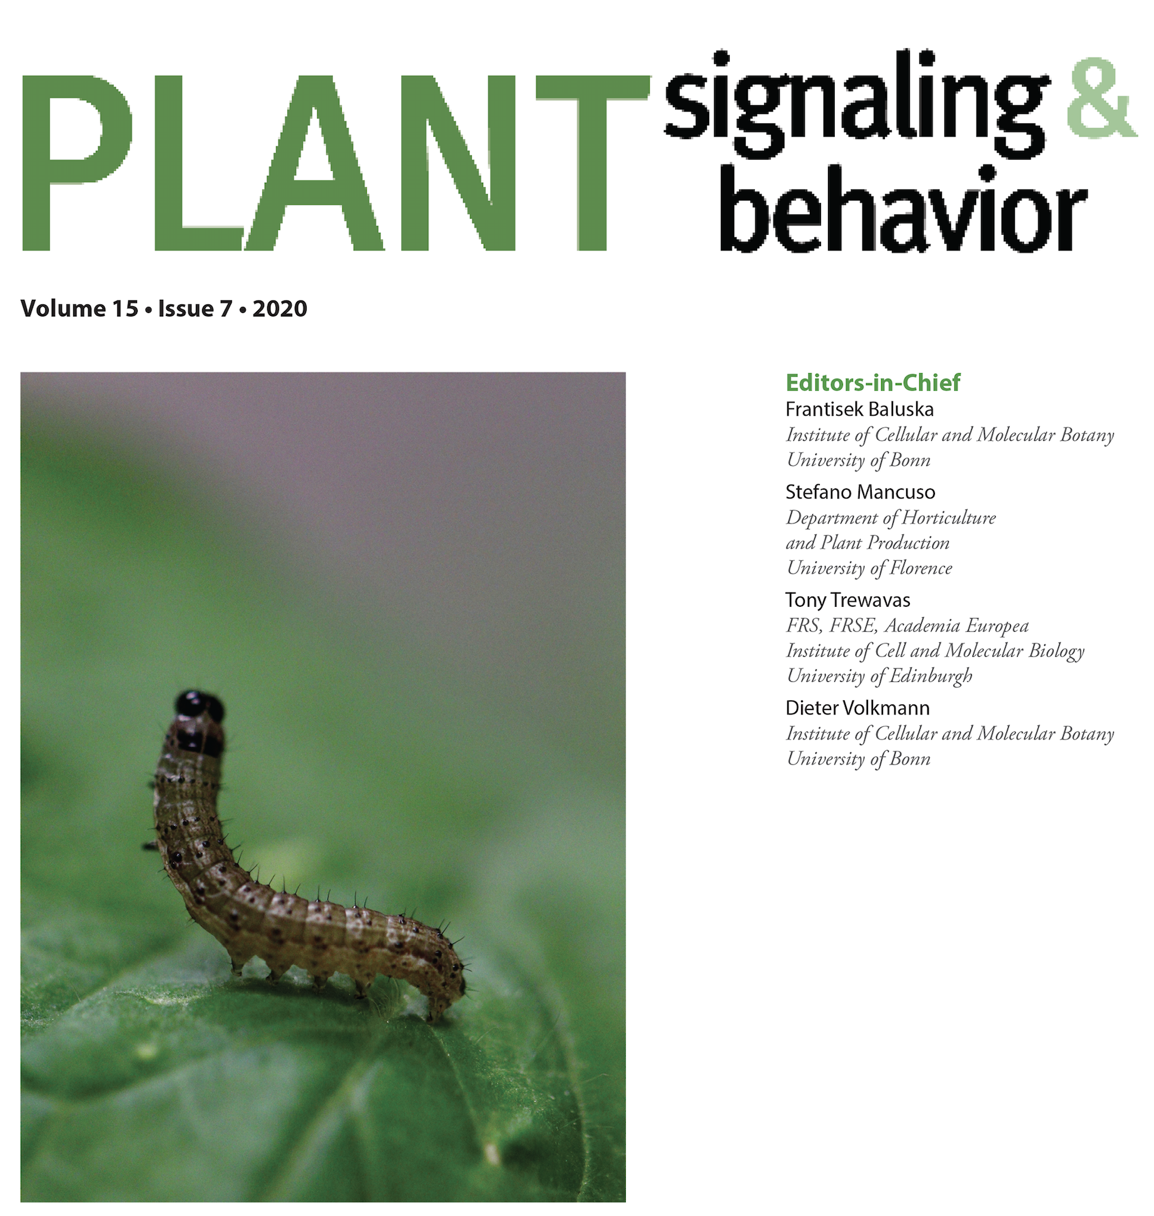
Conclusions:
Bioactive compounds present in purple corn pericarp can be toxic to insect pests.
It can act as antioxidant against insect herbivores.
Purple corn pericarp have potential to be used as bio pesticide against insect herbivores.
Singh and Kariyat 2020

Slide 13
References:
GuptaS, DikshitA . Biopesticides: an ecofriendly approach for pest control. JBiopest;2010..
LiQ, SomavatP, SinghV, ChathamL, MejiaEGD . A comparative study of anthocyanin distribution in purple and blue corn coproducts from three conventional fractionation processes. Food Chem. 2017;231:332–339. doi:10.1016/j.foodchem.2017.03.146.
TayalM, SomavatP, RodriguezI, ThomasT, ChristoffersenB, KariyatR . Polyphenol-rich purple corn pericarp extract adversely impacts herbivore growth and development. Insects. 2020;11(2):98. doi:10.3390/insects11020098

Slide 14
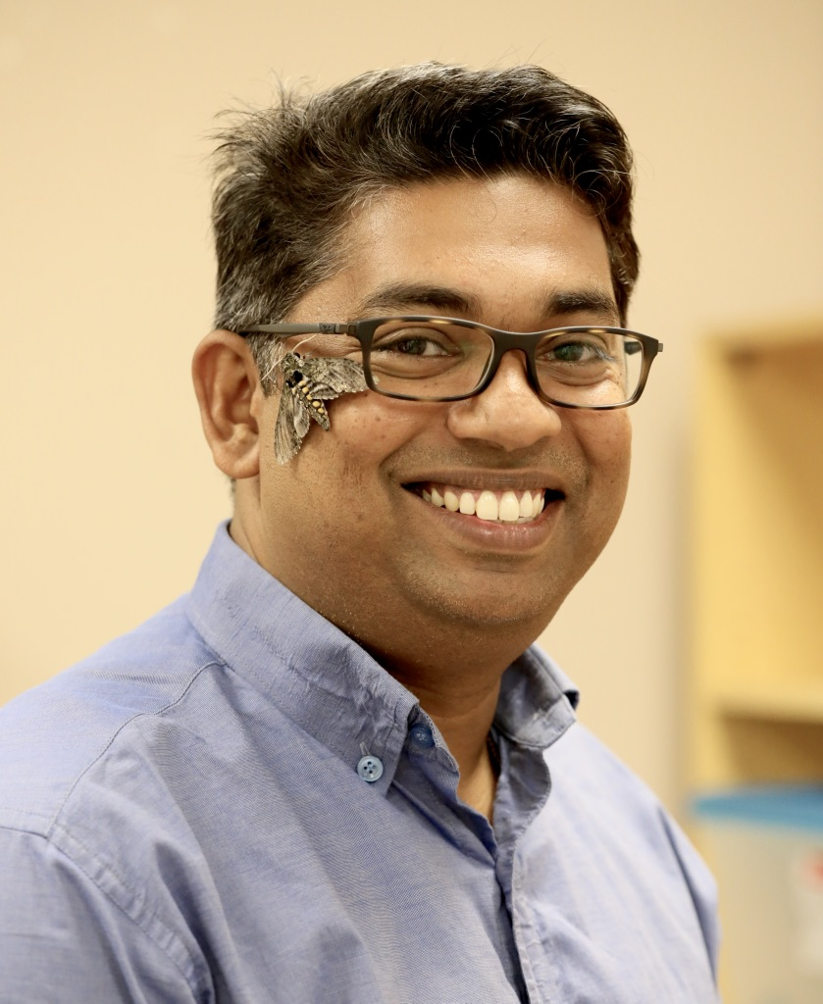
Acknowledgements:
Dr. Rupesh Kariyat
Dr. Pavel Somavat

Slide 15
Questions?

