Slide 1
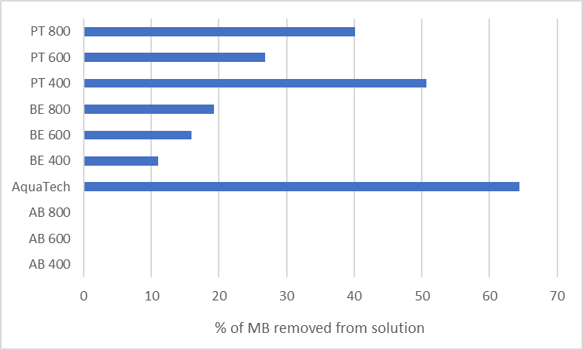
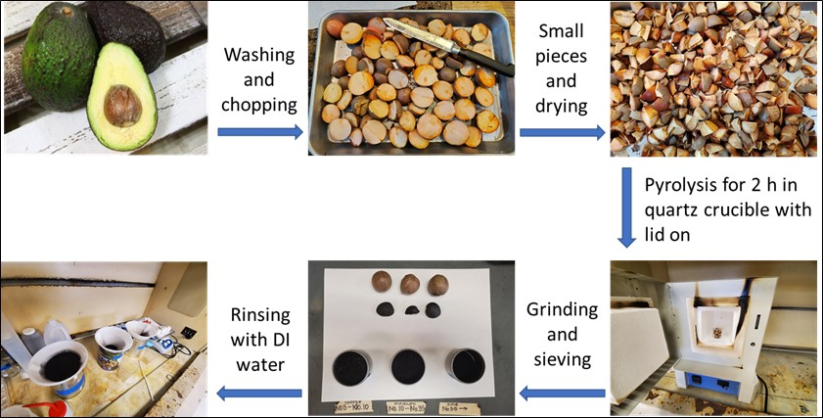
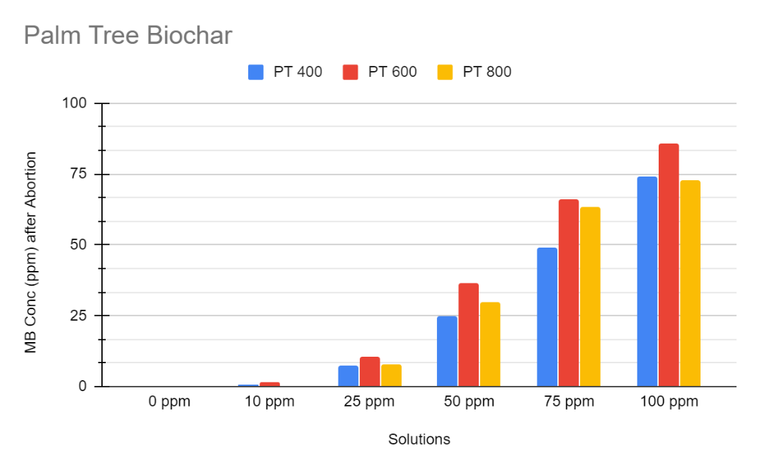
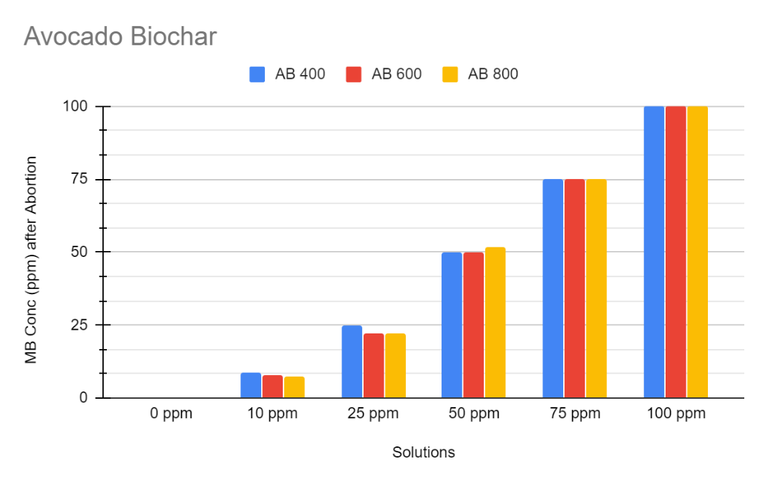
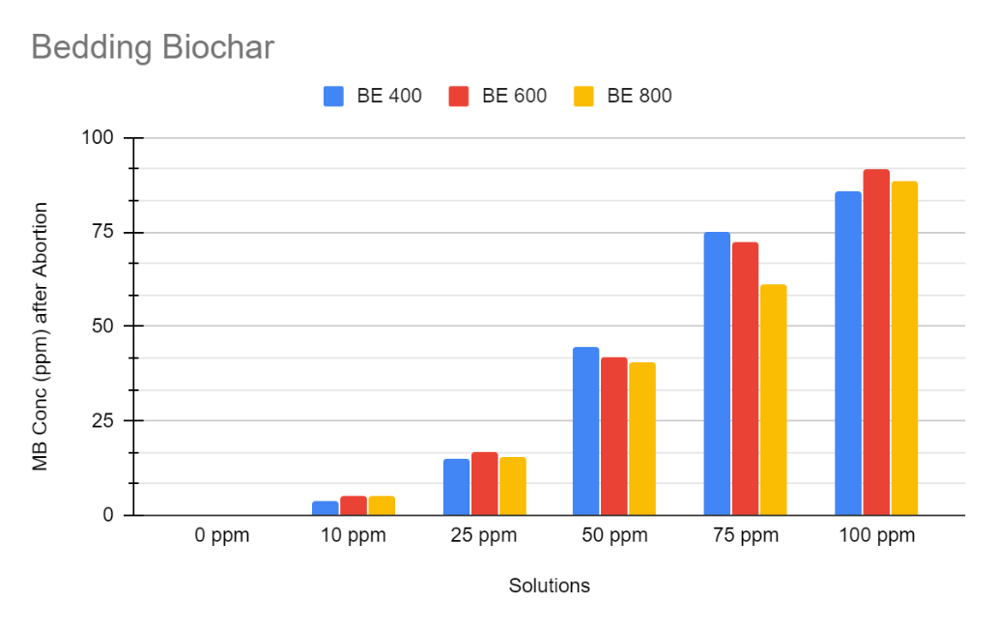
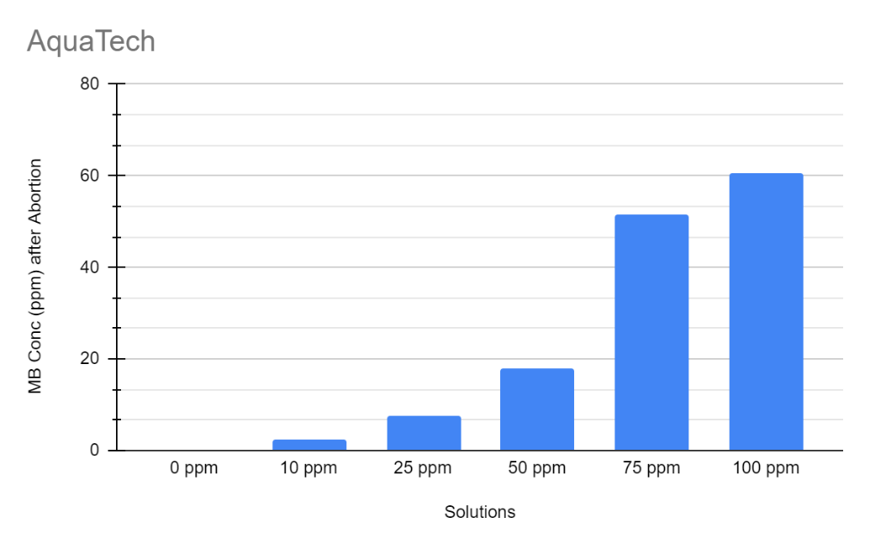
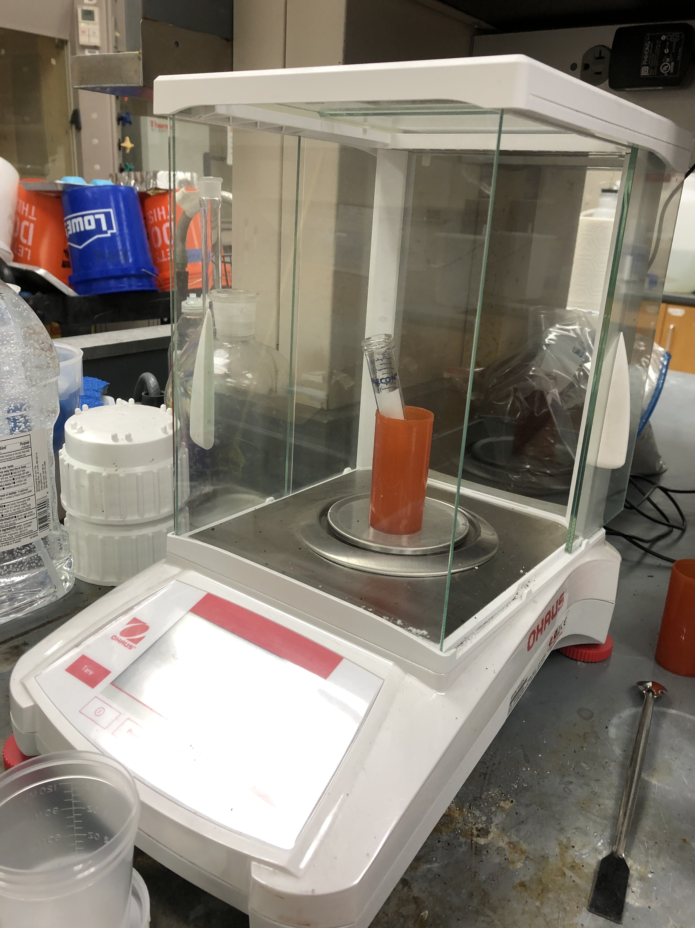
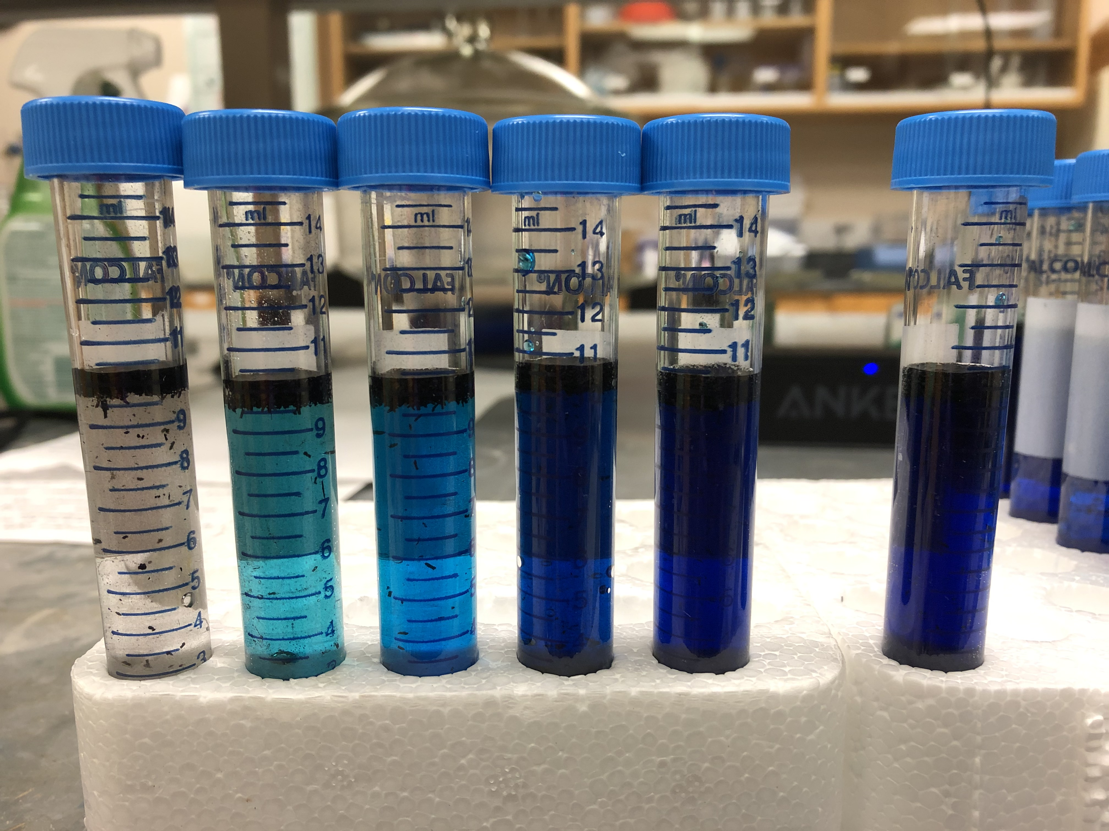
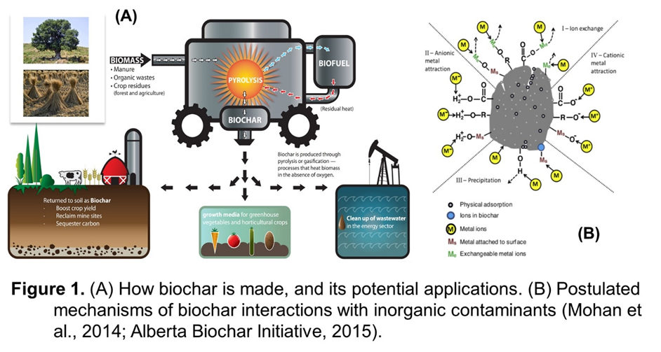
Removal of methyl blue from aqueous solution affected by biochar feedstock and pyrolysis temperature.
Carlos Garcia Patlan, Dr. James Kang
University of Texas Rio Grande Valley, School of Earth, Environmental, and Marine Sciences
Abstract
Methodology
Results
Results
Micropollutants in water are a problem for individuals in lower income communities, but low-cost, organic water filters can help resolve this problem. In this study, different biochars were tested in the filtration of methyl blue, a mimic water pollutant, from water samples at different concentrations. Methylene blue acts as a pollutant when placed in water; it dilutes, and it is difficult to filter out of the water. Four different types of Biochar were put to the test by absorbing the methyl blue from the solutions at different concentrations; the biochars were created using aspen bedding, palm tree biomass, and avocado seeds, all of which were cooked at three different temperatures, as well as a commercially bought biochar, Aquatech biochar, all medium grain sized (2.8-1.4 mm). Overall, the most effective biochars are AquaTech and Palm tree biochar, while the least effective biochar was Avocado biochar.
There were four different types of biochars used for this experiment, as stated before. These included Aspen Bedding, Avocado, Palm tree, and Aquatech biochar. They were all produced (except for Aquatech, which is a commercially available biochar) by thoroughly washing the biomass with distilled water, left soaking over night, oven dried at 110 ℃ for over 20 hours, and then placed in a Muffle Furnace to be cooked at different temperatures, which included 400 ℃, 600 ℃, and 800 ℃. The biomass was then crushed and separated according to grain sizes, which included Coarse grain (5-2.8mm), Intermediate grain (2.8-1.4 mm), and Fine grain (﹤1.4 mm). This was done using a sieving mesh.
For this experiment, only the intermediate grain size was used. Samples of water contaminated with of Methyl-Blue were prepared. A stock solution of 100 mg/L of methyl blue was prepared using distilled water and concentrated Methyl-Blue, and from that stock solution samples of 0 mg/L, 10 mg/L, 25 10mg/L, 50 mg/L, 75 mg/L, and 100 mg/L concentrations were produced.
Test tubes were then filled with 0.05 g of each type of biochar, and this was repeated for every concentration of the methyl blue solution, each test tube was then duplicated for a total of 120 samples.
10 mL of each of the Methyl Blue solutions were added to have two types of each of the biochar-Methyl-blue- concentrations combinations
The samples were then shaken over night.
The graph above shows the percentage of Methyl blue removed from the solution by each of the biochars. AquaTech on average removed 65% of the MB, Palm tree 400 biochar on average removed 52%, while Avocado biochar removed 0%
Conclusion
Introduction
The AquaTech biochar proved to be the most effective biochar, being able to remove over 70% of the methyl blue in the lower concentrations (10 mg/L, 25 mg/L) and over 25% in the higher concentrations (75 mg/L, 100 mg/L). Palm tree biochar was a close second, producing similar results to the Aquatech biochar. Overall, PT biochar cooked at 400 ℃ rendered the best results out of that group. Avocado seed biochar proved to be the least effective biochar, with any concentration above 25 mg/L practically the same as the beginning of the experiment
Results suggested that the Palm Tree frond biochar could be an alternative carbon material that can be effective in aqueous MB removal.
Column experiment from selected biochars is pending to investigate their performance on the MB removal under flowing condition.
The efficiency of the biochars was tested by two different methods. The first method involved placing each type of biochar in a test tube, as well methyl blue solutions at different concentrations, each test tube duplicated. The second method involved creating a filter using the biochars and pumping methyl blue to the filter creating a saturated environment. This was done until reaching a breakthrough. Water filtration was measured by collecting water samples and measuring their volume and placing samples in the spectrophotometer to determine the concentration of methyl blue as the solution was filtered through the biochar filter. For this presentation, only the first method will be explored.
Data Recording
All the biochar was carefully measured into each test tube, as well as the volume of the contaminated water samples. Once they were done, water samples from each test tube were extracted and measured in a spectrophotometer. The formula y=6.402x-0.3924 was used to determine the concentration of methyl blue still present within the water samples by inserting the numbers recorded from the spectrophotometer.
Acknowledgements
The work was financially supported by USDA TRESS (Training, Research, and Education in Soil Sciences), EPA P3 (People, Prosperity and the Planet), and Department of Defense summer faculty fellowship.

