Slide 1
Effect of fruit ripeness and post-harvest storage conditions on the survival of Salmonella spp., in fresh-cut papaya
Amandeep singH
MS in Agriculture, Environmental & Sustainability Sciences

Slide 2
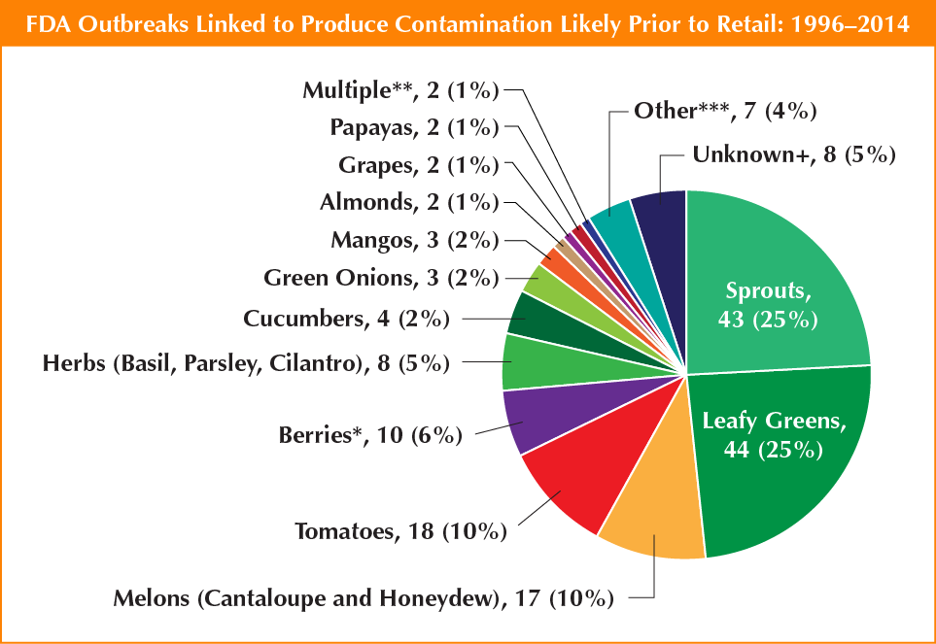
Microbial safety of fresh produce
360 M
Health & wellness
>30% are imported & RGV is major hub for imports
Mostly consumed raw
Focus is on microbial safety of papaya
48 M
128 K
3 K
48% are related to fresh produce
US Foodborne illness outbreaks,
CDC 2011 Estimate.

Slide 3
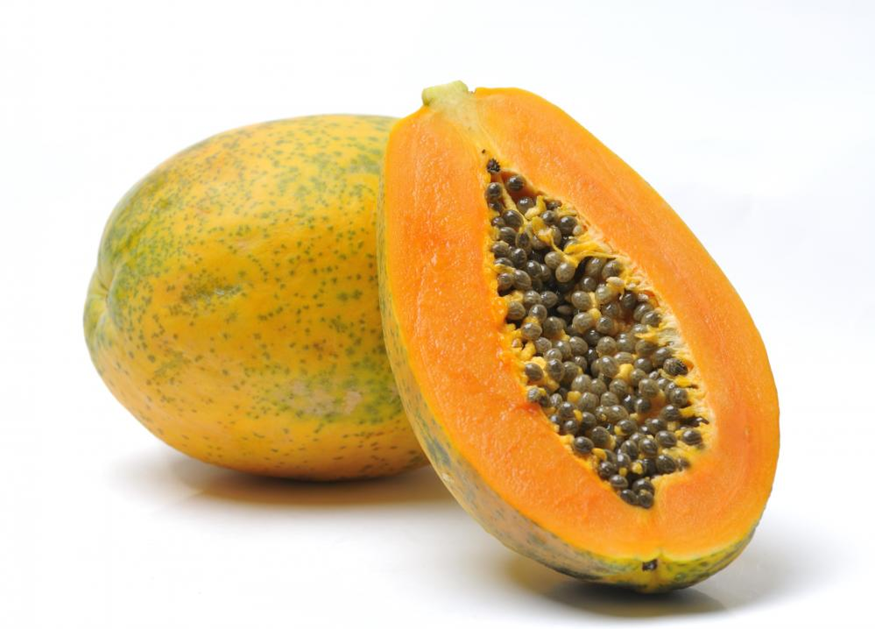
Papaya
Botanical name - Carica papaya
Popular tropical & subtropical fruit
High nutritional value
Large volume of imports

Slide 4
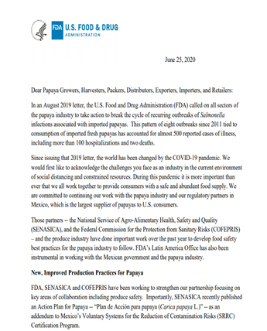
Multiple outbreaks associated with Papaya
Pathogen of concern | Year
Salmonella Uganda | 2019
Salmonella Urbana | 2017
Salmonella Newport & Salmonella Infantis | 2017
Salmonella Anatum | 2017
Salmonella Thompson & Salmonella Agona | 2017

Slide 5
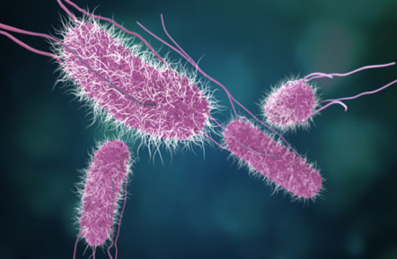
Salmonella
Ubiquitous in the environment
Gram-negative
Facultative anaerobic
Mesophile 8 to 45ºC
pH tolerance 4.0 to 9.5
Water activity ≥0.94
Can survive for months/years in detrimental conditions

Slide 6
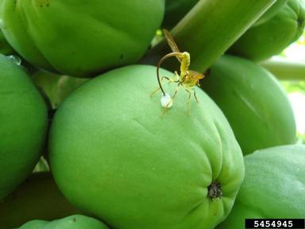
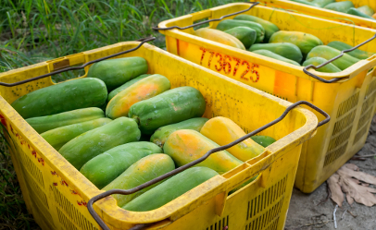
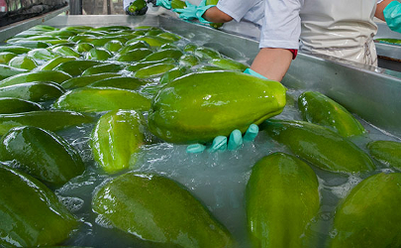
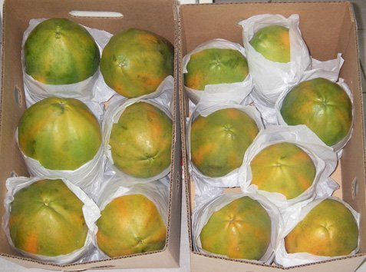
Potential sources of contamination
Pre-harvest
During harvest
Packing house
Post-harvest storage & distribution

Slide 7
Motivation for our research
Why Salmonella is a persistent problem in Papayas
What factors will influence its growth & persistence
How can the industry/consumers better address this issue

Slide 8
Research hypothesis
Predictive models can be developed to understand the growth kinetics of Salmonella on Papaya
Objectives are to determine:
The effect of ripeness level, storage temperature & RH, physico-chemical properties on the growth kinetics of Salmonella
The efficacy of novel & sustainable interventions to mitigate the risk

Slide 9
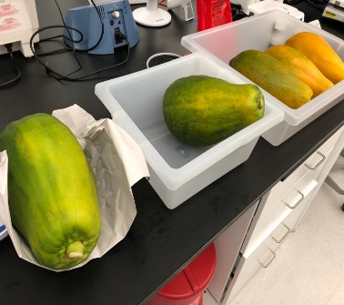
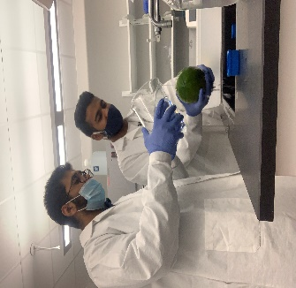
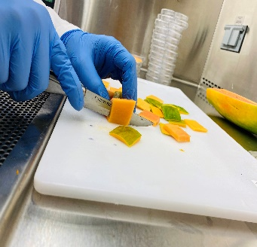
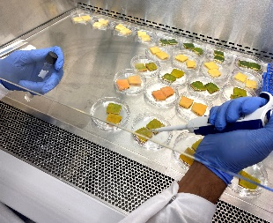
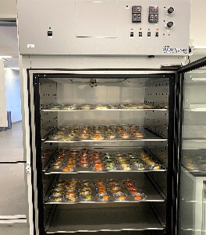
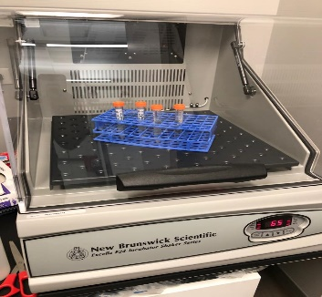
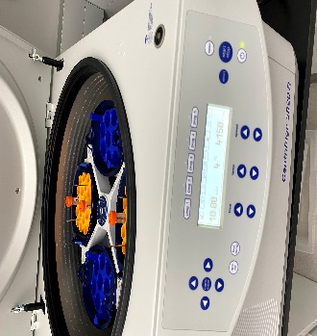
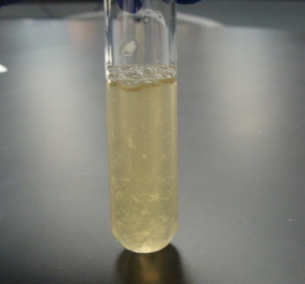
Methodology
Fresh papaya at different ripeness levels(0,25, 50, 75 and 100%)
Washing of papaya with 100ppm chlorine solution
Cutting into 3*3*1 cm pieces
Inoculation (25µl)
Environmental chamber
RH- 50%,90%
Temp- 4,12 and 21 ° C
S. enterica poona
S. enterica St. Paul
S. enterica Agona
S. newport
Growing cells at 37 C at 65 RPM for 18-24 hrs
Centrifugation at 4000 RPM for 10 minutes

Slide 10
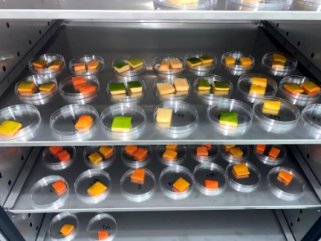
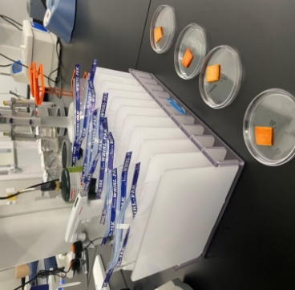
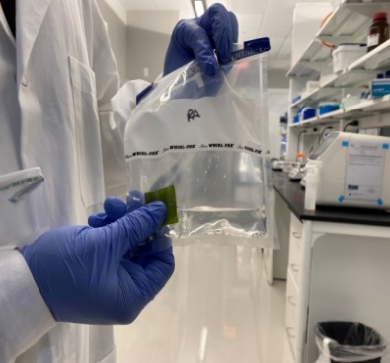
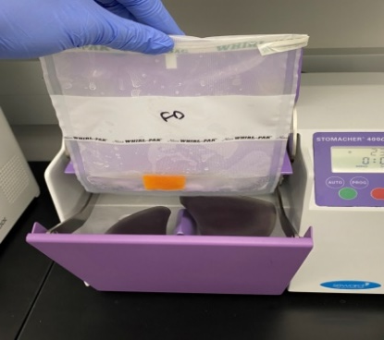
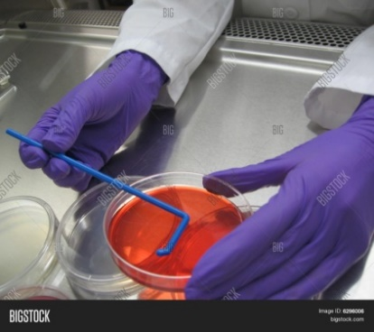
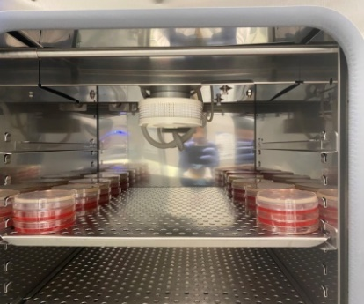
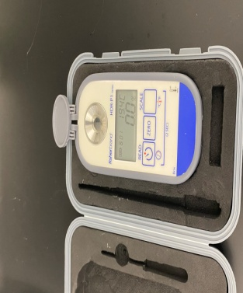
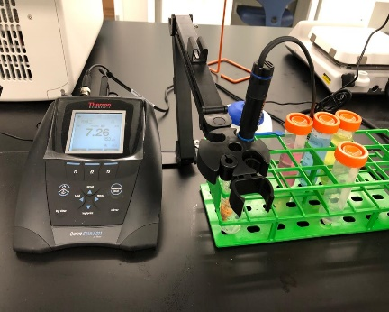
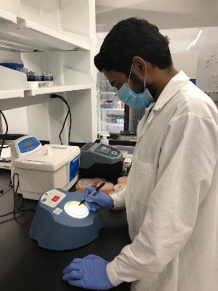
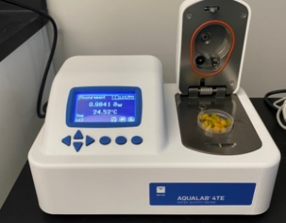
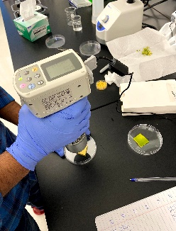
Collection of samples at respective time intervals
Incubate plates at 37 C for 24 hrs
Rubbing of sample for 1 min.
Stomaching 230 rpm for 2 min.
Plating on XLD and TSAN
Water activity
Total soluble solids
Color
pH
Enumeration
Ph analysis

Slide 11
Experimental design
Test Variables
Fruit ripeness (0, 25, 50, 75, 100%)
Peel (5 ripeness levels)
Flesh (5 ripeness levels)
Temperature (4, 12, and 21ºC)
Time (0, 1, 3, 5, 7, 9, 11, and 14 days)
RH (50, 90%)
physico-chemical properties (pH, water activity, TSS, color)
Total samples= 5 ripeness levels x 2 conditions x3 temperatures x 2 relative humidity conditions x 8 time points x 2 duplicate samples x 2 replicates = 1920

Slide 12
Data analysis
Data were analyzed by ANOVA
Experimental data will be fitted to test for the predictive power and correlation among variables using different empirical models:
Baranyi model
Modified logistic model
Polynomial model

Slide 13
Results & Discussion
Fig 1. Growth kinetics of Salmonella on papaya at different ripeness levels when stored at 21C and 90% RH
Fig 2. Growth kinetics of Salmonella on papaya at different ripeness levels when stored at 21C and 50% RH

Slide 14
Fig 3. Growth kinetics of Salmonella on papaya at different ripeness levels when stored at 12C and 90% RH
Fig 3. Growth kinetics of Salmonella on papaya at different ripeness levels when stored at 4C and 90% RH

Slide 15
Physico-chemical properties
Table 1. pH at different storage conditions and ripeness levels
Table 2. Total soluble solids content at different storage conditions and ripeness levels
 | pH
Temp (C)-RH | 4C-90% RH | 12C-90% RH | 21C-90% RH | 21C-50% RH
Storage time (Days) | 0-14 | 0-14 | 0-7 | 0-7
Ripeness-0 | 6.33-6.63 | 6.72-7.08 | 6.60-6.97 | 6.3-6.86
Ripeness-25 | 6.4-6.99 | 6.48-7.01 | 6.48-6.85 | 6.25-6.62
Ripeness-50 | 6.29-6.67 | 6.40-6.86 | 6.46-5.81 | 6.3-6.53
Ripeness-75 | 6.47-6.93 | 6.34-6.85 | 6.56-6.89 | 6.14-6.72
Ripeness-100 | 6.50-6.76 | 6.61-6.98 | 6.64-6.79 | 6.36-6.81
 | Total soluble solids
Temp (C)-RH | 4C-90% RH | 12C-90% RH | 21C-90% RH | 21C-50% RH
Storage time (Days) | 0-14 | 0-14 | 0-7 | 0-7
Ripeness-0 | 0.4-0.5 | 0-0.4 | 0-0.4 | 0.5-0.5
Ripeness-25 | 0-0.6 | 0-0.5 | 0.3-0.6 | 0.7-0.8
Ripeness-50 | 0.4-0.7 | 0.3-0.7 | 0.6-1.1 | 0.7-1.2
Ripeness-75 | 0.5-0.7 | 0.6-0.9 | 0.5-1.1 | 0.7-1.1
Ripeness-100 | 0.9-1.1 | 0.5-0.6 | 0.35-1.0 | 1-1.2

Slide 16
Table 3. Water activity at different storage conditions and ripeness levels
Table 4. Color (L values) at different storage conditions and ripeness levels
 | Water activity
Temp (C)-RH | 4C-90% RH | 12C-90% RH | 21C-90% RH | 21C-50% RH
Storage time (Days) | 0-14 | 0-14 | 0-7 | 0-7
Ripeness-0 | 0.99-0.72 | 0.99-0.77 | 0.99-0.76 | 0.99-0.51
Ripeness-25 | 0.99-0.75 | 0.99-0.78 | 0.99-0.78 | 0.99-0.51
Ripeness-50 | 0.98-0.78 | 0.98-0.77 | 0.98-0.80 | 0.99-0.51
Ripeness-75 | 0.99-0.71 | 0.97-0.76 | 0.98-0.76 | 0.99-0.52
Ripeness-100 | 0.98-0.77 | 0.98-0.75 | 0.98-0.76 | 0.98-0.52
 | Color (L values)
Temp (C)-RH | 4C-90% RH | 12C-90% RH | 21C-90% RH | 21C-50% RH
Storage time (Days) | 0-14 | 0-14 | 0-7 | 0-7
Ripeness-0 | 68.10-52.87 | 71.27-55.19 | 76.28-56.52 | 71.87-56.04
Ripeness-25 | 62.27-49.57 | 60.35-54.34 | 64.91-50.38 | 53.02-46.52
Ripeness-50 | 57.31-53.27 | 57.66-48.27 | 57.01-47.60 | 57.39-49.10
Ripeness-75 | 54.59-52.01 | 56.21-48.23 | 57.1-52.66 | 55.93-43.95
Ripeness-100 | 53.56-45.07 | 52.73-46.30 | 48.68-45.96 | 45.93-41.50

Slide 17
Summary of major findings
Increase in storage temperature from 4 to 21C and RH from 50 to 90% increased the survival of Salmonella
Growth of Salmonella is less pronounced at lower temperatures and relative humidity levels
Fruit ripeness level showed significant effect on the survival of pathogen. Less ripe fruits mitigated the growth compared 100% ripe fruit
pH and TSS levels increased while a_{w} levels decreased during the storage which had an impact on the survival of Salmonella
Follow-up studies will be focused on developing predictive models and investigating natural antimicrobial compounds as an intervention

Slide 18
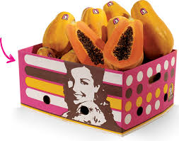
Acknowledgements
Dr. Veerachandra K. Yemmireddy (Major professor)
Mr. Juan Carlos, Chula Brands
UTRGV & College of Sciences

