Slide 1
A GIS-Based Model to Assess Onsite Sewage Facility (OSSF) Contamination Risk to Local Water Resources
By Alvaro Garcia

Slide 2
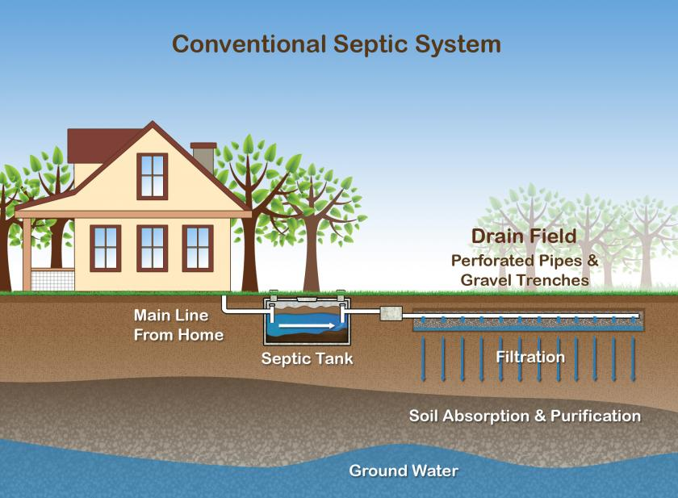
What is an On-Site Sewage Facility?
Decentralized wastewater treatment systems
Efficiently treat wastewater through physical, chemical, and biological processes
Cost effective especially for rural areas
Rely on the proper design, installation, and management of the system
“A Conventional Septic System”
Source: EPA

Slide 3
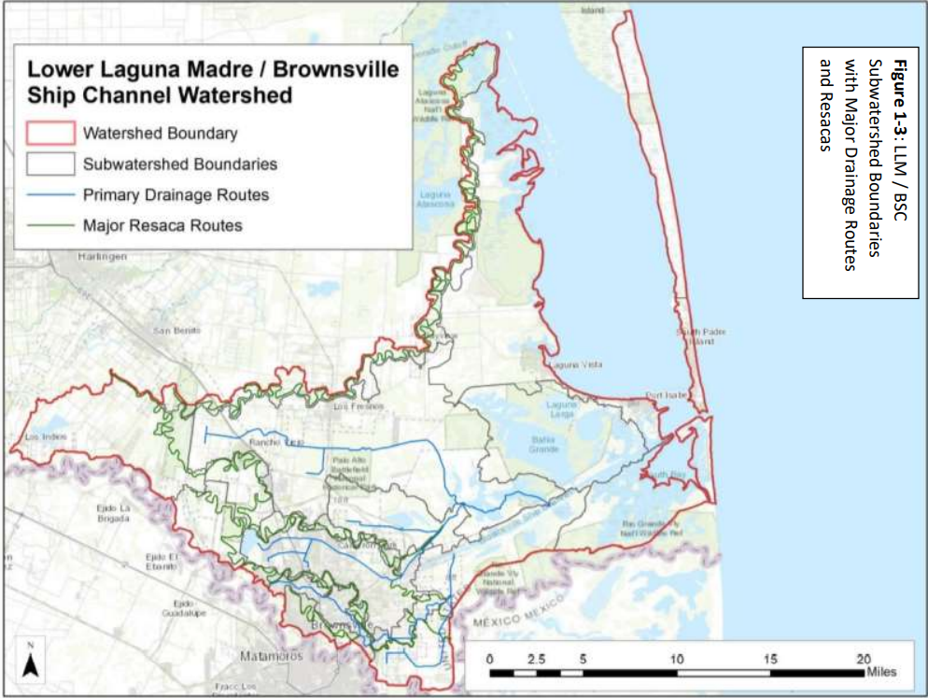
OSSF Potential Risks
Public Health
Bacterial exposure via public waterways
Drainage ditches
Resacas
Groundwater
Contact recreation in the Lower Laguna Madre
Environment
Nutrient discharge
Eutrophication
Subwatershed Boundaries with Major Drainage Routes and Resacas (Benavides, LLM/Ship Channel Watershed Characterization, 2018)

Slide 4
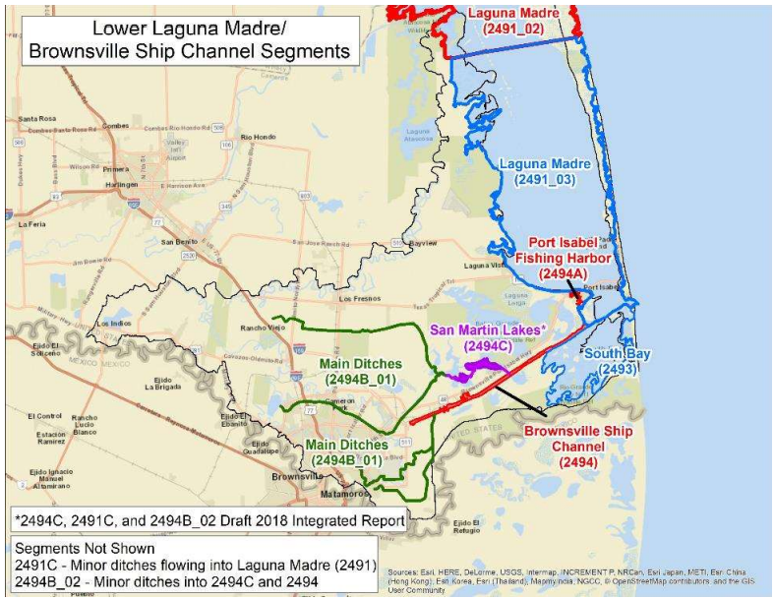
OSSF Potential Risks
Public Health
Bacterial exposure via public waterways
Drainage ditches
Resacas
Groundwater
Contact recreation in the Lower Laguna Madre
Environment
Nutrient discharge
Eutrophication
LLM/Brownsville Ship Channel TCEQ Segments (Benavides, LLM/Ship Channel Watershed Characterization, 2018)

Slide 5
Research Objectives
Develop a GIS risk assessment model that considers relevant OSSF risk parameters
Determine the relative importance between the risk model’s parameters
Evaluate the risk model’s performance using E. Coli counts.

Slide 6
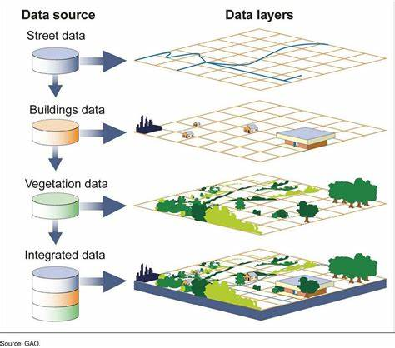
Geographic Information Systems (GIS)
Notes:
Add Up and down arrow and side to side arrow

Slide 7
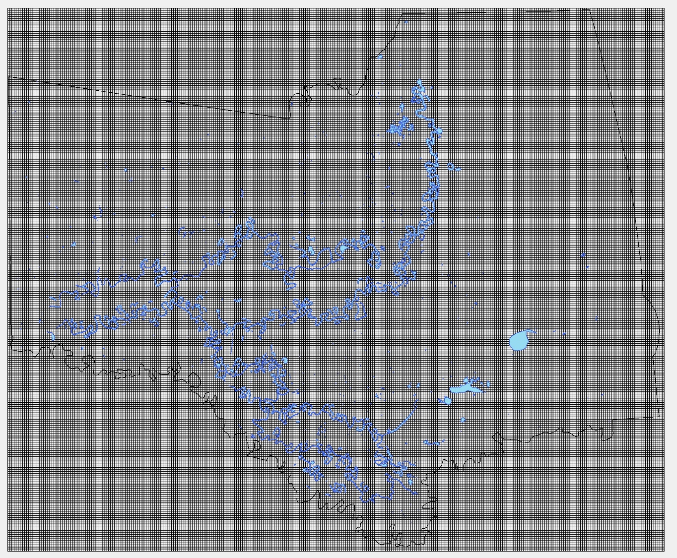
OSSF Risk Assessment Model (Oosting and Joy, 2011)
Environmental
Soil Type
Land Slope
Floodplain
Groundwater Recharge Areas
OSSF System Design
Lot Size
Surface Water Proximity
System Age
Water Supply Proximity
OSSF Density
250 m by 250 m survey grid generated in GIS

Slide 8
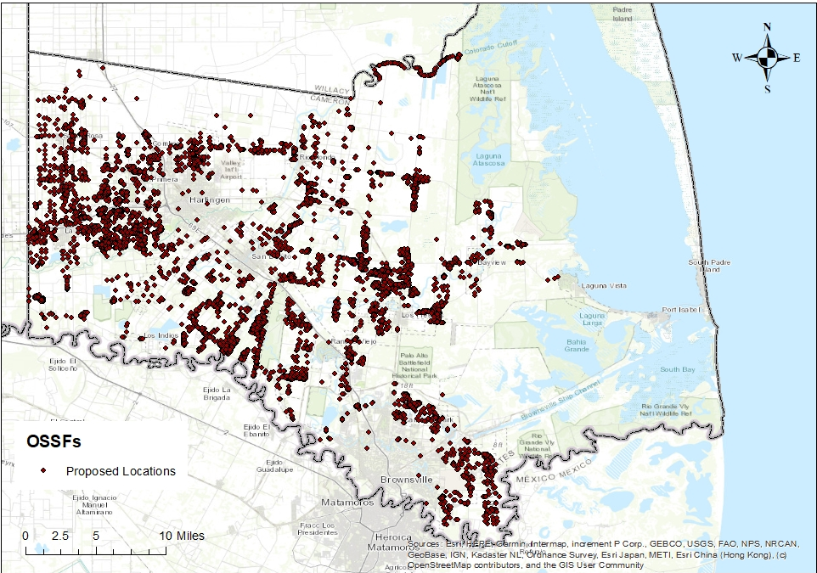
OSSF Database
OSSF records from Cameron County Public Health department were matched with appraisal district parcel maps and 911 addresses
Around 10,000 permits were automatically matched
Remaining permits are being manually matched using physical permit copies
OSSF locations of automatically matched permits.
Source: Texas Water Resource Institute & Texas A&M Agrilife Extension Service

Slide 9
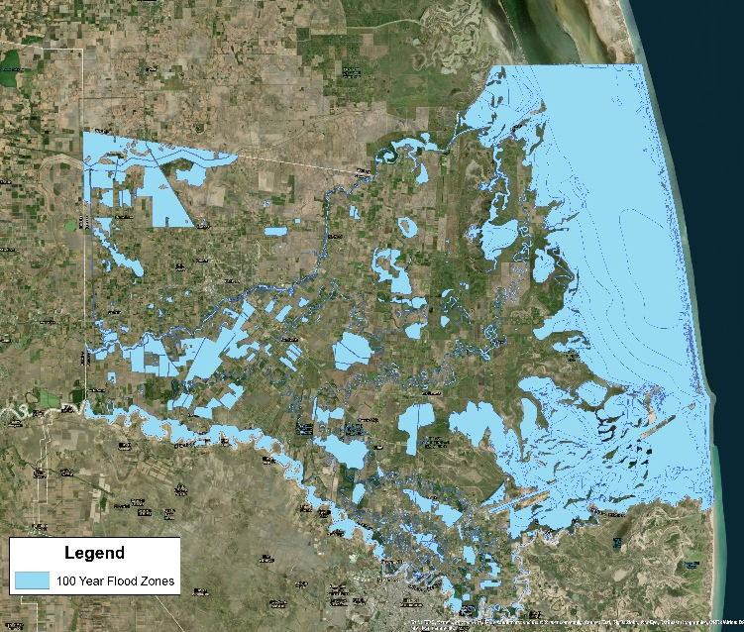
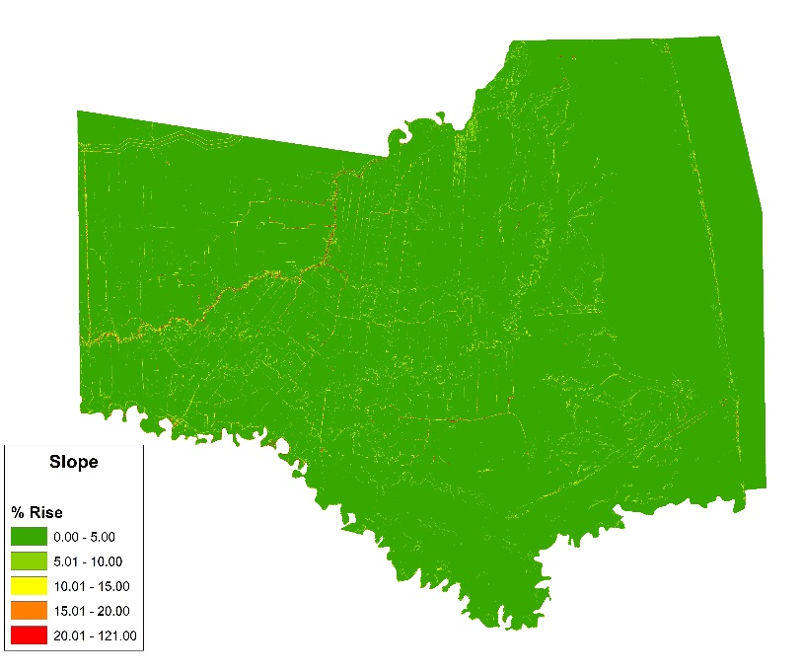
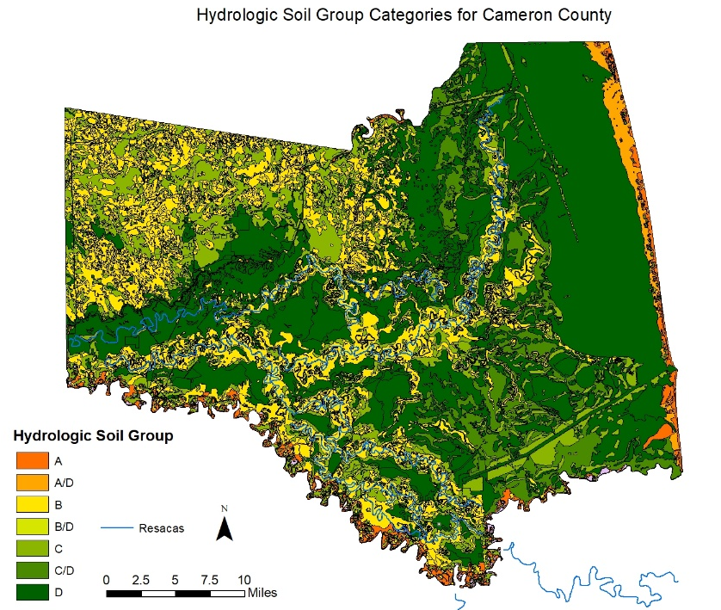
Environmental Parameters
Soil Type
Class A and Class D = 5
Class B = 3
Class C = 1
Land Slope
< 5% = 1
5-10% = 2
10-15% = 3
15-20% = 4
>20% = 5
Floodplain
Within = 5
Outside = 1
Groundwater Recharge Areas
Within = 5
Outside = 1

Slide 10
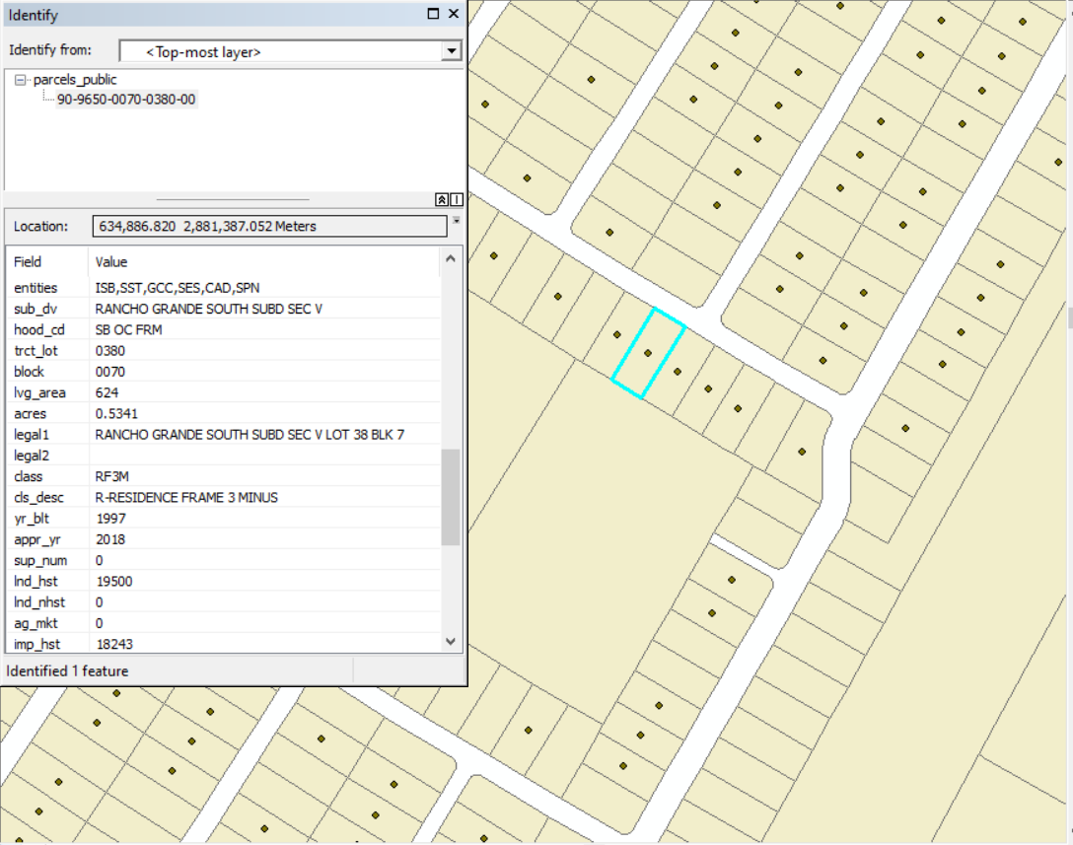
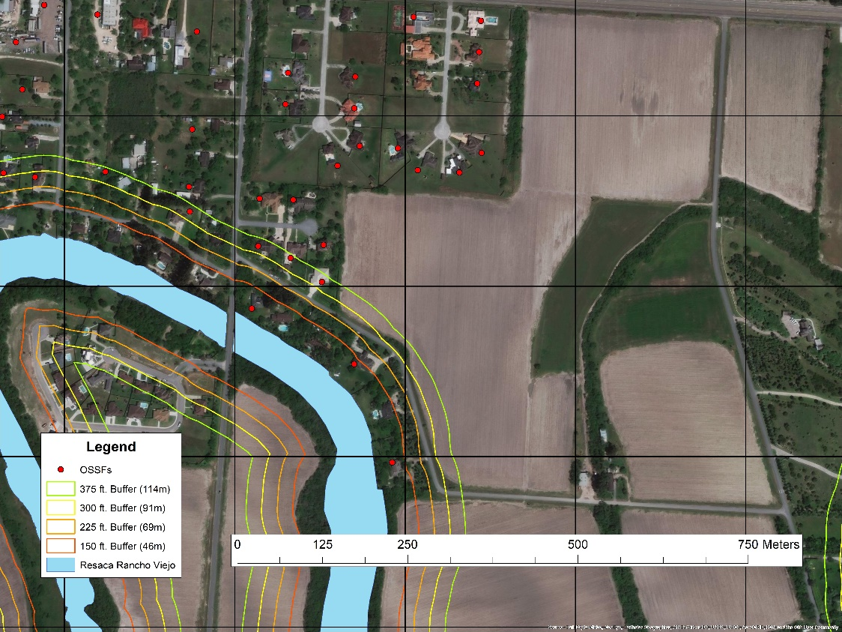
System Design Parameters
Lot Size
>1 acre = 1
0.75 - 1 acre = 2
0.50 – 0.75 acres = 3
0.25 – 0.50 acres = 4
<= 0.25 acres = 5
Surface Water Proximity
Within 150 ft. = 5
150 - 225 ft. = 4
225 - 300 ft. = 3
300 - 375 ft. = 2
Beyond 375 ft. = 1

Slide 11
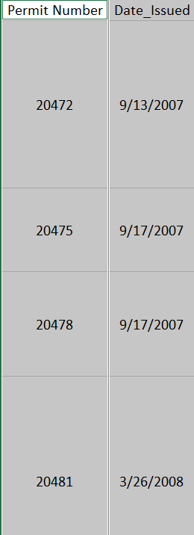
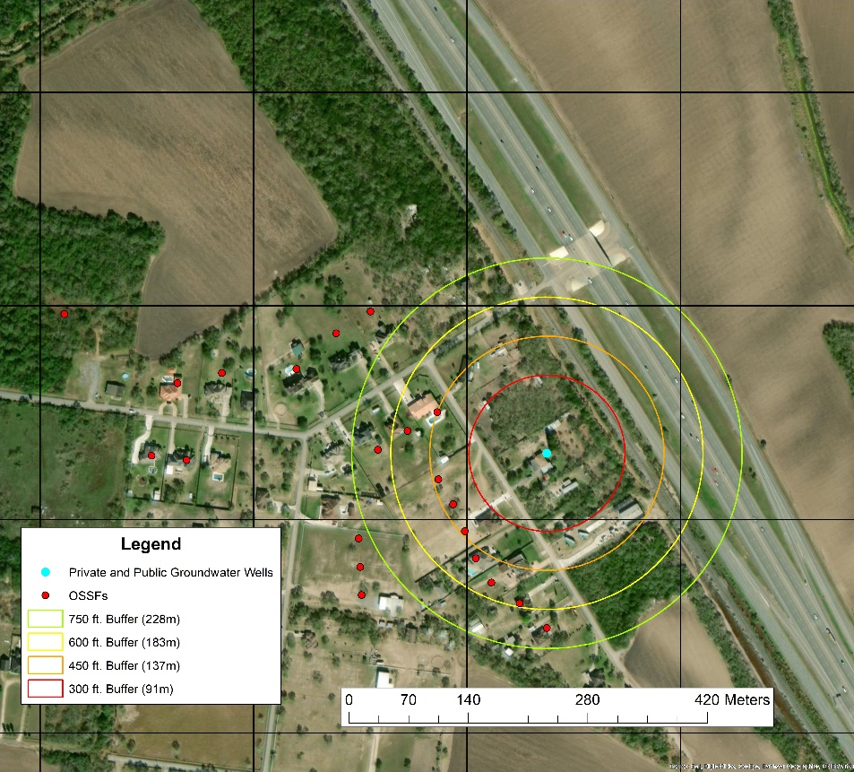
System Design Parameters
System Age
<10 years = 1
10-20 years = 2
20-25 years = 3
25-30 years = 4
>30 years = 5
Water Supply Proximity
Within 300 ft. = 5
300 – 450 ft. = 4
450 ft. – 600 ft. = 3
600 ft. – 750 ft. = 2
Beyond 750 ft. = 1

Slide 12
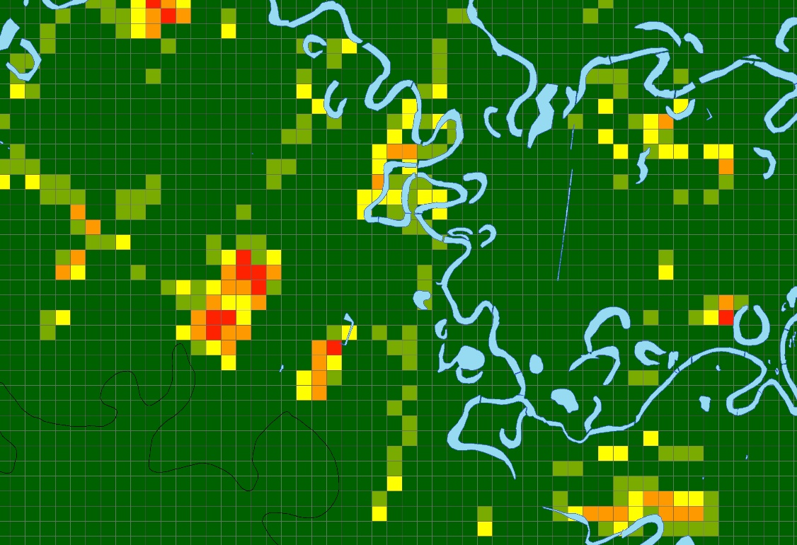
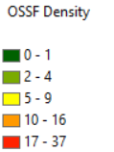
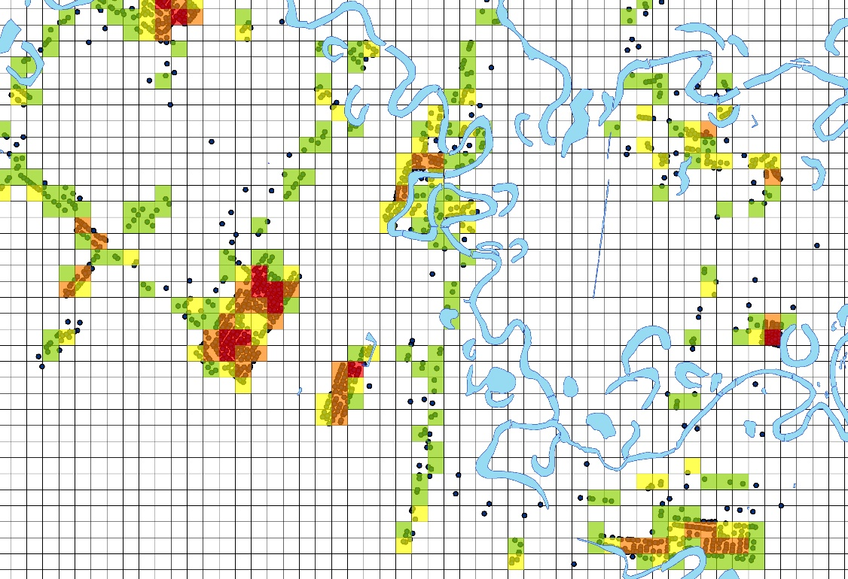
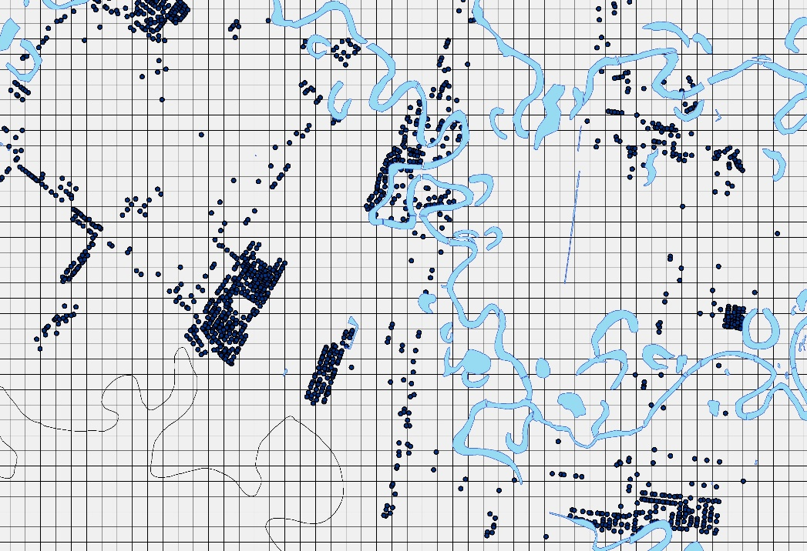
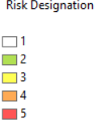
System Design Parameters
Test Grid → Value → Risk Designation
OSSF Density
0-1 = 1
2-4 = 2
5-9 = 3
10-16 = 4
17-37 = 5

Slide 13
Questions

