Slide 1
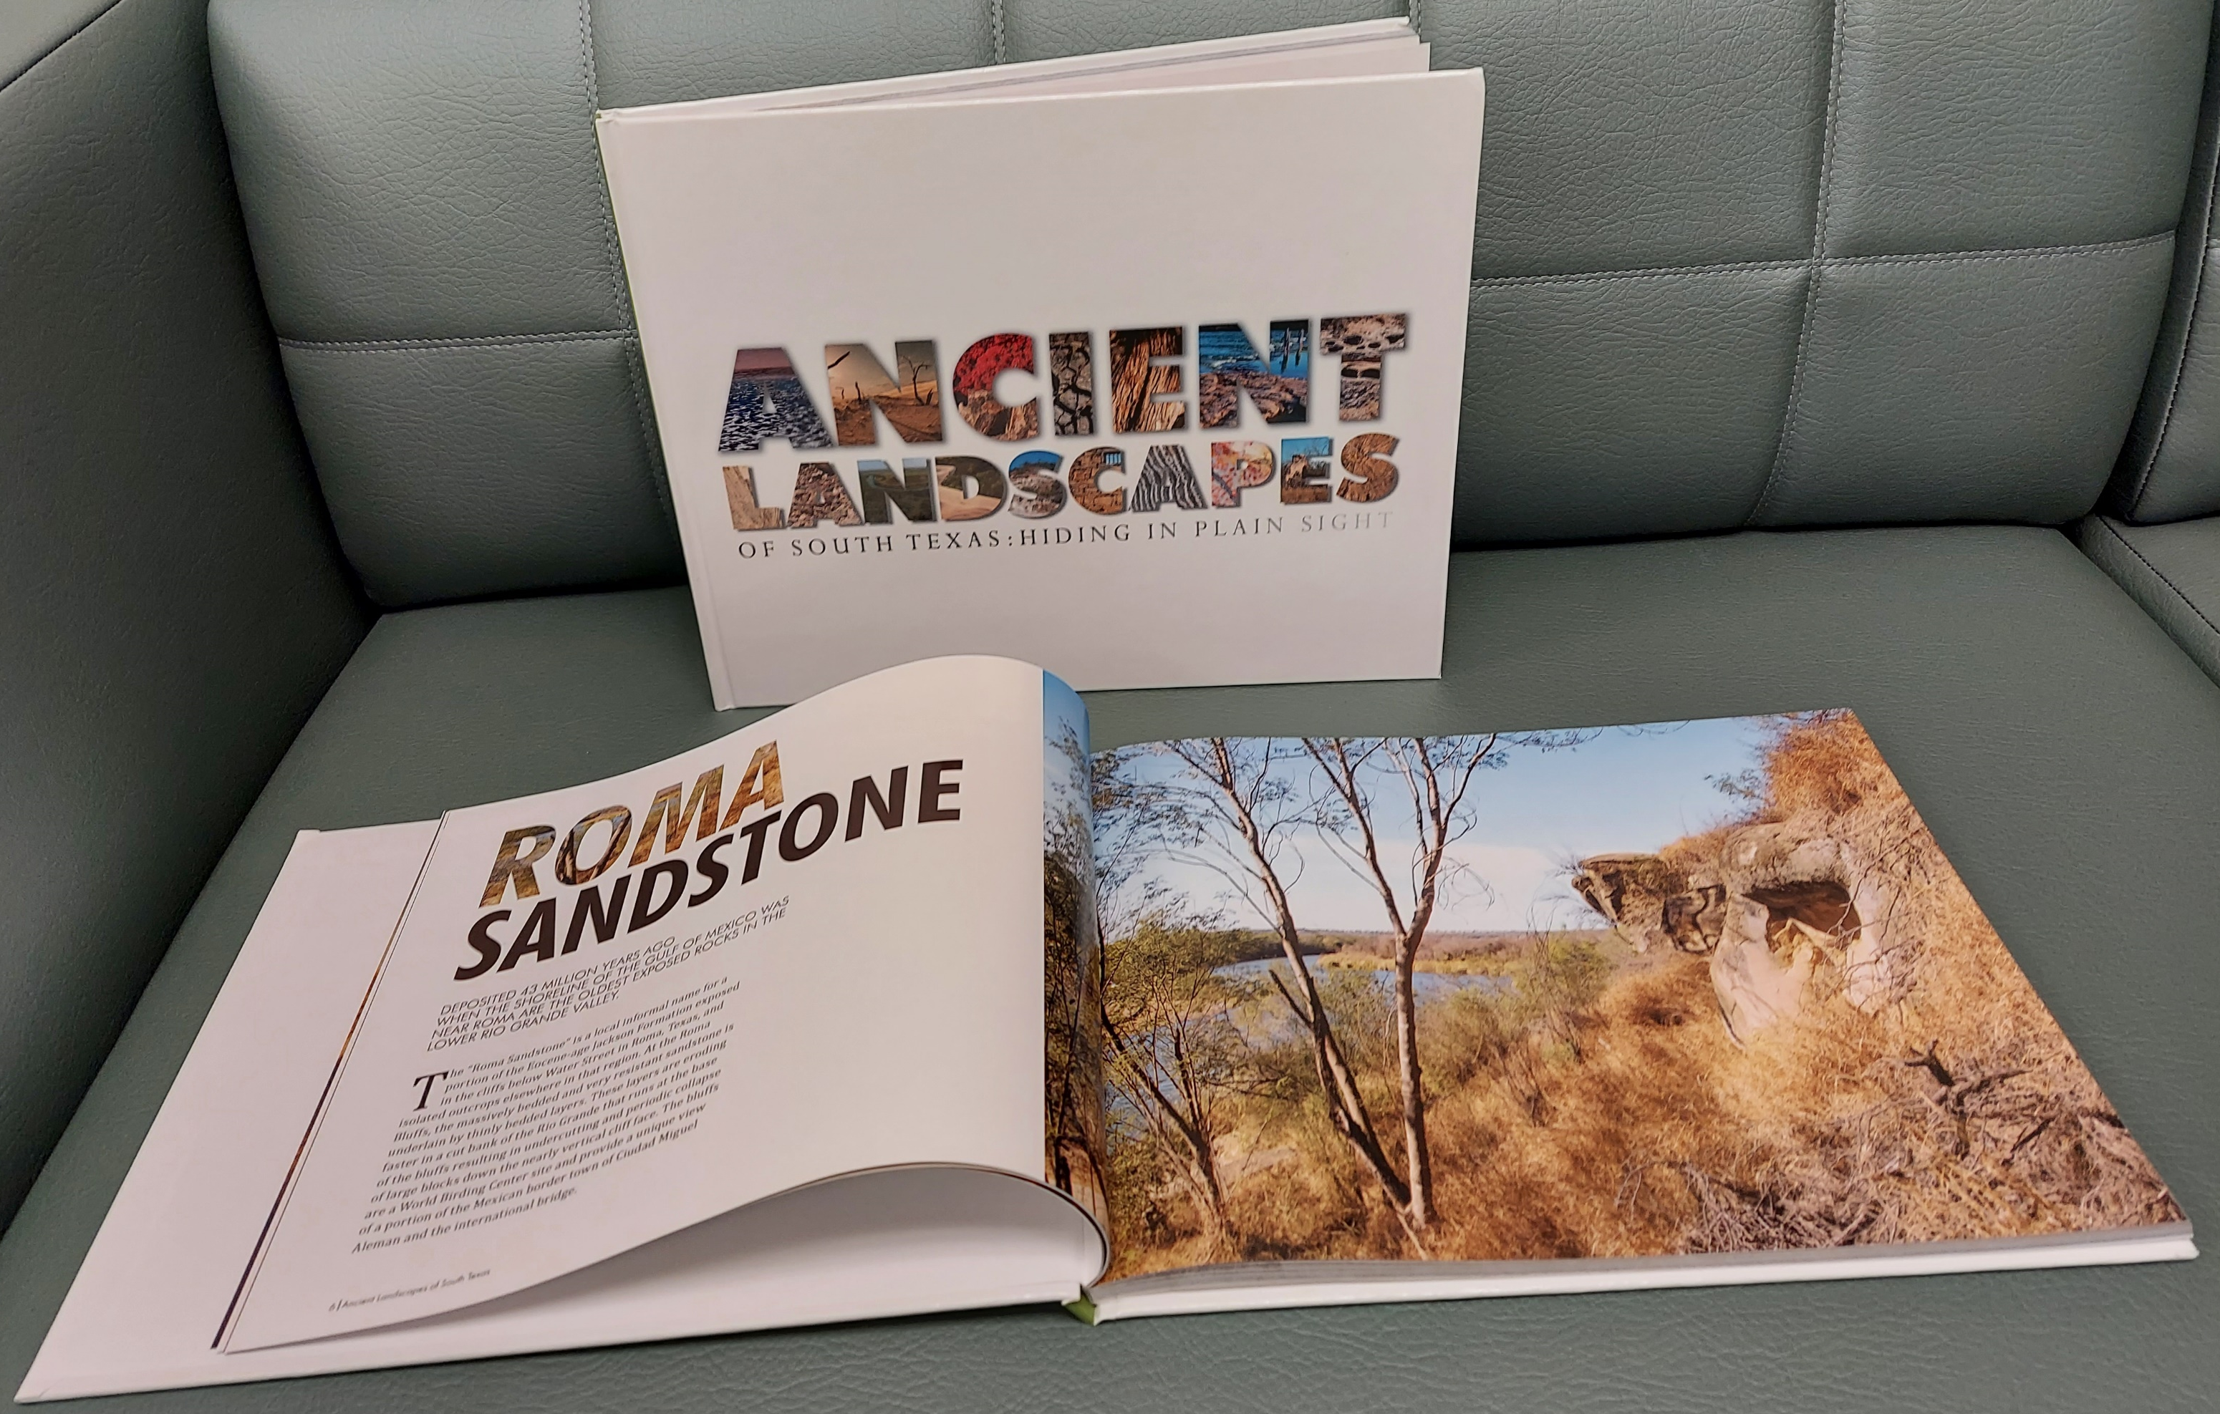
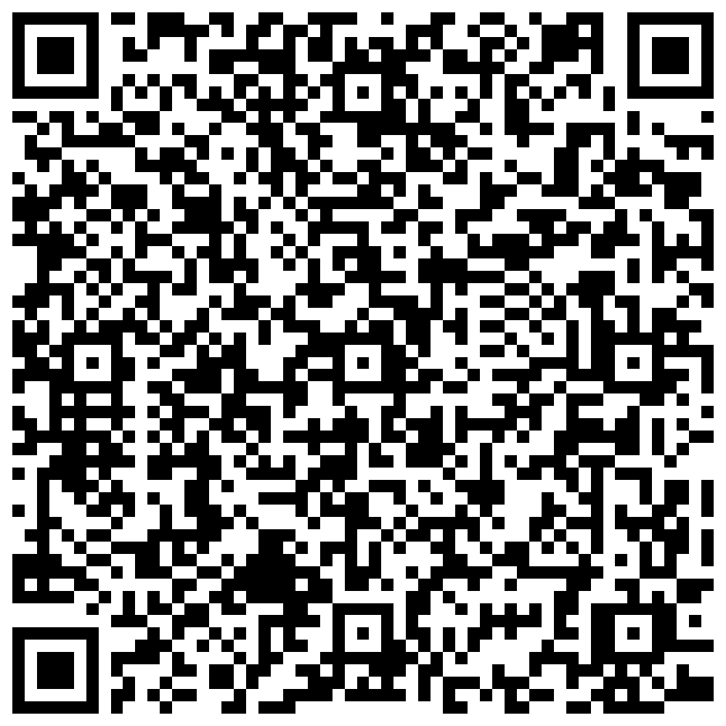


If you would like a copy of our Geoheritage photo book, scan the QR code or go to www.lulu.com
For further information about the CHAPS Program,
contact us at chaps@utrgv.edu
www.utrgv.edu/ancient-landscapes-southtexas
www.utrgv.edu/chaps
Like us on facebook UTRGV CHAPS

