Slide 1
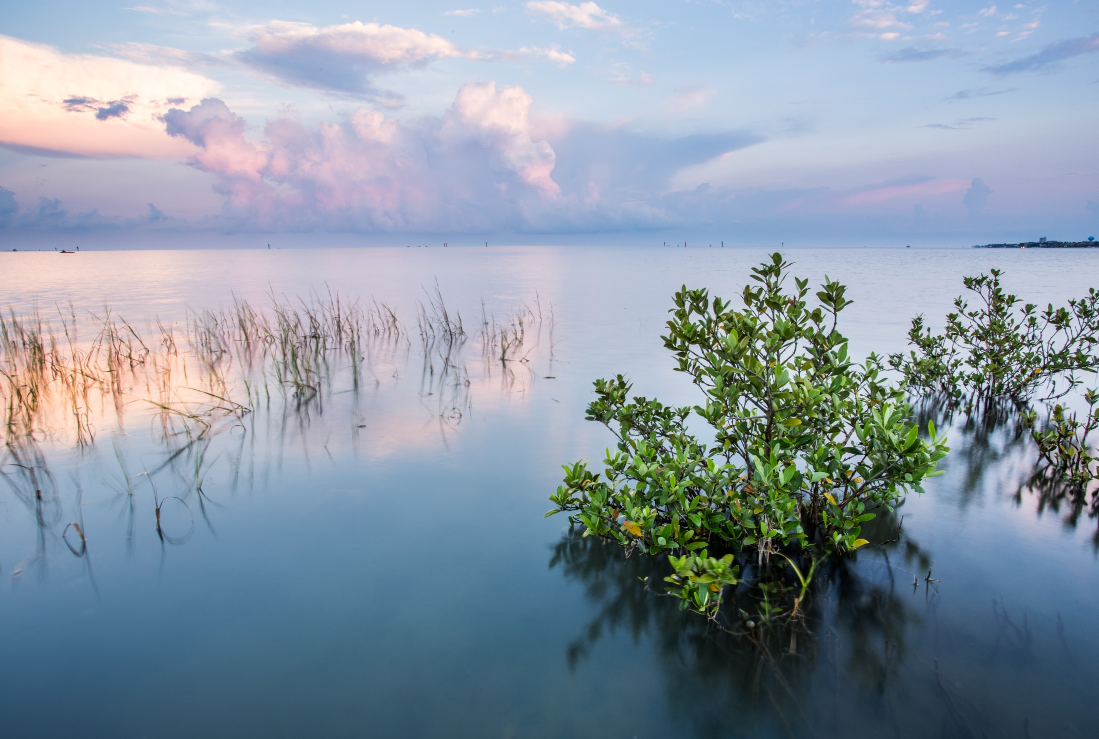



Texas Sea Grant RFP FY 2020-2022
Texas Sea Grant RFP FY 2020-2022
TexasSeaGrant.org

Slide 2
What does Texas Sea Grant want to Fund?
Integrated research and extension projects that improve the understanding, wise use and stewardship of Texas’ coastal and marine resources.
Outcome-oriented research that spans broad areas of natural, physical, social, behavioral and economic sciences and engineering.
Research that will generate substantial long-term impacts in Texas.
Research aligned with Texas Sea Grant Strategic Plan 2018-2021.
Research that addresses one of Texas Sea Grant’s research priorities.
TexasSeaGrant.org

Slide 3
Texas Sea Grant is a unique partnership that unites the resources of the federal government (NOAA), the State of Texas and universities across the state to create knowledge, tools, products and services that help coastal communities, marine industries and the people of Texas.
TexasSeaGrant.org

Slide 4
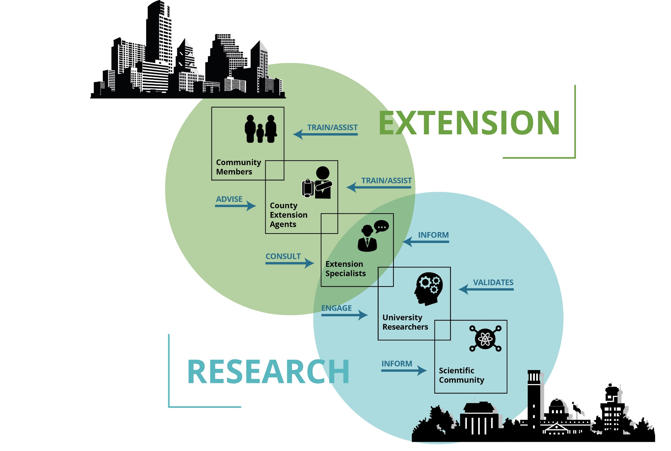
TexasSeaGrant.org

Slide 5
TexasSeaGrant.org

Slide 6
Texas Sea Grant Supports Research that Aligns with its Strategic Plan
Strategic Plan Focus Areas
Resilient Communities and Economies
Sustainable Fisheries and Aquaculture
Healthy Coastal Ecosystems
TexasSeaGrant.org

Slide 7
Research Priorities
How were the Research Priorities Developed?
Based on Texas Sea Grant’s Strategic Plan Focus Areas.
From input submitted to Texas Sea Grant’s public survey.
From input received from Texas Sea Grant’s Advisory Committee.
From input received from Texas Sea Grant’s Extension staff.
TexasSeaGrant.org

Slide 8
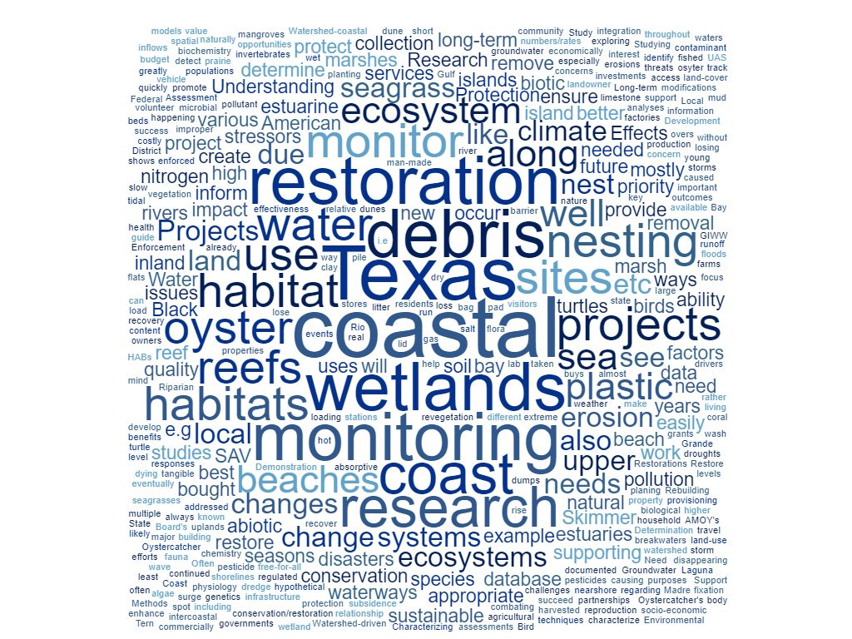
TexasSeaGrant.org

Slide 9

Research Priorities
Focus Area: Resilient Communities and Economies
• Social vulnerability, coastal planning, risk perception, risk-informed decision-making, hazard mitigation, disaster preparedness, sea-level rise, flooding, climate change, green infrastructure.
• Water availability and use, water systems, water management and planning, water desalination, the water-energy nexus.
Focus Area: Sustainable Fisheries and Aquaculture
• Fishing gear/methods/practices, safety, and technology, fisheries management.
• Seafood consumer behavior, seafood markets, seafood quality and safety.
• Fishing and seafood industry labor practices, safety and vulnerability.
• Current and emerging aquaculture species, aquaculture production systems, aquaculture economics and viability, and aquaculture seafood quality and safety.
Focus Area: Healthy Coastal Ecosystems
• Ecosystem-based management, ecosystem assessments, ecosystem health, ecosystem restoration, and ecosystem valuation.
• Water quality and quantity, freshwater inflows, desalination.
TexasSeaGrant.org

Slide 10
Examples of Outcome-Oriented Research
Peer-reviewed and other publications
PK-12 students reached
PK-12 curricula developed and adopted by formal and informal educators
Students completing degree requirements and engaging in research and scientific careers related to their degrees
Educational programs and products developed
Ecosystems and habitats protected, enhanced or restored
Tools, technologies and/or information services developed
Impact on policy and/or decision-making
Impact on regulatory action
Impact on planning; Impact on mapping
Impact on coastal communities, resource management, business and/or industry
Impact on sustainable economic and environmental development practices and policies
Impact on community resiliency
Ecosystem-based approaches developed
Jobs/businesses created or retained
Market and non-market economic impacts
Volunteer engagement
Patents
TexasSeaGrant.org

Slide 11
Example #1: Previously Funded Project
Title: Perception of the rip current hazard at Galveston and South Padre Islands
PIs: Chris Houser and Christian Brannstrom, Texas A&M
Partners: Galveston Island Beach Patrol; Galveston Island Park Board; City of Galveston; National Commission of Emergencies
Goal: Examine ability of beach users how to identify a rip current and the effectiveness of NOAA rip current sign.
Outcomes:
Galveston Island Park Board and the City of Galveston increased number of rip current warning signs on the beach and made adjustments to the location of lifeguard stations.
NOAA is revising its rip current sign based on specific suggestions that originated from this study to improve their warning signs which are distributed nation-wide.
TexasSeaGrant.org

Slide 12
Example #2: Previously Funded Project
Title: Identification of organic matter sources contributing to hypoxia formation in two eutrophic South Texas estuaries: relationships to watershed land use practices.
PI: Michael Wetz and Xinping Hu, Texas A&M Corpus Christi
Partners: Coastal Bend Bays and Estuaries Program, Baffin Bay Working Group, etc.
Goal: To identify factors contributing to hypoxia formation and habitat degradation in 2 important South Texas estuaries, ultimately leading to targeted management efforts.
Outcomes:
PI is a founding member of the Baffin Bay Working Group, a coalition of scientists, citizens, state and NGO resource agencies and organizations, collaborating to save Baffin Bay.
Using research results to: (1) educate local municipalities about the harmful effects of wastewater discharge entering the bay and how to minimize the discharge, (2) educating private landowners about the harmful effects of increased organic matter entering the bay and how changes in agricultural land-use practices can reduce these inputs, and (3) seeking conservation easements from adjacent land owners.
TexasSeaGrant.org

Slide 13
Example #2: Previously Funded Project
Reviewer #1 comments: This is an excellent proposal that will result in tangible benefits where resource managers can utilize the results from the study to mitigate environmental stressors resulting in hypoxia in south Texas estuaries and bays.
Reviewer #2 comments: Results from this study will provide answers to continuing environmental problems such as hypoxia and will enable resource managers to take specific mitigation measures. The investigators propose to disseminate information via working groups such as Coastal bend Bays & Estuaries Program comprised of various stakeholder groups resource managers, university scientists and general public.
TexasSeaGrant.org

Slide 14
Example #3: Previously Funded Project
Title: A Coastal Communities Planning Atlas for Decision Makers and Local Residents.
PI: Sam Brody et al., Texas A&M Galveston
Partners: Multiple
Goal: To provide an easily accessible, graphically represented, interactive web-based system featuring environmental, hazard, and land use-related issues to assist local communities in planning for the future.
Outcomes:
Engagement tool that has helped shape the dialogue on coastal planning and management for Texas.
This system offers anyone with an Internet connection critical information on the consequences of living on the coast, from regional issues down to an individual structure.
TexasSeaGrant.org

Slide 15
Examples of Outcome-Oriented Research
Peer-reviewed and other publications
PK-12 students reached
PK-12 curricula developed and adopted by formal and informal educators
Students completing degree requirements and engaging in research and scientific careers related to their degrees
Educational programs and products developed
Ecosystems and habitats protected, enhanced or restored
Tools, technologies and/or information services developed
Impact on policy and/or decision-making
Impact on regulatory action
Impact on planning; Impact on mapping
Impact on coastal communities, resource management, business and/or industry
Impact on sustainable economic and environmental development practices and policies
Impact on community resiliency
Ecosystem-based approaches developed
Jobs/businesses created or retained
Market and non-market economic impacts
Volunteer engagement
Patents
TexasSeaGrant.org

Slide 16
Merit Review Process
There are two phases to the merit review process – a pre-proposal phase and a full proposal phase.
Pre-proposals and full proposals are peer-reviewed, scored and ranked by technical review panels guided by objective criteria.
These scores and ranks substantially inform Texas Sea Grant’s decision to “encourage/not encourage” pre-proposals for development into full proposals, and to “fund/not fund” full proposals.
TexasSeaGrant.org

Slide 17
Pre-proposal Requirements
Required Content
Project Title
PI and co-PI names and Institutional Affiliation(s)
Primary Focus Area selected from the Texas Sea Grant Strategic Plan 2018-2021
Research Priority
Project Description – Objectives, Intellectual Merit and Broader Impacts
Relationship to Texas Sea Grant Focus Area(s)/Research Priorities - How the research proposed relates to the focus areas and research priorities
Programmatic Justification and outcomes you anticipate from your proposed research
TexasSeaGrant.org

Slide 18
Pre-proposal Requirements
Format
Text must be single-spaced.
12-point minimum font, with 1-inch margins.
The pre-proposal must not exceed a two-page PDF.
Content must be written in third person, informative to those working in the same or related disciplines, and understandable to a scientifically literate audience.
DO NOT include page numbers, headers, footers, or exceed two pages.
Investigators may submit no more than two Pre-proposals as PI and/or co-PI. Successful investigators will receive a maximum of one grant.
TexasSeaGrant.org

Slide 19

Pre-proposal Requirements
Submission
Pre-proposals must be submitted using the eSeaGrant online system in order to be eligible to submit a full proposal.
Due February 4, 2019, before 5:00PM CST
Access: http://eseagrant.texasseagrant.org/index.php
TexasSeaGrant.org

Slide 20
Pre-proposal Review and Selection
Technical Review:
Each pre-proposal will be reviewed and ranked by at least three scholars and/or extension specialists with expertise relevant to the proposed research to evaluate the proposals against the review criteria.
Review Criteria:
1. The degree to which the proposed research relates to Texas Sea Grant focus areas and research priorities identified in the RFP.
2. The degree to which the proposed activity will contribute, as an essential or complementary unit to other projects, to reaching the objectives of the Texas Sea Grant Program or the degree to which it addresses the needs of important state, regional, or national constituencies.
Selection Process: The Texas Sea Grant Director will conduct a final review of the pre-proposals and reviewers’ comments, and make a final determination to “encourage/not encourage” pre-proposals based on the reviews and programmatic priorities.
TexasSeaGrant.org

Slide 21
After the Pre-proposal Submission
Reviewers' comments (blinded) will be made available to the lead PI. There will be no rebuttal or response process.
All investigators who successfully submitted a pre-proposal to this RFP are eligible to submit a full proposal, regardless of whether they have been encouraged to do so following the outcome of the pre-proposal review.
A Full Proposal Workshop is scheduled May 6, 2019, time and place TBD.
TexasSeaGrant.org

Slide 22
Goals of Full Proposal Workshop
Help PIs develop competitive research proposals.
Introduce PIs to the research-extension model and provide ideas for integration.
Introduce PIs to Texas Sea Grant Extension Team.
Work one-on-one with PIs to expand the outcomes, connect researchers with coastal communities and their needs, develop robust partnerships, and ultimately enrich the impacts and accomplishments of the research.
TexasSeaGrant.org

Slide 23
What does Texas Sea Grant want to Fund?
Integrated research and extension projects that improve the understanding, wise use and stewardship of Texas’ coastal and marine resources.
Outcome-oriented research that spans broad areas of natural, physical, social, behavioral and economic sciences and engineering.
Research that will generate substantial long-term impacts in Texas.
Research aligned with Texas Sea Grant Strategic Plan 2018-2021.
Research that addresses one of Texas Sea Grant’s research priorities.
TexasSeaGrant.org

Slide 24

TexasSeaGrant.org

