Slide 1
Position Control
Planning and Analysis Office

Slide 2
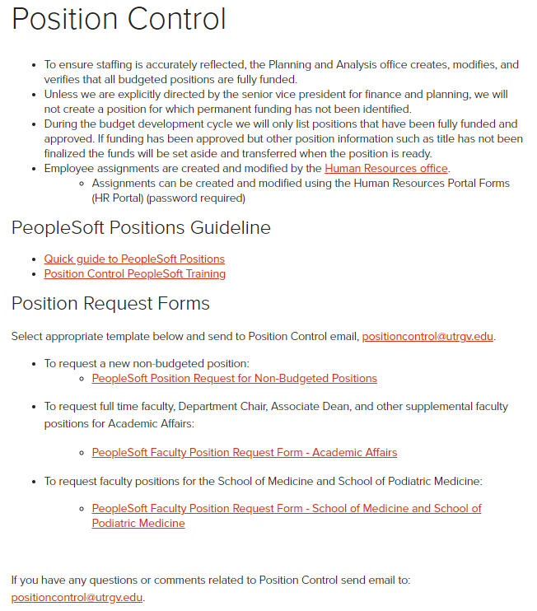
Position Control site
Planning & Analysis site: www.utrgv.edu/planning-and-analysis
Position Control site: www.utrgv.edu/planning-and-analysis/services-and-resources/position-control

Slide 3
Responsibility: To ensure university staffing is accurately reflected in the budget and carried out as planned or subsequently authorized.
To ensure staffing is accurately reflected, the Planning and Analysis office creates, modifies, and verifies that all budgeted positions are fully funded.
Unless we are explicitly directed by the EVP for Finance & Business Affairs and CFO, we will not create a position for which permanent funding has not been identified.
During the budget development cycle, we will only list positions that have been fully funded and approved. If funding has been approved but other position information such as title has not been finalized, the funds will be set aside and transferred when the position is ready.

Slide 4
Position
Position is a job title into which you place an employee.
Positions belong to a department.
Position should have only one incumbent, however, can be reused when vacant.

Slide 5
Types of positions
Administrative & Professional (AP)
President, Vice Presidents, Directors, Managers, Associate or Assistant Directors.
Classified Positions (CL)
Accountants, Business Analyst, Administrative Assistants, etc.
Faculty (FA1, FA2, FA3, & FA4)
Professors, Associate Professors, Assistant Professors.
Direct Wage (STU, CLN)
Employees paid by the hour, usually Students.
Work-study (WS)
Student Employees whose pay is funded by the federal government.
Graduate Assistants (GRA or GTA)
Graduate Student employees.
Special Assignments (APN or CLN)
Used to provide an additional job to an employee outside their normal job duties for a specific amount of time. This only applies to exempt employees.

Slide 6
Permanent vs Temporary Positions
Permanently Budgeted positions
A&P, Classified, and Faculty Positions
Usually, Full-Time
Benefit Eligible
Controlled positions
Fully funded – funds set aside for each position
Temporary position
Direct Wage, Work-Study, Part-Time Faculty, Summer Assignments, and Special Assignments.
Usually, Part-Time
Positions are not controlled
A pool of Funds is set aside

Slide 7
Process for creating new positions
Permanent Staff Positions
Job Title needs to be approved by HR Compensation office.
Funding needs to be in place or requested.
Funds needed – President Approval.
Submit a Staff Position Posting Request Form (found on HR Forms website).
Indicate position is new.
P&A creates position # when funding is identified.
Form is also used for setting up recruitment.
SOM Position requests are processed by the SOM HR Office.
Permanent Faculty Positions
The position request comes from the division or the College offices using the appropriate faculty request form.
Temporary Positions
Send email to Positioncontrol@utrgv.edu and attach the Request on Non-Budgeted Position (found on Planning and Analysis website).

Slide 8
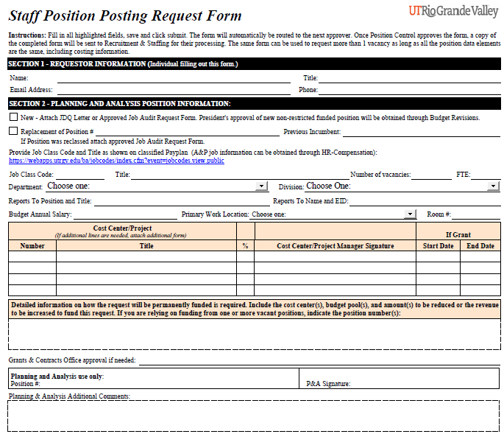
Staff Position Posting Request form:

Slide 9
Changes to Position Data Elements
Changes submitted on a Change in Job Data (CJD) form in the HR Portal along with the creation of the assignment.
Job Code
Permanent positions
Requires approval from HR Compensation Office.
Requires approval of funding if funded from Institutional funds.
Requires submission of Change in Job Data (CJD) form in the HR Portal.
Temporary positions – The job code/title should not be changed especially if the employee classification is changing. Changes can also be submitted on the HR Portal.
Organization – Usually only when there is a reorganization.
FTE and Standard Hours.
Funding Source - If only funding needs to change, use the Change in Funding Source (CFS) form.
Location or Office #.
Reports To (supervisor) Position.
If only Location/Office or Reports To needs a change, use the Change of Location/Supervisor (CLS) form in the HR Portal.
This form usually will come to Position Control directly from the creator.

Slide 10
Data Elements of Position Position # start with a “7” and are 8 digits long (70001000)
Title – Job Code
This infers an Employee Classification: AP, CL, FA1, STU, WS, GRA, etc.
Department
Business Unit (Division)
FTE
Standard Hours
Regular or Temporary Flag (for Benefit purposes)
Fulltime or Part-Time Flag (FTE of 0.75 or greater is full time)
Reports to (Supervisor) Position #
Location (Building code)
Office/Room #
Funding Source (Cost Center or Project)

Slide 11
How to find a position number
In the HR Portal, search for position # by department, or
Run PeopleSoft Query “RGV_POSITION_ROSTER”:
Positions without EIDs are vacant or have a future dated assignment tied to it.
Very important that you keep track of positions you are using.
Filter by any other field to narrow your search.

Slide 12
PeopleSoft Position Query RGV_POSITION_ROSTER
This is a tool used to help maintain a department’s position listing.
The query contains current data processed by HR, not what is in the workflow.
To run this PeopleSoft query, need to have access to:
Workforce Administrator / Commitment Accounting / Query Viewer.
Submit a “Get Access!” ticket to IT if access is needed.
Query Name: RGV_POSITION_ROSTER.
Access control is at the department level.

Slide 13
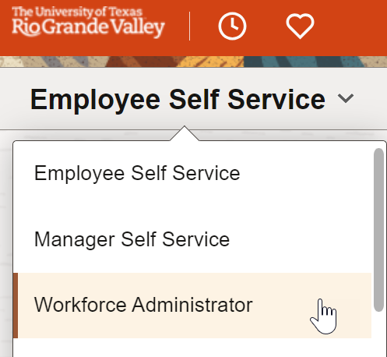
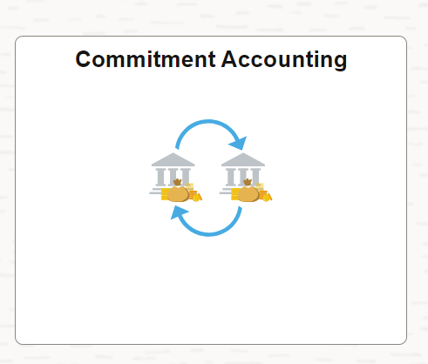
Navigation to position query location
My.utrgv.edu – Under applications click on PeopleSoft.
On the Homepage selector, click on “Workforce Administrator”.
Click on “Commitment Accounting”.

Slide 14
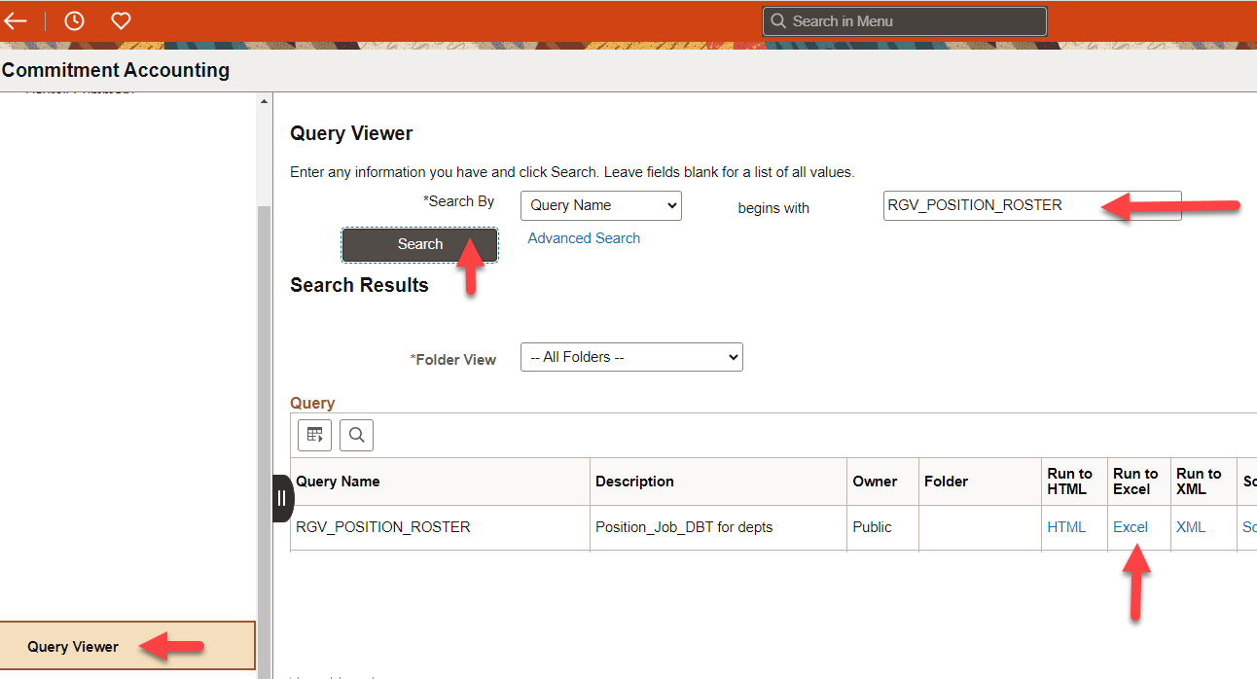
Navigation to position query location
On the menu, click on “Query Viewer”.
Enter “RGV_POSITION_ROSTER”, then click “Search” button.
On the query name result, click “Run to Excel”.

Slide 15
Request for non-budgeted positions
Go to P&A Position Control website, and under “Position Request Forms”, click on “PeopleSoft Position Request for Non-Budgeted Positions”.
Fill out position request form as per instructions.
Email completed form to PositionControl@utrgv.edu.

Slide 16
Questions?
Contact us at:
PositionControl@utrgv.edu

