Slide 1
PRESENTATION STEPS
Content & Delivery

Slide 2
Do you want to: Establish or Strengthen Presentation Skills?
First, let us look at definitions for verbal communication and nonverbal communication.
Anything that is spoken or written (35%)
Anything other than spoken or written language (65%)
Which is which? Let’s take a vote.
Posture (everyone sit straight up then slouch in chair)
Saying, “Good evening.”
Facial expression of joy. (everyone show your joy face)
Writing, “This presentation is boring me to tears.”
* try giving me an example and tell me whether it is a verbal or nonverbal communication

Slide 3
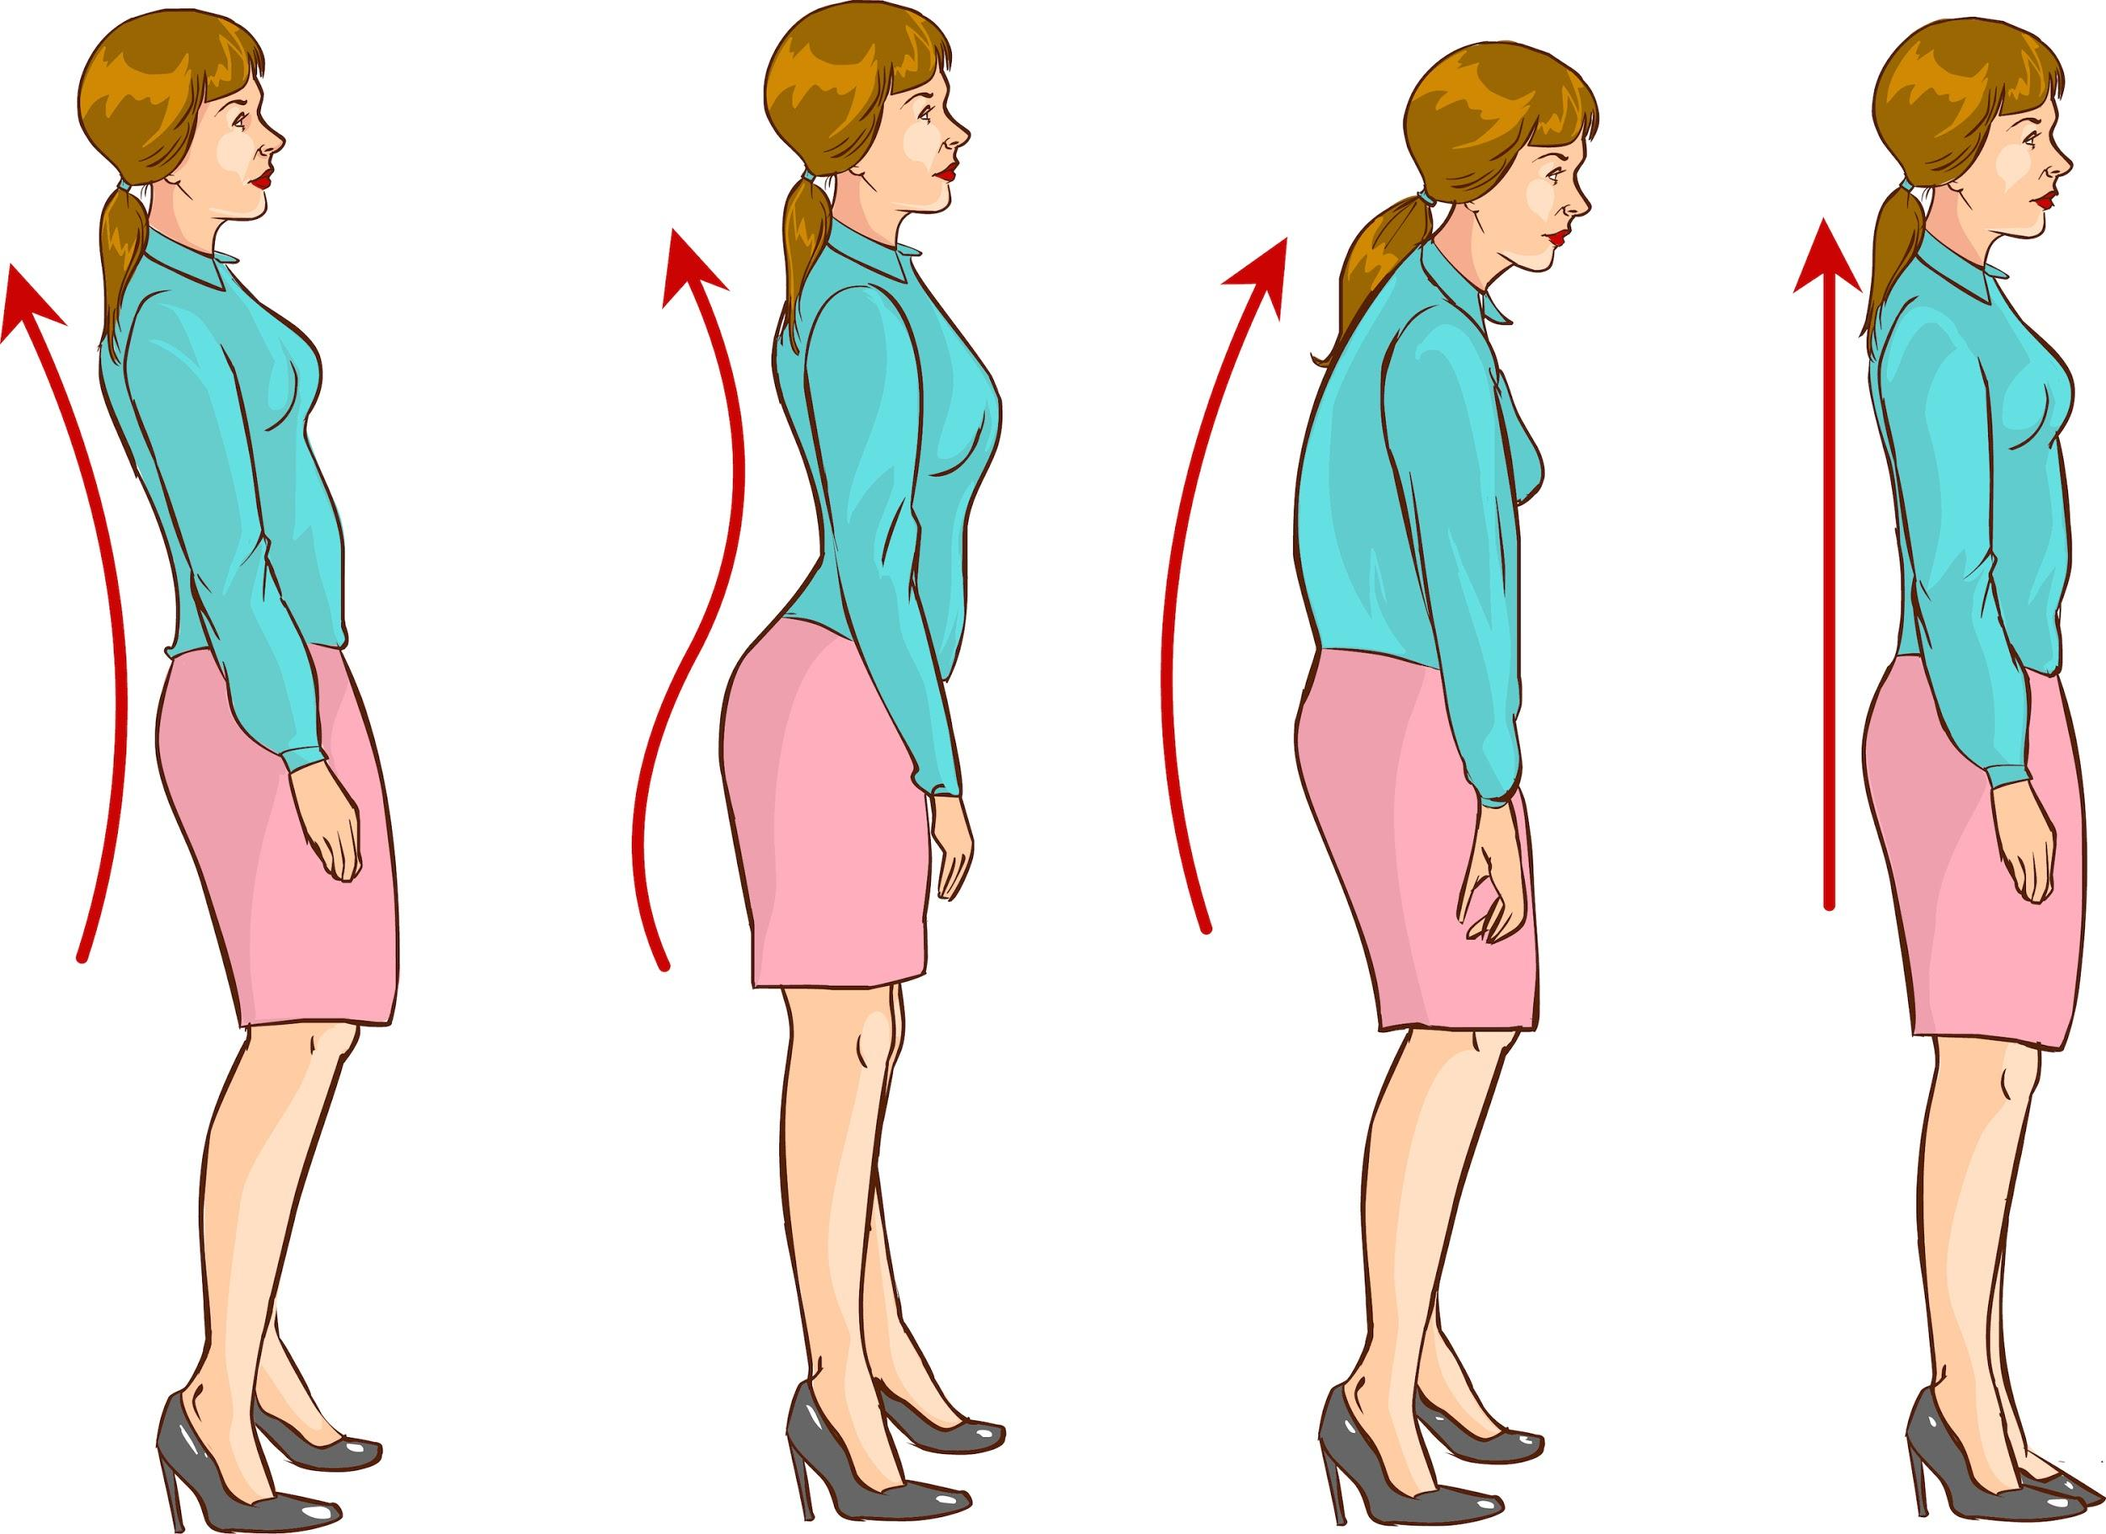
Posture
Position which you hold your body upright
It can convey:
Confidence, pride, courage
Doubt, insecure, afraid

Slide 4
Body language
Gestures, posture, movement & expressions that a person uses to communicate

Slide 5
Overview
Topic
Research
Structure
Present

Slide 6
Topic
Understand the audience you are presenting to
Consider ideas that would be relevant to the majority
Finalize the topic you will discuss

Slide 7
Research
Under the chosen topic, ask yourself what you want to do
Inform?
Persuade?

Slide 8
Research (continued)
Do research in appropriate resources, noting citations
Informative: Collect supportive material
Persuasive: Collect supportive material for all sides considered in presentation

Slide 9
Structure
Introduction: Attention getter; main idea & main points; transition into body
Body
Three main points that are relevant to main idea, with transitions between
Conclusion: Restate main idea & main points; end with memorable closing

Slide 10
Present
Write outline draft. Have it reviewed (UTRGV Writing Center or Grammarly)
Use proofed outline to make notecards with trigger words or memorize
Rehearse presentation with recording
Audio and/or video for timing accuracy (modify as needed to meet required time)
Consider appropriate attire and mannerisms when presenting

Slide 11
Appearance
The way a person looks
First impression matters
Common examples:
Clothes
Business attire
Hair

Slide 12
How I need to say: Voice
Voice - The sound or sounds uttered through a person’s mouth
Vocalics - meaning of voice
Tone
“Higher” vs. “lower”
Pace
Speed of which you speak
Ex: speak slow to emphasize
Volume
Loudness or intensity of a sound
Pauses; silence
Gasps & sighs

Slide 13
Recap
Topic
Research
Structure
Present

Slide 14
PRESENTATION STEPS
Thank you,
April Marie Cruz & Rick Montero

Slide 15
PARTICIPATION
Topic
Understand the audience you are presenting to
Consider ideas that would be relevant to the majority
Finalize the topic you will discuss
As a group, ask questions of your peers to determine interests.
As a group, write 2 – 3 popular topics.
Separate into groups if more than four, pick topic from list.

Slide 16
PARTICIPATION
Research
Under the chosen topic, ask yourself what you want to do
Inform?
Persuade?
Discuss what type of presentation is most appropriate.
Discuss when informative would be beneficial.
Discuss what situations would best be suited for persuasive.

Slide 17
PARTICIPATION
Research (continued)
Do research in appropriate resources, noting citations
Informative: Collect supportive material
Persuasive: Collect supportive material for all sides considered in presentation
Use digital devices to locate one credible source; write citation
Incorporate a cited source; write/type your information
Incorporate a cited source; write/type 80% to your side & 20% opposing information (facts, not conjecture or opinion)

Slide 18
Structure
Introduction: Attention getter; main idea & main points; transition into body
Body
Three main points that are relevant to main idea, with transitions between
Conclusion: Restate main idea & main points; end with memorable closing
PARTICIPATION
Write: quote/story/example, main idea, three main points, & transition
Check that main idea is general & main points support it.
Consider sequence of delivery of main points; write transitions (verbal bridges)
Write main idea & main points in past tense; write memorable closing

Slide 19
Present
Write outline draft. Have it reviewed (UTRGV Writing Center or Grammarly)
Use proofed outline to make notecards with trigger words or memorize
Rehearse presentation with recording
Audio and/or video for timing accuracy (modify as needed to meet required time)
Consider appropriate attire and mannerisms when presenting
PARTICIPATION
Start your draft. Peer review.
Create notecards with proofread outline; side mark those that can be deleted
Self record a read through
Document the time it took to give presentation (modify as needed to meet required time).
Discuss what you believe is what you would wear as a presenter/co-presenter.
Discuss verbal and non-verbal presentation concerns.

Slide 20
Recap
PARTICIPATION
Topic – How did you decide?
Research – Where did you look?
Structure – Is everything there?
Present – Confidence beats anxiety!

Slide 21
Speech - Warm-up Exercises
Deep breath in - arms up & “sigh” out saying, “ah”
Tongue - Say “la la la”
(overexaggerate)
Lips - “ba ba ba”
Tongue - rolling “rrr’s”
Lips - “brrr” (bubble sounds)
Siren - “wee” to “aww”
“Wee” - high
“Aww” - low

Slide 22
Let’s use our PRESENTATION STEPS
GREAT JOB, EVERYONE!

